Slide 2
Objectives
Define phishing and identify various types of phishing scams
Recognize common baiting tactics used in phishing scams
Examine real phishing messages
Understand how to protect yourself from being hooked by a phishing scam

Slide 3
Phishing: What is it?
Phishing – Cybercriminal attempts to steal personal and financial information or infect computers and other devices with malware and viruses
Designed to trick you into clicking a link or providing personal or financial information
Often in the form of emails and websites
May appear to come from legitimate companies, organizations or known individuals
Take advantage of natural disasters, epidemics, health scares, political elections or timely events

Slide 4
Types of Phishing
Mass Phishing – Mass, large-volume attack intended to reach as many people as possible
Spear Phishing – Targeted attack directed at specific individuals or companies using gathered information to personalize the message and make the scam more difficult to detect
Whaling – Type of spear phishing attack that targets “big fish,” including high-profile individuals or those with a great deal of authority or access
Clone Phishing – Spoofed copy of a legitimate and previously delivered email, with original attachments or hyperlinks replaced with malicious versions, which is sent from a forged email address so it appears to come from the original sender or another legitimate source
Advance-Fee Scam: Requests the target to send money or bank account information to the cybercriminal

Slide 5
Common Baiting Tactics
Notification from a help desk or system administrator Asks you to take action to resolve an issue with your account (e.g., email account has reached its storage limit), which often includes clicking on a link and providing requested information.
Advertisement for immediate weight loss, hair growth or fitness prowess Serves as a ploy to get you to click on a link that will infect your computer or mobile device with malware or viruses.
Attachment labeled “invoice” or “shipping order” Contains malware that can infect your computer or mobile device if opened. May contain what is known as “ransomware,” a type of malware that will delete all files unless you pay a specified sum of money.
Notification from what appears to be a credit card company Indicates someone has made an unauthorized transaction on your account. If you click the link to log in to verify the transaction, your username and password are collected by the scammer.
Fake account on a social media site Mimics a legitimate person, business or organization. May also appear in the form of an online game, quiz or survey designed to collect information from your account.

Slide 6
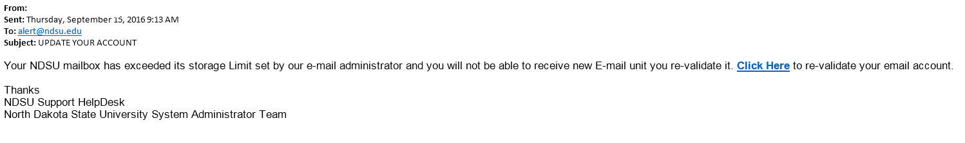
Phishing Lure
Claims to come from the NDSU IT Help Desk and system administrators
References NDSU and North Dakota State University
Calls for immediate action using threatening language
Includes hyperlink that points to fraudulent site

Slide 7
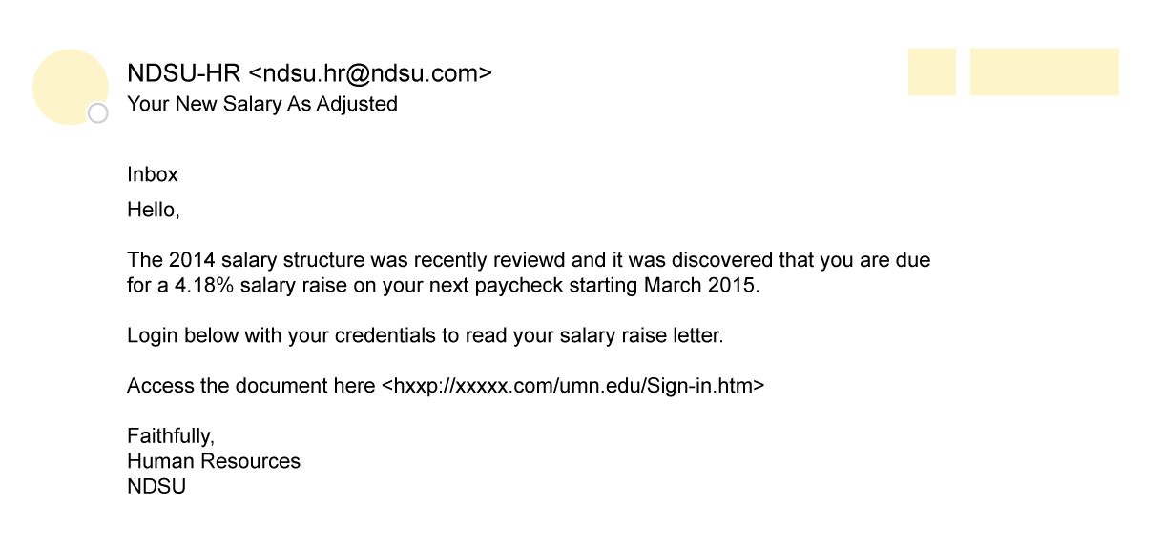
Phishing Lure
Claims to come from the NDSU Human Resources
Timely call for action during annual review season
From address includes NDSU, but not .edu address (@ndsu.com)
Includes hyperlink that points to fraudulent site

Slide 8
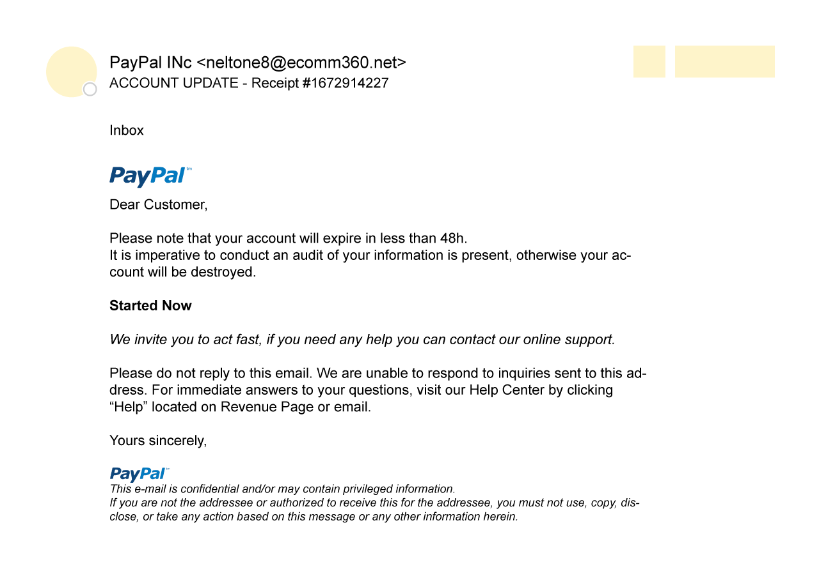
Phishing Lure
Claims to come from PayPal
Includes PayPal logo, but from address is not legitimate (@ecomm360.net)
Calls for immediate action using threatening language
Includes hyperlink that points to fraudulent site

Slide 9
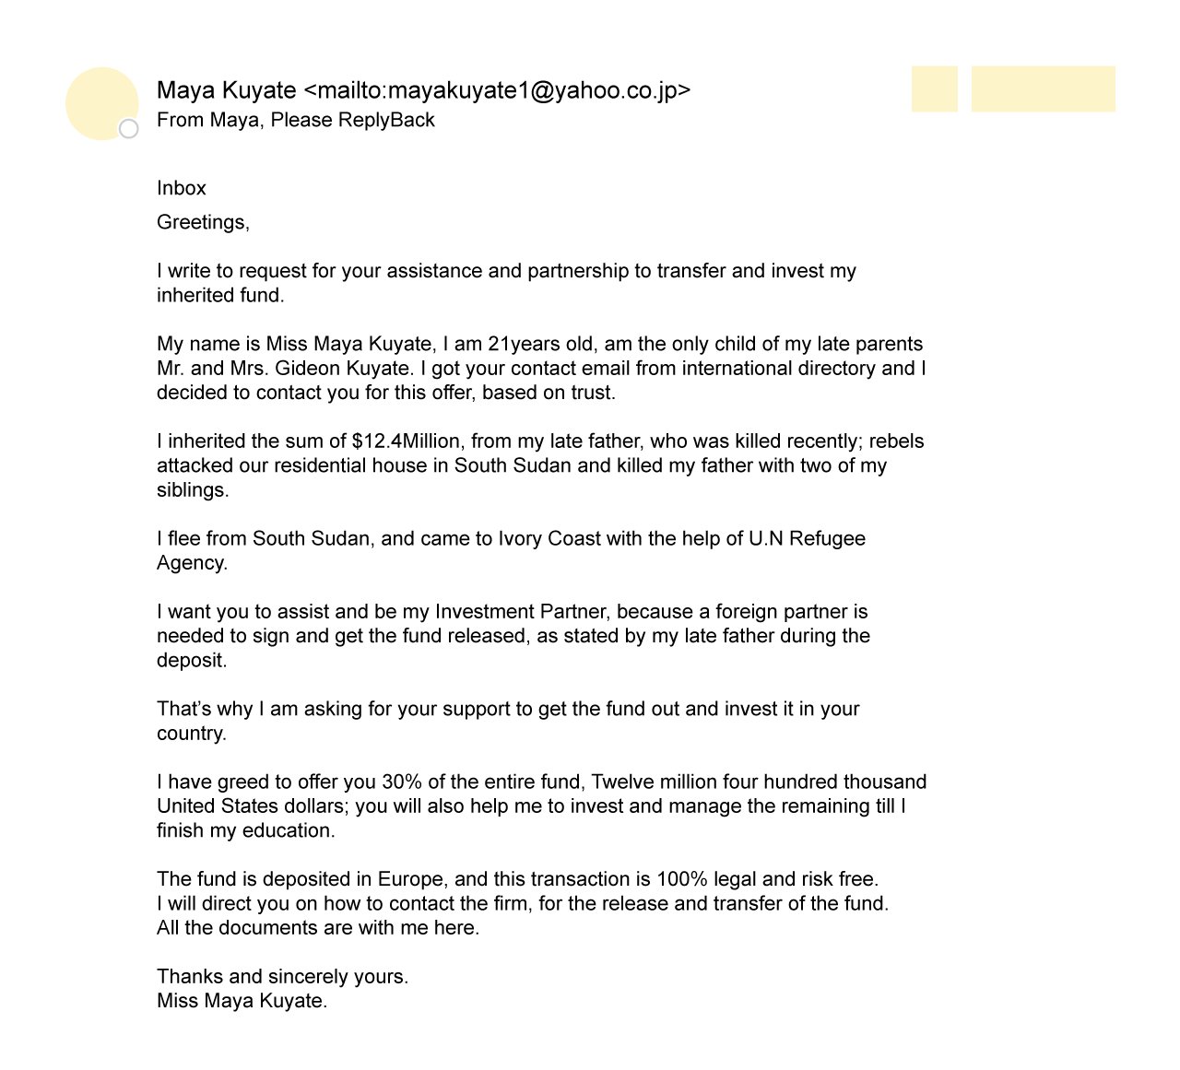
Phishing Lure
Likely an advanced-fee scam
Takes advantage of ongoing humanitarian crisis
If it sounds too good to be true, it likely is

Slide 10
Detect a Phishing Scam
Spelling errors (e.g., “pessward”), lack of punctuation or poor grammar
Hyperlinked URL differs from the one displayed, or it is hidden
Threatening language that calls for immediate action
Requests for personal information
Announcement indicating you won a prize or lottery
Requests for donations

Slide 11
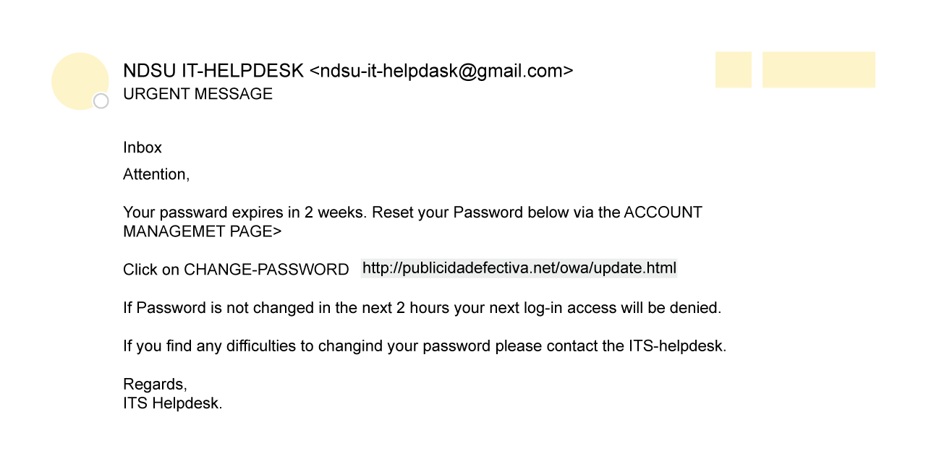
Can you detect a phishing scam?

Slide 12
Is the name of the staff mailing list correct?
Use the “hover” technique.
Does the displayed URL match the actual URL?
Examine the spelling, grammar and punctuation.

Slide 13
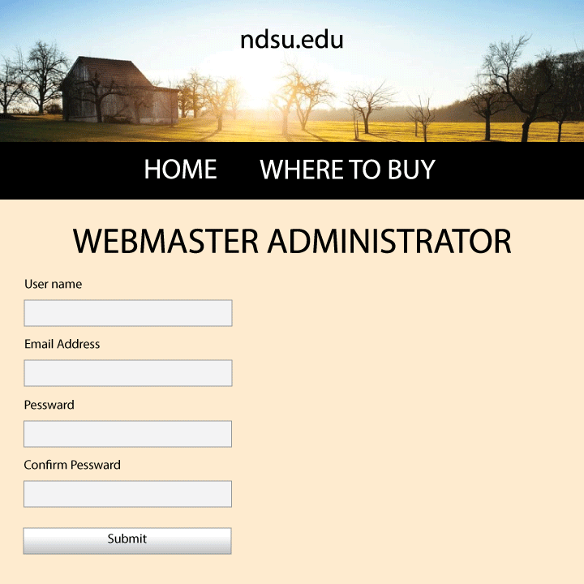
Examine the login page – is the logo familiar?
Look at the subtitles on the logo, is anything unusual?
Who is requesting this information?
Is it someone who would normally request it?
Check for spelling errors

Slide 14
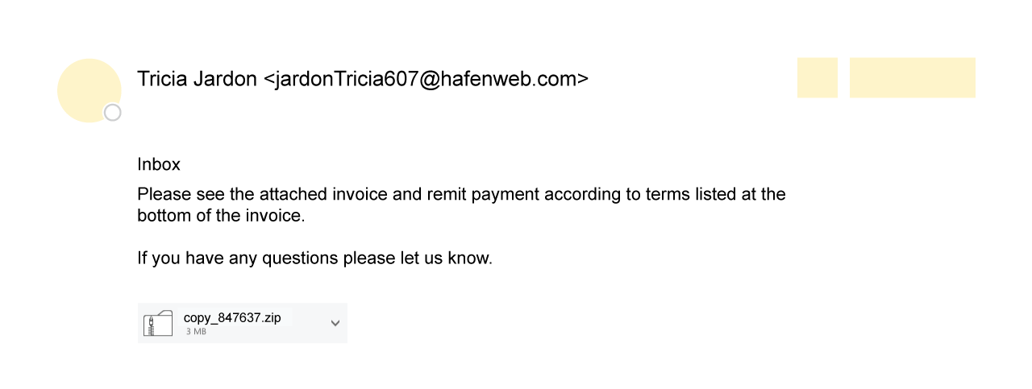
Do you know the sender?
There is no greeting
There is no salutation or signature
Are you expecting an attachment from this person or company?

Slide 15
Protect Yourself: Refuse the Bait
STOP. THINK. CONNECT.
Before you click, look for common baiting tactics
If the message looks suspicious or too good to be true, treat it as such
Install and maintain antivirus software on your electronic devices
Use email filters to reduce spam and malicious traffic

Slide 16
Protect Yourself: Refuse the Bait
Be wary of messages asking for passwords or other personal information
No one from NDSU will ask for your password
Most reputable businesses and organizations will not ask for this information via email
Never send passwords, bank account numbers or other private information in an email
Do not reply to requests for this information
Verify by contacting the company or individual, but do not use the contact information included in the message

Slide 17
Protect Yourself: Refuse the Bait
Do not click on any hyperlinks in the email
User your computer mouse to hover over each link to verify its actual destination, even if the message appears to be from a trusted source
Pay attention to the URL and look for a variation in spelling or different domain (e.g., ndsu.edu vs. ndsu.com)
Consider navigating to familiar sites on your own instead of using links within messages
Examine websites closely
Malicious websites may look identical to legitimate sites
Look for “https://” or a lock icon in the address bar before entering any sensitive information on a website

Slide 18
Protect Yourself: Report a Phish
If you have received a phishing message
Forward it directly to ndsu.reportaphish@ndsu.edu, which keeps intact important information that may help IT staff identify the source of the scam.
Then delete the message.

Slide 19
Got Hooked? Protect Yourself: Take Action Now
If you suspect… | You should…
You interacted with or replied to a phishing scam using your NDSU email account | Immediately contact the NDSU IT Help Desk: ndsu.helpdesk@ndsu.edu or 701-231-8685
You might have revealed or shared personal or financial information | Immediately change the password(s) for your account(s). If you use the same password for multiple accounts and sites, change it for each account. Do not reuse that password in the future. Watch for signs of identity theft by reviewing your bank and credit card statements for unauthorized charges and activity. If you notice anything unusual, immediately contact your credit card or bank. Consider reporting the attack to the police, and file a report with the Federal Trade Commission: www.ftc.gov.

Slide 20
More Information
Credible Online Resources:
Stay Safe Online: https://staysafeonline.org/stay-safe-online/keep-a-clean-machine/spam-and-phishing
Federal Trade Commission: https://www.consumer.ftc.gov/articles/0003-phishing
United States Computer Emergency Readiness Team: https://www.us-cert.gov/report-phishing
NDSU Information Security Office
ndsu.itso@ndsu.edu
Theresa Semmens, chief information security officer 701-231-5870 or theresa.semmens@ndsu.edu
Jeff Gimbel, senior security analyst 701-231-6730 or jeff.gimbel@ndsu.edu

