Slide 1

ONLINE POLLING SYSTEM
HARISH SINGH BISHT
00221102010

Slide 2
Advantages:
Fast and easy service.
The online voting system provides a less time consuming .
It reduces the paper work
It is a better way for polling.
By this voting percentage will increase drastically

Slide 3
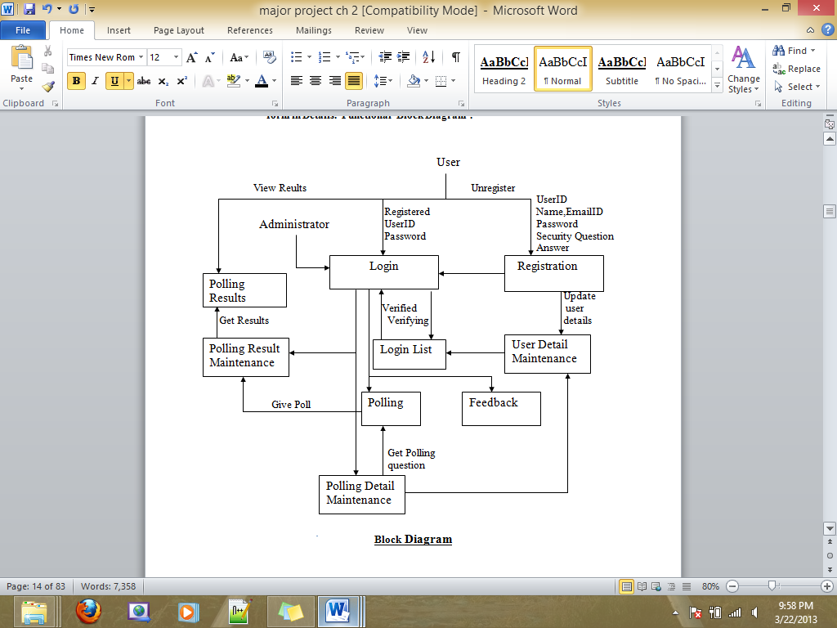
Block Diagram

Slide 4
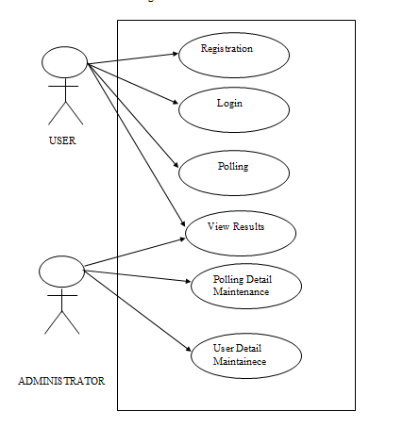
Use Case Diagarm

Slide 5
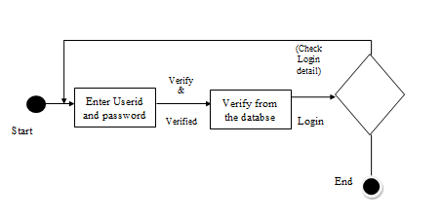
Activity diagram for Login

Slide 6
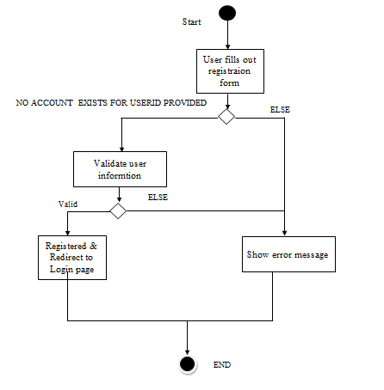
Activity diagram for Registration

Slide 7
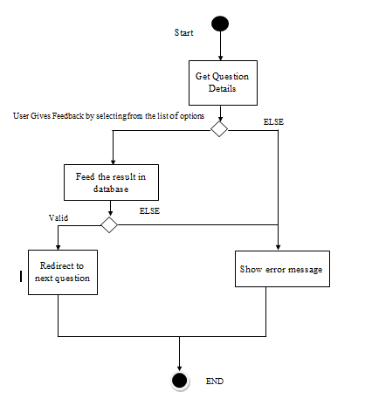
Activity diagram for Polling

Slide 8
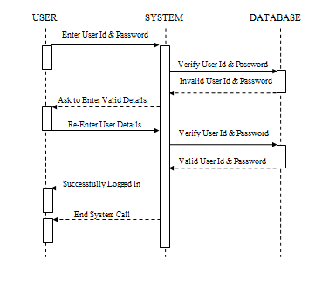
Login Sequence Diagram

Slide 9
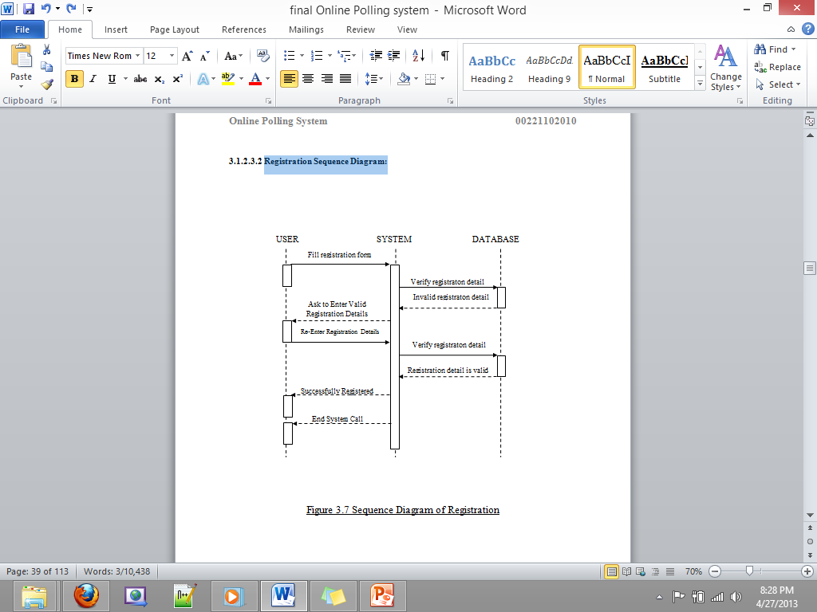
Registration Sequence Diagram

Slide 10
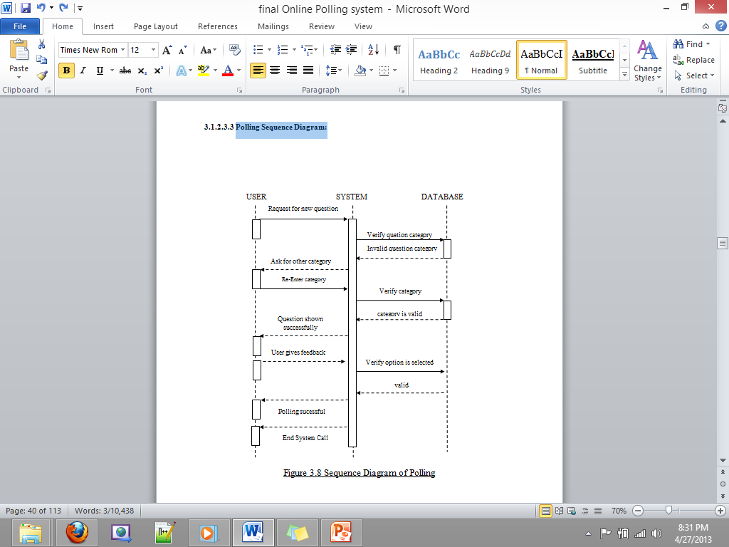
Polling Sequence Diagram

Slide 11
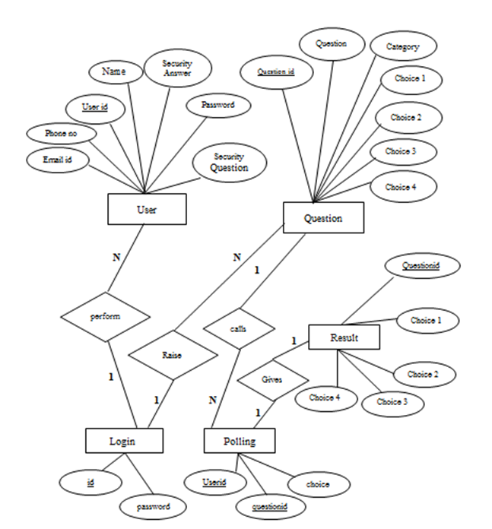
ER Diagram

Slide 12
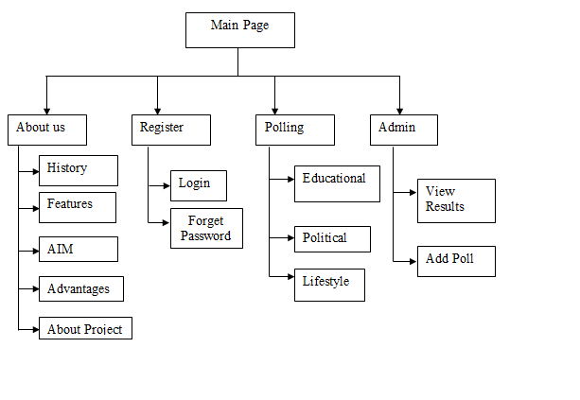
SITE MAP

Slide 13
Question Table
QUESTION TABLE
Field Name | Field Type | Field Size(No of Character) | Description
ID | VARCHAR | 10 | Unique question id for polling
QUESTION | VARCHAR | 50 | This is the actual question
CATEGORY | VARCHAR | 10 | This is the category of the question like educational, politics etc
CHOICE 1 | VARCHAR | 20 | It contain the choice1 text
CHOICE 2 | VARCHAR | 20 | It contain the choice2 text
CHOICE 3 | VARCHAR | 20 | It contain the choice3 text
CHOICE 4 | VARCHAR | 20 | It contain the choice4 text

Slide 14
Registration Table
USER TABLE
Field Name | Field Type | Field Size(No of Character) | Description
ID | VARCHAR | 10 | It contains the unique user id which is choosen by user
NAME | CHAR | 20 | It contain the name of the user
EMAIL_ID | VARCHAR | 30 | It contain the email id of user
PASSWORD | VARCHAR | 20 | It contain the password of user
SEQURITY QUESTION | VARCHAR | 30 | It contain the sequrity question. It is used at the time of recovery of account
ANSWER | VARCHAR | 20 | It contain the answer. . It is used at the time of recovery of account

Slide 15
Login Table
LOGIN TABLE
Field Name | Field Type | Field Size(No of Character) | Description
ID | VARCHAR | 10 | It contains the unique user id which is choosen by user
PASSWORD | VARCHAR | 20 | It contain the password of user

Slide 16
Poll Table
POLL TABLE
Field Name | Field Type | Field Size(No of Character) | Description
QUESTION _ID | VARCHAR | 10 | Unique question id for polling
USER_ID | VARCHAR | 10 | It contains the unique user id which is choosen by user
CHOICE | BOOLEAN | 1 | It contain the result in 1,2,3,4

Slide 17
Result Table
RESULT TABLE
Field Name | Field Type | Field Size(No of Character) | Description
QUESTION _ID | VARCHAR | 10 | Unique question id for polling
CHOICE1 | INT | 5 | It contain the total no of choice1
CHOICE2 | INT | 5 | It contain the total no of choice2
CHOICE3 | INT | 5 | It contain the total no of choice3
CHOICE4 | INT | 5 | It contain the total no of choice4

Slide 18
Feedback Table
FEEDBACK TABLE
Field Name | Field Type | Field Size(No of Character) | Description
S.NO | VARCHAR | 10 | It contain the S.no
FEEDBACK | VARCHAR | 100 | It contain the feedback text
USER ID | VARCHAR | 20 | It contain the user id

Slide 19
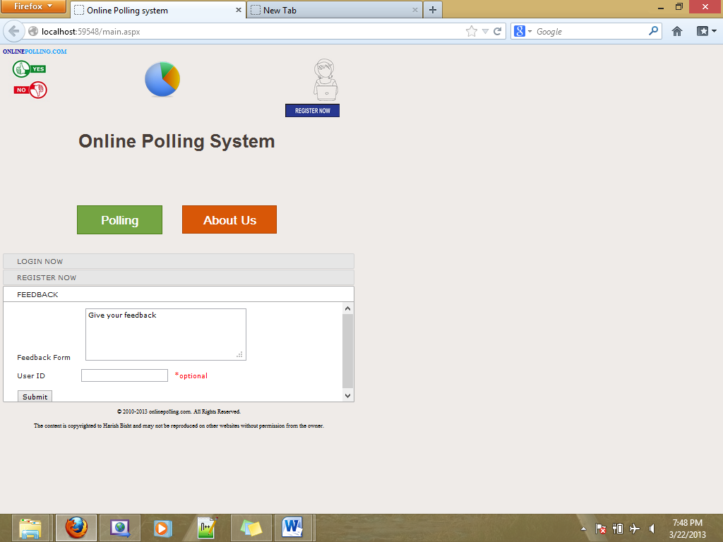
Main Page

Slide 20
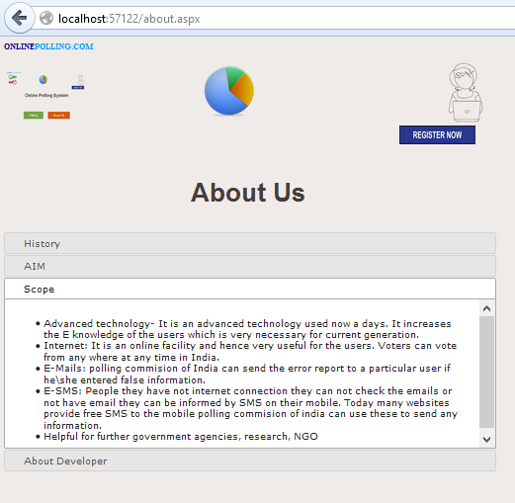
About page

Slide 21
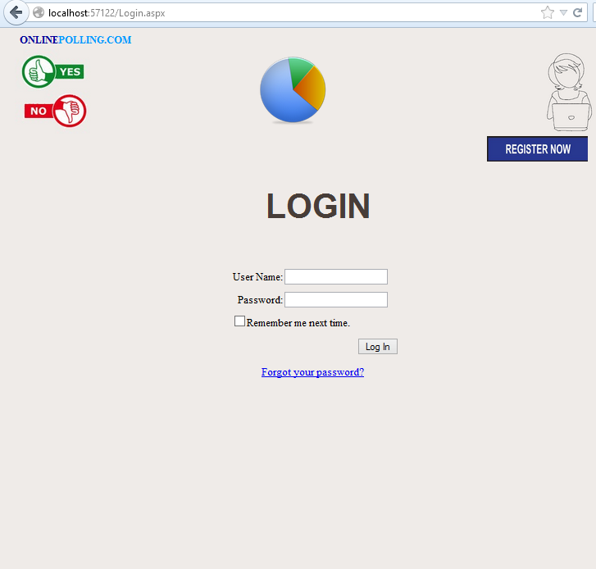
Login Page

Slide 22
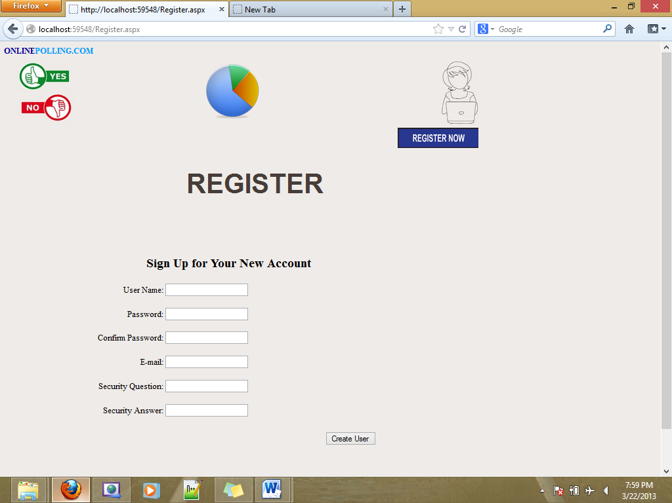
Register Page

Slide 23
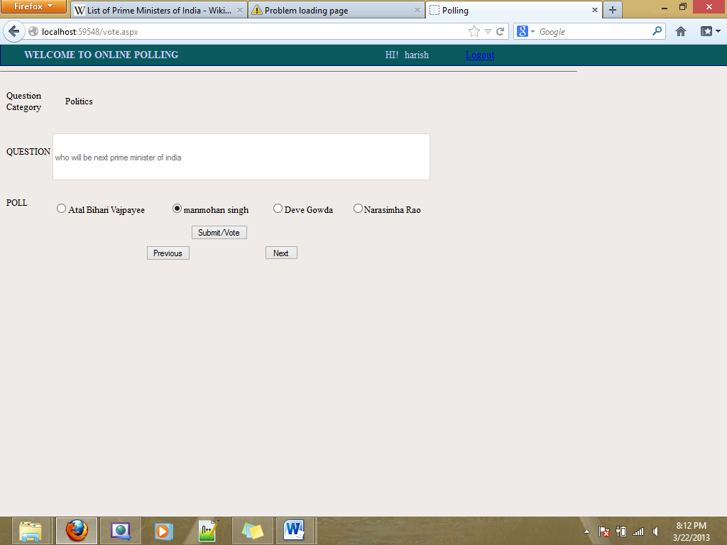
Polling Page

Slide 24
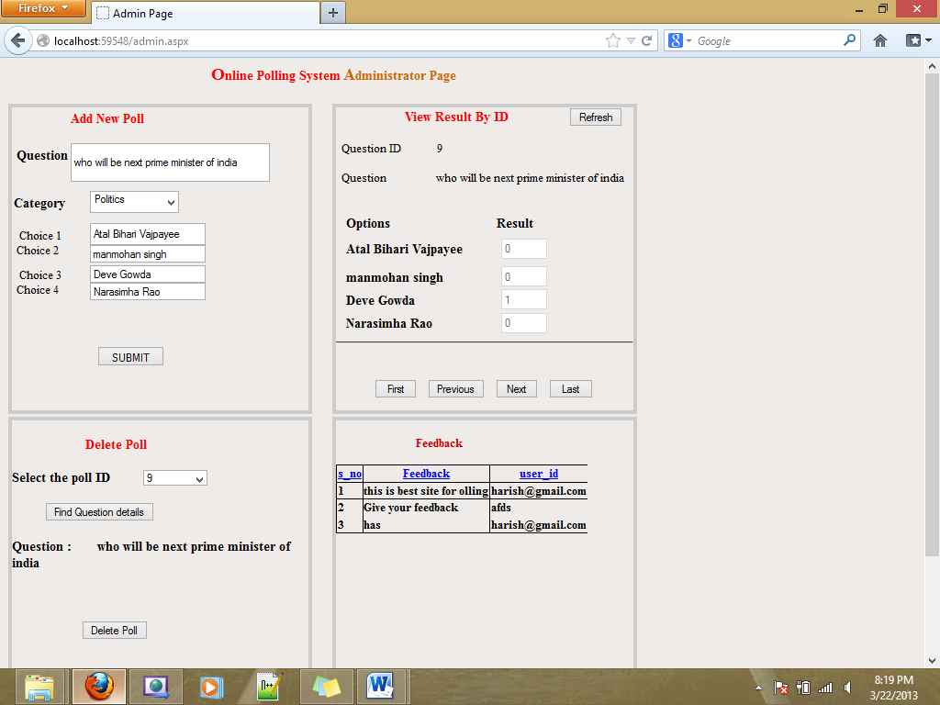
Admin Page

