Slide 1
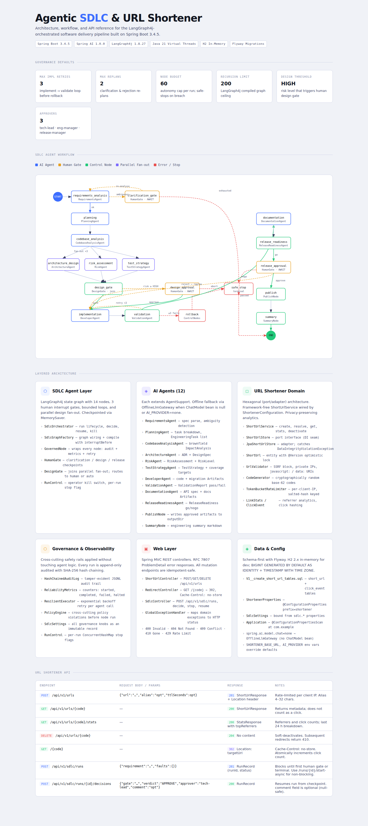
Agentic SDLC & URL Shortener — Architecture Reference
Spring Boot 3.4.5 + Spring AI 1.0.0
H2 in-memory · Flyway migrations · Java 21 virtual threads
3 Human Interrupt Gates
clarification_gate · design_approval · release_approval
Governance Defaults
Max retries: 3 · Max replans: 2 · Node budget: 60 · Recursion: 200
12 AI Agents via LangGraph4j 1.8.27
Requirements → Planning → Codebase → Arch / Risk / Tests → Dev → Validate → Docs → Release
NPE Fix Applied — HumanGate.java
Null comment guard added; decision requests no longer crash at approval gates
Hexagonal URL Shortener Domain
ShortUrlService · SSRF guard · Token-bucket rate limiter · SHA-256 analytics

Slide 2
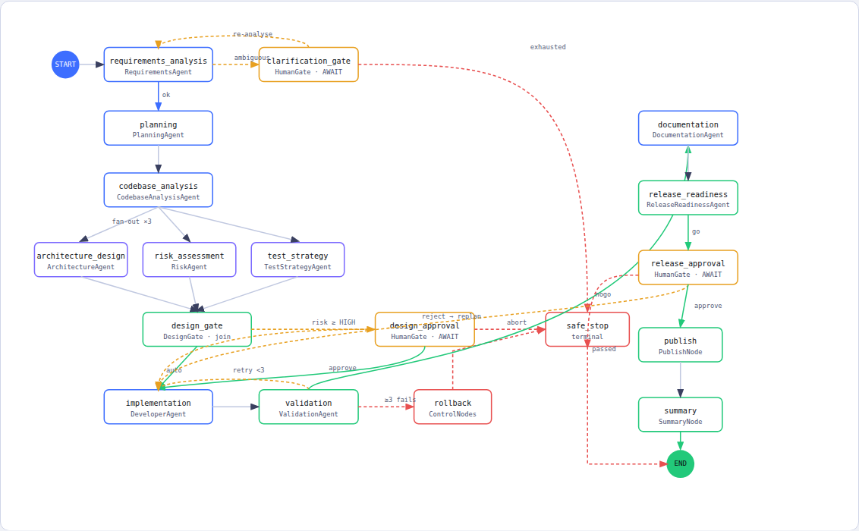
SDLC Agent Workflow — LangGraph4j State Graph (14 nodes)
■
AI Agent
■
Human Gate
■
Pass / Approve
■
Parallel fan-out
■
Error / Abort

Slide 3
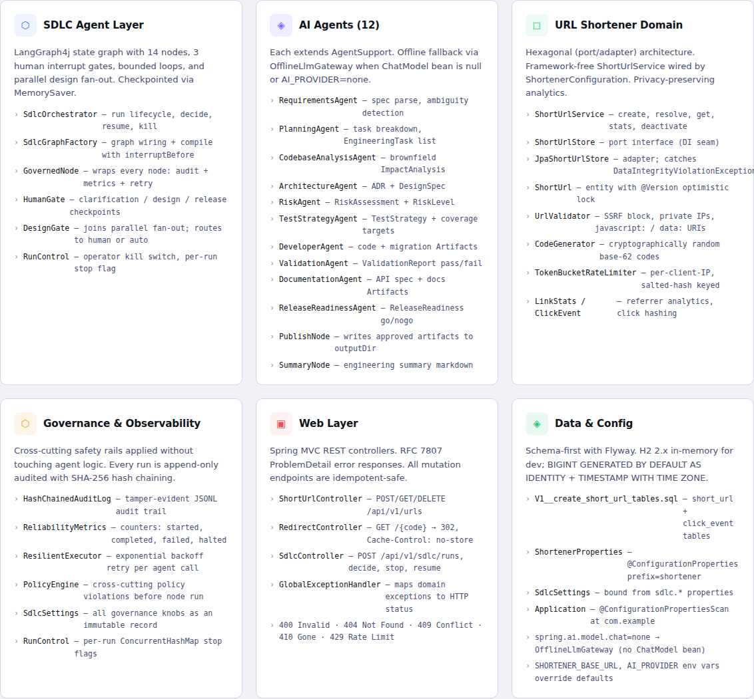
Layered Architecture — Six Domains

Slide 4
URL Shortener & SDLC API Reference
METHOD
ENDPOINT
ST
REQUEST BODY
NOTES
POST
/api/v1/urls
201
{"url":"…","alias":"opt","ttlSeconds":opt}
Rate-limited per IP. Alias 4–32 chars.
GET
/api/v1/urls/{code}
200
—
Metadata only — no click counted.
GET
/api/v1/urls/{code}/stats
200
—
Clicks + last 24h + topReferrers.
DEL
/api/v1/urls/{code}
204
—
Soft-deactivate. Redirect → 410.
GET
/{code}
302
—
Cache-Control: no-store. Atomic click++.
POST
/api/v1/sdlc/runs
201
{"requirement":"…"}
Blocks until human gate or terminal.
POST
/api/v1/sdlc/runs/{id}/decisions
200
{"gate":"…","verdict":"APPROVE","approver":"tech-lead"}
comment optional (null-safe).
Spring Boot 3.4.5 · Spring AI 1.0.0 · LangGraph4j 1.8.27 · Java 21 · H2 2.x · Flyway

