Slide 1

PySpark
Full Image Background, Full Innovation Curve

Slide 2
Spark Overview
Apache Spark is a lightning-fast real-time processing framework. It does in-memory computations to analyze data in real-time. It came into picture as Apache Hadoop MapReduce was performing batch processing only and lacked a real-time processing feature. Hence, Apache Spark was introduced as it can perform stream processing in real-time and can also take care of batch processing.
Apart from real-time and batch processing, Apache Spark supports interactive queries and iterative algorithms also. Apache Spark has its own cluster manager, where it can host its application. It leverages Apache Hadoop for both storage and processing. It uses HDFS (Hadoop Distributed File system) for storage and it can run Spark applications on YARN as well.

Slide 3
What is Apache Spark?
Apache Spark is a distributed processing system used to perform big data and machine learning tasks on large datasets. With Apache Spark, users can run queries and machine learning workflows on petabytes of data, which is impossible to do on your local device.
This framework is even faster than previous data processing engines like Hadoop and has increased in popularity in the past eight years. Companies like IBM, Amazon, and Yahoo are using Apache Spark as their computational framework.

Slide 4
What is Apache Spark?
Apache Spark is an open-source distributed cluster-computing framework introduced by Apache Software Foundation. It is a general engine for big data analysis, processing and computation. It is built for high speed, ease of use, offers simplicity, stream analysis and run virtually anywhere. It can analyze data in real-time. It provides fast computation over the big data.
The fast computation means that it's faster than previous approaches to work with Big Data such as MapReduce. The main feature of Apache Spark is its in-memory cluster computing that enhances the processing speed of an application.
It can be used for multiple things like running distributed SQL, creating data pipelines, ingesting data into a database, running Machine Learning algorithms, working with graphs or data streams, and many more.

Slide 5
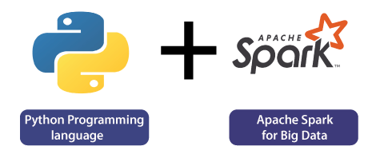
Python and Spark
We require a more efficient tool to perform different types of operations on the big data. There are various tools to perform the multiple tasks on the huge dataset, but these tools are not so appealing anymore. It is needed some scalable and flexible tools to crack big data and gain benefit from it.

Slide 6
Python and Scala
Python | Scala
Python is an interpreted, dynamic programming language. | Scala is a statically typed language.
Python is Object Oriented Programming language. | In Scala, we need to specify the type of variable and objects.
Python is easy to learn and use. | Scala is slightly difficult to learn than Python.
Python is slower than Scala because it is an interpreted language. | Scala is 10 times faster than Python.
Python is an Open-Source language and has a huge community to make it better. | Scala also has an excellent community but lesser than Python.
Python contains a vast number of libraries and the perfect tool for data science and machine learning. | Scala has no such to
Apache Spark is officially written in the Scala programming language

Slide 7
PySpark Overview
Apache Spark is written in Scala programming language. To support Python with Spark, Apache Spark Community released a tool, PySpark. Using PySpark, you can work with RDDs in Python programming language also. It is because of a library called Py4j that they are able to achieve this.
PySpark offers PySpark Shell which links the Python API to the spark core and initializes the Spark context. Majority of data scientists and analytics experts today use Python because of its rich library set.

Slide 8
What is PySpark?
PySpark is an interface for Apache Spark in Python. With PySpark, you can write Python and SQL-like commands to manipulate and analyze data in a distributed processing environment. Using PySpark, data scientists manipulate data, build machine learning pipelines, and tune models.
Most data scientists and analysts are familiar with Python and use it to implement machine learning workflows. PySpark allows them to work with a familiar language on large-scale distributed datasets. Apache Spark can also be used with other data science programming languages like R.

Slide 9
Why Use PySpark?
The reason companies choose to use a framework like PySpark is because of how quickly it can process big data. It is faster than libraries like Pandas and Dask,and can handle larger amounts of data than these frameworks. If you had over petabytes of data to process, for instance, Pandas and Dask would fail but PySpark would be able to handle it easily.
While it is also possible to write Python code on top of a distributed system like Hadoop, many organizations choose to use Spark instead and use the PySpark API since it is faster and can handle real-time data. With PySpark, you can write code to collect data from a source that is continuously updated, while data can only be processed in batch mode with Hadoop.
Apache Flink is a distributed processing system that has a Python API called PyFlink and is faster than Spark in terms of performance. However, Apache Spark has been around for a longer period and has better community support, which means that it is more reliable.
Furthermore, PySpark provides fault tolerance, which means that it has the capability to recover loss after a failure occurs. The framework also has in-memory computation and is stored in random access memory (RAM). It can run on a machine that does not have a hard-drive or SSD installed.

Slide 10
What is PySpark?
PySpark is the Python API for Apache Spark. It allows you to interface with Spark's distributed computation framework using Python, making it easier to work with big data in a language many data scientists and engineers are familiar with.
By using PySpark, you can create and manage Spark jobs, and perform complex data transformations

Slide 11

PySpark Architecture

Slide 12
PySpark Architecture
PySpark architecture consists of a driver program that coordinates tasks and interacts with a cluster manager to allocate resources.
The driver communicates with worker nodes, where tasks are executed within an executor’s JVM. SparkContext manages the execution environment, while the DataFrame API enables high-level abstraction for data manipulation.
SparkSession provides a unified entry point for Spark functionality. Underneath, the cluster manager oversees resource allocation and task scheduling across nodes, facilitating parallel computation for processing large-scale data efficiently.

Slide 13
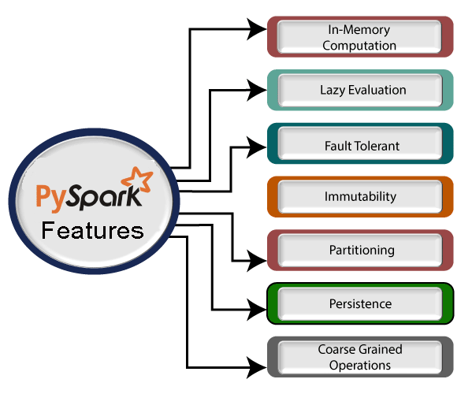
PySpark Features

Slide 14
PySpark Features Cont..
Real-time Computation
PySpark provides real-time computation on a large amount of data because it focuses on in-memory processing. It shows the low latency.
Support Multiple Language
PySpark framework is suited with various programming languages like Scala, Java, Python, and R. Its compatibility makes it the preferable frameworks for processing huge datasets.
Caching and disk constancy
PySpark framework provides powerful caching and good disk constancy.
Swift Processing
PySpark allows us to achieve a high data processing speed, which is about 100 times faster in memory and 10 times faster on the disk.
Works well with RDD
Python programming language is dynamically typed, which helps when working with RDD.

Slide 15
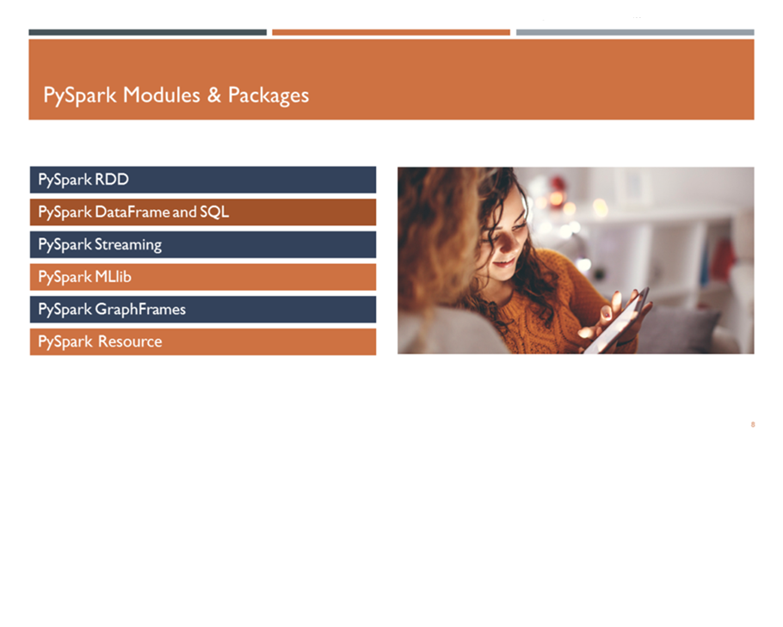
PySpark Modules & Packages
In Apache Spark, the PySpark module enables Python developers to interact with Spark, leveraging its powerful distributed computing capabilities. It provides a Python API that exposes Spark’s functionality, allowing users to write Spark applications using Python programming language.

Slide 16
PySpark Modules & Packages Cont…
RDD (pyspark.RDD)
DataFrame and SQL (pyspark.sql)
Streaming (pyspark.streaming)
MLib (pyspark.ml, pyspark.mllib)
GraphFrames (GraphFrames)
Resource (pyspark.resource) It’s new in PySpark 3.0

Slide 17
Real-life usage of PySpark
Data is an essential thing for every industry. Most of the industries works on big data and hires analysts to extract useful information from the raw data.
1. Entertainment Industry
The entertainment industry is one of the largest sectors which is growing towards online streaming. The popular online entertainment platform Netflix uses the Apache spark for real-time processing to personalized online movies or web series to its customers. It processes approx. 450 billion events per day that are streamed on server-side application.
2. Commercial Sector
The commercial sector also uses Apache Spark's Real-time processing system. Banks and other financial fields are using Spark to retrieve the customer's social media profile and analyze to gain useful insights which can help to make the right decision.
The extracted information is used for the credit risk assessment, targeted ads, and customer segmentation.
Spark plays a significant role in Fraud Detection and widely used in machine learning tasks.

Slide 18
Real-life usage of PySpark Cont..
3. Healthcare
Apache Spark is used to analyze the patient records along with the previous medical reports data to identify which patient is probable to face health issues after being discharged from the clinic.
4. Trades and E-commerce
The leading e-commerce websites like Flipkart, Amazon, etc, use Apache Spark for targeted advertising. The other websites such as Alibaba provides targeted offers, enhanced customer experience and optimizes overall performance.
5. Tourism Industry
The tourism industry widely uses Apache Spark to provide advice to millions of travelers by comparing hundreds of tourism websites.

Slide 19
SparkSession
SparkSession is an entry point to Spark, and creating a SparkSession instance would be the first statement you would write to program with RDD, DataFrame, and Dataset. SparkSession will be created using SparkSession.builder().

Slide 20
How to Create SparkSession
Creating a SparkSession is fundamental as it initializes the environment required to leverage the capabilities of Apache Spark.
To create SparkSession in Scala or Python, you need to use the builder pattern method builder() and calling getOrCreate() method. It returns a SparkSession that already exists; otherwise, it creates a new SparkSession.

Slide 21
Setting Spark Configs
If you want to set some configs to SparkSession, use the config() method.

Slide 22
Create DataFrame
SparkSession also provides several methods to create a Spark DataFrame and Dataset. The below example uses the createDataFrame() method which takes a list of data.

Slide 23
PySpark show() Function
The show() function is a method available for DataFrames in PySpark. It is used to display the contents of a DataFrame in a tabular format, making it easier to visualize and understand the data.
This function is particularly useful during the data exploration and debugging phases of a project.
Syntax
DataFrame.show(n=20, truncate=True, vertical=False)
Parameters:
n: The number of rows to display. The default value is 20.
truncate: If set to True, the column content will be truncated if it is too long. The default value is True.
vertical: If set to True, the output will be displayed vertically. The default value is False.

Slide 24
PySpark Read CSV File into DataFrame
By utilizing DataFrameReader.csv("path") or format("csv").load("path") methods, you can read a CSV file into a PySpark DataFrame. These methods accept a file path as their parameter. When using the format(“csv”) approach, you should specify data sources like csv or org.apache.spark.sql.csv.
# Import
from pyspark.sql import SparkSession
# Create SparkSession
spark = SparkSession.builder().master("local[1]")
.appName("SparkByExamples.com")
.getOrCreate()
# Read CSV File
df = spark.read.csv("/path/zipcodes.csv")
df.show()

Slide 25
Working with Spark SQL
Using SparkSession you can access Spark SQL capabilities in Apache Spark. In order to use SQL features first, you need to create a temporary view in Spark. Once you have a temporary view you can run any ANSI SQL queries using spark.sql() method.
// Spark SQL
df.createOrReplaceTempView("sample_table")
val df2 = spark.sql("SELECT _1,_2 FROM sample_table")
df2.show()

Slide 26
PySpark Part2

Slide 27
Spark
Spark
It is General Purpose in Memory Computation Engine
1.General Purpose
Data Cleaning -PIG
Query -HIVE
ML Operation -MAHOUT
Spark -Each and every operation we can perform or do in spark
1.Data cleaning
2.SQL
3.Spark MLLib

Slide 28
Spark Cont…
2.Computation
Hadoop Vs Spark
Hadoop provide 3 components
1.HDFS -Storage
2.Resource Manager
3.Map reduce - Computation
we must compare Spark with Map reduce
Spark -HDFS, Amazon S3 storage

Slide 29
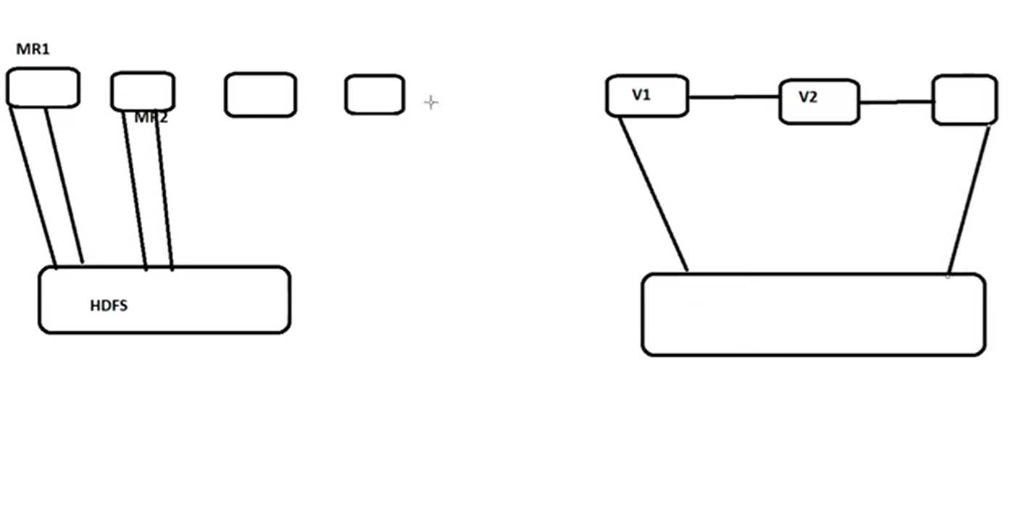
Spark Cont…
Hadoop Vs Spark
HDFS

Slide 30
Spark Cont…
3.In Memory ->RAM
Spark does all computation in memory
Spark is faster than Map Reducer

Slide 31
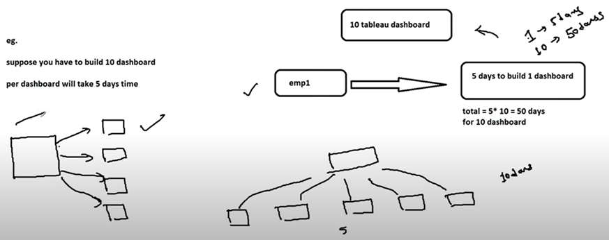
Distributed

Slide 32
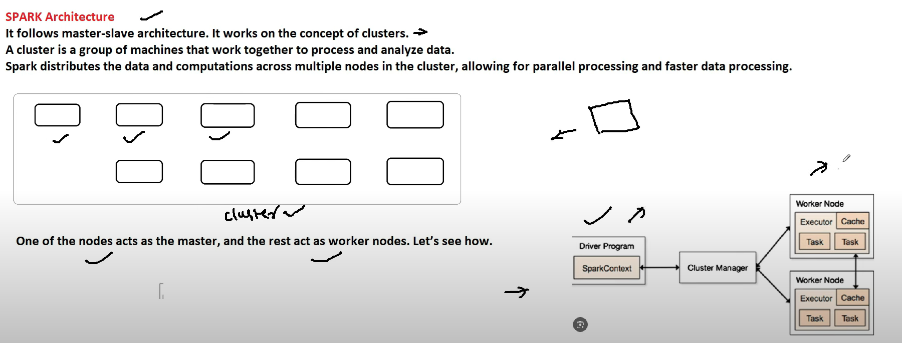
Spark Architecture

Slide 33
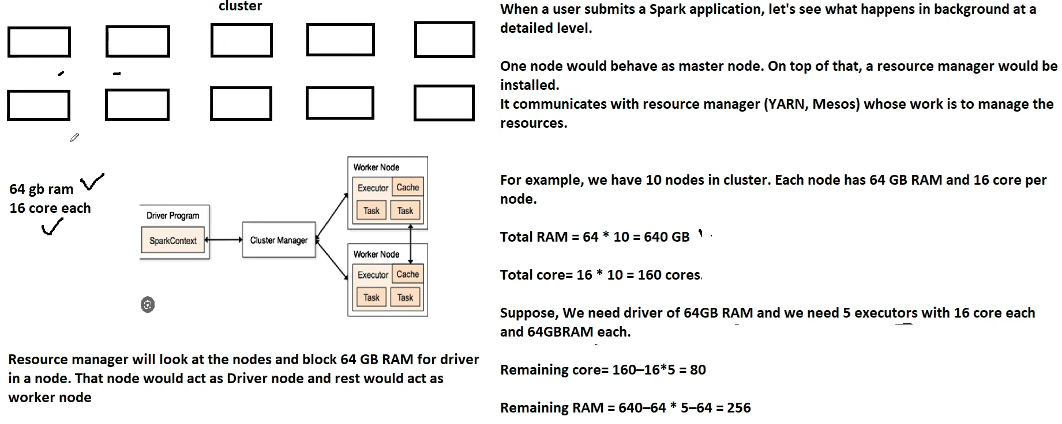
Spark Architecture Cont…

Slide 34
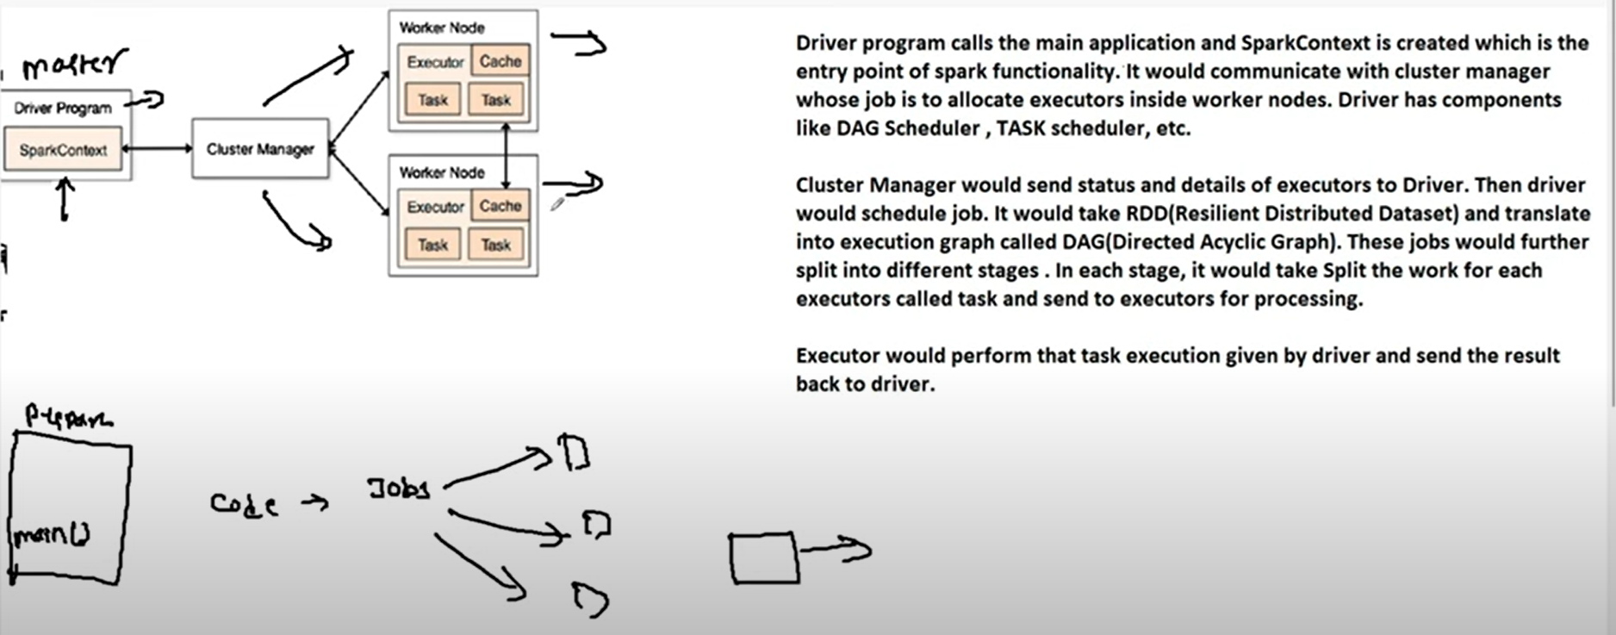
Spark Architecture Cont…

Slide 35
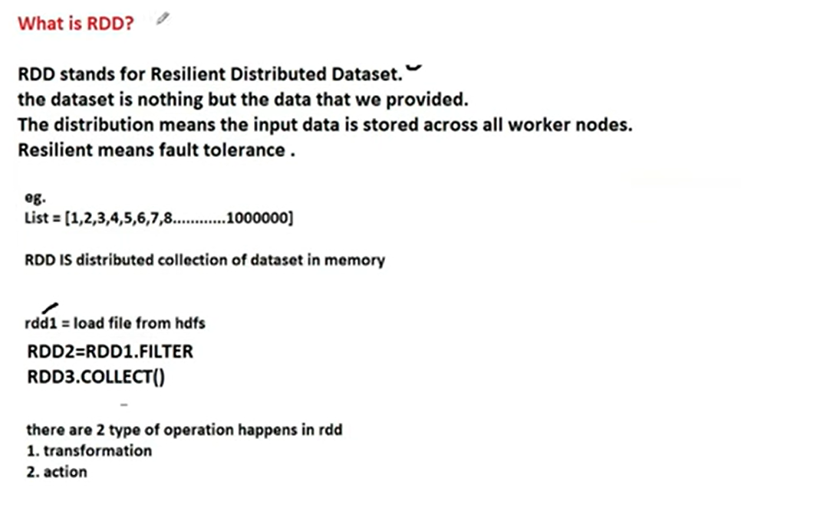
RDD

Slide 36
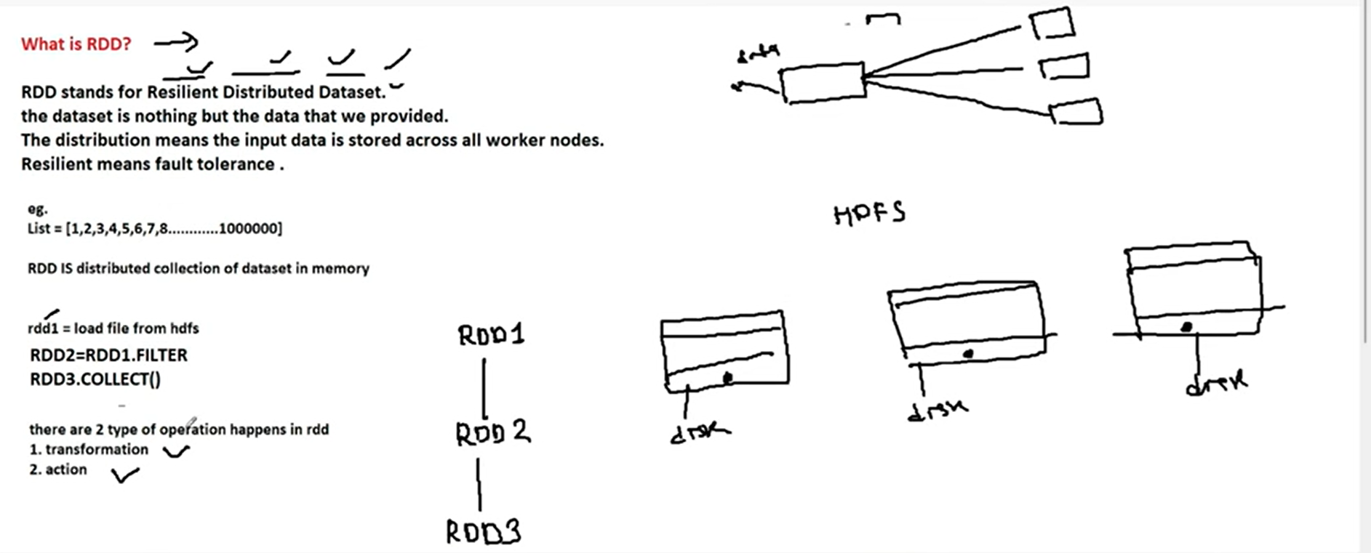
RDD

Slide 37
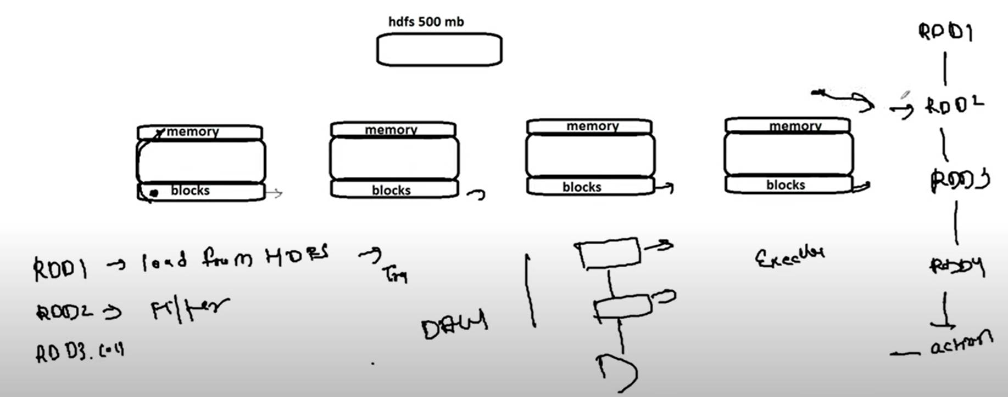
RDD Cont…

Slide 38
RDD Cont..
In order to create an RDD, first, you need to create a SparkSession which is an entry point to the PySpark application. SparkSession can be created using a builder() or newSession() methods of the SparkSession.
Spark session internally creates a sparkContext variable of SparkContext. You can create multiple SparkSession objects but only one SparkContext per JVM. In case you want to create another new SparkContext, you should stop the existing Sparkcontext (using stop()) before creating a new one.

Slide 39
RDD Cont..
Let’s create an RDD from a text file using textFile() function of the SparkContext.
# Import SparkSession
from pyspark.sql import SparkSession
# Create SparkSession
spark = SparkSession.builder \
.master("local[1]") \
.appName("SparkByExamples.com") \
.getOrCreate()
# Create RDD from external Data source
rdd2 = spark.sparkContext.textFile("/path/test.txt")
Once you have an RDD, you can perform transformation and action operations. Any operation you perform on RDD runs in parallel.

Slide 40
RDD Cont..
RDD Operations
You can perform two types of operations on RDD; Transformations and Actions.
RDD transformations in PySpark are lazy operations and they execute only when an action is called on RDD.
Transformation operations are map, filter, flatMap, groupByKey, reduceByKey, join, union, sortByKey, distinct, sample, mapPartitions, and aggregateByKey. These functions transform RDDs by applying computations in a distributed manner across a cluster of machines and return a new RDD
RDD actions in PySpark trigger computations and return results to the Spark driver. Key actions include collect, count, take, reduce, foreach, first, takeOrdered, takeSample, countByKey, saveAsTextFile, saveAsSequenceFile, saveAsObjectFile, foreachPartition, collectAsMap, aggregate, and fold. These actions initiate execution and materialize RDD data. Remember any RDD operation that returns non RDD is considered as an action.

Slide 41
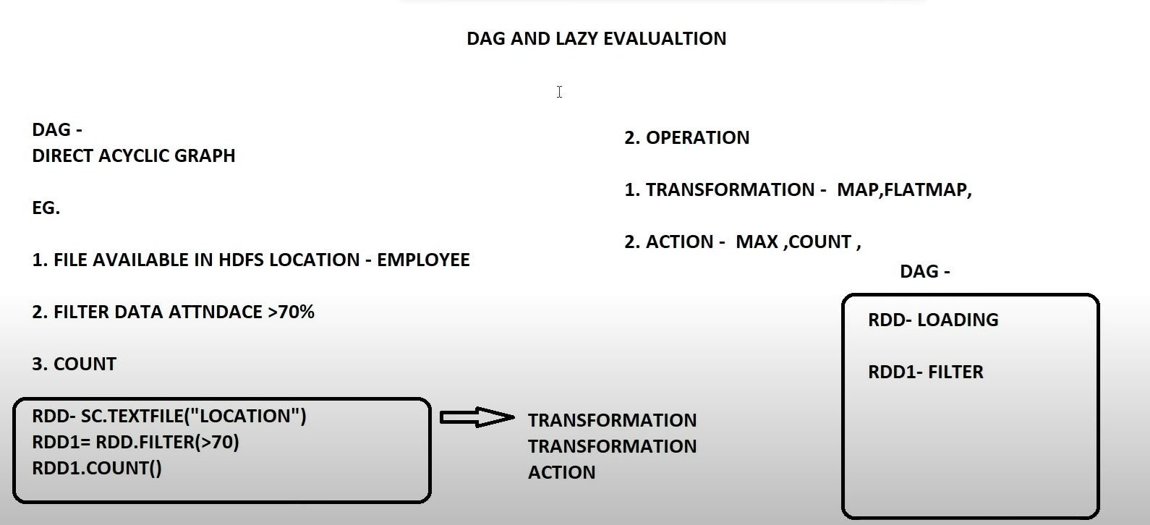
DAG and LAZY Evaluation
Until Action is called execution will not happen->called as Lazy Evaluation

Slide 42
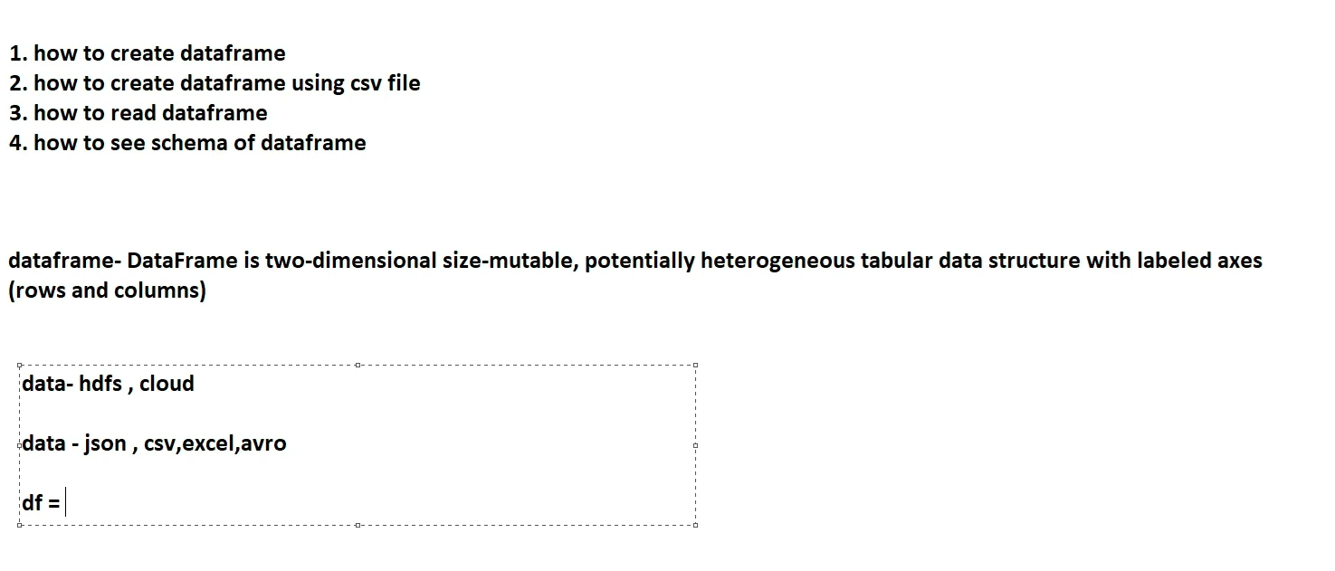
Demo

Slide 43
What is Parquet File?
Apache Parquet file is a columnar storage format available to any project in the Hadoop ecosystem, regardless of the choice of data processing framework, data model, or programming language.
Advantages:
While querying columnar storage, it skips the nonrelevant data very quickly, making faster query execution. As a result aggregation queries consume less time compared to row-oriented databases.
parquet-file

