Slide 1


CS19P11 – INTERNET OF THINGS
Design Thinking Centre
PROUDLY PRESENTS
24.05.2024
EMERGENCY ALERT HELMET
Team Member 1 :
Team Member 2 :
HARISH S(210701077-IIIYR-CSE)
HARISH D(210701073-IIIYR-CSE)

Slide 2
ABSTRACT
In the critical moments following a road accident, timely medical assistance is paramount to saving lives. The Emergency Alert Helmet is a groundbreaking innovation designed to expedite emergency response times and enhance the chances of survival for accident victims. This smart helmet is equipped with a force resistive sensor and a GSM module, integrated with an Arduino microcontroller, to detect significant impacts indicative of an accident. Upon detecting a force exceeding a predefined threshold, indicative of a collision, the helmet's system automatically triggers an alert message. This message is sent to the nearest ambulance service and emergency contacts, ensuring that first responders are dispatched promptly to the location. By bridging the gap between the occurrence of an accident and the arrival of medical help, the Emergency Alert Helmet stands as a beacon of hope, potentially reducing fatalities and improving outcomes for accident victims.

Slide 3

PROPOSED SOLUTION
FORCE RESISTIVE SENSOR(DETECTS IMPACT FORCE OF COLLISION)
ARDUINO UNO
POWER SUPPLY
GSM MODULE
NOTIFICATION TO EMERGENCY CONTACTS

Slide 4
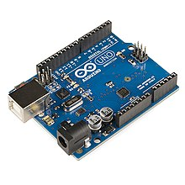
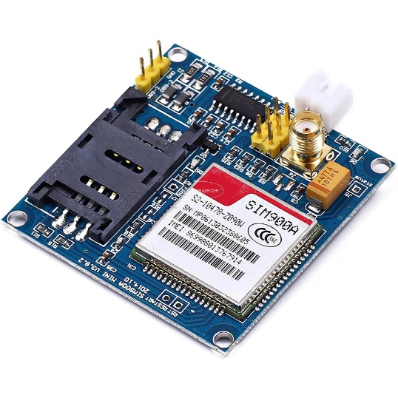
TECHNOLOGY USED
HARDWARE USED:
ARDUINO UNO:
The Arduino Uno is an open-source microcontroller board based on the Microchip ATmega328P microcontroller (MCU) and developed by Arduino.cc
GSM MODULE:
SIM900A is an ultra compact and reliable wireless module. This is a complete GSM/GPRS module in a SMT type and designed with a very powerful single-chip processor integrating AMR926EJ-S core, allowing you to benefit from small dimensions and cost-effective solutions.

Slide 5
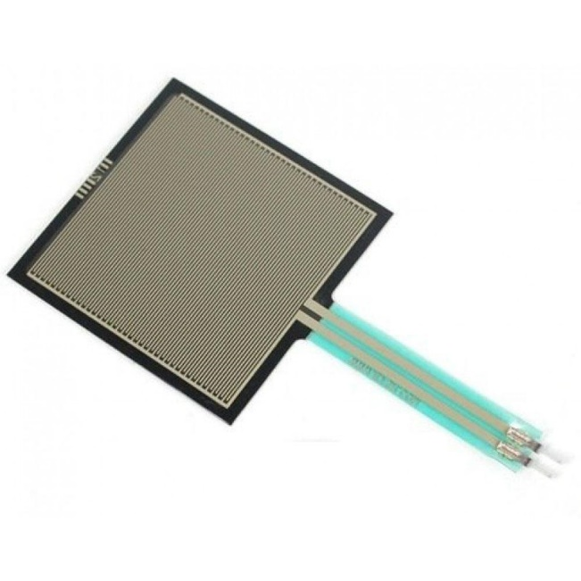

FORCE RESISTIVE SENSOR:
A force-sensing resistor is a material whose resistance changes when a force, pressure or mechanical stress is applied. They are also known as force-sensitive resistor and are sometimes referred to by the initialism FSR.
SOFTWARE USED:
ARDUINO IDE:
The Arduino Integrated Development Environment - or Arduino Software (IDE) - contains a text editor for writing code, a message area, a text console, a toolbar with buttons for common functions and a series of menus. It connects to the Arduino hardware to upload programs and communicate with them.

Slide 6
NOVELTY
Integrated Impact Detection: Unlike standard helmets, this project incorporates a force resistive sensor that detects the impact force of a collision. This allows for immediate and automatic detection of accidents, which is not a common feature in conventional helmets.
Customizable Threshold Settings: The system allows for the customization of impact thresholds, which can be calibrated according to different safety standards or user preferences. This flexibility is not always available in off-the-shelf safety devices.
Versatility and Adaptability: The design of the Emergency Alert Helmet is adaptable to various types of helmets, making it versatile for different users, such as motorcyclists, cyclists, and industrial workers.
Cost-Effectiveness:The use of widely available and affordable components like Arduino and GSM modules makes the Emergency Alert Helmet a cost-effective alternative to more expensive commercial products.

Slide 7
SOCIAL RELEVANCE
As per the report, a total of 4,61,312 road accidents have been reported by States and Union Territories (UTs) during the calendar year 2022, which claimed 1,68,491 lives and caused injuries to 4,43,366 persons.
In 2022, the Indian state with the highest number of road accidents was Tamil Nadu, with over 64 thousand cases reported, followed by Madhya Pradesh, with over 54 thousand reported road accidents.
In Karnataka, the report by CAG(comptroller and auditor general)highlights that, in a staggering 90,000 instances, accident victims did not receive timely medical care.
Our project will certainly increases the timely medical care service and provide a most beautiful solution to the society by saving their invaluable lives.

Slide 8
FUTURE ENHANCEMENTS
GPS ENABLED ARDUINO
GYROSCOPE
ACCELEROMETER(MPU-6050)

Slide 9
REFERENCES
https://morth.nic.in/road-accident-in-india
https://timesofindia.indiatimes.com/city/bengaluru/cag-report-accident-victims-didnt-receive-timely-care-in-90000-cases/articleshow/90298359.cms
https://www.tutorialspoint.com/arduino/arduino_program_structure.htm
https://www.researchgate.net/publication/358504410_INTELLIGENT_ACCIDENT_DETECTION_AND_SMART_ALERT_SYSTEM_FOR_VEHICLES

Slide 10
THANK YOU

