Slide 1
E-Commerce Sales Chatbot
Presentation for Full Stack Developer Internship
By Harish Gupta

Slide 2
1. Project Overview
A full-stack chatbot web application that simulates a bookstore assistant.
Users can sign up, log in, and chat with the bot to find books
Bot handles queries by genre, price, rating, author
Backend parses input and filters books from MySQL DB
Chat history is saved per user
Built using Flask, React, MySQL

Slide 3
2. Technology Stack
Frontend: React, Axios, Custom CSS
Backend: Flask, Flask-Login, Flask-CORS
ORM: SQLAlchemy (Python)
Auth: Werkzeug for secure password hashing
Database: MySQL
Testing & Mock Data: Faker

Slide 4
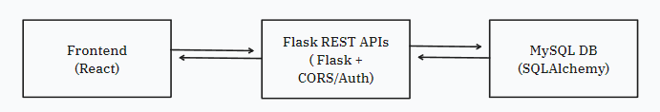
3. System Architecture

Slide 5
4. Chatbot Functionality
• Uses rule-based parsing using regex
• Detects:
- Genre (e.g., thriller, sci-fi)
- Price (under ₹500)
- Rating (above 4.5)
- Author (e.g., by Agatha Christie)
• Matches filters with database records
• Returns formatted response to frontend

Slide 6
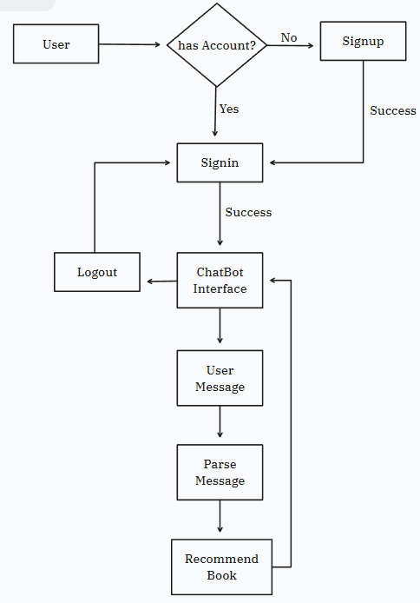
Workflow

Slide 7
6. Key Learnings
• Flask-React integration using session-based auth
• Regex-based natural language parsing
• CORS handling with Flask-CORS and Axios
• Scalable data modeling with SQLAlchemy
• Stateless frontend design using React state

Slide 8
8. Future Scope
• Integrate NLP (OpenAI or Rasa)
• Add cart, product images, and detail views
• Add voice input support
• Enable feedback/rating per book response

Slide 9
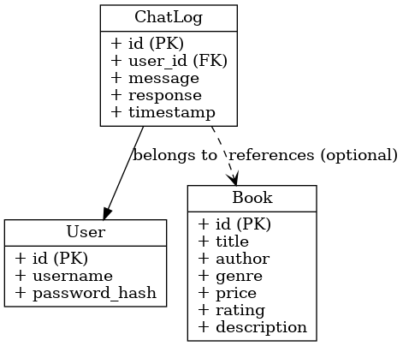
ER Diagram

Slide 10
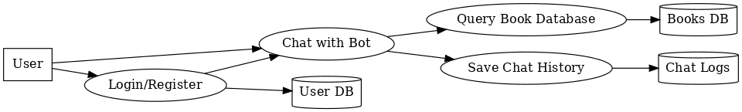
DFD Diagram (Level 1)

Slide 11
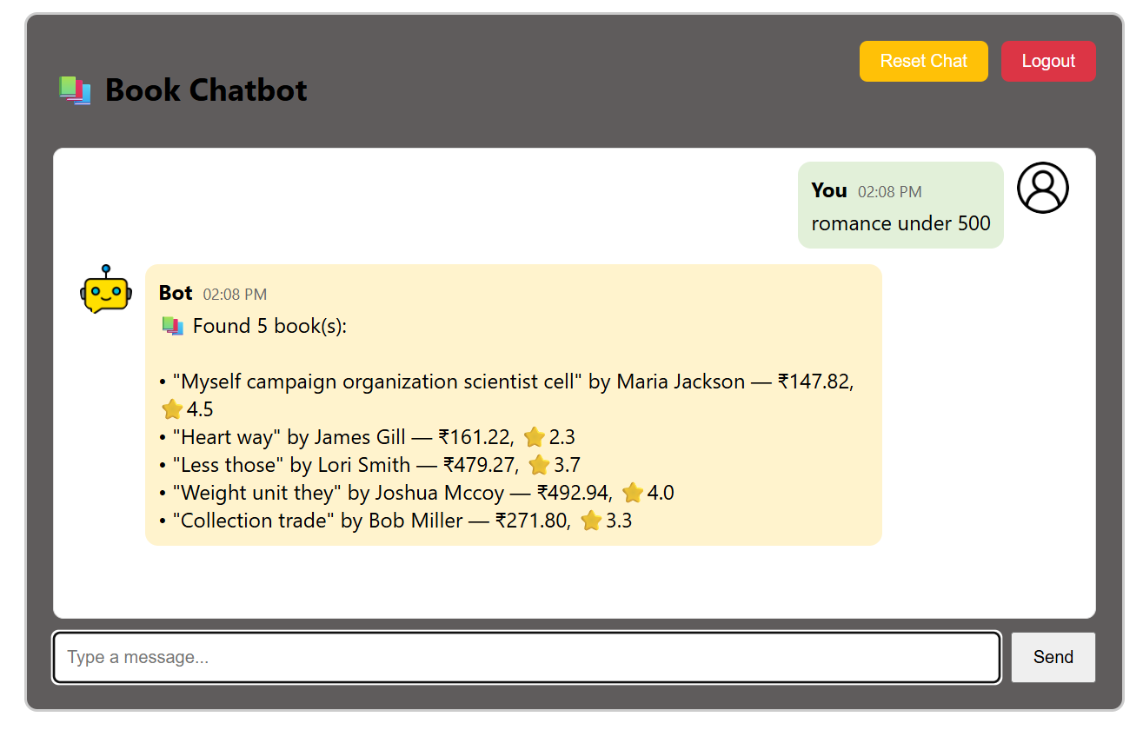
Screenshots

Slide 12
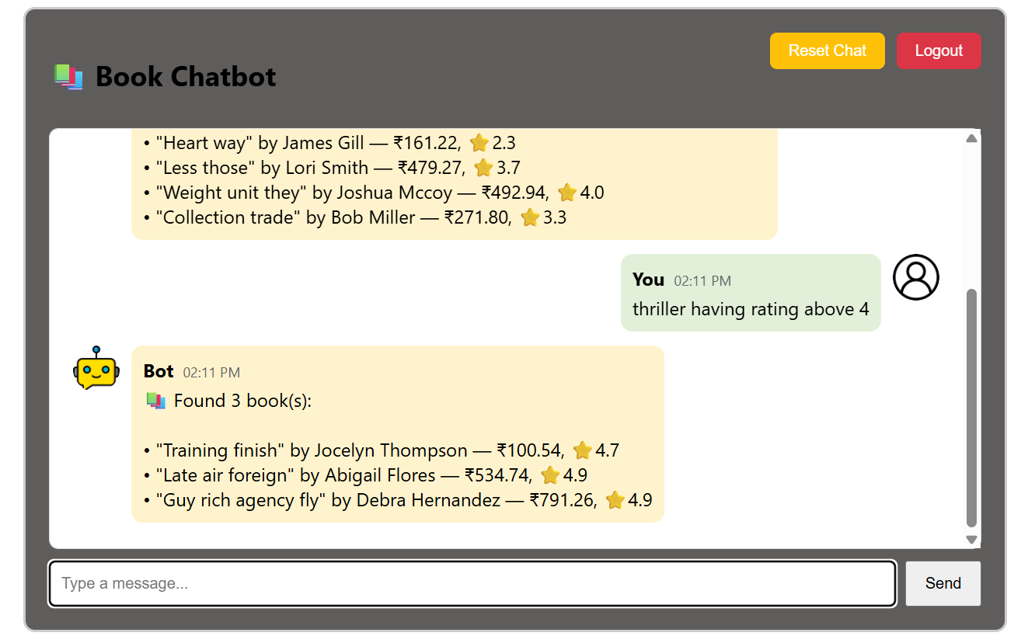

Slide 13
Thank You!
Presented by: Harish Gupta
CSE Final Year Student

