Slide 1
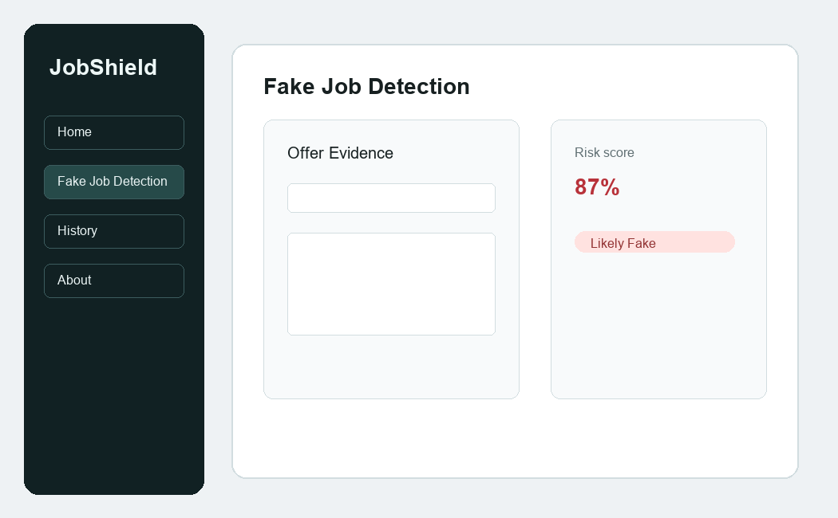
AI-Based Fake Job Offer Detector
Using AI methods, cryptography, network security, and cyber law awareness
- Fake offer detection
- Domain and link inspection
- SHA-256 document fingerprint
- Cybercrime reporting guidance
PROJECT PRESENTATION

Slide 2
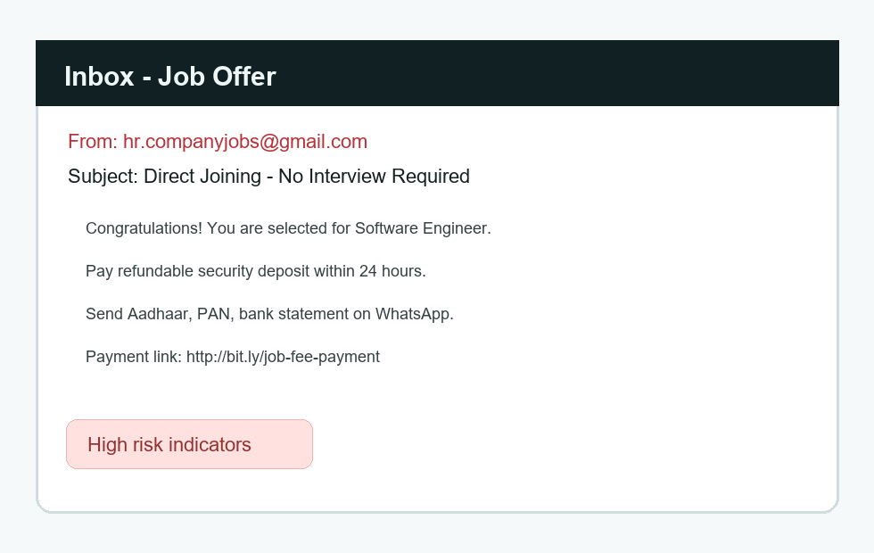
JD
Problem Statement
Understanding the threat of fake job offers
- Fake job offers are a growing cyber threat targeting job seekers worldwide
- Scammers use sophisticated impersonation techniques to appear legitimate
- Victims often lose money through fraudulent fees, deposits, or data theft
- Fresh graduates and unemployed individuals are particularly vulnerable
- Lack of awareness and easy verification tools exacerbates the problem
- Economic impact includes financial losses and damaged trust in job markets
- Cybercrime statistics show increasing incidents of employment fraud
JobShield

Slide 3
JD
Objectives
Goals and scope of the project
- Develop an accessible tool for detecting suspicious job offers
- Implement multiple detection methods: AI text analysis, network checks, cryptography
- Provide clear risk scoring with explainable reasons
- Include cyber law guidance for appropriate response actions
- Create a browser-based prototype for easy deployment and use
- Support both text input and file upload for flexibility
- Maintain user privacy by processing data client-side only
JobShield

Slide 4
JD
Technologies Used
- Frontend: HTML5, CSS3, JavaScript ES6+ for responsive web interface
- Web APIs: Web Crypto API for SHA-256 hashing, Local Storage for data persistence
- Text Processing: Regular expressions and rule-based pattern matching
- Security: URL parsing, domain validation, link analysis
- UI Framework: Custom CSS with light/dark theme support
- Build Tools: Python with python-pptx for presentation generation
- Image Generation: PIL/Pillow for mock UI screenshots
- Deployment: Static web server (Python http.server) for local hosting
AI Text Analysis
Network Security
Risk Score
Technical stack and implementation details
SHA-256 Hash
Cyber Law Guide
JobShield

Slide 5
JD
Architecture Diagram
Client-side prototype with modular detection logic
Text Analyzer
Frontend UI
Risk Engine
Network Checks
Crypto Hash
History Store
JobShield

Slide 6
JD
System Workflow
How the detector converts offer evidence into a final decision
User input
Extract indicators
Run checks
Hash document
Final output
Text or .txt file
Emails, URLs, risk terms
AI rules + network logic
SHA-256 fingerprint
Score, verdict, guidance
End-to-end detection flow
JobShield

Slide 7
JD
SHA-256 Cryptography Method
Document integrity verification using cryptographic hashing
- SHA-256 is a cryptographic hash function producing 256-bit (32-byte) hash values
- Used to create unique fingerprints of job offer documents
- Any change in input text produces completely different hash output
- Provides document integrity verification without revealing content
- Implemented using browser's Web Crypto API for client-side processing
- Hash values are displayed in hexadecimal format for readability
- Helps users verify if offer content has been tampered with
- Cryptographically secure and collision-resistant algorithm
JobShield

Slide 8
JD
Advantages and Limitations
Strengths and areas for improvement
- Advantages:
- Browser-based, no installation required
- Client-side processing ensures privacy
- Multiple detection methods for comprehensive analysis
- Explainable AI approach with clear reasoning
- Cyber law guidance for appropriate actions
- Lightweight and fast performance
- Limitations:
- Rule-based detection may miss sophisticated scams
- No machine learning model for advanced pattern recognition
- Limited to text analysis, no image or PDF processing
- Cannot verify actual company hiring practices
- Depends on user-provided evidence quality
JobShield

Slide 9
JD
Future Scope
Potential enhancements and research directions
- Integrate machine learning models trained on real fake job datasets
- Add support for PDF and image OCR processing
- Implement live API checks for domain reputation and WHOIS data
- Create verified employer portal with digital signatures
- Develop mobile app version for broader accessibility
- Add multi-language support for global users
- Implement real-time URL scanning and malware detection
- Partner with employment agencies for official verification services
- Research advanced NLP techniques for better text analysis
- Explore blockchain-based verification systems
JobShield

Slide 10
JD
Conclusion
Summary of the project's impact and achievements
- The AI-Based Fake Job Offer Detector successfully combines multiple cybersecurity approaches to protect job seekers.
- Key achievements include rule-based AI text analysis, network security checks, SHA-256 document hashing, and cyber law guidance.
- The prototype demonstrates how client-side technologies can provide immediate risk assessment without requiring backend infrastructure.
- Future enhancements could include machine learning models, live API integrations, and verified employer portals.
- This project contributes to digital literacy and cyber safety awareness among job seekers in India and globally.
Thank You
JobShield

