Slide 1


CareerBud: Your friendly Job recommender chatbot
Zeinab Keserwan, Mohammed Adnan, Kartik Banga, Harish Nair
uOttawa.ca
Notes:
PAGE COUVERTURE (option 2)
REMARQUE : À lire avant d’utiliser le gabarit
Les éléments suivants du gabarit ne peuvent pas être modifiés : • En-tête institutionnel grenat (Université d’Ottawa | University of Ottawa) • Pied de page institutionnel comprenant la bande grise et grenat ainsi que le logo
Les éléments suivants du gabarit peuvent être modifiés : • L’adresse Web uOttawa.ca dans le pied de page peut être personnalisée afin de répondre aux besoins de l’utilisateur et le nom du document peut être inséré à la droite de l’URL si nécessaire. Vous pouvez simplement taper l’adresse Web désirée dans la boîte appropriée
• La photo ou l’image de fond peut être remplacée par celle de votre choix
COVER PAGE (option 2)
NOTE: Read before using template
The following elements of the template must remain untouched and cannot be modified:
• Corporate (Université d'Ottawa | University of Ottawa) garnet header
• Corporate uOttawa footer including the grey/garnet stripe and logo
The following elements of the template may be customized:
• You may include the uOttawa.ca URL of your choice in the footer, and insert the name of the document to the right of the URL, if needed
• The URL can be customized to a specific URL by following these simple steps: On the PowerPoint View tab, in the Master Views group, select Slide Master. Select the third slide on the left side panel, and type in the desired URL on the slide • The photo or background image may be replaced by the photo or background image of your choice

Slide 2
Introduction
Job hunting is daunting, requiring resume customization and interview preparation.
The job market is competitive, with numerous applicants and limited positions.
Job search process is also made more difficult by elements including industry developments, personal situations, and economic conditions.
Goal: To simplify job search with high level of efficiency. Develop a Chatbot Job Recommender to streamline the job search process.

Slide 3
Core Features
Natural Language Understanding (NLU):
Understands user queries accurately.
Conversation Flow Management:
Guides users effectively through the job search process.
User Profiling:
Captures relevant information for personalized recommendations.
Recommendation Engine:
Generates personalized job recommendations based on user profiles and job data.
Implementation steps:
Ontology development
Chatbot Development
User Profiling using parameters and values

Slide 4
Ontology Development
A key component in guaranteeing the efficacy and precision of our job recommender chatbot is the creation of its ontology.
Establishing Relationships: The ontology enables the establishment of connections and relationships between user attributes and job attributes facilitating more accurate matching and recommendation of job opportunities based on user profiles.
We have four main classes in our job recommendation system: - Experience_level, industry, location and user.

Slide 5
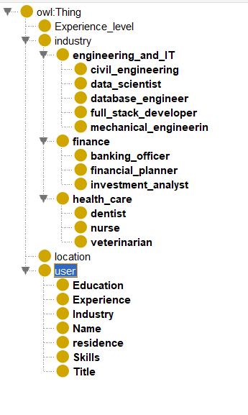
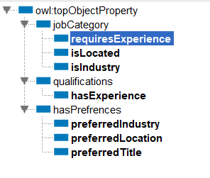
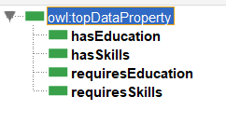
Ontologies hierarchy

Slide 6
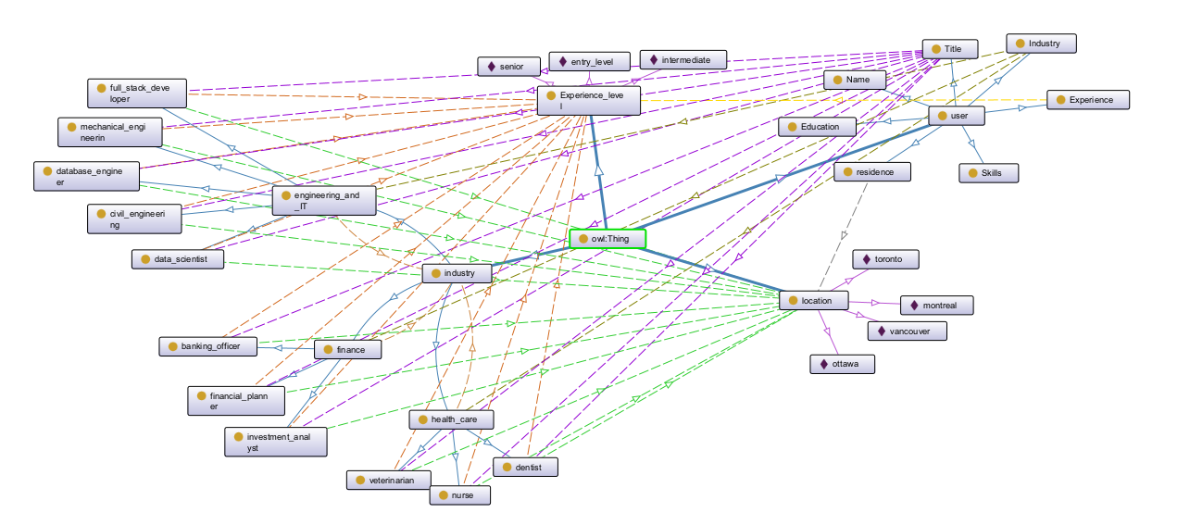
Schematic view

Slide 7
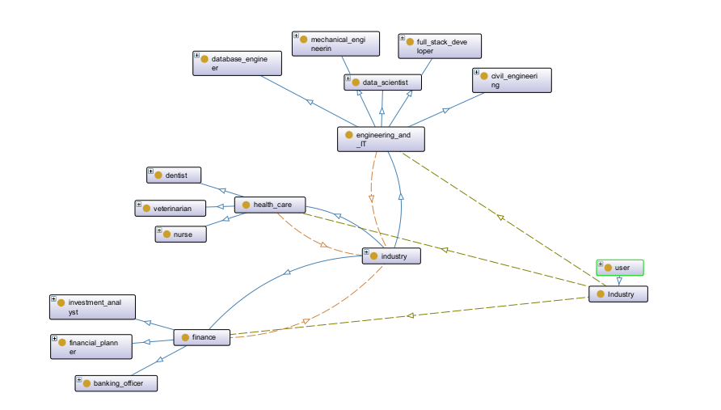
User subclass: Industry

Slide 8
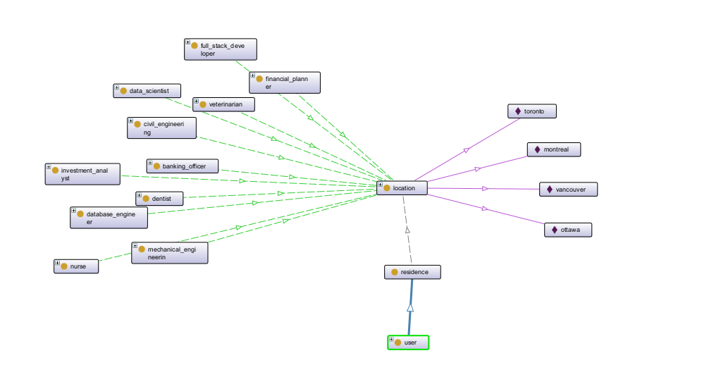
User subclass: Location

Slide 9
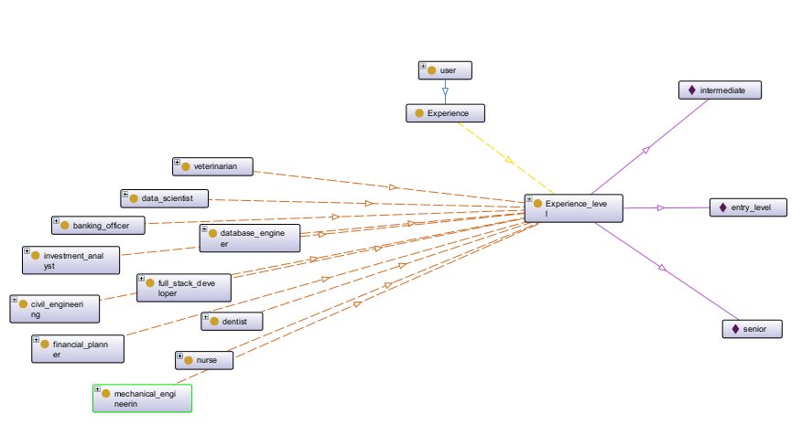
User subclass: Experience

Slide 10
Chatbot Development
Chatbot’s Main Goal: Tailor job recommendations to users by gathering information such as their industry preference, job title preference, location preference, education level, skills, and experience level.
⇒ Personalized approach which ensures that our chatbot recommends relevant job postings to the users which align with their preferences and qualifications.
⇒ Use Google Dialogflow Essentials to bring this vision to life

Slide 11
Entity Design
Entity: Used to extract specific information from user messages
⇒ Design entities to capture user’s industry preference, job title preference, location preference, education level, skills, and experience level
Reference Values: Standard set of terms that the chatbot recognizes
Synonyms: Account for variations in how users may express the same concept
⇒ For each entity, define several reference values along with synonyms for each reference value to improve the chatbot's ability to accurately understand and interpret user input

Slide 12
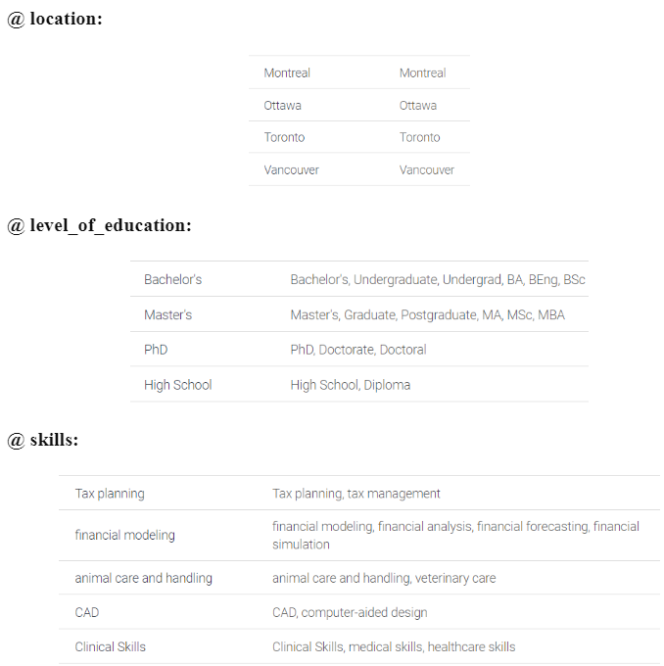
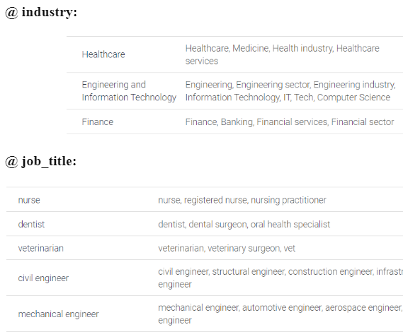
Entity Design

Slide 13
Intent Design
Mapping between what a user says and what actions should be taken by the chatbot
Training Phrases: Examples of what users might say to trigger the intent
Parameters: Pieces of information extracted from the user's input that are relevant to the intent
Responses: Messages that the chatbot sends back to the user when intent is triggered, can triggers to other intents
⇒ Use the Default Welcome Intent and design get_preferred_industry, get_preferred_job_title, get_preferred _location, get_education_level, get_skills, and get_experience _level to gather the user’s industry preference, job title preference, location preference, education level, skills, and experience level respectively

Slide 14
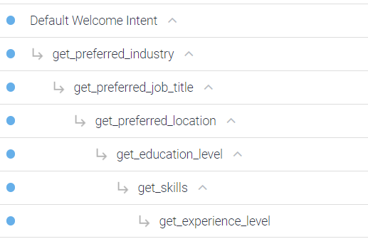
Intent Design: Hierarchy Structure
Use hierarchy structure in building intents, i.e. follow-up intents
⇒ Maintains a logical flow of conversation
⇒ Guides the users through a step-by-step process,
⇒ Easier for users to provide necessary information without feeling overwhelmed.

Slide 15
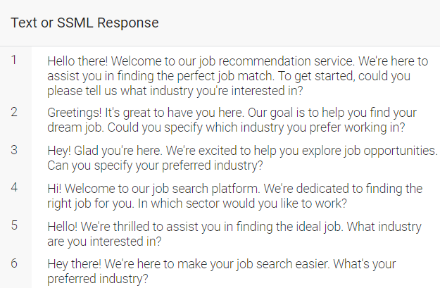
Intent Design: Default Welcome Intent
Triggered when user says hi, hello, etc
Use predefined training phrases
Modify responses to trigger get_preferred_industry intent

Slide 16
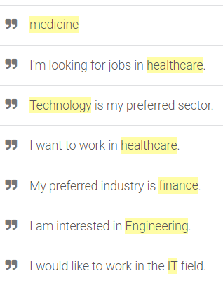
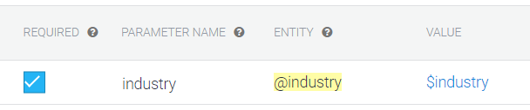
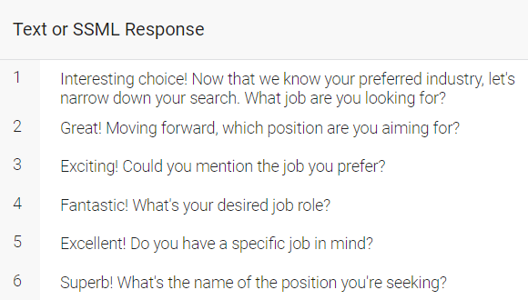
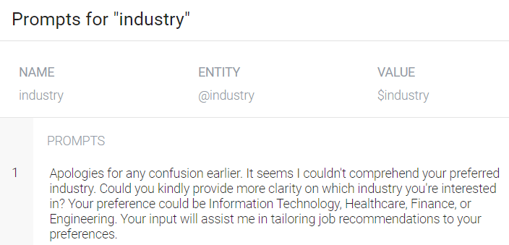
Intent Design: get_preferred_industry
Triggered when the user states his preferred industry
Captures industry parameter from user’s response
Prompts the user if not able to detect parameter
Response triggers get_preferred_job_title intent by asking the user about his preferred job title

Slide 17
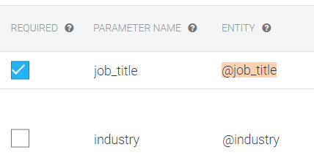
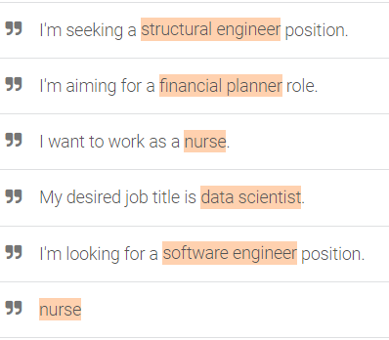
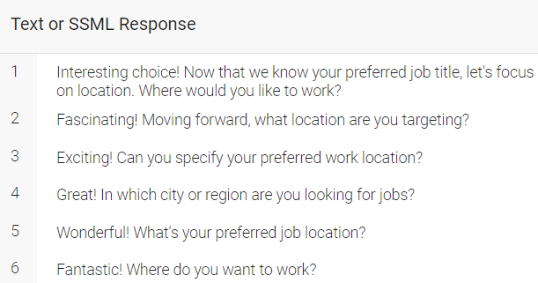
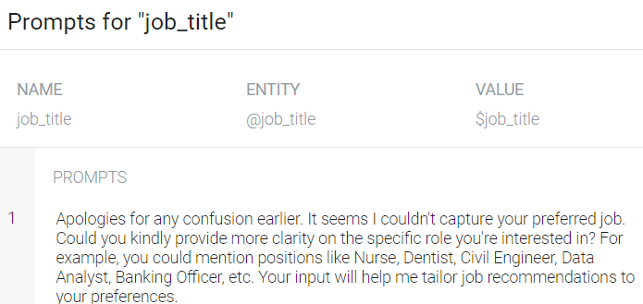
Intent Design: get_preferred_job_title
Triggered when the user states his preferred job title
Captures job_title parameter from user’s response
Carries the parameters of its parent intent
Prompts the user if not able to detect parameter
Response triggers get_preferred_location intent by asking the user about his preferred location

Slide 18
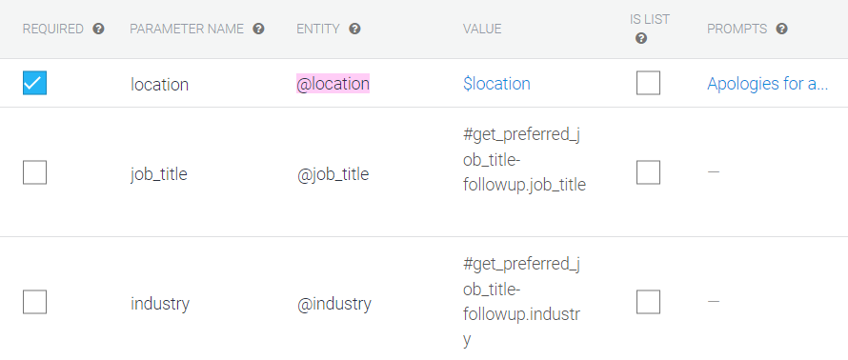
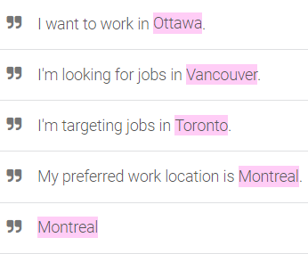
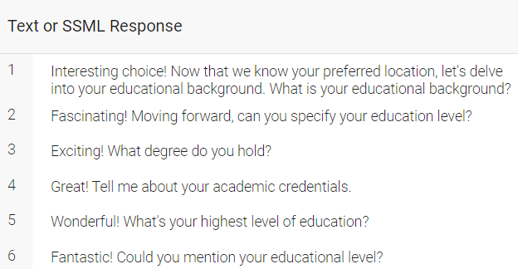
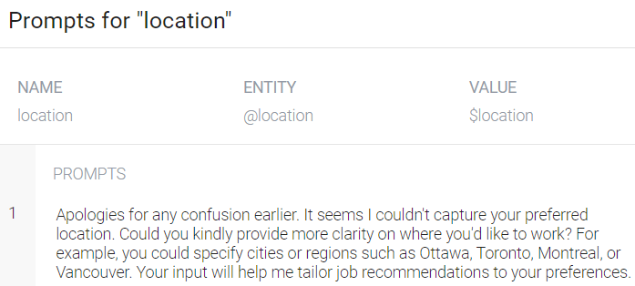
Intent Design: get_location
Triggered when the user states his preferred location
Captures location parameter from user’s response
Carries the parameters of its parent intent
Prompts the user if not able to detect parameter
Response triggers get_education_level intent by asking the user about his education level

Slide 19
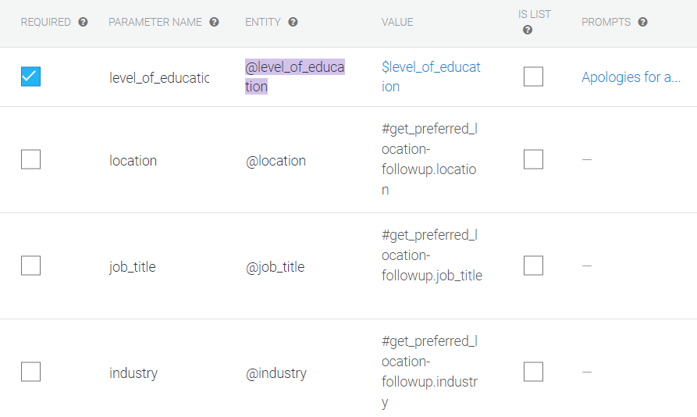
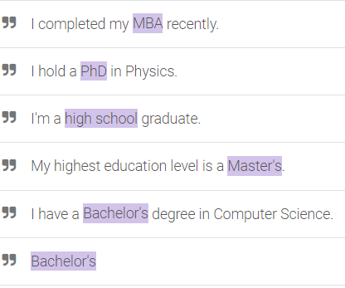
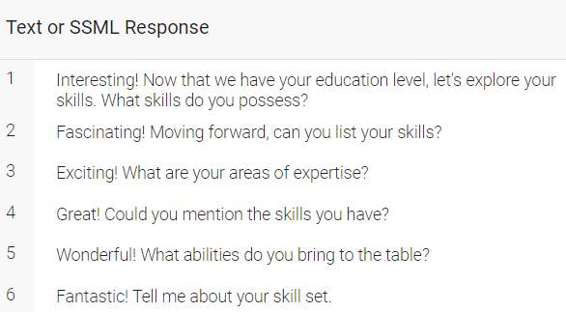
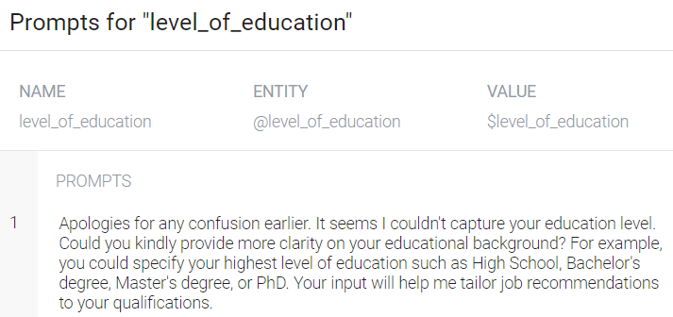
Intent Design: get_education_level
Triggered when the user states his education level
Captures level_of_education parameter from user’s response
Carries the parameters of its parent intent
Prompts the user if not able to detect parameter
Response triggers get_skills intent by asking the user about his skills

Slide 20
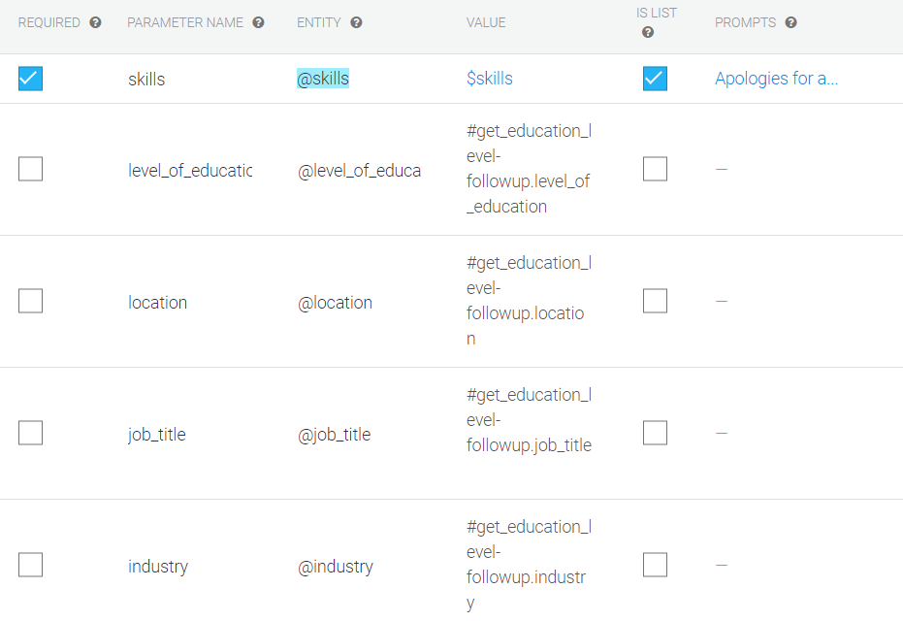
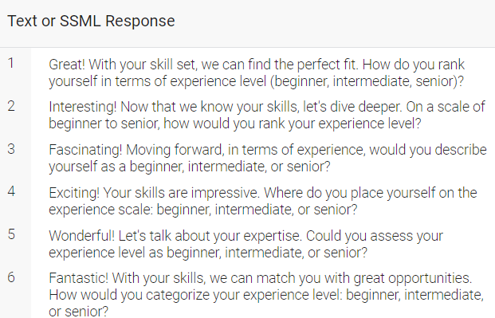
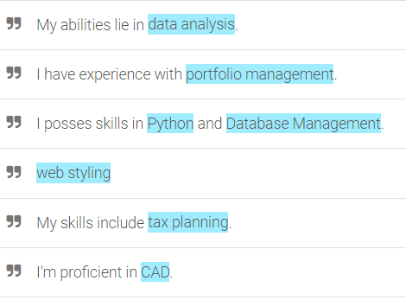
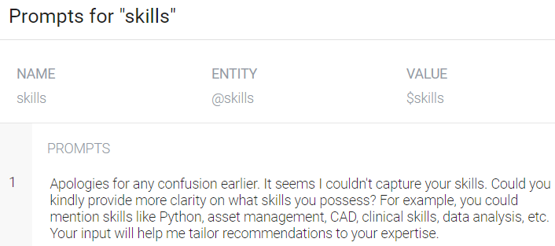
Intent Design: get_skills
Triggered when the user states his skills
Captures skills parameter from user’s response
Carries the parameters of its parent intent
Prompts the user if not able to detect parameter
Response triggers get_experience_level intent by asking the user about his experience level

Slide 21
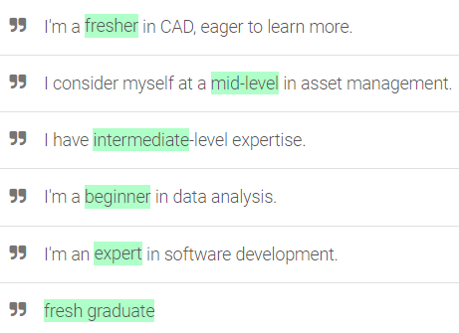
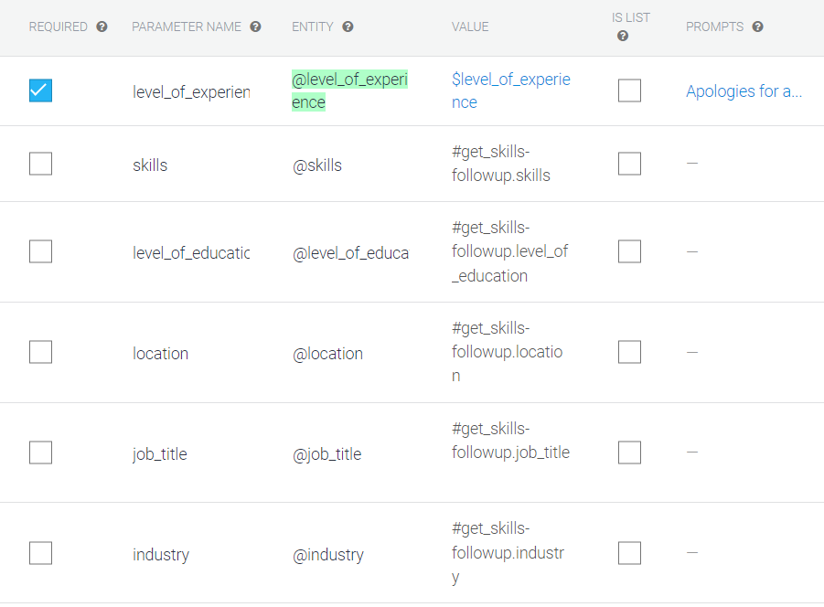
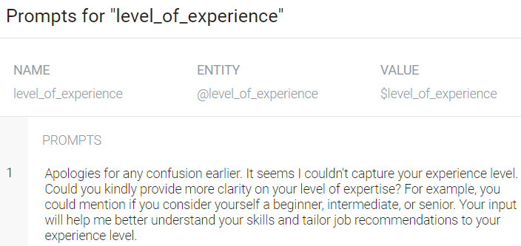
Intent Design: get_experience_level
Triggered when the user states his experience level
Captures level_of_experience parameter from user’s response
Carries the parameters of its parent intent
Prompts the user if not able to detect parameter
Set as end of conversation
Uses index.js fulfillment to retrieve the parameters given by the user and recommend the most appropriate job posting accordingly

Slide 22
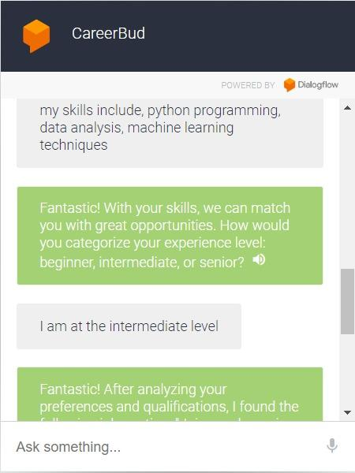
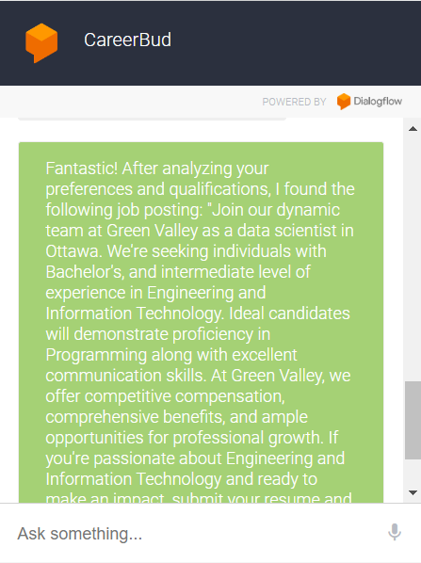
Chatbot Implementation
Scenario 1:
user preferences:
industry: IT sector
job title: data scientist
location: ottawa
user qualifications:
education: masters
skills: python, data analysis, machine learning modelling
work experience: intermediate

Slide 23
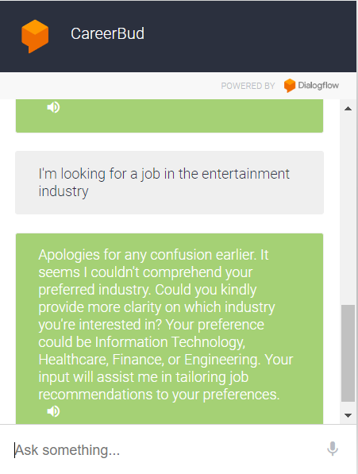
Chatbot Implementation
Scenario 2:
The user gives an out-of-scope preference to industry, so the chatbot prompts him about it.

Slide 24
Challenges and Weaknesses
Limited Domain Knowledge: Dialogflow's reliance on predefined intents and entities may lead to inaccurate job recommendations, especially in niche fields.
Inability to Handle Ambiguity: Predefined synonyms may limit the chatbot's ability to interpret user inputs accurately, causing frustration and inaccuracies in recommendations.
Inability to Handle User Feedback: The chatbot's inability to adapt to user feedback may result in suboptimal recommendations over time.
Lack of Flexibility: Users' uncertainty in providing preferences may impede conversation flow, reducing the effectiveness of the recommendation process.

Slide 25
Conclusion
Summary:
Accurate User Interaction: The chatbot's robust Natural Language Understanding ensures precise comprehension of user queries, enhancing the effectiveness of interactions.
Efficient User Guidance: Through adept Conversation Flow Management, users are seamlessly navigated through the job search journey, ensuring a smooth and productive experience.
Tailored Profiling: Leveraging comprehensive User Profiling, the chatbot delivers personalized recommendations, aligning with individual preferences and requirements for enhanced user satisfaction.
Future steps:
Integration of Recommendation Engine: Incorporating a recommendation engine using the inputs to provide tailored and relevant job recommendations.

Slide 26

Thank you!
uOttawa.ca
Notes:
PAGE COUVERTURE (option 1) REMARQUE : À lire avant d’utiliser le gabarit
Les éléments suivants du gabarit ne peuvent pas être modifiés : • En-tête institutionnel grenat (Université d’Ottawa | University of Ottawa) • Pied de page institutionnel comprenant la bande grise et grenat ainsi que le logo
Les éléments suivants du gabarit peuvent être modifiés : • L’adresse Web uOttawa.ca dans le pied de page peut être personnalisée afin de répondre aux besoins de l’utilisateur et le nom du document peut être inséré à la droite de l’URL si nécessaire. Vous pouvez simplement taper l’adresse Web désirée dans la boîte appropriée
• La photo ou l’image de fond peut être remplacée par celle de votre choix
COVER PAGE (option 1)
NOTE: Read before using template
The following elements of the template must remain untouched and cannot be modified:
• Corporate (Université d'Ottawa | University of Ottawa) garnet header
• Corporate uOttawa footer including the grey/garnet stripe and logo
The following elements of the template may be customized:
• You may include the uOttawa.ca URL of your choice in the footer, and insert the name of the document to the right of the URL, if needed
• The URL can be customized to a specific URL by following these simple steps: On the PowerPoint View tab, in the Master Views group, select Slide Master. Select the third slide on the left side panel, and type in the desired URL on the slide • The photo or background image may be replaced by the photo or background image of your choice

