Slide 1

The Carbon Footprint of the Food Supply Chain Database : Review-1
Presented To :
Dr. Jayalakshmi S.L. Ma’am
On
06/09/2021
RISHIKESH RAJ NAIR - 20BRS1245
ABRAR HUSSAIN - 20BRS1244
HARISH KUMAR K - 20BRS1231

Slide 2

ABSTRACT
The quantity of greenhouse gases (GHGs) generated by our food can vary considerably across the global food supply chain. In fact, the difference between specific food types can vary by orders of magnitude, meaning what we eat could be a significant factor impacting GHG emissions on the environment.
Therefore, the food we consume , which are assumed to be harmless , actually does affect the environment as the energy required for the creation of food item gets released into the environment in the form of gases and heat , of which most of the gases released contribute to global warming, which is in turn being a overall cause for the incremental increase in the overall temperature of the earth and melting of glaciers.

Slide 3
ABSTRACT CONTINUATION
For the DBMS J-component project, we have designed a carbon footprint database for food items which basically allows the user to select the food item from the drop down list which is connected to a backend database which will be made using SQL. It displays the contribution of greenhouse gases and then warning indicator , which uses color coding to make the user aware of the extent of the greenhouse emissions made by each one of the foods.
This helps the user to be aware of the effects of the various food items and optimize the diet to be a environmentally conscious citizen and it is also observed that food items with lesser greenhouse emissions are found to be healthy. So this project aims to help a person to be healthy on a personal level and also protect the environment by mitigating the possibilities of further emissions of gases.

Slide 4

PROBLEM STATEMENT
Most of the people are aware about global warming & its direct causes. But the alarming fact is that many people are not aware of the indirect causes.
One of those indirect causes is actually the diet we follow, which is quite an unknown fact to many.
The food we consume emit various levels of greenhouse gas emissions, whose levels are quite high if we consider animal meat and other animal products & quite low if we consider the plant based food products.
It is not just the process of growing the plants or grazing the animals that lead to the problem of emission of greenhouse gases. The whole process of growing it , processing it in factories and transporting it to our houses is considered in the calculation of how much greenhouse gases are emitted.

Slide 5

PROBLEM SOLUTION
Our solution to this problem would be to create a database that stores the food items along with their greenhouse emission levels.
A warning indicator is one of the implementations made to create an idea of relative emissions using colour coding basically to create an image of the excessive level in the mind of the user.
This database would contain food items both in raw and cooked form so that the user gets a clear idea of how the different permutations & combinations of one item with other could make a drastic effect.
This primarily helps the user to optimize his/her diet accordingly.

Slide 6
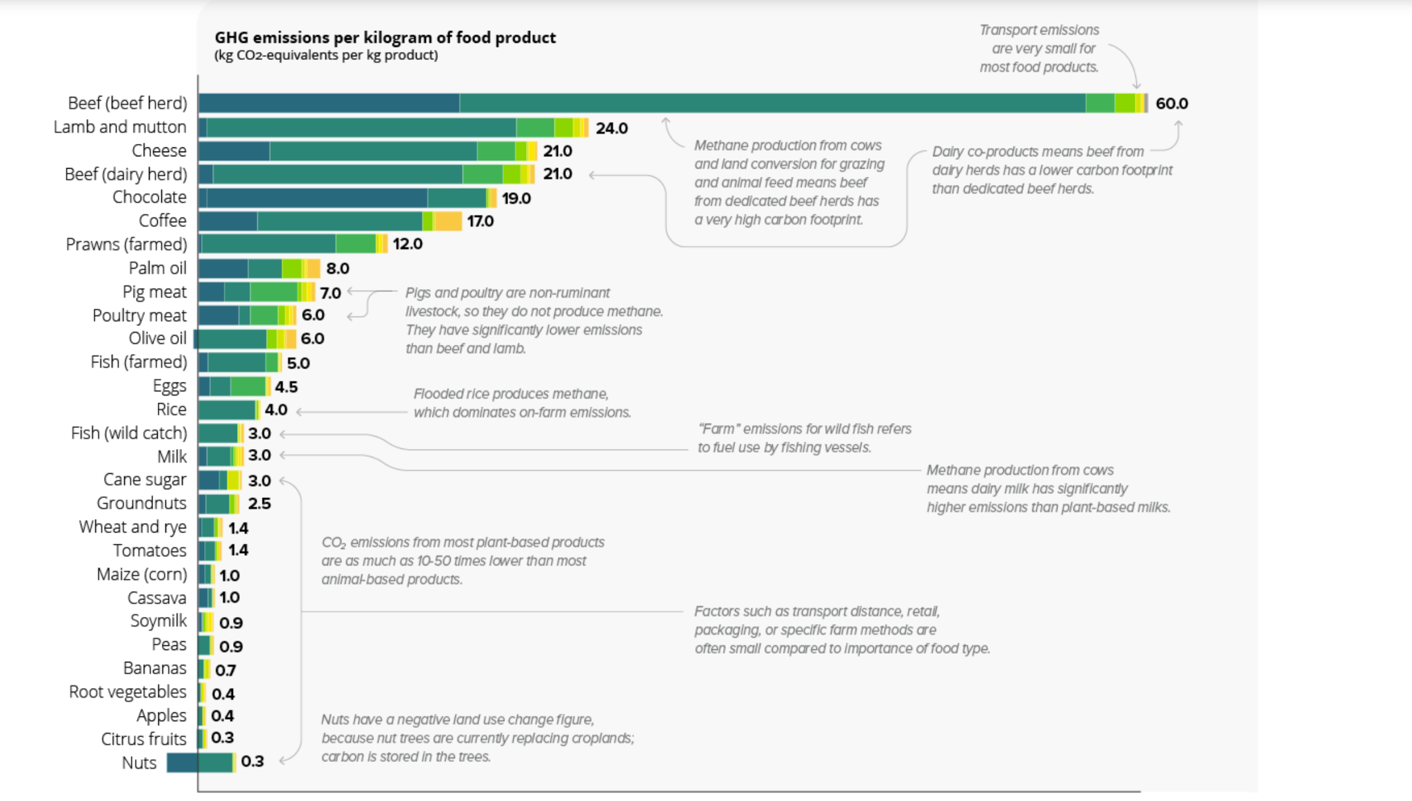
A brief idea on how our diet affects the environment

Slide 7

Resources We Would Use
MySQL : The MySQL platform we use here is to to store & retrieve data of the different food items and their respective greenhouse gas emissions from the database.
HTML & CSS: It is used to design the user interface of the website in which we will display the food products and the respective greenhouse emissions .
JavaScript: it is used for adding interactive behavior to web pages.It helps to connect the frontend to the backend , where all the data can be accessed.

Slide 8

Our Basic Idea of Implementation
Our main aim is to create an interface that displays the food items and their greenhouse emissions to increase awareness among the users about the consequences and also how to adjust their diet in order to reduce the risks of excessive consumption of these foods.
We would be creating a drop down menu which would contain the list of food items, where the user could select from any of them as per their choice.
As soon as the user selects the food item , he/she would be seeing a window where the greenhouse gas emissions would be displayed along with emission and a warning indicator which is color coded to warn the user about the levels of emission of these gases.
This project will act as a source of information for the people who are not much aware of the indirect cause of global warming . Even though it’s unavoidable, we can mitigate the chances of these greenhouse gases being released into the atmosphere and thereby drastically delaying the effect of global warming.

Slide 9
The Carbon Footprint of the Food Supply Chain Database : Review-2
Presented To :
Dr. Jayalakshmi S.L. Ma’am
On
02/11/2021
RISHIKESH RAJ NAIR - 20BRS1245
ABRAR HUSSAIN - 20BRS1244
HARISH KUMAR K - 20BRS1231

Slide 10
Our Basic Idea of Implementation
Our main aim is to create an interface that displays the food items and their greenhouse emissions to increase awareness among the users about the consequences and also how to adjust their diet in order to reduce the risks of excessive consumption of these foods.
We would be creating a drop down menu which would contain the list of food items, where the user could select from any of them as per their choice.
As soon as the user selects the food item , he/she would be seeing a window where the greenhouse gas emissions would be displayed along with emission and a warning indicator which is color coded to warn the user about the levels of emission of these gases.
This project will act as a source of information for the people who are not much aware of the indirect cause of global warming . Even though it’s unavoidable, we can mitigate the chances of these greenhouse gases being released into the atmosphere and thereby drastically delaying the effect of global warming.

Slide 11
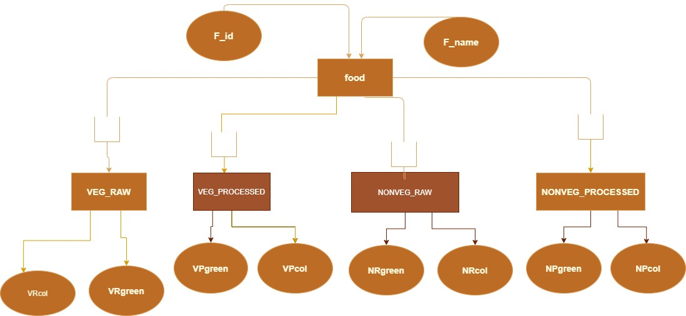
ER Diagram

Slide 12
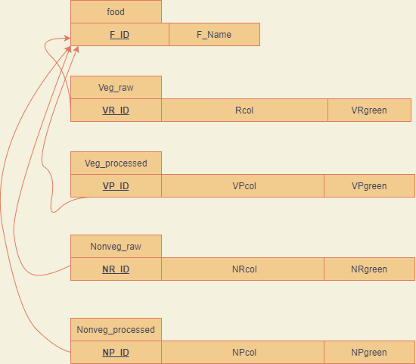
Relational Schema

Slide 13
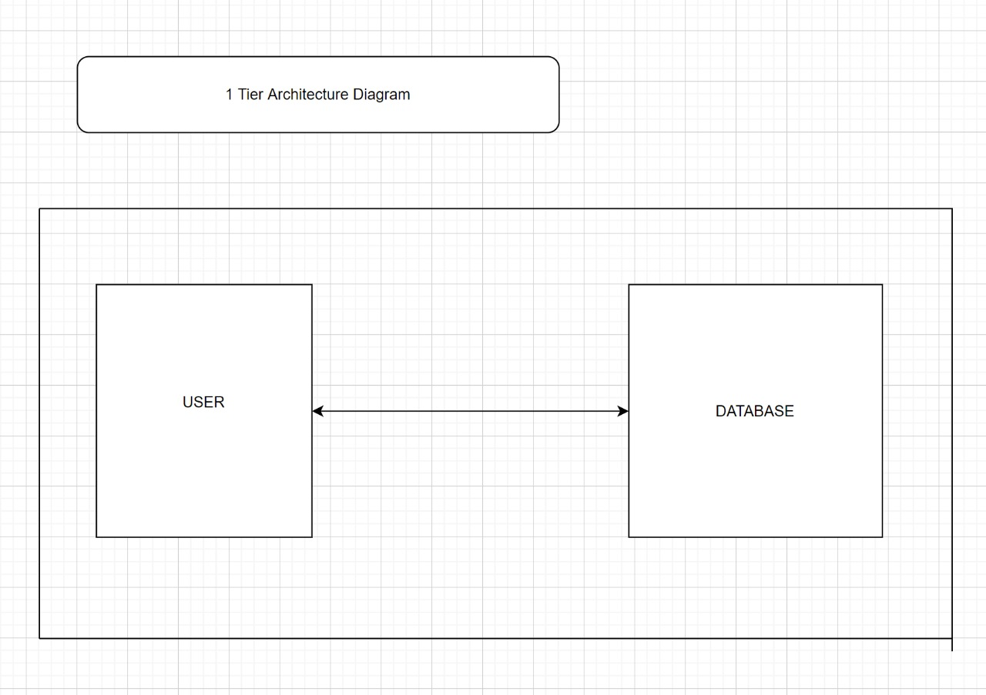
Architecture Diagram

Slide 14
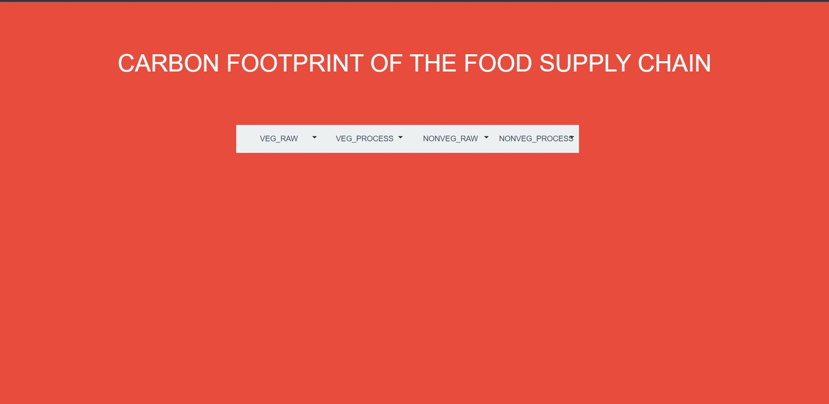
Screen Shot Of Our Work (FrontEnd)

Slide 15
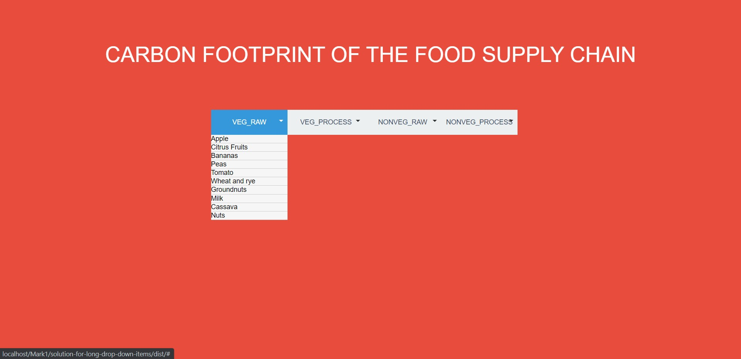
Screen Shot Of Our Work (FrontEnd)

Slide 16
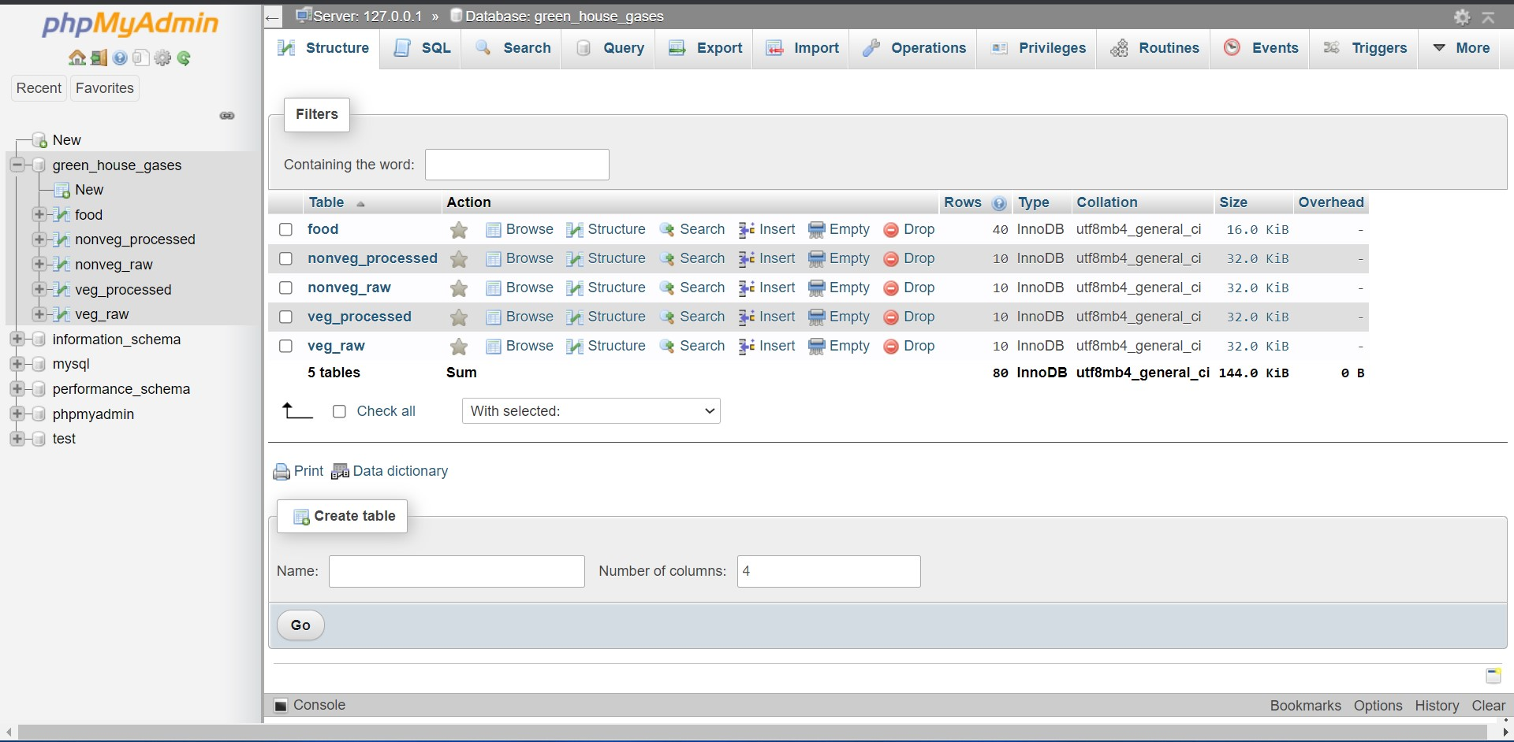
Screen Shot Of Our Work (BackEnd)

Slide 17
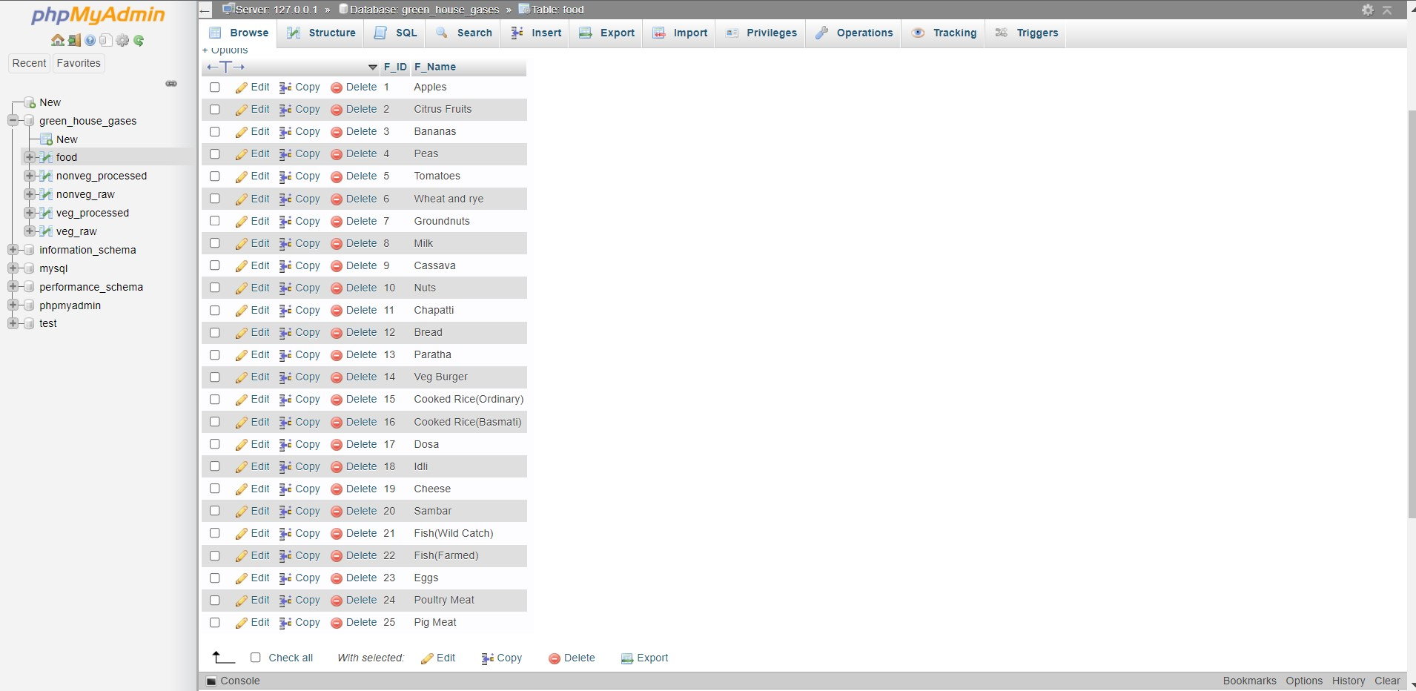
Screen Shot Of Our Work (BackEnd)

Slide 18

References
Chart: The Carbon Footprint of the Food Supply Chain- https://www.visualcapitalist.com/visualising-the-greenhouse-gas-impact-of-each-food/
https://www.researchgate.net/publication/237823809_Food_Production_and_Emissions_of_Greenhouse_Gases
https://eprints.lancs.ac.uk/id/eprint/79432/4/1_s2.0_S0959652616303584_main.pdf
HTML- https://www.geeksforgeeks.org/html-tutorials/
CSS-https://www.geeksforgeeks.org/css-tutorials/?ref=lbp
JAVASCRIPT-https://www.geeksforgeeks.org/javascript-tutorial/?ref=lbp
SQL FOR WEBSITE: https://www.geeksforgeeks.org/sql-tutorial/?ref=lbp

Slide 19
The Carbon Footprint of the Food Supply Chain Database : Review-3
Presented To :
Dr. Jayalakshmi S.L. Ma’am
On
02/12/2021
RISHIKESH RAJ NAIR - 20BRS1245
ABRAR HUSSAIN - 20BRS1244
HARISH KUMAR K - 20BRS1231

Slide 20
ABSTRACT
The quantity of greenhouse gases (GHGs) generated by our food can vary considerably across the global food supply chain. In fact, the difference between specific food types can vary by orders of magnitude, meaning what we eat could be a significant factor impacting GHG emissions on the environment.
Therefore, the food we consume , which are assumed to be harmless , actually does affect the environment as the energy required for the creation of food item gets released into the environment in the form of gases and heat , of which most of the gases released contribute to global warming, which is in turn being a overall cause for the incremental increase in the overall temperature of the earth and melting of glaciers.

Slide 21
ABSTRACT CONTINUATION
For the DBMS J-component project, we have designed a carbon footprint database for food items which basically allows the user to select the food item from the drop down list which is connected to a backend database which will be made using SQL. It displays the contribution of greenhouse gases and then warning indicator , which uses color coding to make the user aware of the extent of the greenhouse emissions made by each one of the foods.
This helps the user to be aware of the effects of the various food items and optimize the diet to be a environmentally conscious citizen and it is also observed that food items with lesser greenhouse emissions are found to be healthy. So this project aims to help a person to be healthy on a personal level and also protect the environment by mitigating the possibilities of further emissions of gases.

Slide 22
Existing system
For the existing system , we searched a lot and come to know a article from BBC on 9th august 2019 regarding the climate change food calendar:what’s your diet’s carbon footprint?
In that website , if we add which food we would like in a list of foods from drop down menu and to select how often we used to eat the food from the dropdown menu so that the website will give three different output and they are ,
How much over an entire year your consumption of your favourite food is contributing to your annual greenhouse gas emissions.
How it is equivalent of driving a regular petrol car for miles and finally it shows it is equal to heating the average uk home for number of days(depends on food we select).
We gained inspiration from this article and wanted to create a standalone website which will show the greenhouse emission values associated with food items.
The main advantage of our website is while the article only covers certain food and everything in this are in raw form , we have added different types of food in the raw form and in the cook form that are part of indian cuisine and display greenhouse gases associated with it.

Slide 23
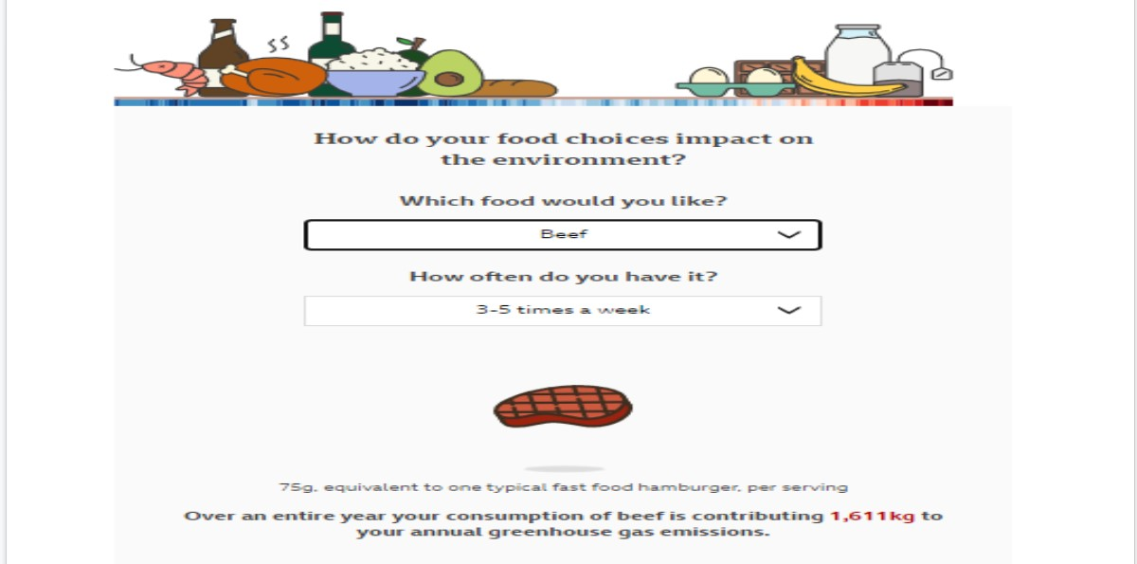

Slide 24
PROPOSED METHODOLOGY
Our solution to this problem would be to create a database that stores the food items along with their greenhouse emission levels.
A warning indicator is one of the implementations made to create an idea of relative emissions using colour coding basically to create an image of the excessive level in the mind of the user.
This database would contain food items both in raw and cooked form so that the user gets a clear idea of how the different permutations & combinations of one item with other could make a drastic effect.
This primarily helps the user to optimize his/her diet accordingly.

Slide 25
Why DBMS for this project?
Since we have a relatively long list of food items along with green-house emission values, we needed a place where we could store all the data together in a tabular format, in a very organised way.
The data needs to be a stored safely and then should be retrieved safely from a stable storage. The DBMS helps us to retrieve the necessary data from database using simple queries.
It helped us to connect different tables using constraints so that we could select specific values based on the select queries we make.
We were able to organise all our work into a single place rather than getting data from scattered sources.

Slide 26
ER Diagram

Slide 27
Relational Schema

Slide 28
Architecture Diagram

Slide 29
Architecture explanation
We have chosen a 1 tier architecture diagram
A 1 tier architecture diagram is chosen because both the database and the user interface is present in the same device
There are several advantages to this architecture:
i) Easy to optimize performance
ii)No compatibility issues between the layers
Since we are not going to have a separate server for storing the backend code. This architecture is convenient
If we are going to launch the website to the network and make it accessible from different places, we can shift to other architectures

Slide 30
Modules
Back End
Database: For creating the database, we used the phpMyadmin software, which is very user friendly and intuitive to create the tables for inserting the data sets to be analysed. Also the queries were much simpler to input to retrieve the values from the database.
It is the most popular application for MySQL database management. We can create, update, drop, alter, delete, import, and export MySQL database tables by using this software. phpMyAdmin also supports a wide range of operation like managing databases, relations, tables, columns, indexes, permissions, and users, etc..These operations can be performed via user interface, while we still have the ability to execute any SQL statement.phpMyAdmin can run on any server or any OS as it has a web browser.
PHP(Hypertext Preprocessor): PHP is a backend language which is technically used when there is a database involved in the project. PHP allowed us to connect to the database and retrieve information from the database and display it. The language also allows us to include HTML and CSS in it. It is also the preferred language for Myadmin software

Slide 31
Module (BackEnd)

Slide 32
Module(BackEnd)

Slide 33
Modules
FrontEnd
HTML(Hypertext Markup Language): It is a Markup Language. We have used this language to get a basic structure of the website like , display text , add images and create a drop down list. It also allowed us to create reference links to other pages in the project and make the ability to go from one page to another easier
CSS(Cascading Style Sheets): Just by the HTML itself, the project won’t look attractive. So for beautifying the frontend, we used CSS so that the user would find it more easy and intuitive to use as many times he/she wishes to.
Javascript: So basically, we have used Javascript along with CSS, in order to enhance the look and feel of our project along with the functionalities of CSS,so the user experience would be significantly improved as compared to just using CSS alone.
Bootstrap: Bootstrap is an interactive CSS framework that is mainly used to create responsive animations to the make the look of the website more professional. As it is visible in the website , when clicked on certain parts of the website , we can see it appears protruded

Slide 34

Module(FrontEnd)

Slide 35
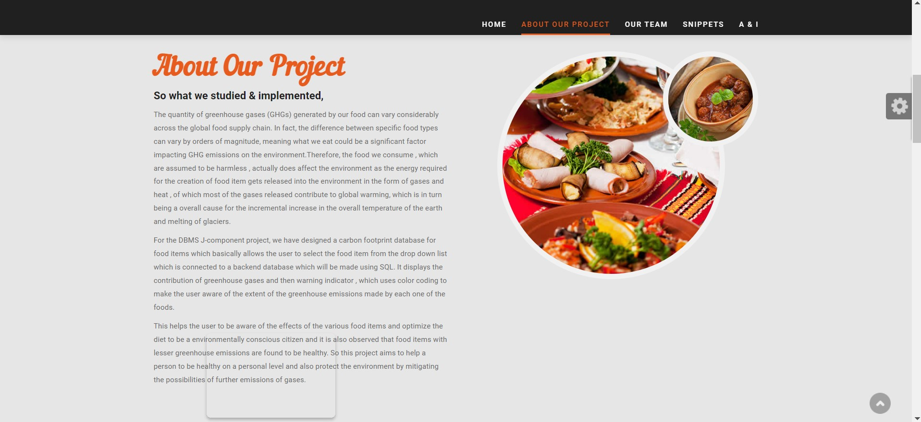
Module (FrontEnd)

Slide 36
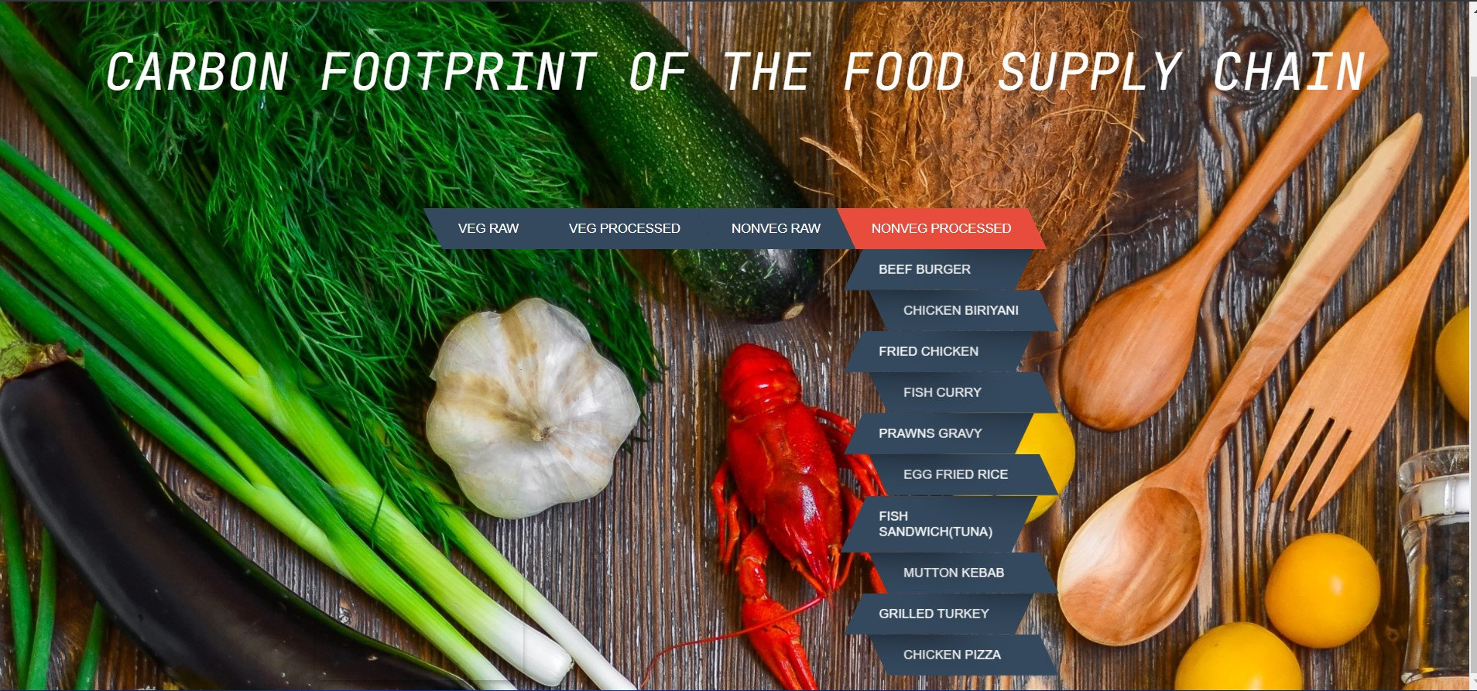
Output Screen

Slide 37
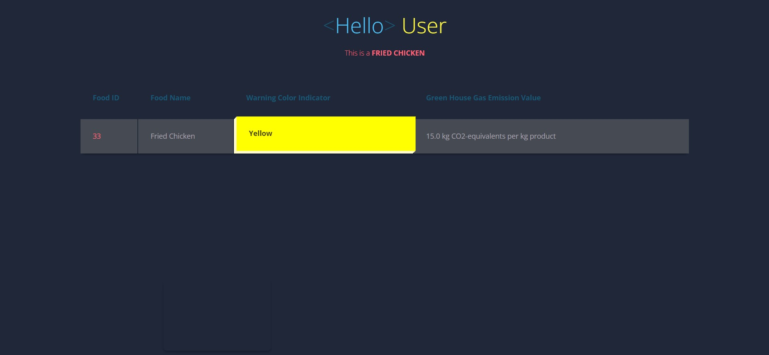
Output Screen

Slide 38
Output Screen Explanation
First of all, the user is presented with a cool looking page, where one can see the different categories of food items, which we had segregated into.
The user would be able to hover his/her mouse pointer over the raw and processed forms of both vegetarian and non-vegetarian food items and see the food items coming down as a drop list in the form a parallelogram, with a zig-zag fashion, towards the bottom of the page.
When clicked on a certain food item , it will transfer to a different page and greet the user and display the name of the food selected just below it.
The user will be presented with all the details regarding the name of the food item, the color indicator value as well as the green-house gas emission value associated with it.
When the user hovers the mouse pointer over the table, he/she will able to see the colour code associated with the food item, being displayed in a 3D pop-out fashion, which shows the relative degree of emissions the food item could emit.

Slide 39
Conclusion
Our main goal was to provide single source destination for viewing Green House Emission Values and we have implemented in such a way that the UI is user friendly & intuitive, so that everything on the surface is easy to navigate through.
Providing awareness among the users about the food they eat and how it would impact the environment. We are aiming to make a big impact through this project by allowing users to use our project and witness the effect of different food items.
Making the users of the environmental friendly food using colour coding mechanism since colours reach the mind of the user and would provide more info than just the numerical value itself.

Slide 40
References
Chart: The Carbon Footprint of the Food Supply Chain- https://www.visualcapitalist.com/visualising-the-greenhouse-gas-impact-of-each-food/
https://www.researchgate.net/publication/237823809_Food_Production_and_Emissions_of_Greenhouse_Gases
https://eprints.lancs.ac.uk/id/eprint/79432/4/1_s2.0_S0959652616303584_main.pdf
HTML- https://www.geeksforgeeks.org/html-tutorials/
CSS-https://www.geeksforgeeks.org/css-tutorials/?ref=lbp
JAVASCRIPT-https://www.geeksforgeeks.org/javascript-tutorial/?ref=lbp
SQL FOR WEBSITE: https://www.geeksforgeeks.org/sql-tutorial/?ref=lbp

Slide 41


