Slide 1
Digital Portfolio
STUDENT NAME: HARISH KUMAR.N
REGISTER NO AND NMID:212405374/65D527AA7FCAFCE99624180F99C6B34E
DEPARTMENT: BCA
COLLEGE: Apollo Arts And Science College Chennai /
MADRAS UNIVERSITY

Slide 2
PROJECT TITLE
PERSONAL PORTFOLIO WEBSITE USING FRONT-END DEVELOPMENT

Slide 3


AGENDA
Problem Statement
Project Overview
End Users
Tools and Technologies
Portfolio design and Layout
Features and Functionality
Results and Screenshots
Conclusion
Github Link
3/21/2024 Annual Review

Slide 4

PROBLEM STATEMENT
Traditional resumes cannot demonstrate coding depth or Ul design ability.
Recruiters and peers need to see real, working projects with measurable skills.
Solution: A portfolio website showcasing skills, projects,and coding expertise in Python, C++, and front- end development.

Slide 5

PROJECT OVERVIEW
This portfolio site is a responsive digital profile that:
Introduces myself and academic background.
Displays skills with progress indicators.
Showcases multiple projects (Frontend, Python, C++).
Provides a contact section for communication.

Slide 6

WHO ARE THE END USERS?
Recruiters - to measure skills and coding abilities.
Faculty - for project evaluation & academic use.
Tech Community - to explore my projects and open-source work.

Slide 7

TOOLS AND TECHNIQUES
HTML, CSS, JavaScript - for Layout & interactivity.
Responsive Web Design - for accessibility.
Creative Typography & Icons - to make it engaging.
CodePen/GitHub - for hosting.
Front end development – accessible and clean design.

Slide 8
PORTFOLIO DESIGN AND LAYOUT
Hero Section - name, intro, and CTA buttons (Projects & Contact).
About Me - short background + interests.
Skills Section - progress bars for Frontend (90%), Python (80%), C++ (75%), HTML & CSS (90%).
Projects Section:
Responsive Portfolio (this site).
b. Python CLI Tool.
C++ Data Structures.
Contact Form - name, email, and message input
8

Slide 9
FEATURES AND FUNCTIONALITY
Responsive portfolio website.
Theme toggle for user-friendly experience.
Skill progress indicators (visual representation of proficiency).
Live project showcase with short descriptions.
Contact form for easy communication.

Slide 10
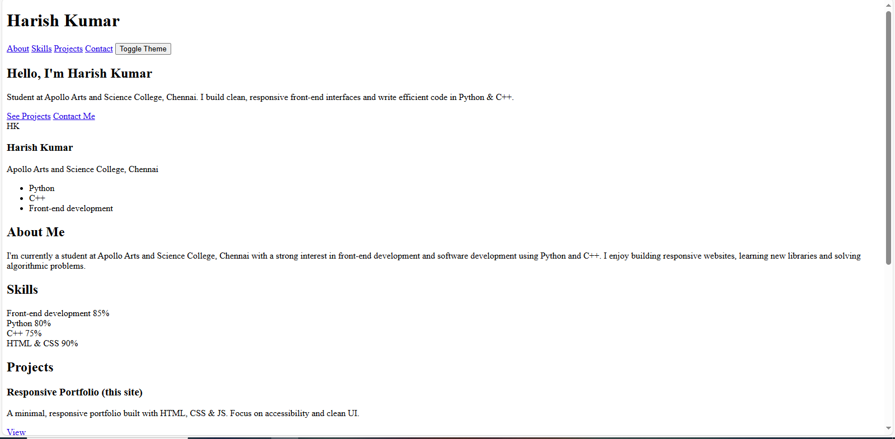
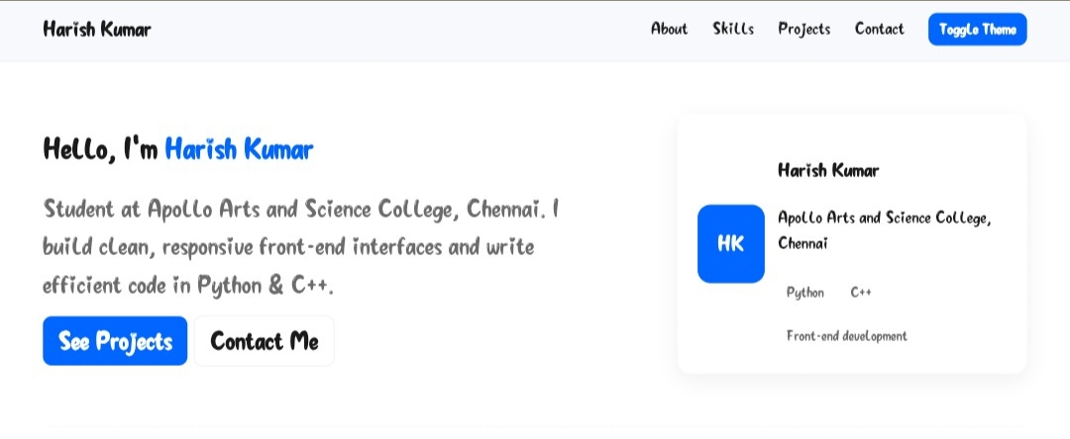
RESULTS AND SCREENSHOTS
BEFORE ADDING CSS : AFTER ADDING CSS:
3/21/2024 Annual Review
10

Slide 11
HOME SECTION:

Slide 12
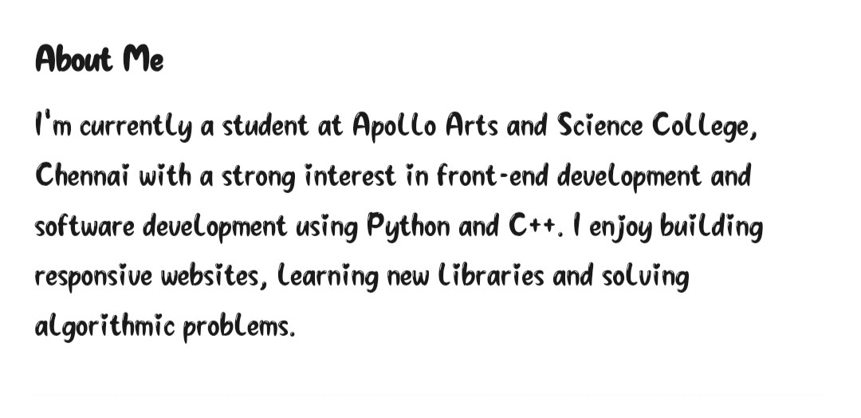
ABOUT SECTION

Slide 13
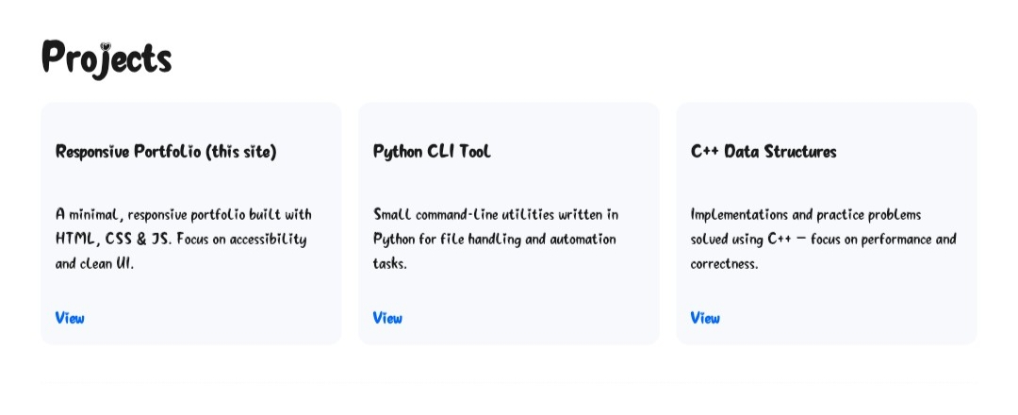
PROJECT SECTION:

Slide 14
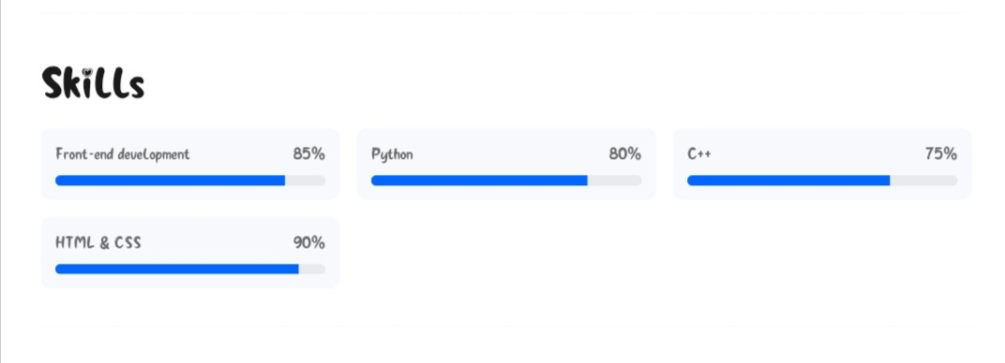
SKILL SECTION:

Slide 15
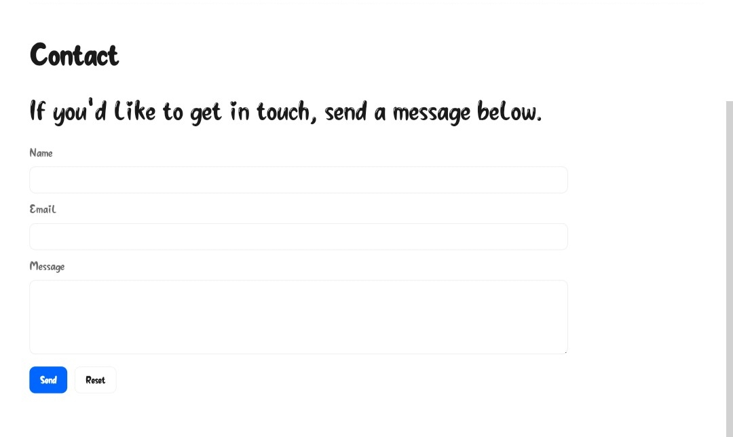
CONTACT SECTION:

Slide 16
CONCLUSION
Designed a portfolio emphasizing Python, C++ & Web DeveLopment.
Combines academic learning with practical project building.
Future scope: Add advanced apps, certifications, and live project demos.
16

Slide 17
GITHUB LINK:
https://harishkumarn1bca-ai.github.io/TNSDC-FWD-Digitalportfolio/

