Slide 1
GPIO(General purpose input and output)

Slide 2
TYPES:
a. General Purpose I/O (GPIO): The GPIO ports are used for interfacing
devices such as LEDs, switches, LCD, keypad, and so on.
b. Special purpose I/O: These I/O ports have designated function such as
ADC (Analog-toDigital), Timer, UART (universal asynchronous receiver
transmitter), and so on.

Slide 3
GPIO uses:
Reading digital signals,
Issuing interrupts,
Generating triggers for external components.
Generic pin whose value consists of one of two voltage settings (high or low),
Behavior can be programmed through software,
Platform-defined grouping of GPIO pins (STM32 16 pins),

Slide 4
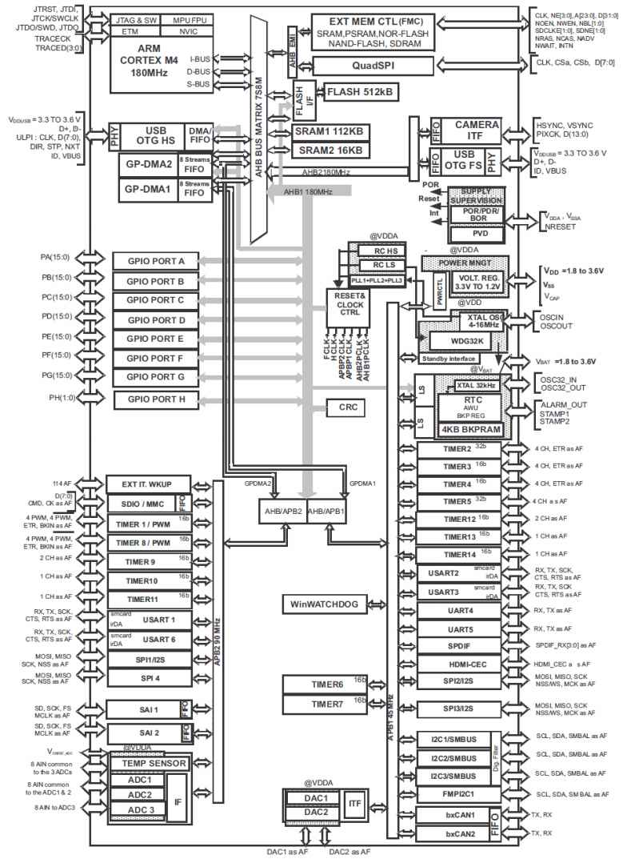
GPIO Pin for STM32F446 RE:
GPIOX Pins for stm32f446re:
GPIOA (0-15);
GPIOB(0-15);
GPIOC(0-15);
GPIOD(0-15);
GPIOE(0-15);
GPIOF(0-15);
GPIOG(0-15);
GPIOH(0-1).

Slide 5
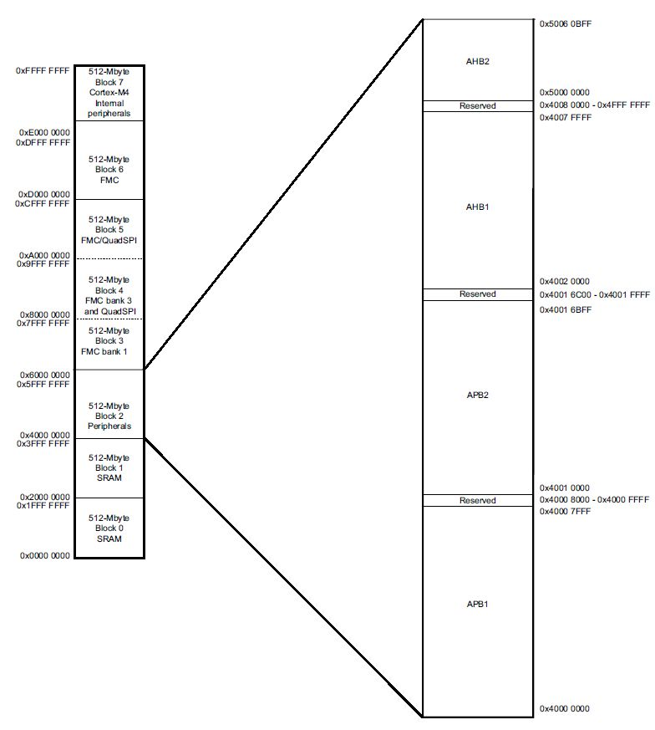
GPIO Registers Address
TWO BUSES,
APB (Advanced Peripheral Bus) is low
speed and low power consumption.
AHB (Advanced HighPerformance Bus)
is high speed and directly connect with
the CPU.

Slide 6
GPIOX ADDRESS:
■ GPIO Port A: 0x4002 0000 - 0x4002 03FF
■ GPIO Port B: 0x4002 0400 - 0x4002 07FF
■ GPIO Port C: 0x4002 0800 - 0x4002 0BFF
■ GPIO Port D: 0x4002 0C00 - 0x4002 0FFF
■ GPIO Port E: 0x4002 1000 - 0x4002 13FF
■ GPIO Port F: 0x4002 1400 - 0x4002 17FF
■ GPIO Port G: 0x4002 1800 - 0x4002 1BFF
■ GPIO Port H: 0x4002 1C00 - 0x4002 1FFF
■ GPIO Port I: 0x4002 2000 - 0x4002 23FF

Slide 7
GPIOX REGISTERS:
Address (Offset) Name 0x00,
GPIOx_MODER 0x04 (GPIOx Port Mode(Direction) Register R/W),
GPIOx_OTYPER 0x08(Output Type Register R/W),
GPIOx_OSPEEDR 0x0C(Output Speed Register R/W),
GPIOx_PUDR 0x10 (Pull-Up / Down Register R/W),
GPIOx_IDR 0x14 (Port Input Data Register R/W),
GPIOx_ODR 0x18 (Port Output Data Register R/W),
GPIOx_BSRR (Bit Set / Reset Register R/W),

Slide 8
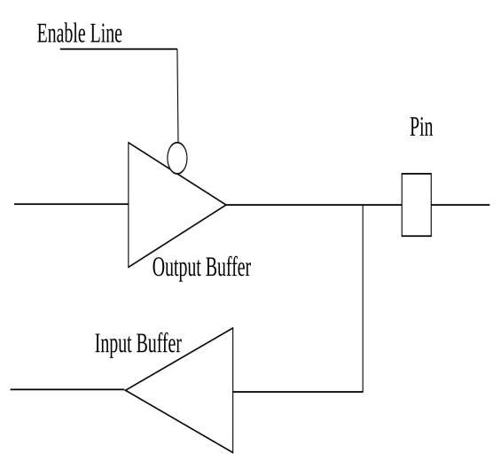
BUFFER:
Input Buffer(an input buffer is filled
at interrupt time and is emptied by
processes that read the device),
output buffer(an output buffer is filled by processes that write to the device, and is emptied at interrupt time).
1-> 1 in output buffer
1-> 1 in input buffer

Slide 9
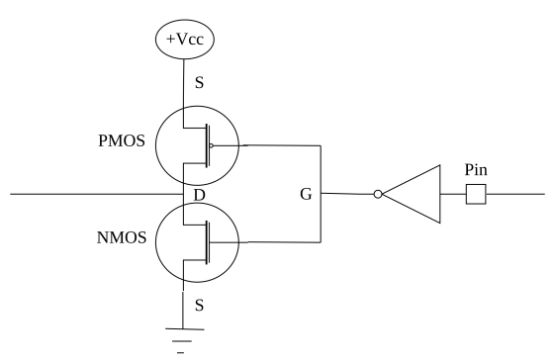
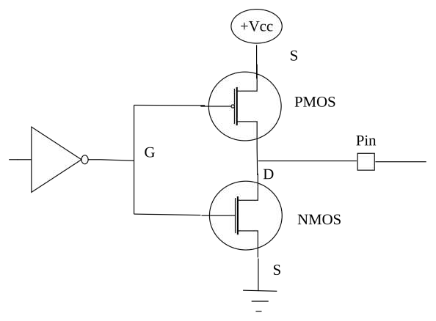
INPUT BUFFER OUTPUT BUFFER

Slide 10
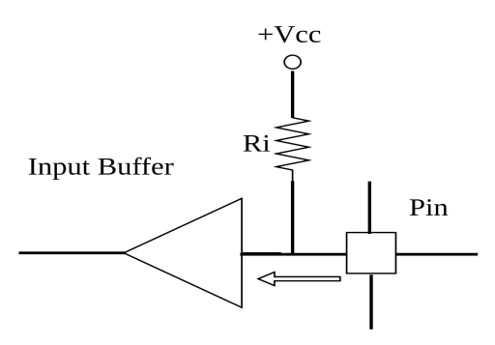
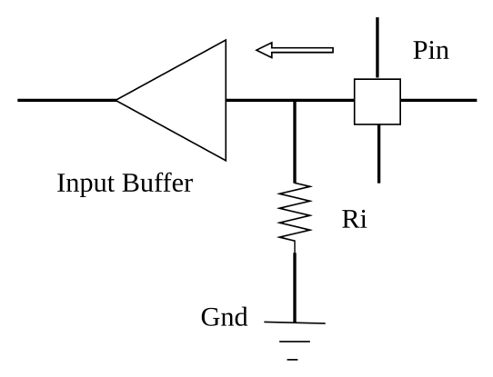
PULL UP HIGH PULL DOWN LOW

Slide 11
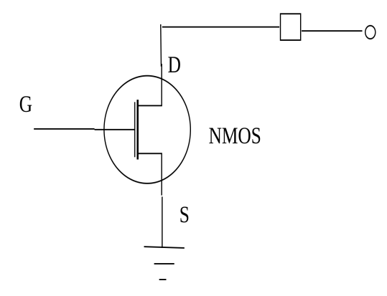
OPEN DRAIN:
Open-drain output configuration
is nothing but the top PMOS
transistor is deactivated
When the transistor is ON,
the pin pulled to the ground
When the transistor is OFF,
the drain of the transistor will
be floating or open.

Slide 12
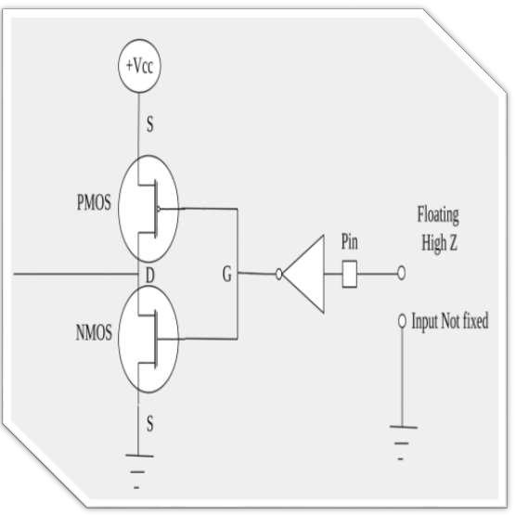
HIGH IMPEDANCE STATE
Default GPIO pins will be in High Z
state orFloating state
After reset MCU default GPIO pins
are InputMode
Neither high state or ground state
Keeping the pin in floating state
lead to leakage current, more power
consumption

Slide 13
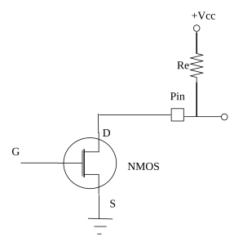

pull-down open drain pullingup

Slide 14
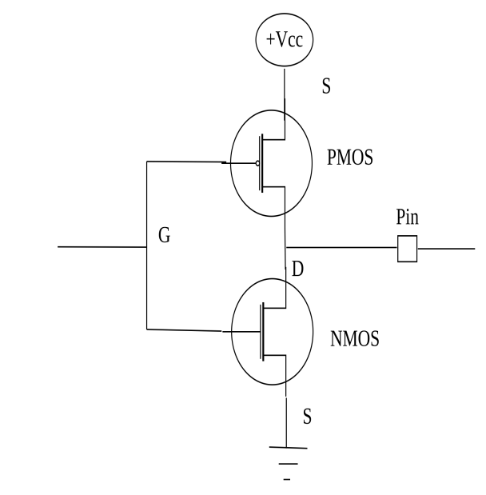
GPIO output mode with push pull state
But if you set any pin as the output mode, then
by default it will be in push-pull configuration.

Slide 15
THANK YOU
ANY QUERIES?

