Slide 1
Agenda
Topic 1
Number System Conversions (BinToHex HexToBin etc)
Topic 2
Bitwise Operation (Basic on bits, Truth table)
Topic 3
Bit Manipulations (Usage Of Bitwise operations)
Notes:
TechnoVision Computer Classes : Mobile: 9921481410 / 7588291640

Slide 2
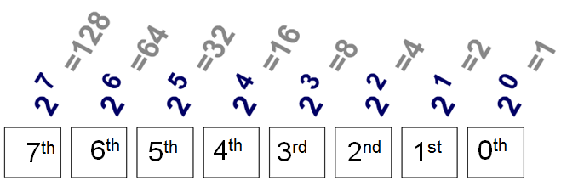
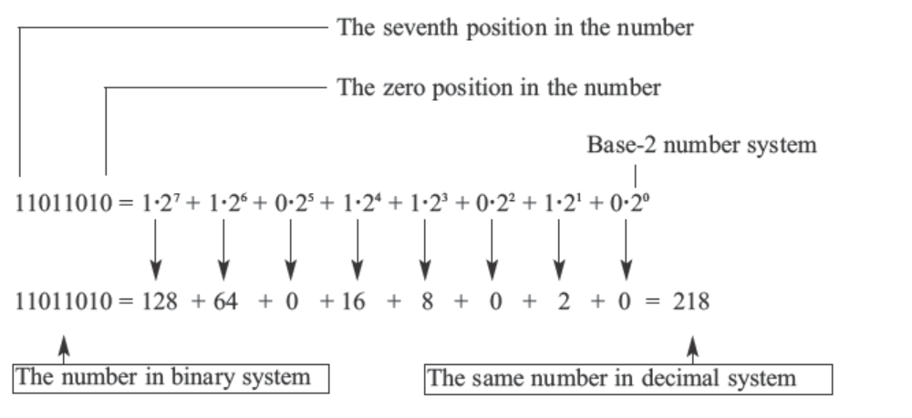
Bits in a Byte
Bitwise Operators works with bits, following is bit representation of byte
MSB
LSB
Notes:
TechnoVision Computer Classes : Mobile: 9921481410 / 7588291640

Slide 3
Conversions – Binary To Hex/Octal
Binary To Hex two step method
Binary = 11101100101001
Step 1: Divide the binary number into sets of 4 bits, starts from LSB.
(Add leading zeros as needed)
← But why set of 4 bits?
Ans: Because each Hex digit is made up of 4 bits.
Binary = 11 1011 0010 1001
00
Step 2: Use the following table to convert each 4-digit binary string to a single hex digit
Binary = 0011 1011 0010 1001
Hex = 3 B 2 9 => 3B29
Binary To Octal similar to above method only change is now set of bits should be 3
Binary = 011 101 100 101 001
Octal = 3 5 4 5 1 => 35451
Binary | 0000 | 0001 | 0010 | 0011 | 0100 | 0101 | 0110 | 0111 | 1000 | 1001 | 1010 | 1011 | 1100 | 1101 | 1110 | 1111
Hex | 0 | 1 | 2 | 3 | 4 | 5 | 6 | 7 | 8 | 9 | A | B | C | D | E | F
Notes:
TechnoVision Computer Classes : Mobile: 9921481410 / 7588291640

Slide 4
Conversions – Hex/Octal To Binary
Hex To Binary
Hex = 3B29
Step: Use the following table to convert each digit of hex to binary 4-bit (nibble) representation.
Hex = 3 B 2 9
Binary = 0011 1011 0010 1001 => 11101100101001
Binary To Octal similar to above method only change is now set of bits should be 3
Octal = 3 5 4 5 1
Binary = 011 101 100 101 001 => 11101100101001
Binary | 0000 | 0001 | 0010 | 0011 | 0100 | 0101 | 0110 | 0111 | 1000 | 1001 | 1010 | 1011 | 1100 | 1101 | 1110 | 1111
Hex | 0 | 1 | 2 | 3 | 4 | 5 | 6 | 7 | 8 | 9 | A | B | C | D | E | F
Notes:
TechnoVision Computer Classes : Mobile: 9921481410 / 7588291640

Slide 5

Conversions – Binary To Hex/Octal
Lets Try
Binary = 10101110101001 Convert this to Hex
Answer = 2BA9
Hex = 2BA9 Convert this to Binary
Binary | 0000 | 0001 | 0010 | 0011 | 0100 | 0101 | 0110 | 0111 | 1000 | 1001 | 1010 | 1011 | 1100 | 1101 | 1110 | 1111
Hex | 0 | 1 | 2 | 3 | 4 | 5 | 6 | 7 | 8 | 9 | A | B | C | D | E | F
Notes:
TechnoVision Computer Classes : Mobile: 9921481410 / 7588291640

Slide 6
Conversions – Not much required
Binary To Decimal (Power of two method, start with 2⁰ * bit0)
Decimal To Binary (Divide the decimal number by 2, Stop when the quotient is 0, Starting with the bottom remainder, read the sequence of remainders upwards to the top)
Decimal To Hex (Same method as “Decimal To Binary” conversion only divide decimal number by 16)
Decimal To Octal (Same method as “Decimal To Binary” conversion only divide decimal number by 8)
Binary | 0000 | 0001 | 0010 | 0011 | 0100 | 0101 | 0110 | 0111 | 1000 | 1001 | 1010 | 1011 | 1100 | 1101 | 1110 | 1111
Hex | 0 | 1 | 2 | 3 | 4 | 5 | 6 | 7 | 8 | 9 | A | B | C | D | E | F
Notes:
TechnoVision Computer Classes : Mobile: 9921481410 / 7588291640

Slide 7

Bitwise Operators – bitwise AND ‘&’
Binary AND’s Truth Table
bit a | bit b | a & b
0 | 0 | 0
0 | 1 | 0
1 | 0 | 0
1 | 1 | 1
Byte a = 0xAB; // 10101011
Byte b = 0xCD; // 11001101
Byte c = a & b;
Print (c);
Output will be: ?? Bin = ??
0x89
10001001
For instance, working with a byte (the char type):
Binary | 0000 | 0001 | 0010 | 0011 | 0100 | 0101 | 0110 | 0111 | 1000 | 1001 | 1010 | 1011 | 1100 | 1101 | 1110 | 1111
Hex | 0 | 1 | 2 | 3 | 4 | 5 | 6 | 7 | 8 | 9 | A | B | C | D | E | F
Notes:
TechnoVision Computer Classes : Mobile: 9921481410 / 7588291640

Slide 8

Bitwise Operators – bitwise OR ‘|’
Binary OR’s Truth Table
bit a | bit b | a | b
0 | 0 | 0
0 | 1 | 1
1 | 0 | 1
1 | 1 | 1
Byte a = 0xAB; // 10101011
Byte b = 0xCD; // 11001101
Byte c = a | b;
Print (c);
Output will be: ?? Bin = ??
0xEF
11101111
For instance, working with a byte (the char type):
Binary | 0000 | 0001 | 0010 | 0011 | 0100 | 0101 | 0110 | 0111 | 1000 | 1001 | 1010 | 1011 | 1100 | 1101 | 1110 | 1111
Hex | 0 | 1 | 2 | 3 | 4 | 5 | 6 | 7 | 8 | 9 | A | B | C | D | E | F
Notes:
TechnoVision Computer Classes : Mobile: 9921481410 / 7588291640

Slide 9
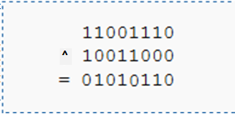
Bitwise Operators – bitwise XOR ‘^’
Binary XOR’s Truth Table
bit a | bit b | a ^ b
0 | 0 | 0
0 | 1 | 1
1 | 0 | 1
1 | 1 | 0
Byte a = 0xAB; // 10101011
Byte b = 0xCD; // 11001101
Byte c = a ^ b;
Print (c);
Output will be: ?? Bin = ??
0x66
01100110
For instance, working with a byte (the char type):
Binary | 0000 | 0001 | 0010 | 0011 | 0100 | 0101 | 0110 | 0111 | 1000 | 1001 | 1010 | 1011 | 1100 | 1101 | 1110 | 1111
Hex | 0 | 1 | 2 | 3 | 4 | 5 | 6 | 7 | 8 | 9 | A | B | C | D | E | F
Notes:
TechnoVision Computer Classes : Mobile: 9921481410 / 7588291640

Slide 10
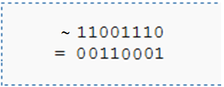
Bitwise Operators – bitwise Negation ‘~’
Binary Negation’s Truth Table
bit a | ~ a (1’s complement of a)
0 | 1
1 | 0
Byte a = 0xAB; // 10101011
Byte c = ~a;
Print (c);
Output will be: ?? Bin = ??
0x54
01010100
For instance, working with a byte (the char type):
Binary | 0000 | 0001 | 0010 | 0011 | 0100 | 0101 | 0110 | 0111 | 1000 | 1001 | 1010 | 1011 | 1100 | 1101 | 1110 | 1111
Hex | 0 | 1 | 2 | 3 | 4 | 5 | 6 | 7 | 8 | 9 | A | B | C | D | E | F
Notes:
TechnoVision Computer Classes : Mobile: 9921481410 / 7588291640

Slide 11
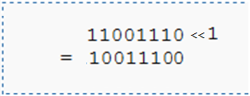
Bitwise Operators – bitwise Left Shift ‘<<’
It shifts each bit in its left operand to the left and pads zero at LSB
Byte a = 0xAB; // 10101011
Byte b = 0x8F; // 10001111
Byte c = a << 1;
Byte d = b << 1;
Print (c); Output will be: ?? Bin = ??
Print (d); Output will be: ?? Bin = ??
0x56
01010110
0x1E
00011110
For instance, working with a byte (the char type):
Binary | 0000 | 0001 | 0010 | 0011 | 0100 | 0101 | 0110 | 0111 | 1000 | 1001 | 1010 | 1011 | 1100 | 1101 | 1110 | 1111
Hex | 0 | 1 | 2 | 3 | 4 | 5 | 6 | 7 | 8 | 9 | A | B | C | D | E | F
Notes:
TechnoVision Computer Classes : Mobile: 9921481410 / 7588291640

Slide 12
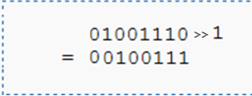
Bitwise Operators – bitwise Right Shift ‘>>’
It shifts each bit in its left operand to the right and pads zero at MSB
Byte a = 0xAB; // 10101011
Unsigned Byte b = 0xAB; // 10101011
Byte c = a >> 1;
Byte d = b >> 1;
Print (c); Output will be: ?? Bin = ??
Print (d); Output will be: ?? Bin = ??
0xD5
11010101
0x55
01010101
For instance, working with a byte (the char type):
Binary | 0000 | 0001 | 0010 | 0011 | 0100 | 0101 | 0110 | 0111 | 1000 | 1001 | 1010 | 1011 | 1100 | 1101 | 1110 | 1111
Hex | 0 | 1 | 2 | 3 | 4 | 5 | 6 | 7 | 8 | 9 | A | B | C | D | E | F
Notes:
TechnoVision Computer Classes : Mobile: 9921481410 / 7588291640

Slide 13
Bitwise Operators – Why to learn?
A bitwise operation is a fast, primitive action directly supported by the processor.
It is used to manipulate values for comparisons and calculations.
On simple low-cost processors, typically, bitwise operations are substantially faster than division.
Several times faster than multiplication, and sometimes significantly faster than addition.
While modern processors usually perform addition and multiplication just as fast as bitwise operations due to their longer instruction pipelines and other architectural design choices, bitwise operations do commonly use less power/performance because of the reduced use of resources.
Binary | 0000 | 0001 | 0010 | 0011 | 0100 | 0101 | 0110 | 0111 | 1000 | 1001 | 1010 | 1011 | 1100 | 1101 | 1110 | 1111
Hex | 0 | 1 | 2 | 3 | 4 | 5 | 6 | 7 | 8 | 9 | A | B | C | D | E | F
Notes:
TechnoVision Computer Classes : Mobile: 9921481410 / 7588291640

Slide 14
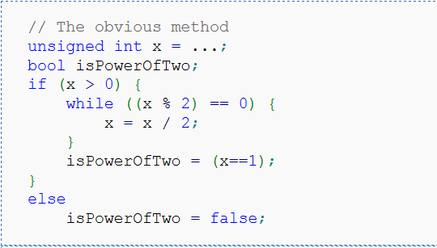
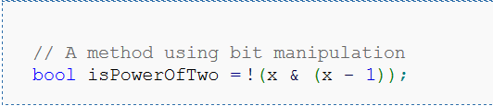
Bit Manipulations – power of 2
Determine if the given unsigned integer x is a power of two
Negative Case
x = 00000101 = 5
& (x-1) = 00000100 = 4
-----------------------
00000100 = 4
Positive Case
x = 00001000 = 8
& (x-1) = 00000111 = 7
-----------------------
00000000 = 0
Binary | 0000 | 0001 | 0010 | 0011 | 0100 | 0101 | 0110 | 0111 | 1000 | 1001 | 1010 | 1011 | 1100 | 1101 | 1110 | 1111
Hex | 0 | 1 | 2 | 3 | 4 | 5 | 6 | 7 | 8 | 9 | A | B | C | D | E | F
Notes:
TechnoVision Computer Classes : Mobile: 9921481410 / 7588291640

Slide 15
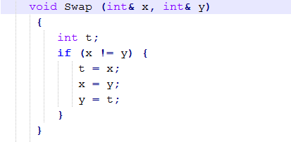
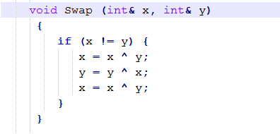

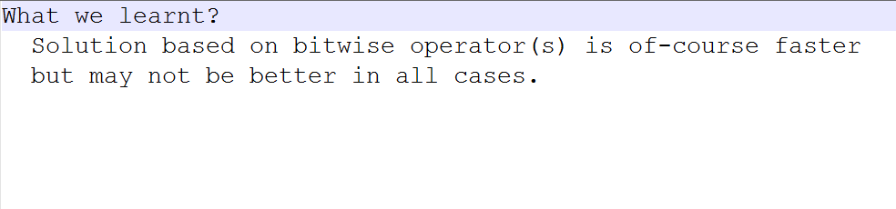
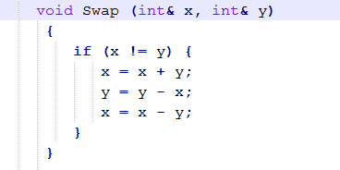
Bit Manipulations – Swapping Numbers
Solution 1
Solution 3
Solution 2
Binary | 0000 | 0001 | 0010 | 0011 | 0100 | 0101 | 0110 | 0111 | 1000 | 1001 | 1010 | 1011 | 1100 | 1101 | 1110 | 1111
Hex | 0 | 1 | 2 | 3 | 4 | 5 | 6 | 7 | 8 | 9 | A | B | C | D | E | F
Notes:
TechnoVision Computer Classes : Mobile: 9921481410 / 7588291640

Slide 16
Bit Manipulations – Changing Byte Order
input X = 0xABCD // ABCD
Solution 1: X = ( (X & 0xFF) << 8 ) + ( (X & 0xFF00) >> 8 )
Solution 2: X = ( (X & 0xFF) << 8 ) | ( (X & 0xFF00) >> 8 )
output X = 0xCDAB // CDAB
X = ( (X << 8) | (X >> 8) )
input X = 0x89ABCDEF // 89ABCDEF
Solution 1: X = ( (X & 0xFF) << 24 ) + ( (X & 0xFF00) << 8 )
+ ( (X & 0xFF0000) >> 8 ) + ( (X & 0xFF000000) >> 24 )
Solution 2: X = ( (X & 0xFF) << 24 ) | ( (X & 0xFF00) << 8 )
| ( (X & 0xFF0000) >> 8 ) | ( (X & 0xFF000000) >> 24 )
output X = 0xEFCDAB89 // EFCDAB89
Binary | 0000 | 0001 | 0010 | 0011 | 0100 | 0101 | 0110 | 0111 | 1000 | 1001 | 1010 | 1011 | 1100 | 1101 | 1110 | 1111
Hex | 0 | 1 | 2 | 3 | 4 | 5 | 6 | 7 | 8 | 9 | A | B | C | D | E | F
Notes:
TechnoVision Computer Classes : Mobile: 9921481410 / 7588291640

Slide 17
Bit Manipulations – Changing Byte Order
input X = 0x89ABCDEF // 89ABCDEF
Solution: X = ( (X & 0xFFFF) << 16 ) | ( (X & 0xFFFF0000) >> 16 )
output X = 0xCDEF89AB // CDEF89AB
input X = 0x89ABCDEF // 89ABCDEF (Circular right shift <<< )
Solution: X = ( (X & 0xFFFFFF00) >> 8 ) | ( (X & 0xFF) << 24 )
output X = 0xCDEF89AB // EF89ABCD
input X = 0x89ABCDEF // 89ABCDEF (Circular left shift >>> )
Solution: X = ( (X & 0xFFFFFF) << 8 ) | ( (X & 0xFF000000) >> 24 )
output X = 0xCDEF89AB // ABCDEF89
Binary | 0000 | 0001 | 0010 | 0011 | 0100 | 0101 | 0110 | 0111 | 1000 | 1001 | 1010 | 1011 | 1100 | 1101 | 1110 | 1111
Hex | 0 | 1 | 2 | 3 | 4 | 5 | 6 | 7 | 8 | 9 | A | B | C | D | E | F
Notes:
TechnoVision Computer Classes : Mobile: 9921481410 / 7588291640

Slide 18

Bit Manipulations – Flags / Bit Fields
In the graphics API OpenGL, there is a command, glClear( ) which clears the screen or other buffers.
It can clear up to four buffers (the color, depth, accumulation, and stencil buffers)
You may design above function like:
void glClear(bool color, bool depth, bool accum, bool stencil);
And function call to clear ‘color’ and ‘depth’ buffers as: glClear(1,1,0,0);
This solution is very unstable passing wrong parameters is high, this function prototype not so extensible.
Function call is not much descriptive
Lets design this again:
void glClear(GLbitfield bits); Here GLbitfield is used as Bit fileds
GL_COLOR_BUFFER_BIT, GL_DEPTH_BUFFER_BIT, GL_ACCUM_BUFFER_BIT, GL_STENCIL_BUFFER_BIT
Call to function: glClear(GL_COLOR_BUFFER_BIT | GL_DEPTH_BUFFER_BIT);
: Simple implementation of above solution may not be type-safe, if Glbitfield is just unsigned char.
Notes:
TechnoVision Computer Classes : Mobile: 9921481410 / 7588291640

Slide 19
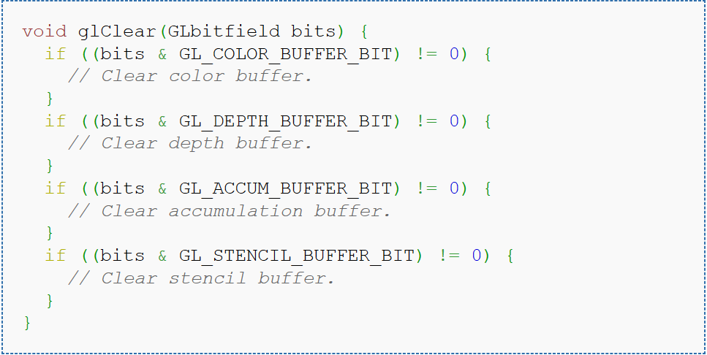
Bit Manipulations – Flags / Bit Fields
Internally, a function taking a bitfield like this can use binary and to extract the individual bits. For example, an implementation of glClear() might look like:
Notes:
TechnoVision Computer Classes : Mobile: 9921481410 / 7588291640

Slide 20
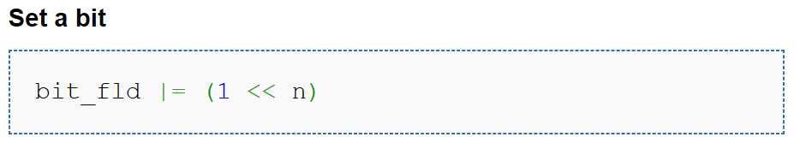
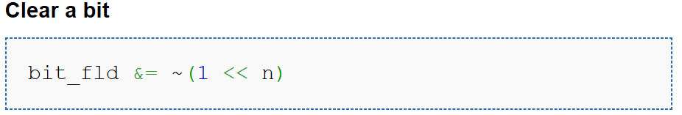
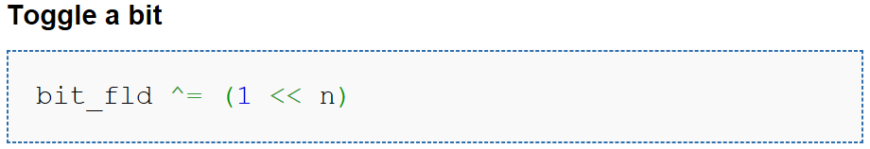

Bit Manipulations – Flags / Bit Fields
Bit Position
Notes:
TechnoVision Computer Classes : Mobile: 9921481410 / 7588291640

