Slide 1

T.HARISH KUMAR(11621A05H2).
R.SRUTHI(11621A05G3).
AURORA’S ENGINEERING COLLEGE,BHUVANAGIRI.

Slide 2
DEVELPOMENT OF LAN CAHT MESANGER (LCM) USING SOCKET COMMUNICATION
ABSTRACT :-
The PPT established how LAN CHAT MESSANGER using SOCKET COMMUNICATION methodology provides low-cost communication between staff in an organization ,Students in lab . The PPT Information on How file transfer are made and how communication is established between clients .This System is developed on pure Object Oriented Language (JAVA) .
Keywords: client ,Java ,SocketCommunication.

Slide 3
1.INTRODUCTION :-
A LAN messenger is an instant messaging program designed for use within a single local area network (LAN).
Many LAN messengers offer basic functionality for sending private messages, file transfer, chatrooms and graphical smileys.

Slide 4
LAN MESSANGER VS INSTANT MESSANGER
The advantage of using a simple LAN messenger over a normal instant messenger is that no active Internet connection or central server is required - and only people inside the firewall will have access to the system.

Slide 5
HISTORY:-
A precursor of LAN messengers is the Unix talk command, and similar facilities on earlier systems^{[5]} which enabled multiple users on one host system to directly talk with each other.
On Windows, WinPopup, was a small utility included with Windows 3.11. WinPopup uses SMB/NetBIOS protocol and was intended to receive and send short text messages.

Slide 6
FILE TRANSFER:-
File transfer is a generic term for the act of transmitting files over a computer network like the Internet. There are numerous ways and protocols to transfer files over a network.
There are 2 types of file transfers:
Pull-based file transfers where the receiver initiates a file transmission request
Push-based file transfers where the sender initiates a file transmission request.

Slide 7
SERVER AND CLIENT :-
Servers are classified by the services they provide. For instance, a web server serves web pages and a file server serves computer files
Whether a computer is a client, a server, or both, is determined by the nature of the application that requires the service functions

Slide 8
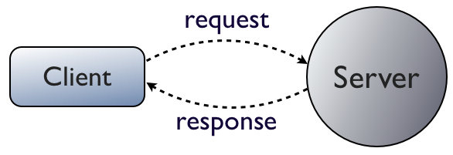
client and server to communicate with each other over raw Tcp/Ip ,java provides a standard library to achieve this :-SOCKET COMMUNICATION.

Slide 9
SOCKET :-
Socket which is an object that represents a low-level access point to the IP stack
Socket is the way by which two computers can establish a communication channel between them.
A socket address is the combination of an IP address and a port number.

Slide 10
GOALS :-
To provide a user friendly gui
TO enable secure communication by enabling Communication using ssl protocol
To enable file transfer facility
To refer a computer with host name rather than IP adress

Slide 11
GOALS:-
Different user availability status.
To identify automatically current users in the network
Providing user friendly access by abstracting the server
It provides confidentiality by enabling User Login
Chat History
Enable both private chat and public Chat(Chat room)

Slide 12
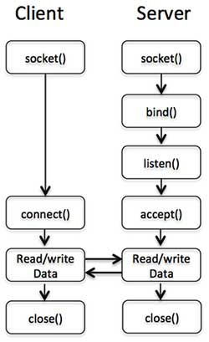
METHOD TO ACHIEVE GOAL :-

Slide 13
TOP LAN MESSANGER
CD MESSANGER:-Disadvantage is ,it request Ip address of a user who wants to login.
TONIC MESSANGER :-It is server based this is application is not user friendly which does not he a chat room and does not even store messages or it does not employe any security.
SQUIGGLE:- It also operates in peer-to-peer mode it does not allow file transfer.

Slide 14


