Slide 1

Tweet Sentiment Analysis
Presented by Team 4
Baishakhi Mitra
Harishma Parthiban
Varun Krishna Ramakrishnan

Slide 2
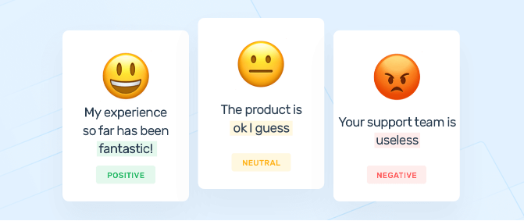
Problem Statement

Slide 3




Project flow
Data Collection
Data Pre-processing
Model Training
Model Evaluation
Kaggle
Text Processing
Multiple Models
Accuracy

Slide 4
Data collection
Kaggle - https://www.kaggle.com/datasets/shashank1558/preprocessed-twitter-tweets
Independent Variable - Tweets
Dependent Variable - Sentiment
Negative - 0
Positive - 1
Neutral - 2

Slide 5
Data Preprocessing & Model Construction
Text processing
Tokenizer
Stop word removal
TF-IDF
Models
Naive Bayes
Decision Tree Classifier
Logistic Regression

Slide 6
Model evaluation
Model Name | Accuracy
Naive Bayes | 83.9
Decision Tree Classifier | 81.6
Logistic Regression | 86.2

Slide 7
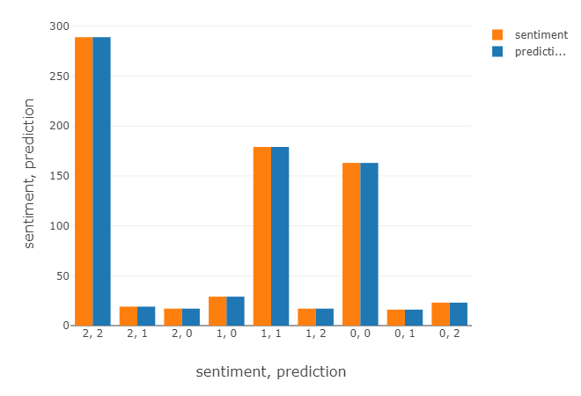
Inference - Naive Bayes

Slide 8
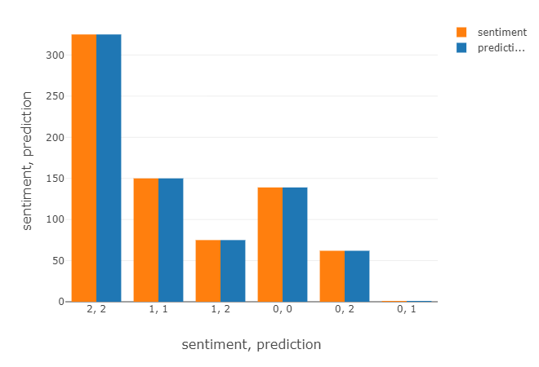
Inference - Decision Tree

Slide 9
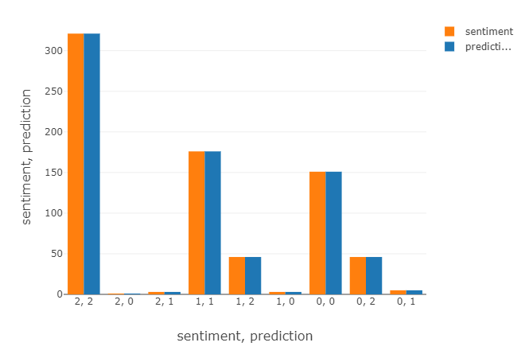
Inference - Logistic Regression

