Slide 1
DATA-VIZ HACK-A-BIT
DATA-DRIVEN IPL INSIGHTS
Bala harshini B - 24BAD015
Harish M K - 24BAD031
Dinesh kumar P - 24BAD021
Jeevadharan G - 24BAD046

Slide 2
PROBLEM STATEMENT
Moneyball: IPL Player Valuation
Issue:
Player auction prices are often influenced by popularity rather than actual performance
Teams may overpay for some players and undervalue others
Core Question:
Does a player's age, role, nationality, or capped status genuinely influence their base auction price?
Goal: Build a strong team within a limited budget using data-driven insights

Slide 3
PROJECT SCOPE
Applications:
Provides insights into player distribution, role importance, and auction trends
Assists sports analysts and team management in strategic planning
Demonstrates how data visualization and statistical methods apply to sports analytics
Limitations:
Dataset contains only auction-related information (no detailed match performance statistics)
Results depend on the quality and completeness of the dataset
Does not include real-time updates

Slide 4
SDG MAPPING
SDG | Alignment
SDG 9 — Industry, Innovation & Infrastructure | Uses data science and machine learning for sports analytics innovation
SDG 10 — Reduced Inequalities | Identifies undervalued players and promotes fair evaluation based on performance
SDG 8 — Decent Work & Economic Growth | Improves decision-making in sports economy and auction investments

Slide 5
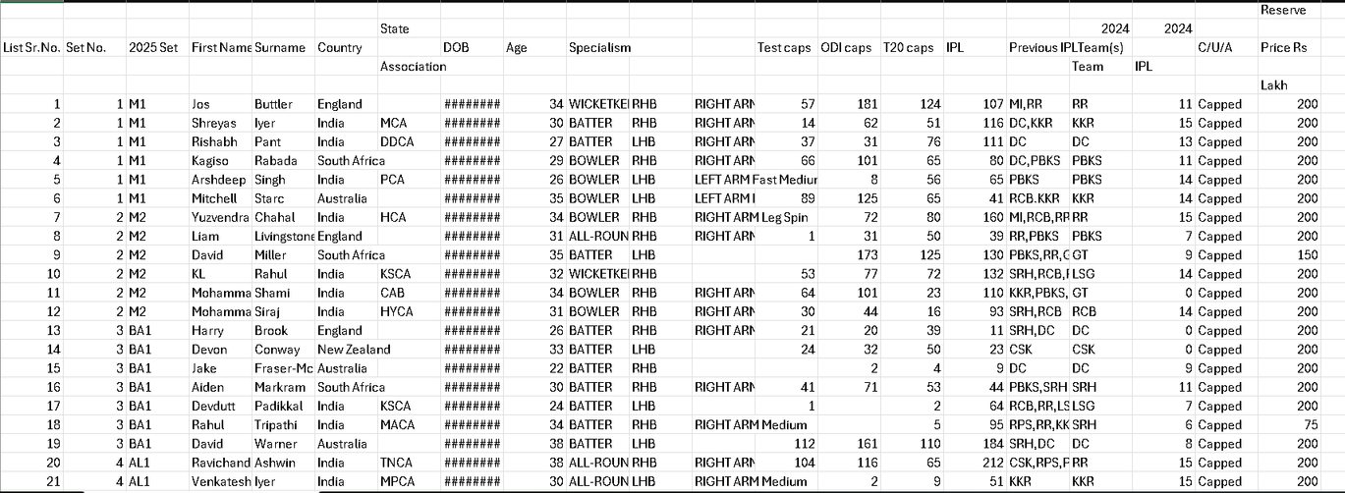
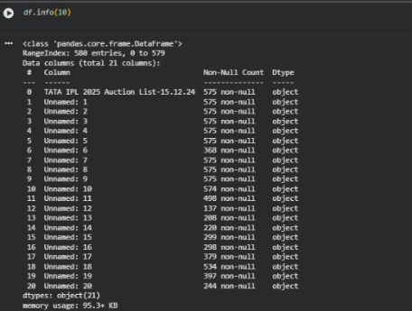
DATASET
Dataset Used: TATA IPL Auction List (2025)
Source:
Kaggle
https://www.kaggle.com/datasets/bhadramohit/tata-ipl-auction-list2025-dataset
Link:
The TATA IPL Auction List (2025) is a CSV dataset of players registered for the IPL 2025 auction.
It contains details like player role, age, country, capped status, previous teams, and reserve price.
It is used to analyze player valuation, auction trends, and team selection patterns.

Slide 6
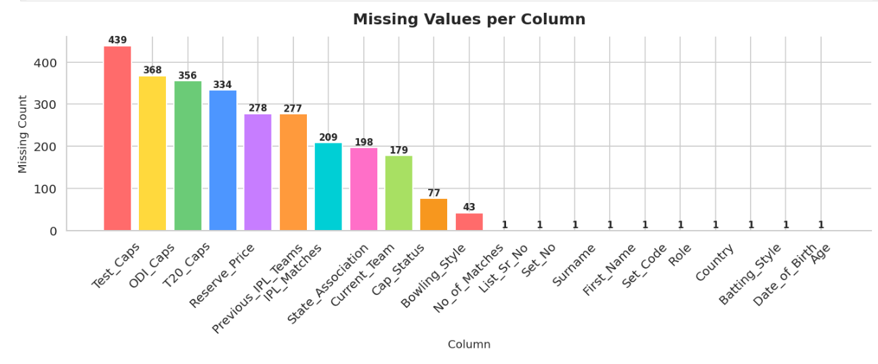
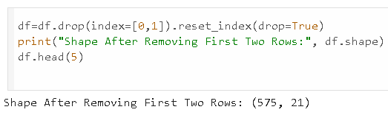
DATA PREPROCESSING SUMMARY
Key Cleaning Steps Performed:
Issue | Solution
Metadata header rows (first 2 rows) | Removed from dataset
Mixed price formats ('2 Cr', ‘30 Lakh') | Converted all to Lakhs (1 Cr = 100 Lakhs)
Misaligned Cap_Status column | Fixed and standardized to ‘ Capped'/'Uncapped'
Missing values in caps columns | Median imputation (structured missingness)
Numeric columns stored as object | Explicit pd.to_numeric() conversion
Outlier Decision:
Outliers were RETAINED (87 price outliers, 278 IPL matches outliers) because extreme values represent genuine superstars in sports analytics

Slide 7
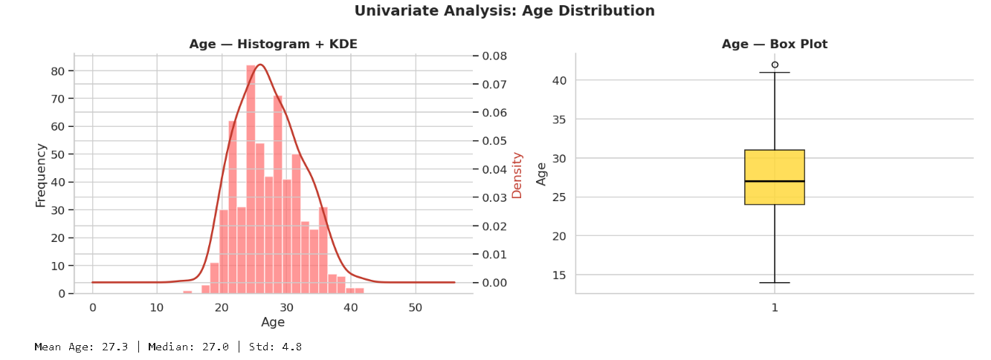
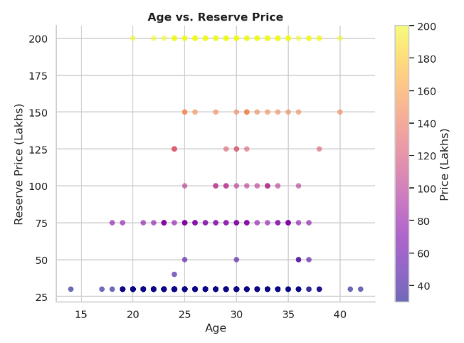
Exploratory Data Analysis - Key Findings
Reserve Price Distribution:
Right-skewed distribution
Most players priced ₹20-50 Lakhs
Few high-value outliers (₹150-200 Lakhs)
Role Distribution:
Batters: Largest group
Bowlers & All-Rounders: Nearly equal, second largest
Wicketkeepers: Smallest group
Capped vs Uncapped:
Capped players priced 2-3x higher than Uncapped
Shows strong international recognition premium
Age vs Price:
Prime age bracket (25-30 years) commands highest prices

Slide 8
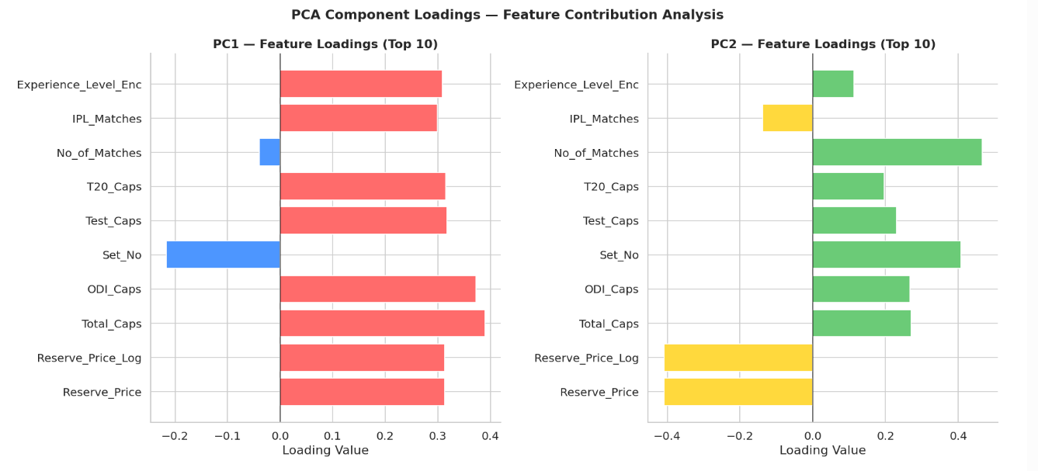
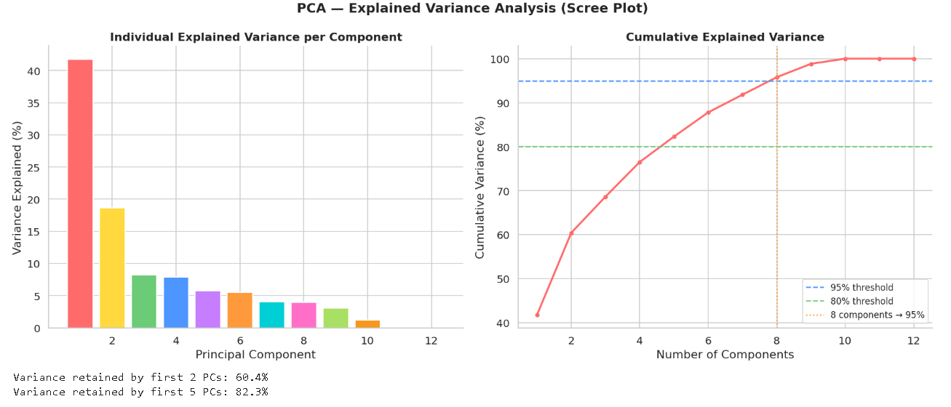
PCA - Dimensionality Reduction
Motivation:
High correlation among Test/ODI/T20 caps (multicollinearity)
Need to reduce redundancy while preserving signal
PCA Results:
Component | Interpretation
PC1 | "Experience Axis" — driven by IPL_Matches, ODI_Caps, Total_Caps
PC2 | Captures trade-off between age and format-specific experience
Key Insight from PCA:
The first 3-5 components capture >95% of variance
High-priced players cluster at positive end of PC1
Overseas players form distinct region in PC2 space

Slide 9
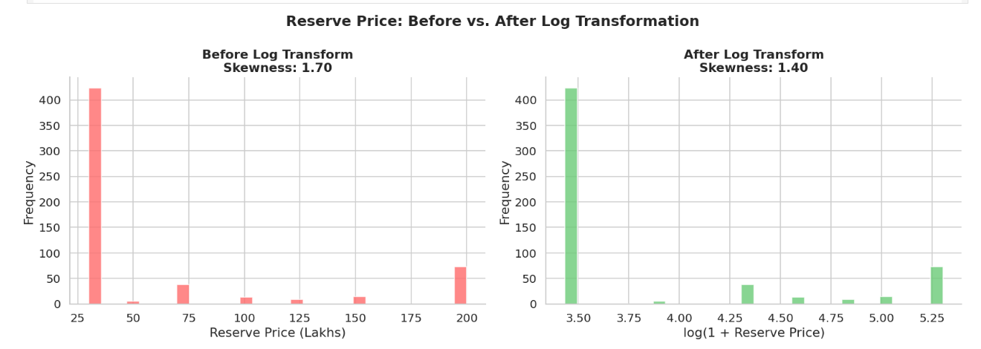
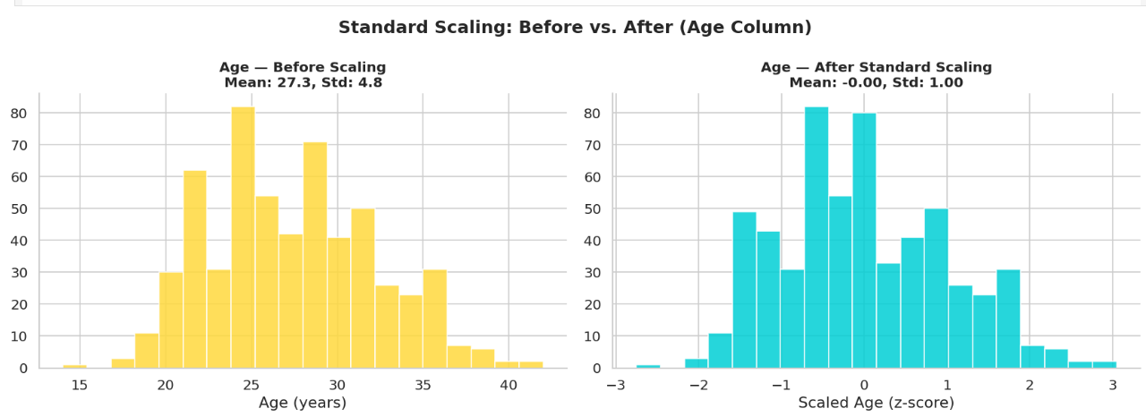
Feature Engineering
Feature engineering is the process of transforming raw data into useful inputs (features) that help a machine learning model perform better.
1.Log Transformation of Reserve Price
Reserve Price showed strong right-skewed distribution
Applied log1p() transformation to normalize values
Reduced skewness and improved model learning
2.Standard Scaling :
Applied Standard Scaler to numeric features:
Age
Total Caps
IPL Matches
Number of Matches
Log Reserve Price
Centered features around mean = 0 and standard deviation = 1

Slide 10
Key Insights & Findings
1. The Capped Premium is Real and Substantial
Capped players priced 2-3x higher than Uncapped
However, several uncapped players deliver competitive output
2. The Overseas Scarcity Premium
Overseas players systematically priced higher than Indian players
Scarcity premium may exceed what performance justifies
3. The Prime Age Sweet Spot (25-30 Years)
Highest median auction prices across all roles
Players combine athleticism with proven experience
4. The Undervalued Player Profile
Domestic Indian player, Uncapped or <10 international caps
Age 23-27 with 15-40 IPL appearances
Priced below Capped median due to lack of international recognition

Slide 11
Interactive Dashboard
Tool Used: Plotly
Narrative Structure (Context → Conflict → Resolution):
Section | Content
Context (Top) | KPI cards: 574 players, ₹46.2L avg price, India (366 players), 27.3 avg age
Conflict (Middle) | Pricing inefficiencies — cap premium, nationality premium, age premium
Resolution (Bottom) | Actionable strategy — undervalued player profile, value recommendations
Interactive Features:
Hover tooltips with player details
Dropdown filters (country, role, cap status)
Consistent colour coding (India blue, Overseas red)
Zoom and pan controls

Slide 12
Conclusion
Moneyball Hypothesis: VALIDATED
IPL player auction prices are systematically influenced by cap status, nationality, age group, and total experience
PCA confirmed "experience axis" (PC1) as the dominant pricing driver
Genuine pricing inefficiencies exist that data can identify
Key Takeaway:
Uncapped domestic players with proven IPL track records (age 23-27) consistently represent underpriced value relative to their likely on-field contribution
All-Rounders offer the best price-to-versatility ratio

Slide 13
Thank you

