Slide 1
Keyword Extraction

Slide 2
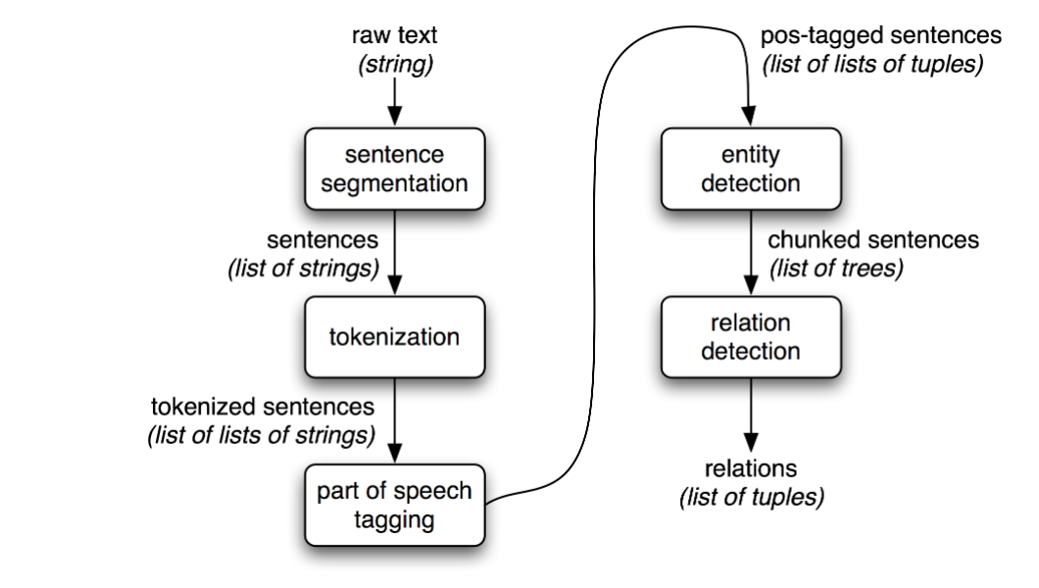
Information Extraction Architecture

Slide 3
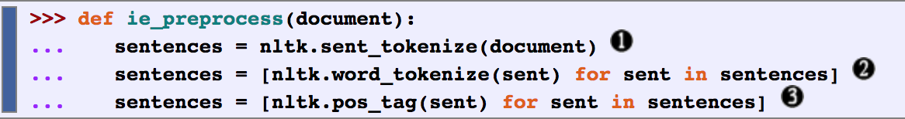
Steps 1-3
To perform the first three tasks, we can define a simple function as below
sentence segmenter (optional in our case)
word tokenizer
part-of-speech tagger

Slide 4
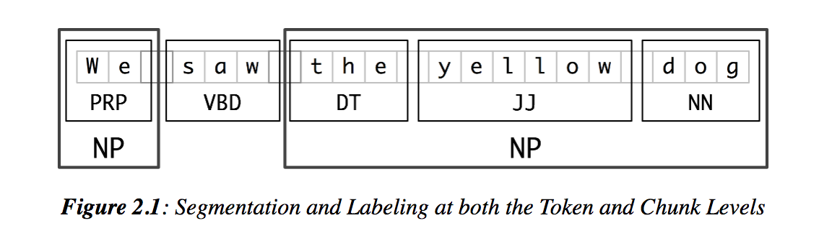
Step 4: Named entity detection
The basic technique we will use for entity detection is chunking,
which segments and labels multi-token sequences
The idea is to extract the Noun Phrases from the sentence
Noun Phrase-a noun and any words in the sentence that modify it;
E.g. The yellow house is for sale

Slide 5
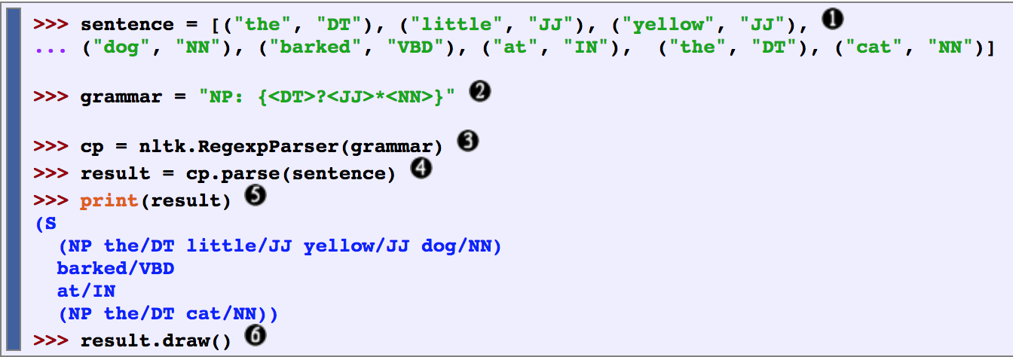
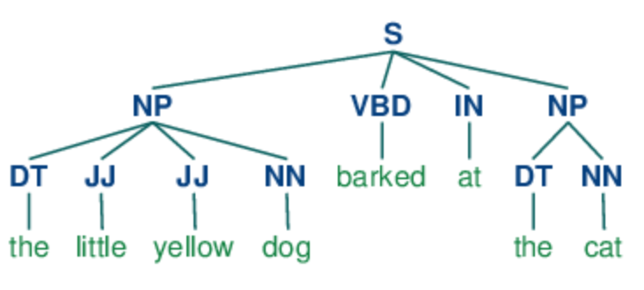
Step 4.1: Noun Phrase Chunking
In order to create an NP-chunker, we will first define a chunk grammar (similar to regular expression) consisting of rules that indicate how sentences should be chunked.
Below rule says that an NP chunk should be formed whenever the chunker finds an optional determiner (DT) followed by any number of adjectives (JJ) and then a noun (NN).

Slide 6
Other examples of chunk grammar

Slide 7
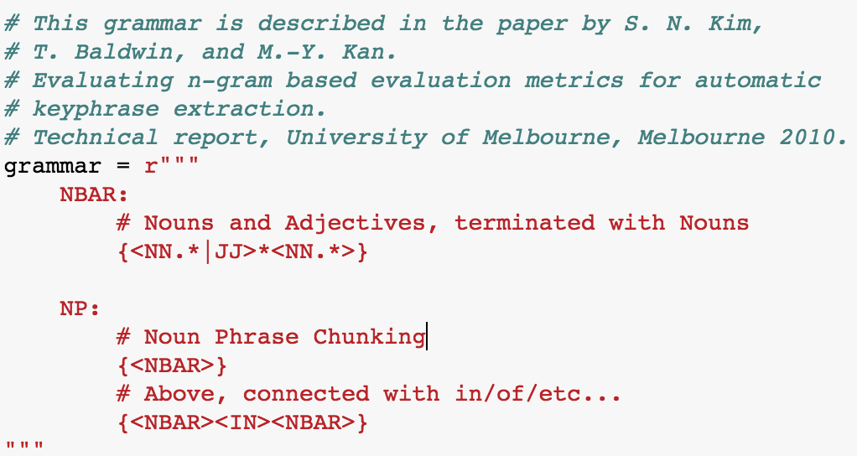
Keyphrase Grammar we will be using
Rule1 detects simplex nouns
Rule2 extracts N-bars with post-modifying PPs.

