Slide 1
MACHINE LEARNING Hands-on Training:
March 29, 2018

Slide 2
Machine Learning basics.
Python recap.
Numpy and Pandas introduction.
Understanding Problem Statement.
Understanding Data Science Concepts while solving problem.

Slide 3
Motivating slide ☺
You Can Do Machine Learning in Python!!!
You do not need to understand everything. (at least not right now)
You do not need to know how the algorithms work.
You do not need to be a Python programmer.
You do not need to be a machine learning expert.
What about other steps in a machine learning project.
Notes:
You do not need to understand everything. (at least not right now) Your goal is to run through the tutorial end-to-end and get a result. You do not need to understand everything on the first pass. List down your questions as you go. Make heavy use of the help(“FunctionName”) help syntax in Python to learn about all of the functions that you’re using.
You do not need to know how the algorithms work. It is important to know about the limitations and how to configure machine learning algorithms. But learning about algorithms can come later. You need to build up this algorithm knowledge slowly over a long period of time. Today, start off by getting comfortable with the platform.
You do not need to be a Python programmer. The syntax of the Python language can be intuitive if you are new to it. Just like other languages, focus on function calls (e.g. function()) and assignments (e.g. a = “b”). This will get you most of the way. You are a developer, you know how to pick up the basics of a language real fast. Just get started and dive into the details later.
You do not need to be a machine learning expert. You can learn about the benefits and limitations of various algorithms later, and there are plenty of posts that you can read later to brush up on the steps of a machine learning project and the importance of evaluating accuracy using cross validation.
What about other steps in a machine learning project. We did not cover all of the steps in a machine learning project because this is your first project and we need to focus on the key steps. Namely, loading data, looking at the data, evaluating some algorithms and making some predictions. In later tutorials we can look at other data preparation and result improvement tasks.

Slide 4
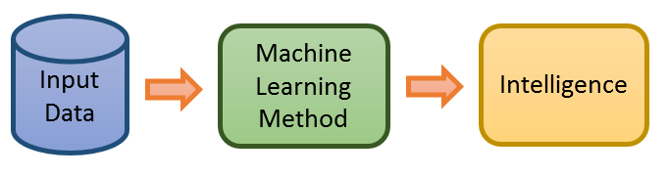
Machine Learning Basics
Wikipedia says:
Machine learning is the subfield of computer science that, according to Arthur Samuel in 1959, gives "computers the ability to learn without being explicitly programmed”.
Let’s consider each term separately.
'Machine' is a computer system.
'Learning' means that the machine will understand something

Slide 5
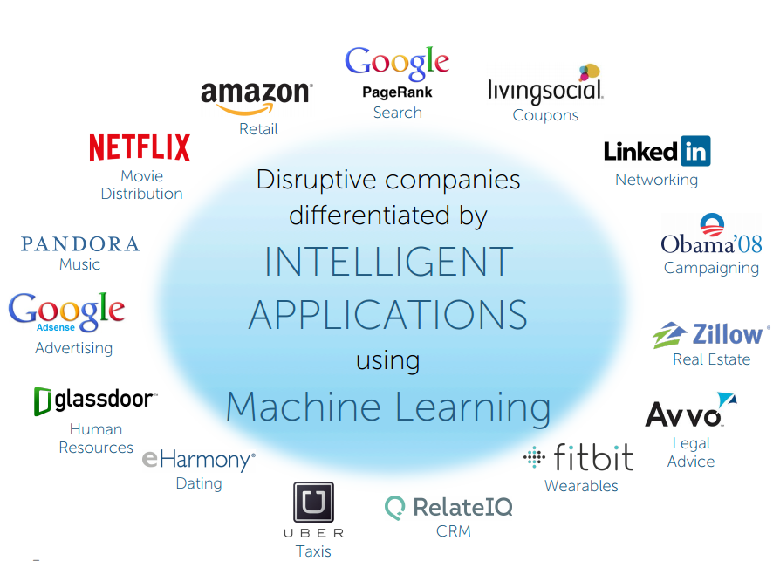
Products using Machine Learning

Slide 6
Types of Machine Learning
Machine Learning
Supervised
Learning
Unsupervised
Learning
Reinforcement
Learning
Classification
Regression
Clustering
Association

Slide 7
What we will talk about in this session ?
Machine Learning
Supervised
Learning
Unsupervised
Learning
Reinforcement
Learning
Classification
Regression
Clustering
Association
Rules
* use case in detail

Slide 8


Types exemplified
Football coach : Garry Student : David ,who wants to learn football.
Garry is teaching David how to play football and David learns the game . This is supervised learning.
David observed the game himself and learned how to play it . This is unsupervised learning
David learned the game himself and while he is playing a match he will be given a feedback by Garry .This is reinforcement learning.

Slide 9

Supervised Learning: Classification
A set of observations A set that we use only for evaluation
(not a chair)
(not a chair)
(chair)
(not a chair)
(chair)
(not a chair)
(not a chair)
(not a chair)
We want to predict a class , whether a new object is a chair or not a chair .

Slide 10
Supervised Learning: Classification
Training Set Test Set
(not a chair)
(not a chair)
(chair)
(not a chair)
(chair)
(not a chair)
(not a chair)
(not a chair)
Chair or not a chair is our label

Slide 11
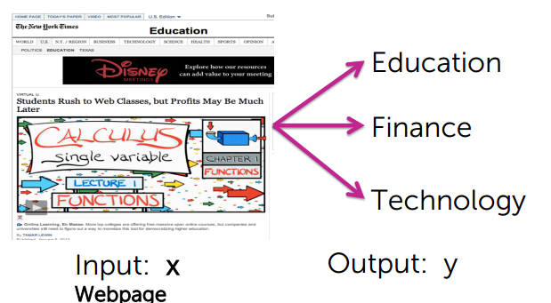
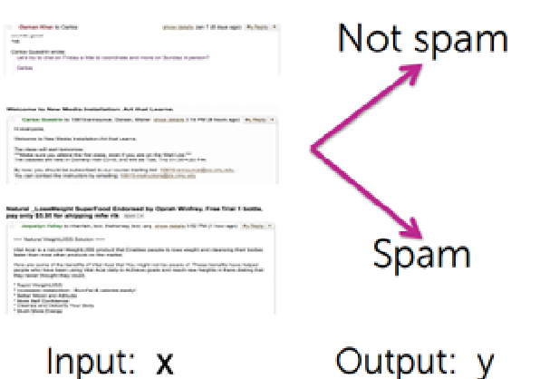
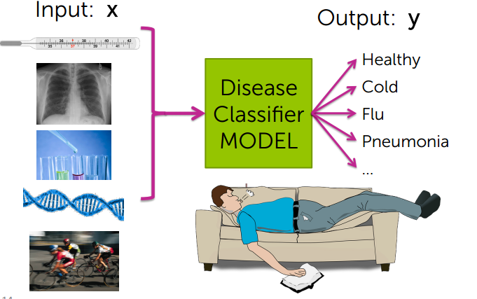
Real world examples
Classifying News Articles
Classifying Emails
Medical Diagnosis
Notes:
In machine learning and statistics, classification is the problem of identifying to which of a set of categories (sub-populations) a new observation belongs, on the basis of a training set of data containing observations (or instances) whose category membership (labels) is known.
Some other real world examples:

Slide 12
Unsupervised Learning
“Unsupervised” means that the training data has no ground truth labels to learn from.
Unsupervised:

Slide 13
Unsupervised Learning : Clustering
Clustering is a key unsupervised problem.

Slide 14
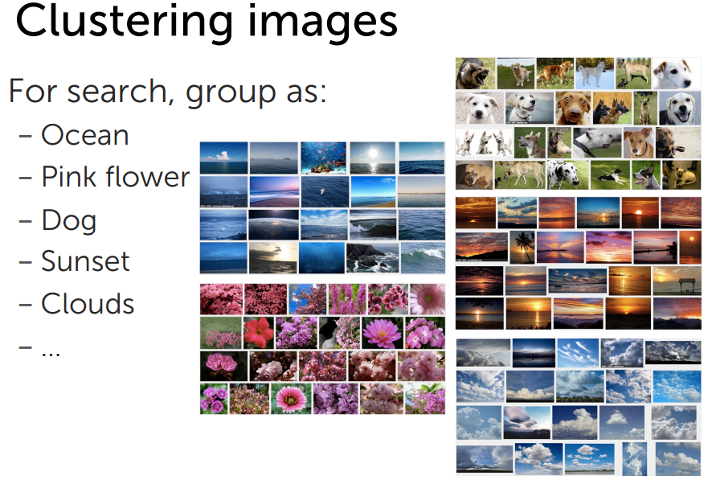
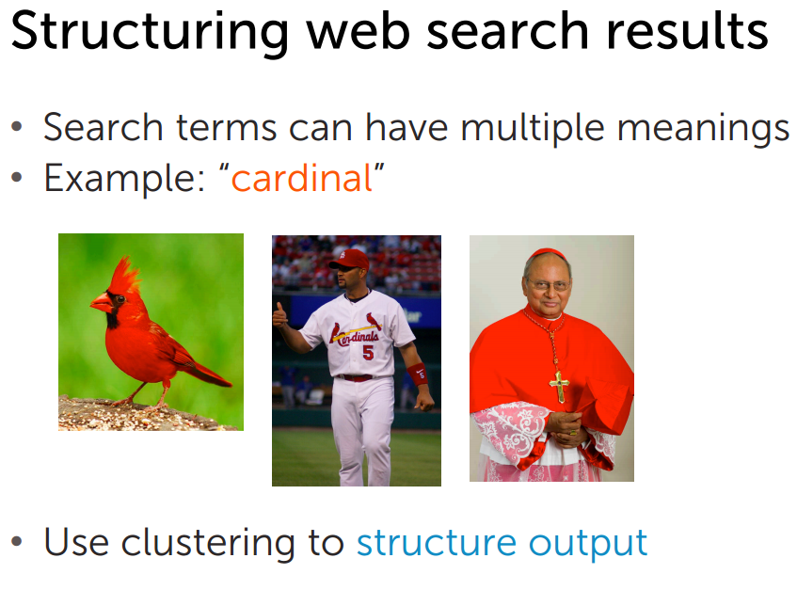
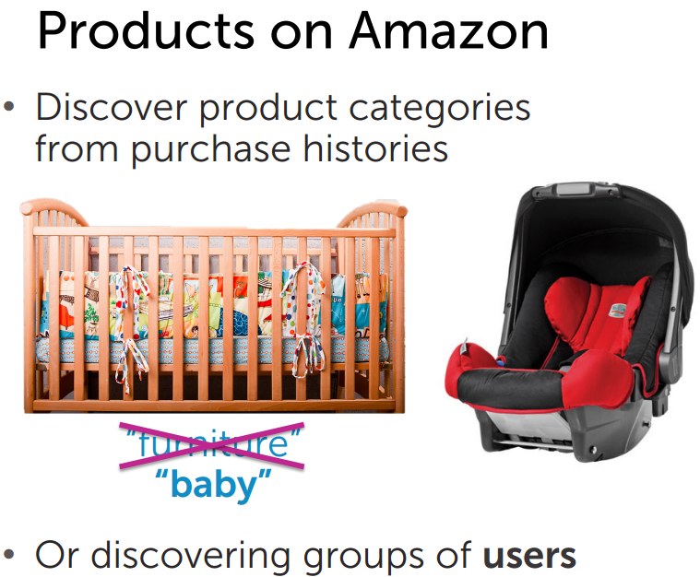
Real world examples
Notes:
Cluster analysis or clustering is the task of grouping a set of objects in such a way that objects in the same group (called a cluster) are more similar (in some sense or another) to each other than to those in other groups (clusters).

Slide 15
Time to code
In this section we will be covering very basic and very high level overview of python and its ML related packages which is enough to write your first ML program.
We will cover the following
Python data structures
Numpy
Pandas
sklearn
Notes:
Sklearn: Scikit-learn is a free software machine learning library for the Python programming language.
It features various classification, regression and clustering algorithms

Slide 16
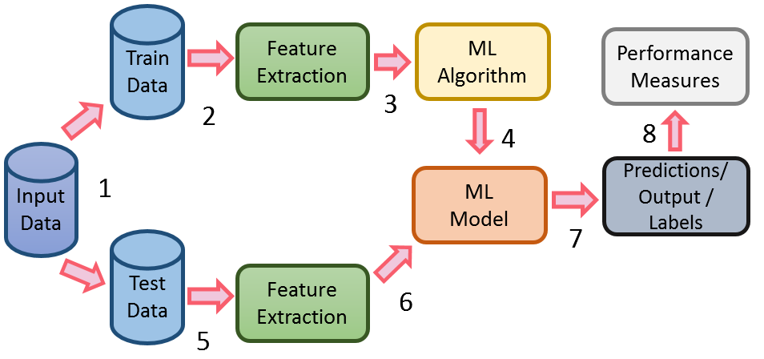
Machine Learning Workflow
Classification and Regression are supervised learning problems.
“Supervised” means that the training data has ground truth labels to learn from.
Notes:
1.The Input data is split into train and test data . The train data will contain the sales price of house and other features as well .
2.Feature Extraction is performed in which the most important features will be analyzed and selected. Say out of all we selected only house area, garage size and roof type.
3.The features are given as an input to the algorithm along with the target variable (sales price) .
4.The machine learns the data with various iterative processes .The machine after learning provides a model which can be used now to predict a sales price for a house .
5.The test data which do not have the target value runs through the feature extraction process as done in step 2 .
6.Features from test data are selected and supplied to the model .
7.The model outputs the target variable, i.e. the sales price for the set of house input data supplied to it.
8.Performance of the model is evaluated by performance measures . In this case the target values of test data are compared with the predicted sale prices to analyse the performance of the model .

Slide 17
Data Preparation
Variable Understanding : Data type of variable
Data Visualization
Descriptive Stats
Univariate Analysis
Mean
Median
Model
Standard Deviation
Variance
DV : Boxplot,histogram,etc.
Multivariate Analysis
Co-relation
DV : Heatmap,scatterplots,etc.
Outliers and handling them
Variable Imputation
Standardization

Slide 18
Variable Understanding
There are broadly 2 types of variables.
1.Numerical : Plot Size, Garage Area etc.
2.Categorical : Street , Roof Style , etc.
Let’s have a look .

Slide 19

Data Visualization
There are various visualization graphs and maps , some of them are :
Histograms
Scatter Plots
Box Plots
Heat Maps

Slide 20
Descriptive Statistics
Univariate Analysis
Mean
Median
Mode
Standard Deviation
Variance

Slide 21
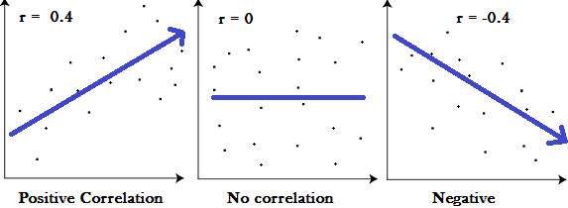
Descriptive Statistics
Multivariate Analysis
Correlation
Correlation coefficient formulas are used to find how strong a relationship is between data. The formulas return a value between -1 and 1, where:
1 indicates a strong positive relationship.
-1 indicates a strong negative relationship.
A result of zero indicates no relationship at all.
Notes:
correlation coefficient of 1 means that for every positive increase of 1 in one variable, there is a positive increase of 1 in the other.
A correlation coefficient of -1 means that for every positive increase of 1 in one variable, there is a negative decrease of 1 in the other.
Zero means that for every increase, there isn’t a positive or negative increase. The two just aren’t related.
The absolute value of the correlation coefficient gives us the relationship strength. The larger the number, the stronger the relationship. For example, |-.75| = .75, which has a stronger relationship than .65.

Slide 22
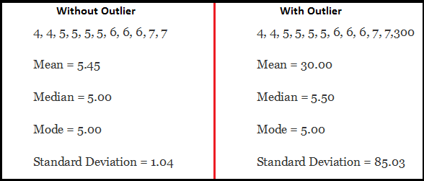
Outliers
What are outliers ?
Impact by outliers
An outlier is an observation point that is distant from other observations. It may be due to variability in the measurement or it may indicate experimental error; the latter are sometimes excluded from the data set.

Slide 23
Missing Value Imputation
Missing values in data .
Remove missing values
Replace them with mean (Numerical)
Replace them with mode (Categorical)
Predict the missing value

Slide 24
Standardization
Data on different scales
Scaling the data
Ways to scale the data

Slide 25
QUESTIONS

Slide 26
THANK YOU

