Slide 1
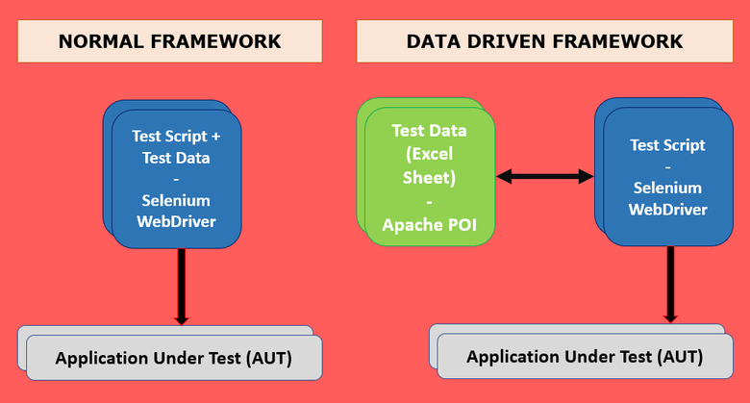

Slide 2
What is Data Driven Framework
Data Driven framework is focused on separating the test scripts logic and the test data from each other. Allows us to create test automation scripts by passing different sets of test data. The test data set is kept in the external files or resources such as MS Excel Sheets, MS Access Tables, SQL Database, XML files etc., The test scripts connect to the external resources to get the test data. By using this framework we could easily make the test scripts work properly for different sets of test data. This framework significantly reduces the number of test scripts compared to a modular based framework.
Why Data Driven Framework
Usually, we place all our test data in excel sheets which we use in our test runs. Assume, we need to run a test script (Say, login test) with multiple test data. If we run the same test with multiple test data sets manually is time-consuming, and error-prone. In the next section, we see a practical example.

Slide 3
Advantages of using Data Driven Test Framework
Re-usability of code
Improves test coverage
Faster Execution
Less maintenance
Permits better error handling
What is Apache POI
Apache POI is an open source library developed and distributed by Apache Software Foundation to design or modify Microsoft Office files using Java program. It is a popular API that allows working around excel files using Java Programs. In short, you can read and write MS Excel files using Java. Apache POI is your Java Excel solution. You’d use HSSF if you needed to read or write an Excel file using Java (XLS). You’d use XSSF if you need to read or write an OOXML Excel file using Java (XLSX). It has many predefined methods, classes, and interfaces.

Slide 4
How To Create Data Driven Framework in Selenium Using Apache POI
Here I will take Facebook Application to showcase implementation of Data Driven Framework in Selenium with Java using Apache POI.
Scenario: Open Facebook page and do log in and log out.
How To Read Data From Excel Sheet Using Apache POI
Prerequisites to implement Data Driven Framework:
Eclipse IDE
TestNG
Selenium jars
Apache POI jars
Microsoft Excel

Slide 5
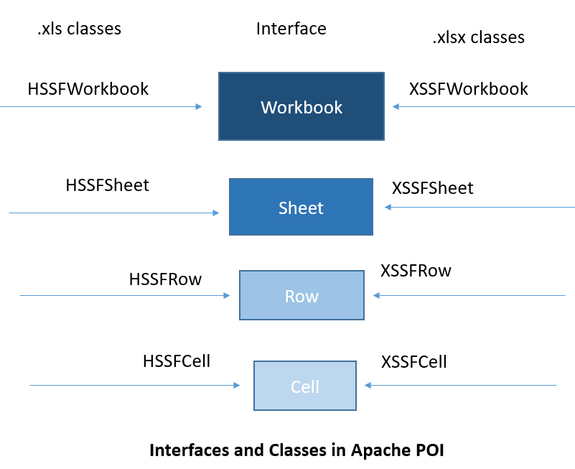
The two mainly used classes for managing Excel Workbooks are:
HSSFWorkbook- These class methods are used to read/write data to Microsoft Excel file in .xls format. It is compatible with MS-Office versions 97–2003.
XSSFWorkbook- These class methods are used to read-write data to Microsoft Excel in .xls or .xlsx format. It is compatible with MS-Office versions 2007 or later.

Slide 6
Step 1: Open Eclipse and configure Apache POI jar files
Step 2: Open Excel Sheet and create some test data.
Step 3: Create a Java Class under your Project

Slide 7
How to write data in Excel in Java
Here are few classes which you need to aware of.
Workbook : This is high level class for representing excel workbook.
Sheet : This is high level class for representing excel sheet.
Row : This is high level class for representing excel row. It has methods which are related to row.
Cell: This is high level class for representing individual excel cell. It has methods which are related to cell for example : getDataType().

Slide 8
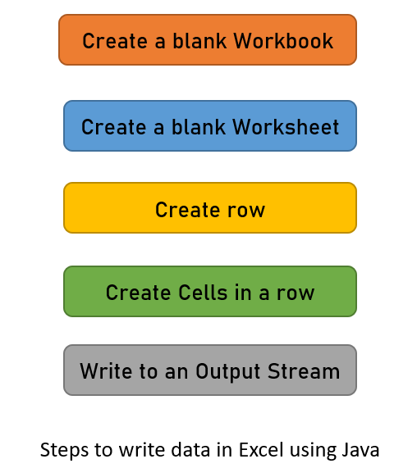
The basic steps for writing data into an excel file using Apache POI API are given below:

