Slide 1

SMART INDIA HACKATHON 2026
SMART INDIA HACKATHON 2026
Problem Statement ID – 26054
Problem Statement Title- AI-Enabled Real-Time Digital Twin System for Health Monitoring, Fault Prediction and Mission Reliability Enhancement of Aero Piston Engines used in MALE UAVs.
Theme- Robotics and Drones
PS Category- Software
Team ID- 171797
Team Name - Hydrovex

Slide 2













PROPOSED SOLUTION
HYDROVEX
Physics-based Digital Twin for Predictive UAV Engine Health
AEROTWIN continuously compares measured engine behaviour with expected healthy behaviour under the current operating condition to detect anomalies, identify probable faults and estimate remaining useful life (RUL).
1
ENGINE TELEMETRY
RPM • CHT • EGT • Oil P/T • Fuel • Vibration • Electrical • Flight context
2
PHYSICS-BASED DIGITAL TWIN
ISA atmosphere + engine thermodynamics + operating condition
3
ACTUAL vs EXPECTED
Measured behaviour vs healthy prediction
4
RESIDUAL GENERATION
Residual = Actual − Expected
5
AI / ML ANALYSIS
Anomaly detection + fault classification + XAI
6
DEGRADATION & RUL
Trend tracking + remaining useful life
7
MAINTENANCE ADVISORY
Actionable decision support
Core diagnostic loop: measure → predict healthy behaviour → compare → diagnose → forecast → advise
WORKING SOFTWARE PROTOTYPE
TELEMETRY INPUTS
INSERT SCREENSHOT
AEROTWIN dashboard (full view)
Real-time engine health monitoring
Actual vs expected Digital Twin comparison
Residual and anomaly detection
Fault classification + XAI
Degradation trend + RUL
Mission replay / simulation
CAN telemetry decoding and validation
Synthetic Data
Simulation
Flight-Data Logs
CSV / FDR
CAN
Real / Virtual ECU
OUTPUTS
Health Status
Probable Fault
Degradation / RUL
Maintenance Advisory
Current prototype is software/simulation validated; real engine degradation data is required for operational calibration.

Slide 3
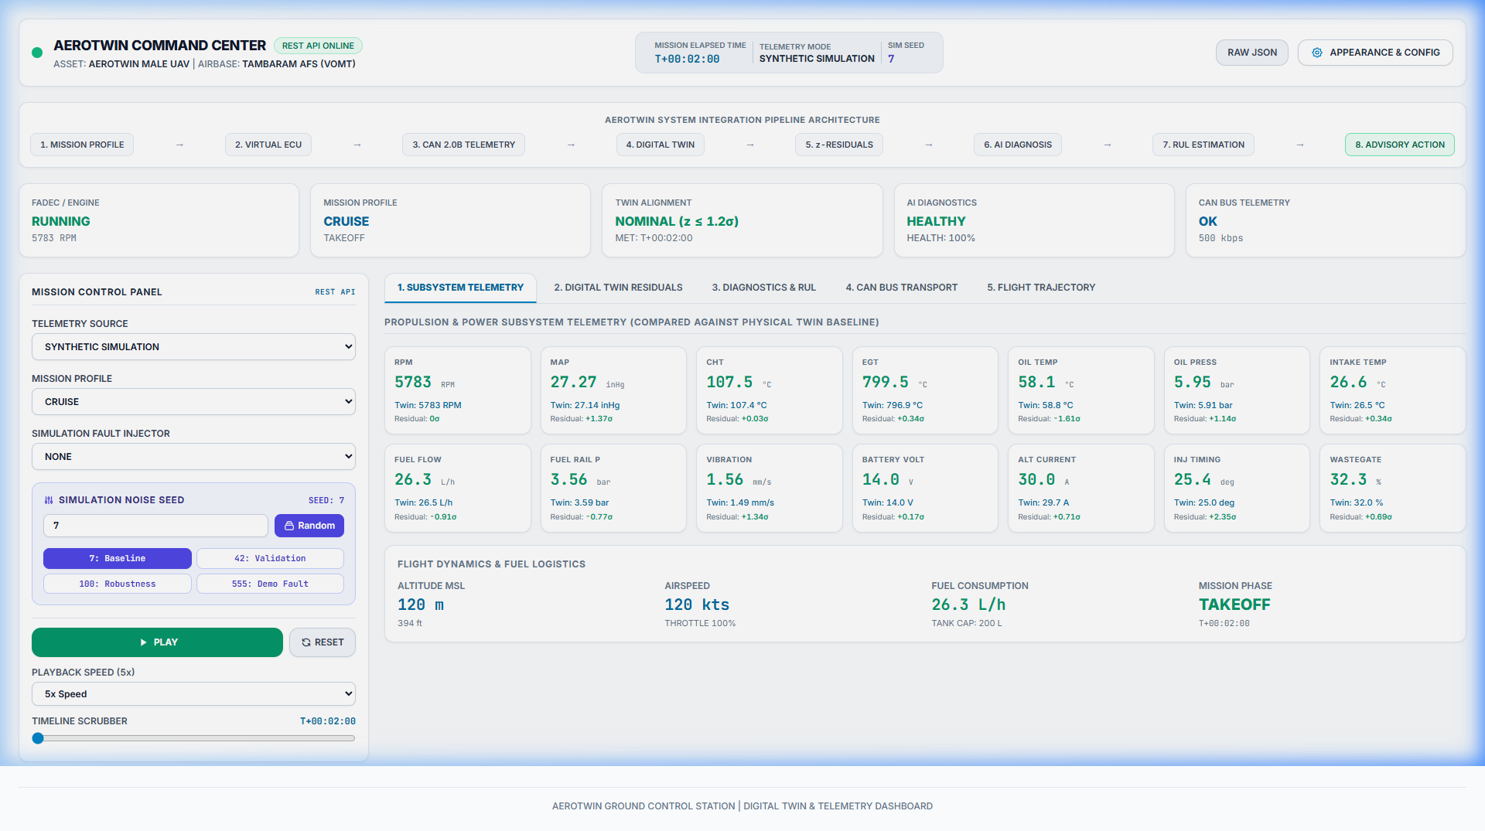
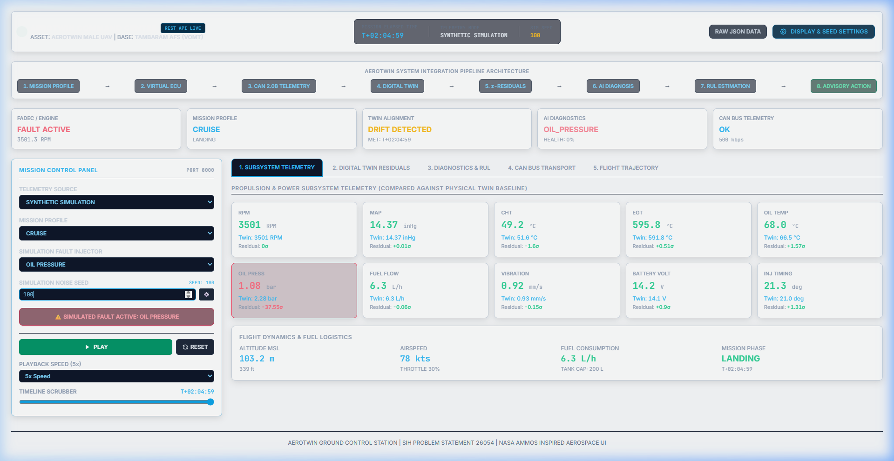
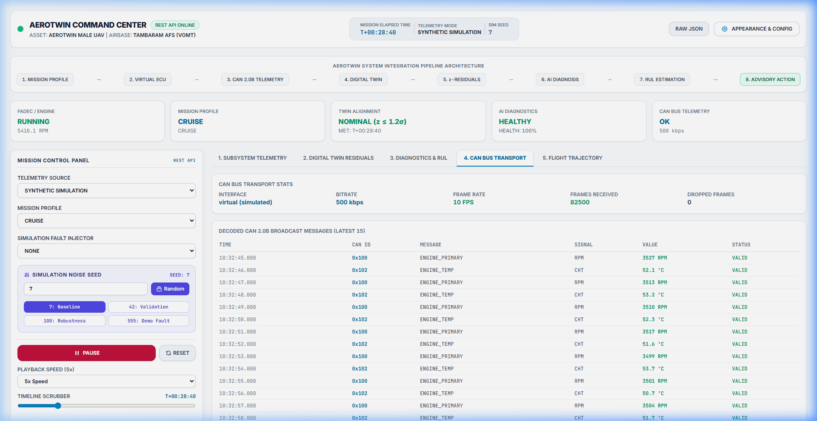
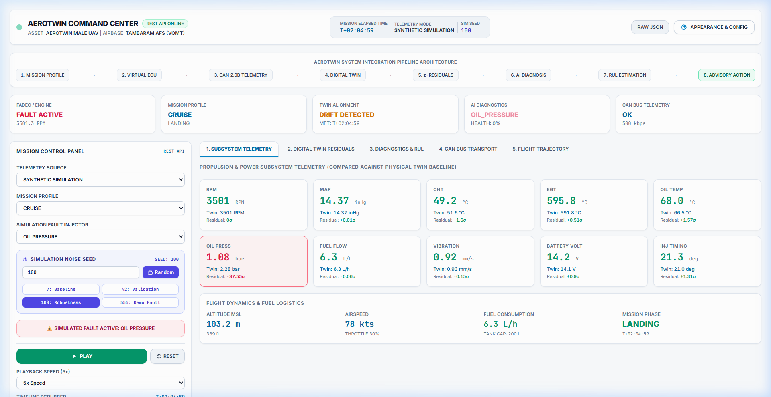
TECHNICAL APPROACH
HYDROVEX
End-to-End Architecture for UAV Engine Health Monitoring
PHYSICAL / EMBEDDED PATH
AEROTWIN SOFTWARE STACK
ENGINE & SENSORS
ECU / FADEC
CAN TELEMETRY
TELEMETRY LAYER
DIGITAL TWIN
ACTUAL vs EXPECTED
RESIDUAL /
z-SCORE
AI / ML DIAGNOSTICS
DEGRADATION & RUL
DASHBOARD / ADVISORY
A. TELEMETRY LAYER
B. DIGITAL TWIN
C. AI / ML DIAGNOSTICS
CAN frame decoding
Signal scaling
Range validation
Missing / stale-frame detection
Standard telemetry schema
ISA atmosphere
Load / MAP estimation
Power / torque model
Thermal dynamics
Lubrication / oil behaviour
Healthy-state prediction
Reference engine class: Rotax 912 S/ULS
Residual Generation → Actual − Expected
Filtering / Normalization
Isolation Forest → anomaly detection
Random Forest → fault classification
XAI → evidence / feature attribution
RUL → degradation trend
CAN 2.0B • 500 kbps
Actual vs Expected
0x100
RPM • state
0x101
MAP
0x102
CHT • EGT
0x103
Oil P • Oil T
— Actual - - Expected
0x104-5
Fuel • Battery
z-score residual (illustrative)
dashed = ±3σ
Residual = Actual − Expected | z = (Actual − Expected) / σbaseline
WORKING SOFTWARE PROTOTYPE
1. Live Engine Telemetry
2. Actual vs Digital Twin
3. Residual / Anomaly Detection
4. Fault Classification + RUL

Slide 4






FEASIBILITY & VIABILITY
HYDROVEX
Implementation Status, Technical Risks and Deployment Roadmap
A. CURRENT IMPLEMENTATION
B. KEY TECHNICAL RISKS & MITIGATIONS
Component | Current Status
Physics-based engine model | Implemented — 13-channel physics twin
Virtual ECU / FADEC | Implemented — State machine & DTC BIST
CAN telemetry layer | Implemented — 8 CAN 2.0B frames (0x100-0x107)
Diagnostic pipeline | Implemented — Dual-stage IF+RF + OLS RUL
Dashboard | Working software GCS dashboard UI
Mission simulation | Implemented — 5 dynamic flight profiles
Automated validation | 100 holdout mission seeds (500–599)
1. Limited real engine degradation data
Risk: AI and RUL reliability depends on representative degradation data.
Mitigation: Engine test-rig data + controlled fault experiments + recalibration.
2. Physics-model mismatch
Risk: Actual engines may deviate from the simplified model.
Mitigation: Parameter tuning against measured engine data.
3. CAN / sensor failure
Risk: Missing/corrupted telemetry can affect diagnosis.
Mitigation: Range checking + stale/missing-data detection + communication monitoring.
4. Edge compute limits
Risk: Onboard hardware has limited compute/power budget.
Mitigation: Lightweight inference + edge/GCS split.
C. VALIDATION software / simulation prototype
D. DEPLOYMENT PATH
99.84%
Holdout Classification Accuracy
10
State Classes (Healthy + 9 Faults)
0.0 / hr
Healthy False Alarm Rate
0.91 min
Mean Absolute RUL Error
PHASE 1 — CURRENT
Simulation + software prototype
PHASE 2
Engine test-rig integration
PHASE 3
Real ECU + CAN / HIL
PHASE 4
UAV edge / GCS deployment
PHASE 5
Multi-UAV / fleet monitoring
Not flight certification.
A modular architecture allows validation and calibration to progress step-by-step from software simulation to real engine integration.

Slide 5




IMPACT & BENEFITS
HYDROVEX
From Reactive Monitoring to Predictive Engine Health Management
THRESHOLD-BASED MONITORING
AEROTWIN
UAV OPERATORS
Real-time engine health visibility
Better mission planning with engine condition
Earlier awareness of abnormal behaviour
Sensor value
Live telemetry
Fixed threshold
Physics-based expected behaviour
MAINTENANCE TEAMS
Fault evidence
Degradation trend visibility
Condition-based servicing support
RUL-based planning
Alarm
Actual vs Expected
Maintenance action
Residual / deviation
ENGINEERING / TESTING
Actual vs expected behaviour
Mission replay and what-if analysis
Support for engine testing and model calibration
Limitations
AI fault diagnosis
Detection after significant deviation
Environmental effects complicate interpretation
Limited degradation / RUL visibility
Degradation trend + RUL
DEFENCE / SYSTEM LEVEL
Modular propulsion-health architecture
Expansion path toward broader UAV telemetry
Multi-UAV monitoring potential
Maintenance / mission decision
99.84%
Holdout Classification Accuracy
100.0%
CAN Classification Agreement
0.0 / hr
Healthy False Alarm Rate
0.91 min
Mean Absolute RUL Error
These are prototype software/simulation validation results, not flight-test or certification results.

Slide 6





RESEARCH, REFERENCES & NEXT STEPS
HYDROVEX
Technical Foundations, Data Sources and Validation Roadmap
A. CORE REFERENCES & B. HOW THEY ARE USED
C. FUTURE WORK ROADMAP
Reference | Used for | Feeds
Rotax 912 Series Technical Documentation | Engine architecture, operating parameters, power / RPM points, operating limits | Physics model
International Standard Atmosphere (ISA) | Altitude, temperature, pressure, air-density modelling | Environment model
Digital Twin for Aerospace and Propulsion Systems | Digital Twin concepts, physics-informed modelling, aerospace health monitoring | Expected healthy behaviour
Isolation Forest & Random Forest (Liu 2008, Breiman 2001) | Unsupervised anomaly detection & 10-class fault classification | Diagnostic pipeline
CAN 2.0 Specification; python-can Documentation | CAN frame structure, telemetry transport, Python CAN interface, decoder / validation path | Telemetry transport
RTCA DO-178C — Reference | Aerospace software-development considerations, reliability-oriented practices | Deployment / reliability practices
PHASE 1 — CURRENT
Software prototype
Physics model • Virtual ECU + CAN • AI pipeline • Dashboard • Simulation • Automated validation
PHASE 2
Engine test-rig integration
Collect real telemetry • Controlled degradation tests • Model calibration
PHASE 3
Real ECU / CAN HIL
Hardware integration • Real engine telemetry • Expanded fault data
PHASE 4
UAV edge / GCS
Edge inference • GCS integration • Operational-environment testing
PHASE 5
Multi-UAV / Fleet
Multiple platforms • Fleet-level analytics • Broader UAV health monitoring
D. NEXT TECHNICAL MILESTONE
Validate and calibrate the Digital Twin and AI/RUL pipeline using real engine test-rig telemetry.
Approval / guidance requested on
Propulsion-focused scope
Current Digital Twin + CAN + AI architecture
Test-rig data collection plan
Additional engine parameters to prioritize
Technical Demo QR
Project Documentation QR

