Slide 1
Exploratory Analysis of Set Top Box
Harish Bhat
Technical Leader
Aug 2018

Slide 2
Problem definition
The Set top box has limited hardware and to support new feature the non-used features need to be replaced by new one. Product team needs to know which screens are not used/rarely used, how they are used. The EPG analysis tool can answer these question.
Given a log its very cumbersome job to go through the log lines and identify the set of calls made, the solution would be to develop a tool which will plot sequence diagram from the logs for ease of debugging.

Slide 3
Why Analyze set Top Box Screens?
To understand the trends of the screens being used
The average time user spends on each screen
To improvise screen usability
Improve unused screens or replace it with new feature screens (value add)
Improve EPG screens testing
The result of screen analytics would help to understand the customer behavior and increase the revenue by providing better user experience
Improve screen performance, quality and stability
Understand the EPG screen access pattern

Slide 4


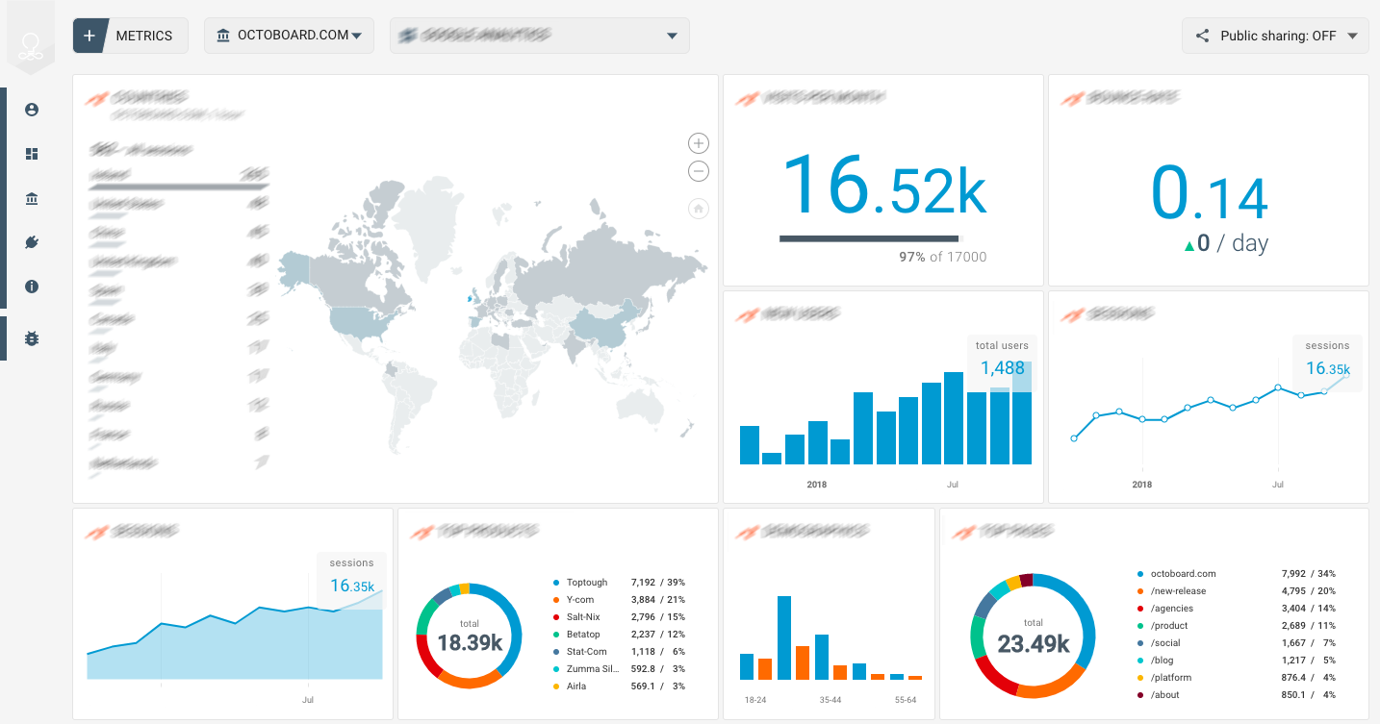
The EPG screen analytics tool overview
Introduction
Second Title Goes Here
Third Title Goes Here
Fourth Title Goes Here
Fifth Title Goes Here
Conclusion
STBs
Analytics Page
Server

Slide 5
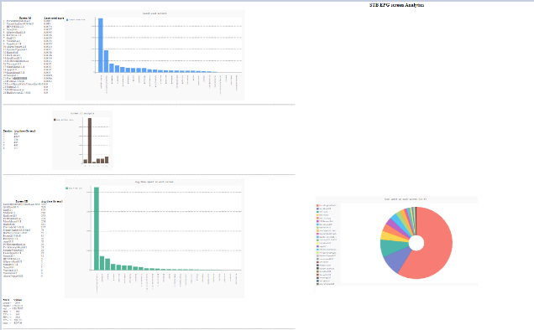
STB EPG Analyzer tool data flow Diagram
STB Log
Parser
Result
Analyzer
Files
Raw Data
Web page Generator

Slide 6
The goal of EPG screen Analysis
Given any logs with particular pattern, able to parse it and extract only required info
From the filtered info, Identify which screens are rarely used
Identify the time STB is switched on (Date time analysis)
STB screen usage statistics
Identify the time spent on each screen
Identify the sequence in which the screen are access given the logs
Try to host it on a server for analysis

Slide 7
Current Status
Activity | Status
Given any logs with particular pattern, able to parse it and extract only required info | Done
From the filtered info, Identify which screens are rarely used | Done
STB screen usage statistics | Done
Identify the time spent on each screen | Done
Identify the time STB is switched on (Date time analysis) | Partial in progress
Identify the sequence in which the screen are access given the logs | Planned to be worked upon
Hosting on a server for analysis | Yet to be started

Slide 8
Estimate for completing pending work
Activity | Remaining estimate
Identify the time STB is switched on (Date time analysis) | 3 days
Identify the sequence in which the screen are access given the logs | 2 week
Deploy tool on Separate server for analysis | 3 weeks
The work details are captured at location:
https://wiki.cisco.com/display/SKYDSTB/SkyD+EPG+-+Analytics

Slide 9
How can this tool be used by other projects for analysis??
For any project to be able to use this tool need, a log line in a particular format needs to be added in the EPG/screen display related code :
<STB/Device ID> <Date & Time> <Screen Name>
Sample log :
3000000 0012021 8:0:2018:1515403699 AlarmPopupGUI
Where STB/device id = 3000000 0012021
Where date and time = 8:0:2018:1515403699 Screen Name = AlarmPopupGUI
The large number (1515403699) is the UNIX epoch time

Slide 10
Sequence Diagram
Given a log file in order to find the sequence of calls made is a cumber some work and consumes most of the developers time.
Also for a new developer working on a new module need to go through the code/logs to understand the sequence of flow.
To address to this problem, if a tool which can draw sequence diagram from log would be helpful. The log sequence diagram tool does this job

Slide 11
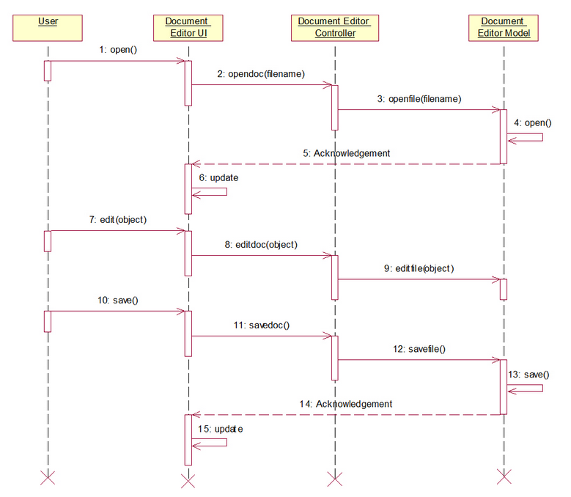
Log to sequence Diagram
Log file
Sequence Generator

Slide 12
Current Status
From the Fusion MW log able to draw the sequence diagram in an svg file.
Fix minor issues with lopping & mention the time spent in particular call
Integrating the svg file in a web page
providing filter for thread based or file based .
additional option of mentioning the line number or time based filtering
Future work

Slide 13
Estimate for completion
Activity | Remaining estimate
Fix minor issues with lopping & mention the time spent in particular call | 1 week
Integrating the svg file in a web page | 1 week
providing filter for thread based or file based . | 3 weeks
additional option of mentioning the line number or time based filtering | 1 week

