Slide 1
Git
Training session @ IBM | 2018
Presented By – Avik Deb
Delivered Through - Proximo Tech Soft (P) Ltd. - http://www.proximo.in/

Slide 2
Topics
Introduction – SCM Fundamentals
Centralized Version Control vs. De-centralized Version Control
Git overview – Internal data structure, Git Architecture
Working locally with Git
Working remotely with Git
Merging, Branching and Rebasing
Git Workflows
Useful Git commands
Collaboration and management with Git – Push and Pull
Code Review
GitHub vs Bitbucket vs GitLab
Best practices – Agile projects
Tracking changes, Searching History, Metric data with Git
Q & A
Feedback
Lab Session / Assignments

Slide 3

SCM Fundamentals
Version Control (aka Revision Control or Source Control) – Management of changes to documents, codes, configurations or in wider sense, collection of information
Why Version Control in DevOps?
Needed by the DEV as golden source for development of the product
Needed by OPS (and QA) as version control for various automation and configuration changes such as:
Scripts (for automation)
Tools
Software Configuration
Previously – CVS, Subversion (SVN), Clear Case (IBM), Perforce, Borland Star Team > Centralized VCS
Now – Git (It’s commercial variants – GitHub, Bitbucket, Git Lab), Mercurial (Hg)
What is Git?
It is a free open-source distributed version control system designed to handle everything from small (a personal blog site or web site) to very large projects (e.g. Linux Kernel development) with equal speed and efficiency
Credit for creation of Git goes to Linus Torvalds – He developed the Linux operating system as well and that was the driver for development of Git
Read - https://git-scm.com/book/en/v2/Getting-Started-A-Short-History-of-Git
Why Git was created?
Read what the creator has to say here:
https://www.linuxfoundation.org/blog/2015/04/10-years-of-git-an-interview-with-git-creator-linus-torvalds/

Slide 4
Advantage Git
Main problem with Centralized Version Control – single point of failure, performance issues for complex and very large distributed project environment
Advantages of Git
Free and open source – Released under GPL open source license
Fast and small – Efficient data compression, most of the operations are local > speed
Implicit backup – Multiple copy of the repositories, any recent one can be used for restore
Security – SHA1 crypto used to name and identify objects in database, impossible to break
Low cost, High yield – No need for high-end server yet operations are fast > High efficiency
Efficient branching model – Creation, deletion and merging is fast due to the way Git stores and manage changes

Slide 5
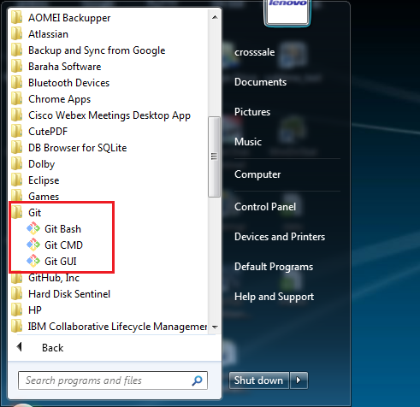
Git Installation
Installation – This means the Local installation. The server or central one usually a hosted solution that you subscribe.
Common providers are – GitHub from GitHub Inc. (now Microsoft), Bitbucket from Atlassian, RTC from IBM, Git Lab etc
In Linux:
For Debian distribution (e.g. Ubuntu): sudo apt-get install git
For Red Hat distribution (e.g. RHEL, CentOS, Fedora): sudo yum install git
In Windows: Run the installer msi > This installs a CLI and GUI
Once installed – check with command: git --version
Installation of Git is very simple – keep default parameters and proceed
IDE integration – All modern IDEs have in-build Git client

Slide 6
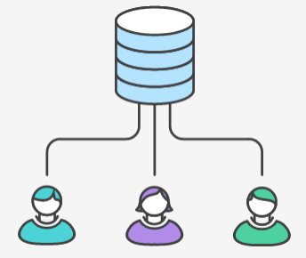
Git Fundamentals
Git is a distributed version control system
It has a central repository (which is remote and shared) hosted by some service provider such as GitHub or Bitbucket or can even be in-house
Developers have a full local copy of the repository – They clone this central repository (git clone)
A repository is a logical space where we have all the objects (read files) that needs to be versioned. It has to be initialized by some command (git init)
Of course, repositories have specific permissions – not all are allowed to do everything there! There are private and public repositories in GitHub
TO DO: Sign-up for your GitHub account today, if not created one so far at github.com

Slide 7
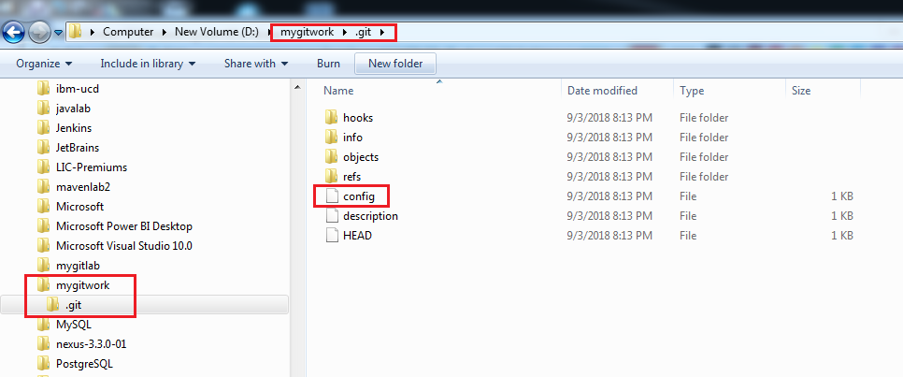
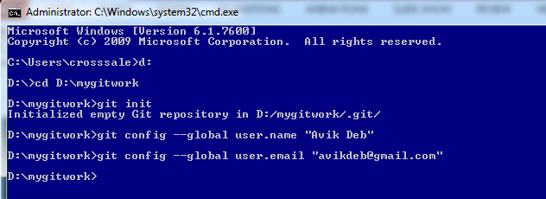
Git Configuration
Once Git in initialized into any blank folder with git init command – It creates it’s own structure there and make the folder a fully qualified Git repository - .git folder gets created inside
The Git configuration settings specific to the repository are done in config file present within .git
The Git configuration setting for the system (or global) is done in user_home/.git location for Windows and /etc/gitconfig file for Linux
These settings can be done with command: git config:
For global: git config –global user.name “Avik Deb”
git config –global user.email “avikdeb@gmail.com”
For local: git config <property name> “<property value>”

Slide 8
Making Changes – Local
Add your files in Git for versioning – Your files are staged now git add : we say we have created a staged snapshot
Local Changes - Commit:
Developer makes local changes – These changes are just recorded but not saved yet!
Commit the change to local repository to stage (read save) your changes – git commit
Remote Changes – Push and Pull:
To share the changes with your team > send your changes to remote repos – git push
Review Changes – git status
To view the state of the working directory – git status
To undo commit – git reset
The pattern followed is:
Edit – make change
Stage – git add
Commit – git commit

Slide 9
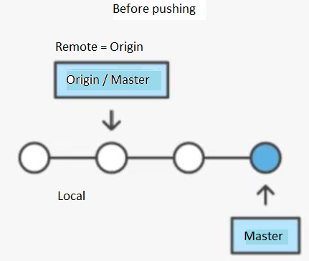
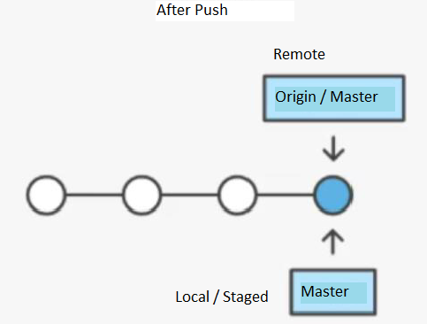
Making Changes - Remote
Local / Staging – git commit
Remote – git push

Slide 10
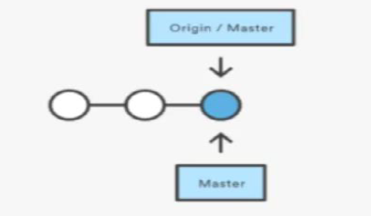
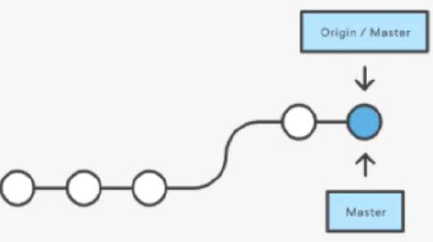
Retrieving Changes
Another developer can now retrieve the changes – git pull
This will fetch changes from the remote (central) repository and merge the remote changes with your local branch (in local repository, of course)

Slide 11
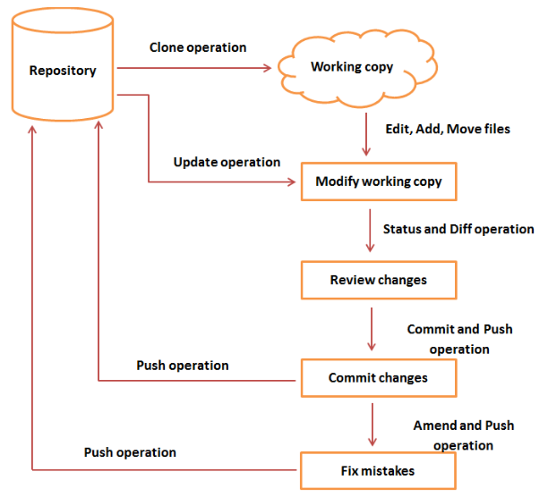
Git Life-cycle
Courtesy: www.tutorialspoint.com

Slide 12
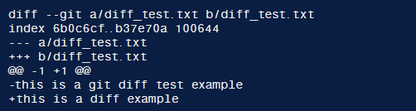
Seeing the Difference
To see the differences between changes – git diff
It is a powerful command that runs a diff function on Git data sources like commits, branches, files and more
git diff command is often used with git status and git log to analyze the current state of a repo
Added lines are annotated with + while removed lines are annotated with –
Git blame – Retrieves the last author who modified something in the file, while git log retrieves the full history of changes in that file. Command: git blame <filename>

Slide 13
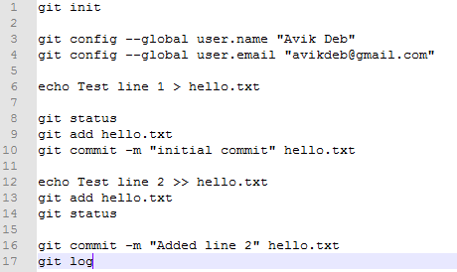
Quick Recap

Slide 14
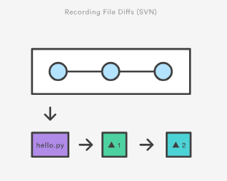
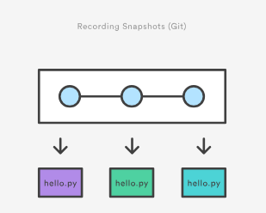
How git store the change
Snapshots and NOT the difference is stored by Git (This is the main difference with traditional version control tools like Subversion etc.)
This makes many Git operations faster than SVN
SVN Git

Slide 15
Stash – Saving Changes Temporarily
Developers can save their changes temporarily and come back later – git stash
It is a very handy way if you are working on multiple things and do not want to lose the context
stash literally means ‘save up as for future use’ – This git command exactly does so!
To re-apply your stashed changes –
git stash apply - apply changes to working copy but keeps the stash as well
git stash pop – apply changes to working copy and removes the changes from stash
Note that stash works only if your files are staged
To view the stash – git stash show
To clear all stash – git stash clear
To clear specific stash – git stash drop <stash name>

Slide 16
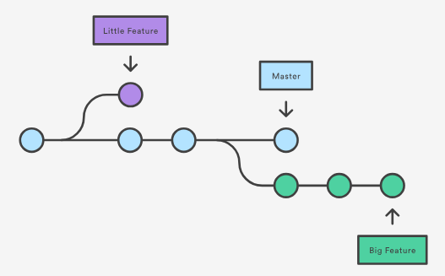
Branches
Developers can work on their own feature branches
Create branch – git branch <name of the branch to create>
Delete branch –
git branch –d <name of the branch to delete>
git branch –D <branch name> will force delete
To list the branches created – git branch (same as git branch –list
To rename current branch – git branch –m <new name>
To list all remote branches – git branch -a

Slide 17
Tags
Once we have released the code (means productionized) – we create a tag
No commit is permitted for tags – it is like a Frozen Branch
Use command – git tag <tag nme>
There are two types of tags:
Annotated – usually public git tag –a v1.4 This will open a new text editor pop-up to collect more metadata such as message, who changed, e-mail etc.
Lightweight – usually private git tag v1.4 -lw
To list the tags in a repository – git tag
To get a refined list of tags (such as all release candidates) – git tag –l *-rc-*
Sharing – Pushing tags to remote: git push origin <tag name>
Deletion of tags – git tag –d <tag name>

Slide 18
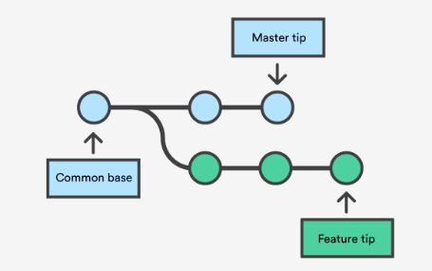
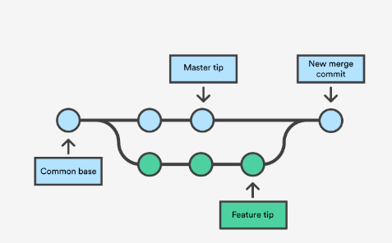
Merging
Merging is simple and fast in Git than any other Version Control Tool
After feature is finished the branch can be merged – git merge
git merge lets you to take the independent lines of development (feature branches – created by git branch) and integrate them into a single branch
git merge will combine multiple sequence of commits into one unified history
merge

Slide 19
Merge conflict
Git merge commit is special – Unlike normal commit, merge commit has two parent commits
When creating a merge commit, git will attempt to automatically (read magically) merge the separate histories for you
If git encounters a data that is changed in both histories, it will be unable to merge automatically – A situation called merge conflict. This needs to be resolved manually
Preparations for merging:
Confirm the receiving branch
Fetch latest remote commits
Fast Forward Merge – It is a linear merging. Meaning, to integrate the histories git just move the current branch tip to the target branch tip
However, Fast Forward merge is not possible if the branches have diverged – Need a 3-way merge

Slide 20
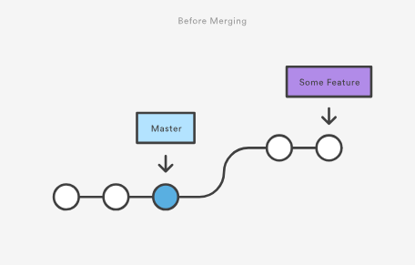
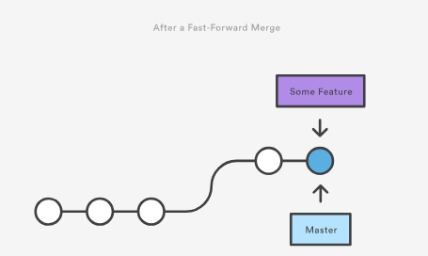
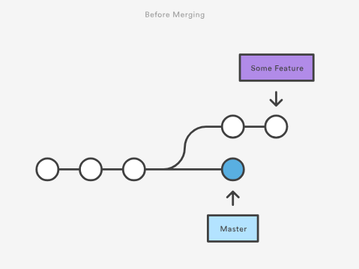
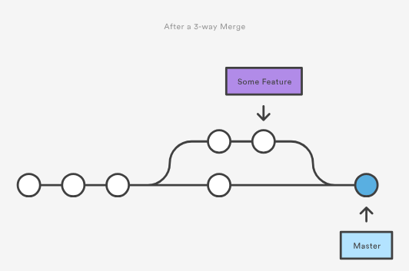
Merge diagrams

Slide 21
Working with Remote – Collaborations 1
git remote – This command lets you create, view and delete connections to other repositories
Multiple repo can serve the purpose of remote – meaning, your repo may have a remote connection to the central repo (origin) and my repo (trainingport). This is how git collaborates
To create, view and delete the remote connections
git remote – lists all the remote repositories
git remote add <name> <url> – creates a new connection to the remote repository. The information is written in /.git/config file (where you have initialized the repo with git init) *
e.g. git remote add trainingport https://github.com/trainingport/incidentmanagement
git remote rm <name> - will delete the connection to remote repo
git remote rename <old name> <new name> - lets you to rename the connection
To see the remote configuration - git remote show <repo name>
* NOTE: Although git will allow to connect remote repo with http but for push / pull and other security concerns use SSH. So you need to have an SSH account created on the remote machine. Otherwise, keep using HTTPS – This is secure.

Slide 22
Working with Remote – Collaborations 2
git push – Use to write to remote repo > it publish your changes that are committed in local at that point
git fetch – This is similar to svn update. It downloads all commits, files and refs from remote to local. This is used when you want to see what everyone else is doing
Note – git fetch will not force you to merge the changes into your repo (local). To do merge we have to explicitly checkout.
This means fetch is a good way to review others changes prior accepting them or merging them to yours. It is a safe mode sort of thing ☺
git pull – This is an aggressive fetch. Means, it will download and then immediately merge those changes into yours.
pull = fetch + merge
git checkout – In git, ‘checkout’ is the act of switching between different versions of a target entity. Checkout operates on – files, commits and branches
Checking out a branch updates the files in the working directory to match the version stored in that branch and it tells Git to record all commits made on that branch –
Very useful when we are working on different features in different feature branches
Difference between clone and checkout:
Clone – works to fetch code from remote repository
Checkout – works to switch between versions of code already on the local system

Slide 23
Workflow
Git Workflow – Is a recipe or recommendation for how to use Git to accomplish work in a consistent and productive manner
When working with a team on a Git managed project, it is important to make sure the team is all in agreement on how the flow of changes will be applied – This calls for a Workflow to be in place
Some standardized popular workflows are:
Centralized Workflow – lists all the remote repositories
Feature Branch Workflow – creates a new connection to the remote repository. The information is written in /.git/config file (where you have initialized the repo with git init) *
e.g. git remote add trainingport https://github.com/trainingport/incidentmanagement
Gitflow Workflow - will delete the connection to remote repo
Forking Workflow - lets you to rename the connection
Remember that the above standardized workflows are designed to be guidelines rather than concrete rules – you can mix and match different aspects from them to fit your needs
A very good discussion on Workflows can be read in Atlassian site - https://www.atlassian.com/git/tutorials/comparing-workflows

Slide 24
General Guidelines
Pre-amble - Though there is no silver bullet that works for all – we still can have some general guidelines in place. In reality, there would be more based on the project concerned.
Select or develop a Git Workflow – This is an agreement on how code flows.
Short lived branches – The longer a branch lives separate from the production branch, the higher the risk for merge conflicts and deployment challenges. Short-lived branches promote cleaner merges and deploys.
Minimize and simplify reverts – It’s important to have a workflow that helps proactively prevent merges that will have to be reverted. A workflow that tests a branch before allowing it to be merged into the master branch is an example.
Match a release schedule – A workflow should complement your business’s software development release cycle. If you plan to release multiple times a day, you will want to keep your master branch stable. If your release schedule is less frequent, you may want to consider using Git tags to tag a branch to a version.
Provide a basic user training – This will help all using a common language with terms know to everyone. Team will not be confused using words like ‘clone’ and ‘checkout’, ‘pull’ and ‘fetch’ etc. ☺

Slide 25
Lab Session - To Practice git operations use the workbook: D01-GitWorkbook.docx

Slide 26
Thank You Email: avikdeb@gmail.com | Mobile: 9654298188 Whatsapp Group: Ingenium

