Slide 1
Jenkins
Training session at IBM
Presented By – Avik Deb

Slide 2
Topics
Fundamentals of Continuous Integration
What is Jenkins
How it works
Installation
Managing Jenkins
Create Nodes
Create Projects and Jobs
Running Jobs – working with SCM (Git)
Creating a Pipeline
Build Radiators
Automation through Jenkins
Doing more with Jenkins – Deployment Management
Working with other tools – Extending Jenkins
Q & A
Feedback
Lab Session

Slide 3
Continuous Integration
Continuous Integration – Your changes are getting integrated and quality checked continuously.
This is actually a build model – code in development branch / QA branch are build instantaneously and QA gates applied
Once passed, they may be deployed at higher environment for full feature testing along with regression (say UAT) This calls for a Continuous Testing cycle (Test Automation)
It is important to define your Path to Production
Build once, deploy at multiple locations This calls for a Continuous Deployment cycle (Deployment Automation)

Slide 4
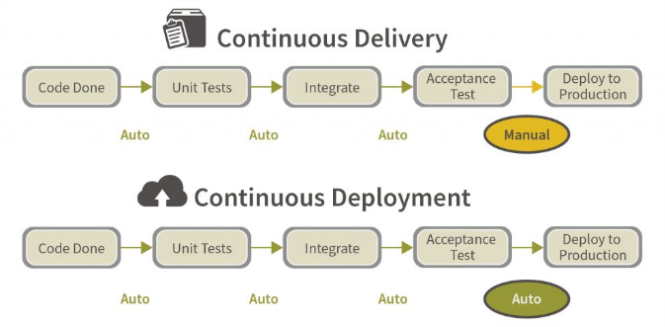
Path to Production
A good article - https://softcrylic.com/blogs/testing-strategies-continuous-delivery

Slide 5
Benefits and Challenges
Benefits:
Defects caught early – Thereby improving the quality of delivery
Helps development team managing their time more efficiently
Developer can do the deployments – Lean project team
Ideal for Agile projects
Better governance with tools / automation
Challenges:
Success depends on proper implementation of tools and automation – if done poorly, will become overhead
Train teams on using the tools and new way of work
Organization culture

Slide 6
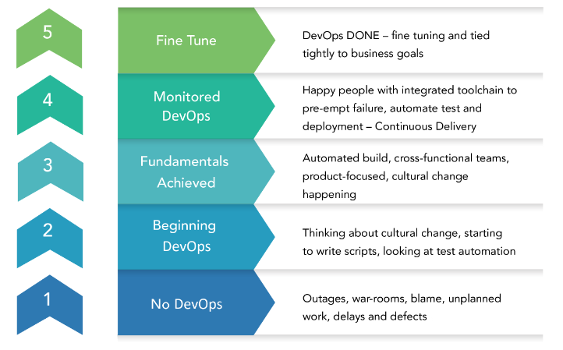
DevOps Maturity Level
Read - https://www.opcito.com/from-the-ceos-desk-devops-maturity-assessment-a-navigator-on-your-devops-journey/

Slide 7
Jenkins
Jenkins is an open source CI server – Tool used to achieve CI
Jenkins is maintained by Oracle – Continuously evolving and upgrading with latest features as per industry needs
Works in Client-server mode (in Jenkins vocabulary Master-slave mode)
Need a JRE – if not set, it will use its default one. It is a java based application
Web application – so console is available on browser
Access control implemented – Native or LDAP based
Dashboard shows the Jobs, where they run and the status with history
Plug-ins are used to enhance features and capabilities

Slide 8
Advantages and Disadvantages
Advantages:
Easy to set-up and maintain
Secured and access control enabled (LDAP or Native)
Thousands of plug-ins are available for enhancement – almost any type of environment fits in
Support from biggest user forum
Easy to learn and use – no special skill required
Web application – can be managed and used over browser
Ideal for both agile and enterprise teams
Easy integration with other tools through plug-ins
Can run on cloud infrastructure as well as on data-center seamlessly
Can manage all types of automation jobs with much lesser cost or zero cost
Disadvantages:
Not easy to use on legacy systems – mainframe, Iseries etc.
Has scalability issue if number of nodes crosses a threshold ( approx. more than 40). Makes it difficult to manage very large infrastructure
Do not have a dedicated support system – mostly you have to work on your own searching forums
Using too many plug-ins may impact the performance
Complex build plan execution is not easy – sometimes performance issues come in running parallel jobs

Slide 9
How it works
JDK is required in both master and slave for job execution – JAVA_HOME needs to be set prior installation for both master and slave
Jenkins operates in Master-slave model
Job run is defined and orchestrated in Master
Selective jobs run on selected slaves – slaves are actual execution environments
Jenkins master communicates with slave nodes over SSH
All required plug-ins are managed by master only
Master, by default can execute jobs – This may be considered as default slave
Jenkins-CLI can be used to get various information from Jenkins master
Jenkins has a REST API as well – can be used for automation / integration
Execution of jobs are done through the web browser – no client installation is required
Projects / Jobs can run in sequence or parallel based on how they are chained in a pipeline > Delivery Pipeline plug-in is a widely used plug-in for creating pipeline builds
Jenkins works for all – Java, Non-java and even Test Automation

Slide 10
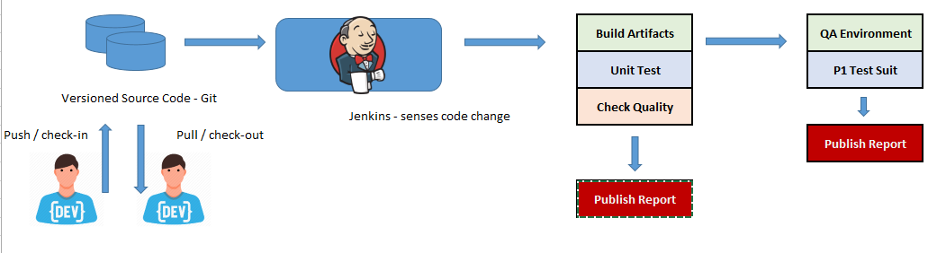
Working with Jenkins
Below is a typical workflow in Jenkins – as used in implementing the CICD pipeline with Unit Tests, Quality checks etc.
Use web-hook is GitHub for auto-sense or Trigger build like a cron job in Jenkins

Slide 11
Installing Jenkins live demo
Installation modes:
Download the msi or rpm and just install it on your server [most common]
Download the war and deploy on your J2EE container – typically apache tomcat
Download and run Jenkins docker [good for automation / on demand environment creation etc.]
Download the src and build / make as per your system – JDK required [rare]
Few important things:
Need to have JDK installed beforehand and JAVA_HOME environment variable set accordingly
Create an admin user during very first installation > Then save and continue. Do not logout without creating and saving an admin user
Install the suggested plug-ins during installation – later all other plug-ins can be added from Plugin Manager
Install Jenkins as Service

Slide 12
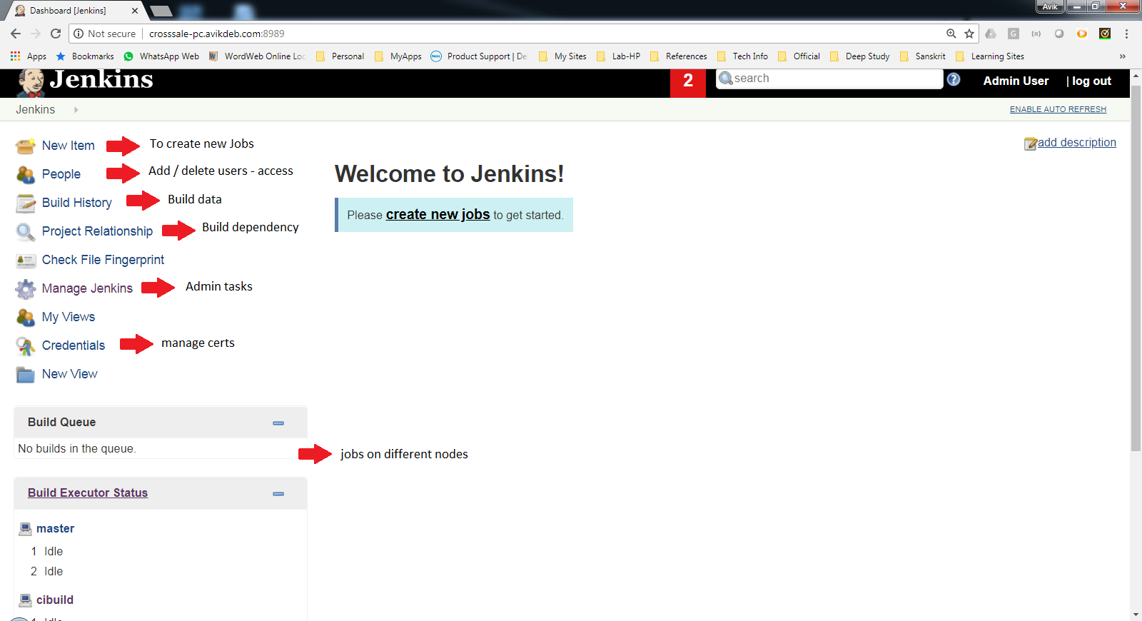
Reading the dashboard live demo

Slide 13
Managing Jenkins – Important Sections live demo
Configure System – For global properties available across all nodes
Check the Global properties – Git and JDK, Maven if you are doing a maven build
Global Security – For access control
Finer control – Use the matrix and configure as per need or use LDAP to work with organization AD
Global Tool Configuration – For access control
Check for Git, JDK, Maven or any other tool and define the variables and values such as JAVA_HOME
Manage Plugins – For installing / updating various plug-ins
Needs Jenkins restart after installation (not server restart – just bounce Jenkins)
Script Console – Need Groovy script to run scripts in Jenkins master (admin works – rare use)
Jenkins CLI – To get info / running few things from CLI and not web UI (limited application)
Manage Nodes – For adding / removing / configuring nodes (slaves)
Manage Users – To mange the user credentials

Slide 14
Managing Nodes – Important Sections live demo
Used to create Nodes – Nodes must have JDK installed and JAVA_HOME defined
Labels – For getting the job associated with the slave – This will be needed while creating Job
Launch Method – How master communicates with slave : SSH is the standard
Provide username / password or use SSH Keys
Node Properties – To define environment variables etc.
Check Environment Variables and Tools section
Node should come online shortly after it is created – They can then be searched and assigned with Jobs
If too many nodes, Jenkins may experience a performance drop – use the nodes judiciously

Slide 15
Jobs – Important Sections live demo
General – Specify node where to run the job
SCM – Git connection parameters
Launch Method – How master communicates with slave : SSH is the standard
Provide username / password or use SSH Keys
Build Trigger – For scheduling and / or defining parent job in case we are creating a pipeline
Build – Select the type of task to perform during execution
Post-Build – Standard post build activities such as applying Quality Gate
Job status can be monitored in the dashboard
Job run history or Analytics can also be seen from the dashboard
Jobs are the automation units

Slide 16
Jobs – Important Sections live demo
General – Specify node where to run the job
SCM – Git connection parameters
Launch Method – How master communicates with slave : SSH is the standard
Provide username / password or use SSH Keys
Build Trigger – For scheduling and / or defining parent job in case we are creating a pipeline
Build – Select the type of task to perform during execution
Post-Build – Standard post build activities such as applying Quality Gate
Job status can be monitored in the dashboard
Job run history or Analytics can also be seen from the dashboard
Jobs can run in sequence or in parallel and in different nodes

Slide 17
Pipeline live demo
Install Delivery Pipeline plug-in
Define the sequence of jobs first
Create the required jobs in Jenkins and select the node where they will run
In Build Trigger section define the parent job (or post which the selected job will run)
Now in Dashboard create a View
Define the parameters in View Creation screen – Select the Enable Execution option there
Define the Initial Job that will trigger the jobs in chain you already have defined
See the view now available in Dashboard
Trigger the pipeline – Execution starts
Another similar plugin – Build Pipeline plugin > This one shows the build statuses in the pipeline more explicitly and with history. This is also created same way as we have created Delivery Pipeline

Slide 18
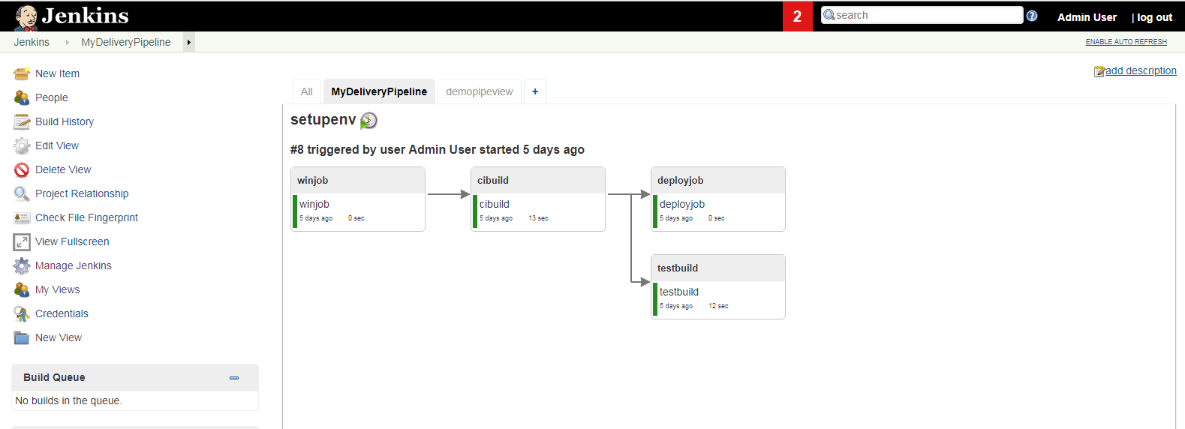
Delivery Pipeline View live demo

Slide 19
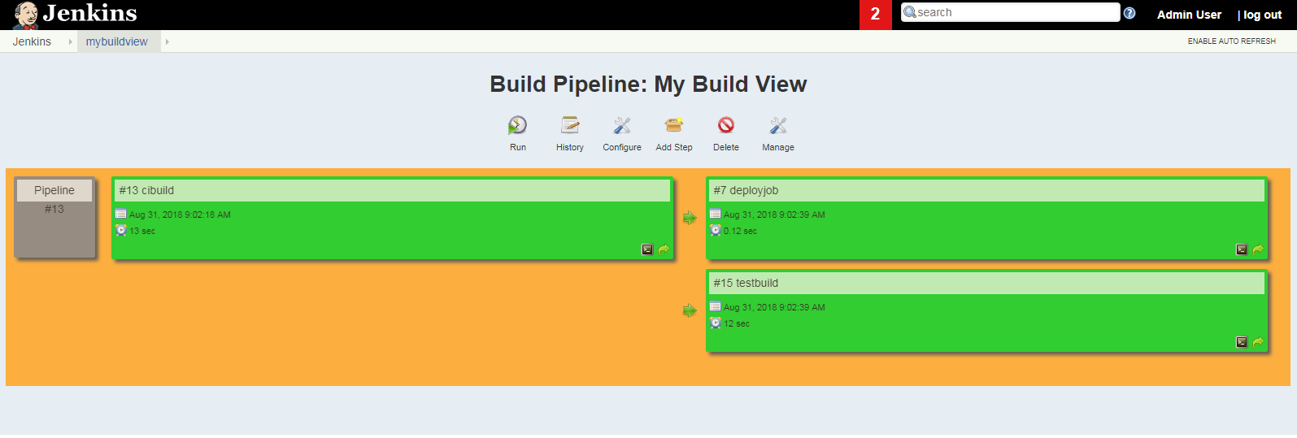
Build Pipeline View live demo

Slide 20
Some Relevant QA
Can I use Jenkins in Non-java projects?
Yes – Jenkins can handle them too. Select the plug-in you require.
Can I use Jenkins on nodes in cloud?
Yes – so long the nodes on cloud are reachable, Jenkins can connect them over SSH
How many Jenkins slave can connect to a master?
As people are saying – 53 slaves can connect seamlessly to a Jenkins master. You can explore more in the link below:
https://www.quora.com/How-many-Jenkins-slaves-do-you-have
Another good technote on Distributed builds in Jenkins - https://wiki.jenkins.io/display/JENKINS/Distributed+builds
Can Jenkins be used to automate in Mainframe or ISeries machines?
Yes they can as ISeries / Mainframe does have Java and accept SSH connections. However, need some special care to implement.
Can I use Jenkins as a Continuous Deployment Tool?
Yes – use deployment plugin or get a plug-in of your choice
A good technote on large scale deployments using Jenkins - https://wiki.jenkins.io/display/JENKINS/Consideration+for+Large+Scale+Jenkins+Deployment
Can I schedule my Test Automation jobs with Jenkins?
Yes, you can use a CLI of the Automation suit or use the relevant plug-in as for most of the commonly used automation suits Jenkins have a plug-in

Slide 21
Thank You Email: avikdeb@gmail.com | Mobile: 9654298188 Whatsapp Group: Ingenium

