Slide 1
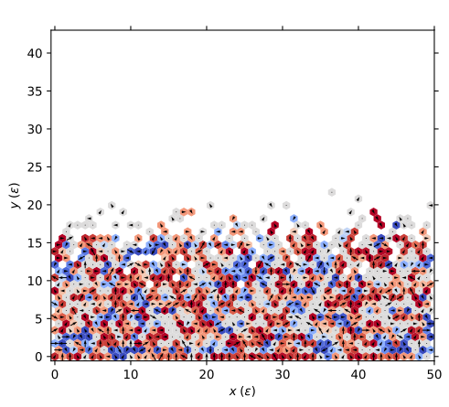
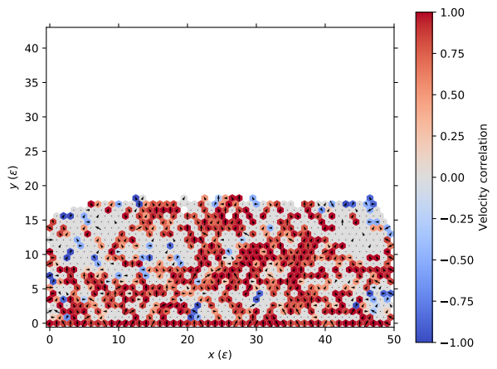
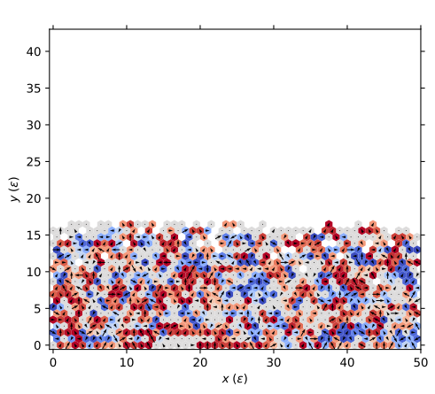
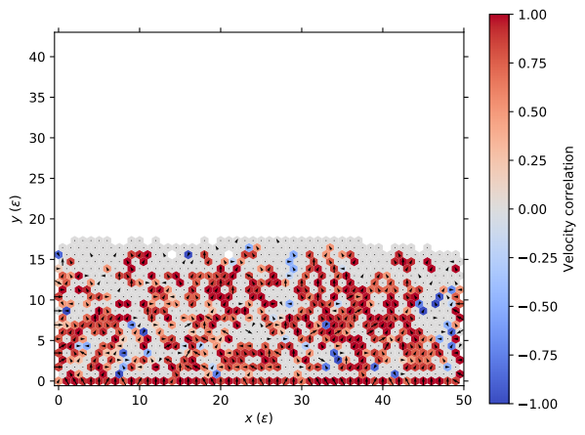
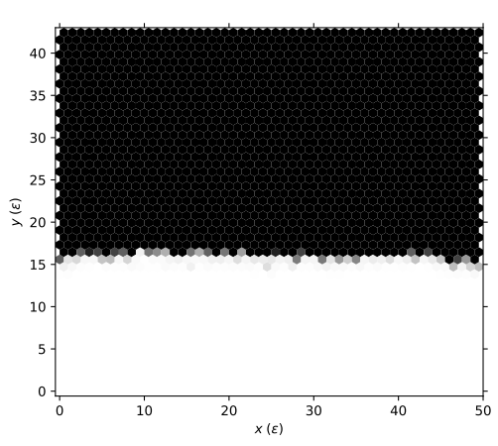
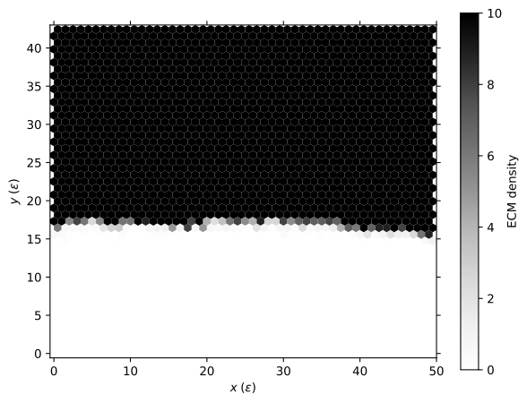
Cell-cell adhesion = 0
Cell-cell adhesion = 10
Ecm density = 0
Ecm density = 10
ECM density | Cell-cell adhesion | Next-neighbor velocity correlation | Speed | # Single cells
0 | 0 | 0.19 | 0.67 | 98
0 | 10 | 0.59 | 0.25 | 0
10 | 0 | 0.22 | 0.64 | 0
10 | 10 | 0.64 | 0.23 | 0

