Slide 1
Generative Adversarial Networks (GAN) to generate fake MNIST digit images
Done By: Harish Prasath V G
715521104013

Slide 2
OUTLINE
Problem Statement
System Development Approach
Algorithm & Deployment
Result
Conclusion
References

Slide 3
Problem Statement
The project aims to develop a Generative Adversarial Network (GAN) capable of generating realistic handwritten digits resembling those from the MNIST dataset. The MNIST dataset consists of 28x28 grayscale images of handwritten digits (0-9), and the objective is to create a GAN that can produce synthetic images resembling these digits.

Slide 4
System Approach
System Requirements:
1. Hardware:
CPU: A multi-core CPU is sufficient for running the training code. However, training GANs can be computationally intensive, so a faster CPU may reduce training time.
Memory (RAM): At least 8GB of RAM is recommended for handling large datasets and training deep neural networks efficiently. Higher RAM capacity may be beneficial for larger batch sizes and complex model architectures.
Internet Connection: An internet connection is needed to download the MNIST dataset and access online resources/documentation during development.

Slide 5
System Approach – cont.
Software Requirements:
Python: The project is implemented using Python programming language.
TensorFlow/Keras: TensorFlow and its high-level API, Keras, are used for building and training the GAN architecture.
Google Colab: These platforms can be used for interactive development, experimentation, and documentation.
NumPy: NumPy is used for numerical computations and array manipulation.
Matplotlib: Matplotlib is used for data visualization, including plotting loss curves and displaying generated images.
.

Slide 6
Proposed solution
The Generative Adversarial Networks (GAN) are a special neural network where two networks compete to maximize their gain (i.e., minimize their losses in machine-learning lingo). GAN's objective is to generate the _synthetic_ or _fake_ data based on the training data it learns from, hence a `Generative` network. Since two networks are _fighting_ with each other, the network is called `Adversarial.` A simple GAN is composed of a dataset (MNIST in our case) and two neural networks. A `Generator` network takes a random `noise` vector and learns to transform this noise such that its probability distribution eventually comes very close to the data it's learning from. A `Discriminator` network is a neural network-based classifier. Both `Generator` and `Discriminator` train in parallel. `Discriminator` gets to see images from actual MNIST dataset as well _fake_ pictures generated by the `Generator,` and its job is to correctly classify _real_ images vs. _fake_ images. At the same time, based on how `Discriminator` is performing in real vs. fake classification, `Generator` keeps improving its generated images to make them look like the images taken from the real dataset. Basically, `Generator` tries to fool the `Discriminator` and `Discriminator` tries not to get fooled.

Slide 7
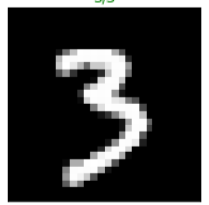
Objective
Our goal in this project is to build a GAN and train it over the MNIST dataset so that the network learns to generate _fake_ MNIST digit images that would have come from the real MNIST dataset.
Dataset
- Dataset consists of 60,000 training images and 10,000 testing images. For this task, we'll use the training dataset.
Every image in the dataset will belong to one of the ten classes (digit 0 to 9); however, the image labels do not matter for this task, and we won't use them.
- Each image in the dataset is a 28x28 pixel grayscale image, a zoomed-in single image shown below...

Slide 8
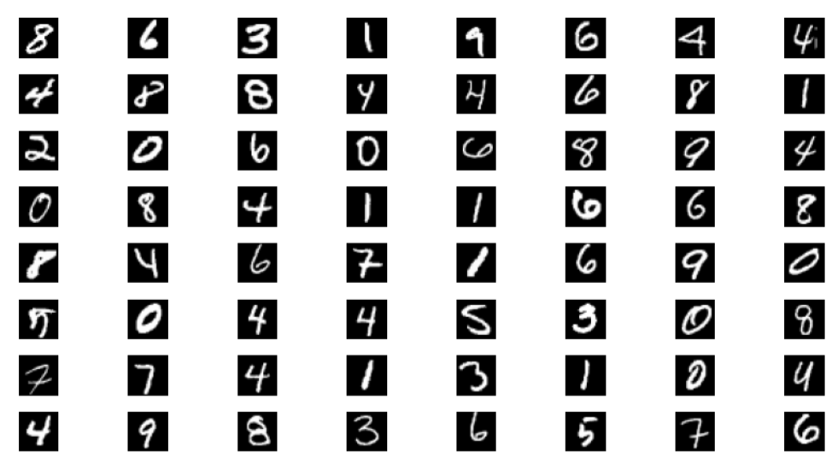

Slide 9
Solution approach
Data Load
- Data is downloaded using the `torchvision` dataset.
- The training dataset is then wrapped in a dataloader object with a `batch_size` of 64. We discard the testing dataset. Note that even though the dataloader will give us the images associated, we'll simply ignore them.
Network Definition
- First, we define the `Discriminator` network
- Its a typical binary classifier where it'd accept 784 (28x28) inputs and produces a single `logit` output that's used to classify the input image as _real_ (1) or _fake_ (0)

Slide 10
Solution approach
- Network has four fully-connected `Linear` layers with `LeakyReLU` activation having a `negative-slope` of 0.2. Furthermore, a `dropout` of 30% is applied after each linear layer except the last one. The activation function and negative slope value are based on the GAN paper recommendation.
- The `forward` method of the Discriminator flattens the input it receives to make it a tensor of shape (batch_size, 784); this is then passed through the network.
- Then, we define the `Generator` network - Generator will consume a `noise` vector (z of length 100) and up-sample it by passing it through various layers of the network.
- Network has four fully-connected `Linear` layers with `LeakyReLU` activation having a `negative-slope` of 0.2. A `dropout` of 30% is applied after each linear layer except the last one
The final linear layer output is then passed through the `tanh` function to produce the final output of the Generator between -1 and 1. This is again as per the original GAN paper.

Slide 11
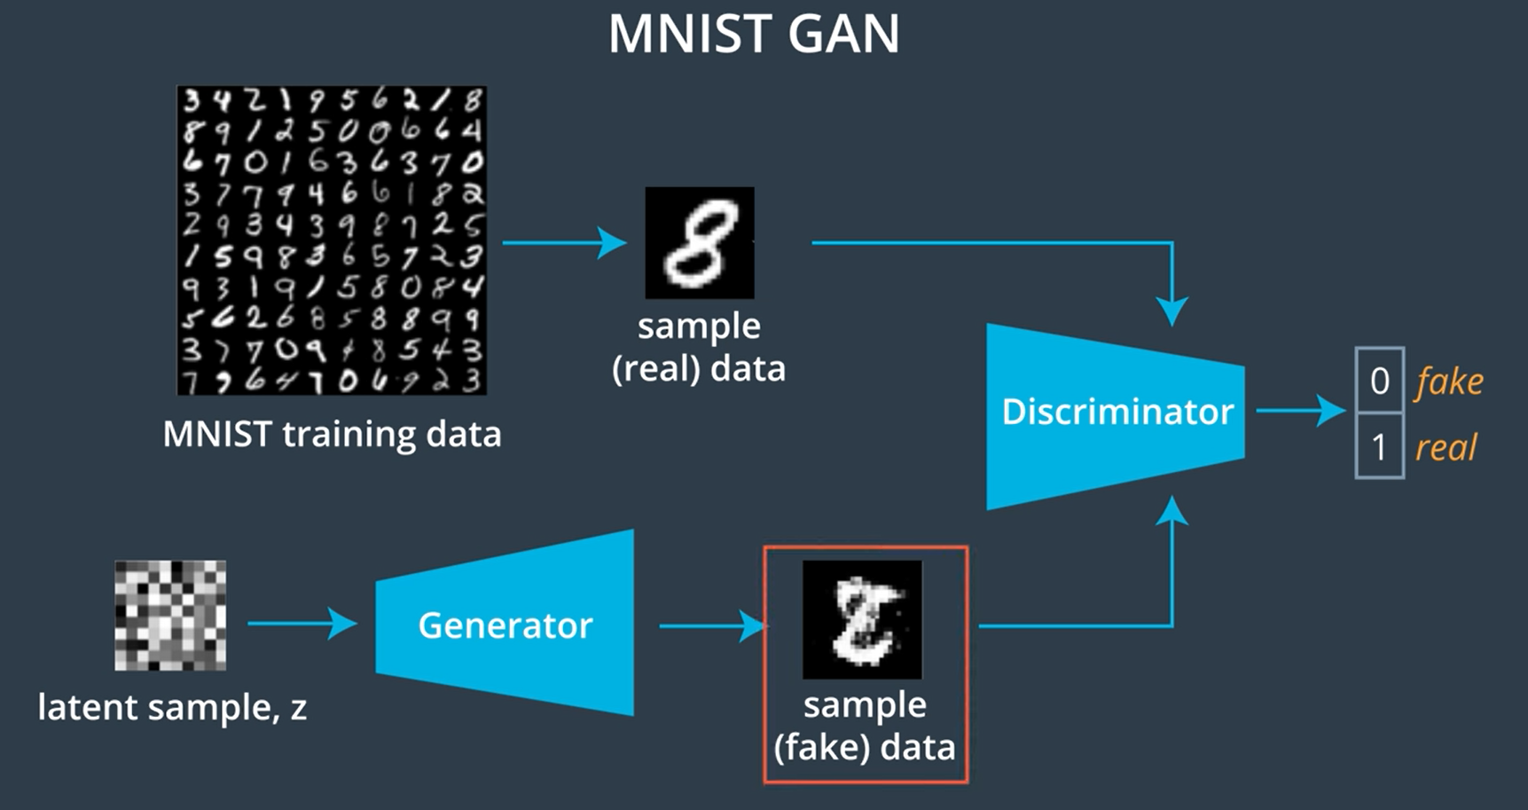

Slide 12
Loss definition
GAN training is a bit different compared to our typical supervised neural-network training. In the case of GAN, two separate networks are being trained together, and this network has different and opposing objectives (i.e., they are competing). The Discriminator is trying to identify if the image sample is real and from the actual MNIST dataset or its fake images generated by our Generator. Note that we are NOT interested incorrectly classifying the digits themselves. We'd need to define two separate loss functions.
real_loss: calculates loss when images are drawn from the actual dataset. The predicted output is compared against the target label 1, indicating real images.
fake_loss: calculates loss when images are generated by the Generator. The predicted output is compared against the target label 0, indicating fake images.
Discriminator computes both of the above losses and adds them together to get a total-loss for back-propagation Generator computes the real_loss to check its success in fooling the Discriminator. In other words, even though it generates fake images (target 0), by computing real_loss, it compares Discriminator's output with 1. In effect, generator loss has its labels flipped.

Slide 13
Network training
Since we are training two separate networks, we need two separate optimizers for each network. In both cases, we use Adam optimizer with a learning-rate of 0.002.
Since classification is between two classes (real and fake) and our Discriminator outputs a logit, we use BCEWithLogitsLoss as the loss function. This function internally first applies a sigmoid activation to logits and then calculates the loss using the BCELoss (log loss) function. Before starting training, we create a (16 x 100) fixed-random-noise-vector drawn from a normal distribution between range -1 and 1. This vector is kept fixed throughout the training. After each epoch of training, we feed the noise vector to, so far, trained Generator to generate fake images; these images help us visualize how and if generated image quality is improving or not. A sample of the noise vector is shown below..

Slide 14
descriminator
- `Discriminator` is trained as follows...
- A batch of `real` MNIST images are drawn from the dataloader
- Each image in the batch is then `scaled` to values between `-1 and 1`. This is a crucial step and required because Discriminator looks at _real_ images from MNIST dataset and looks at _fake_ images from Generator whose output is in range `-1 to 1` (last layer output Generator network is `tanh` activated). So we need to ensure that the range of input values is consistent in both cases.
- data batch is then fed to Discriminator, its predicted output is captured, and `real_loss` is calculated
- A batch noise data (`z`) drawn from a `normal distribution` between range `-1 and 1` is created
- Noise `z` is then fed through the Generator, its outputs (fake images) are captured, and `fake_loss` is calculated
- Then discriminator's `total_loss` is computed as `real_loss + fake_loss`
- Finally, `total_loss` is back-propagated using Discriminator's optimizer

Slide 15
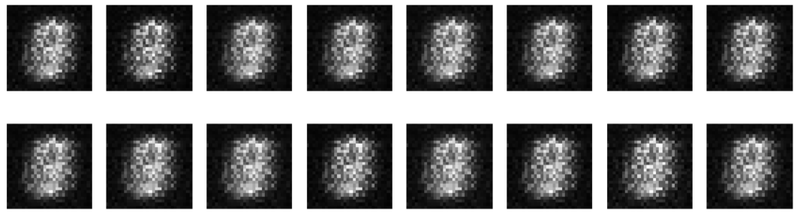
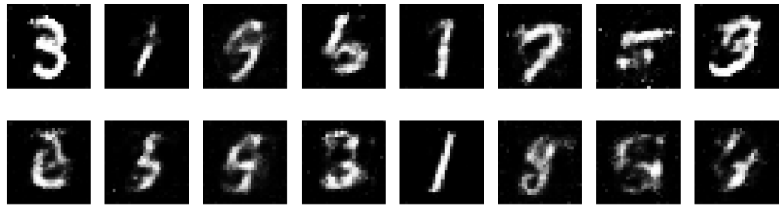
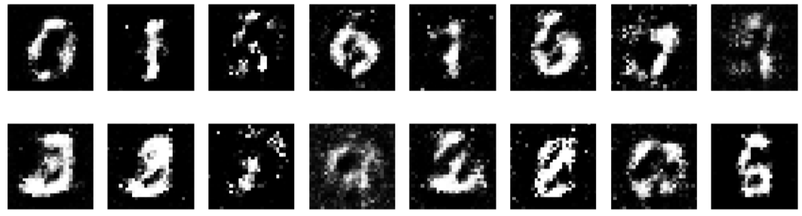
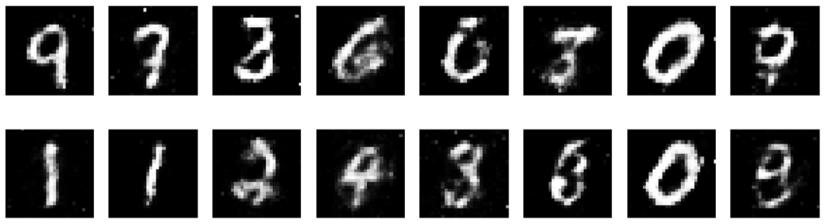
Visualize Training process

Slide 16
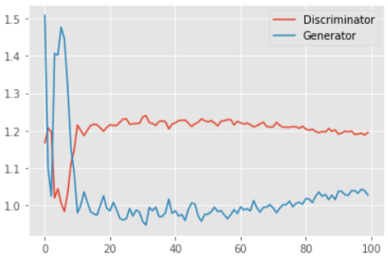
Result

Slide 17
Conclusion
The project demonstrates the effectiveness of GANs in generating realistic handwritten digit images and provides insights into the challenges and opportunities in training and deploying generative models. Moving forward, further research and experimentation will continue to push the boundaries of generative modeling and its practical applications.

Slide 18
References
https://www.tensorflow.org/
https://keras.io/
https://numpy.org/
https://matplotlib.org/
scikit-learn: machine learning in Python — scikit-learn 1.4.1 documentation
MNIST handwritten digit database, Yann LeCun, Corinna Cortes and Chris Burges

Slide 19
THANK YOU

