Slide 1
Harish Raaghav 711721243034
Final Project
3/21/2024 Annual Review

Slide 2
PROJECT TITLE GANpaint: Image Inpainting with Generative Adversarial Networks
3/21/2024 Annual Review

Slide 3


AGENDA 1. Problem Statement 2. Data Collection and Preprocessing 3. GAN Model Architecture 4. Training the GAN Model 5. Image Inpainting Process 6. Evaluation Metrics 7. Results and Discussion 8. Future Work
3/21/2024 Annual Review

Slide 4

PROBLEM STATEMENT Design and implement an image inpainting system leveraging Generative Adversarial Networks (GANs) to automatically fill in missing or damaged parts of images. The system should effectively restore old or damaged photographs by generating realistic and coherent content in the missing regions, preserving the overall visual integrity and quality of the images.
3/21/2024 Annual Review

Slide 5
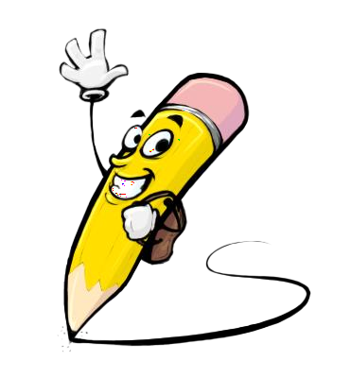
PROJECT OVERVIEW This project focuses on creating an image inpainting system named "GANpaint" using Generative Adversarial Networks (GANs). GANpaint aims to automatically restore missing or damaged parts of images, especially in old or damaged photographs. Through GANs, the system generates realistic content to fill in the gaps, enhancing image quality. The project involves data preprocessing, GAN model development and training, inpainting implementation, evaluation, and discussion of results and future improvements. GANpaint contributes to image restoration tasks across diverse applications.
3/21/2024 Annual Review

Slide 6

The potential end users of the "GANpaint" image inpainting system are: 1. Photographers 2. Archivists and Historians 3. Artists and Designers 4. Forensic Analysts 5. Graphic Designers 6. General Public
3/21/2024 Annual Review

Slide 7

Solution and Value Proposition: "GANpaint" is an advanced image inpainting system powered by Generative Adversarial Networks (GANs). It automates the restoration of missing or damaged image parts, offering efficient, high-quality results. Its versatility caters to various domains such as historical restoration, design, forensics, and personal photo enhancement. With its user-friendly interface and cutting-edge technology, GANpaint delivers innovative solutions, saving time and ensuring superior image quality.
3/21/2024 Annual Review

Slide 8

THE WOW IN YOUR SOLUTION 1. Realism: GANpaint produces incredibly realistic results, seamlessly filling in missing parts of images in a way that often appears indistinguishable from the original. 2. Speed: The speed at which GANpaint can restore images is impressive, offering quick turnaround times for users who need fast results. 3. Ease of Use: Its intuitive interface makes it accessible to users of all skill levels, allowing them to achieve professional-quality results with minimal effort. 4. Versatility: GANpaint's ability to handle a wide range of image inpainting tasks, from restoring old photographs to removing unwanted objects, makes it a versatile tool for various applications. 5. Innovation: Leveraging state-of-the-art GAN technology showcases the cutting-edge innovation behind GANpaint, setting it apart from traditional image editing tools.
3/21/2024 Annual Review
8

Slide 9
MODELLING
1. Generator Network: Designing the generator network responsible for generating realistic content to fill in the missing regions of images. The generator should be capable of producing high-quality inpainted images that seamlessly blend with the original content.
2. Discriminator Network: Developing the discriminator network to distinguish between real and inpainted images. The discriminator plays a crucial role in guiding the generator to produce more realistic results by providing feedback on the quality of the generated images.
3. Loss Functions: Defining appropriate loss functions to train the GAN effectively. Common loss functions used in GAN training include adversarial loss, which encourages the generator to produce realistic images, and reconstruction loss, which ensures that the inpainted images accurately match the missing regions of the original images.
4. Training Procedure: Implementing the training procedure to optimize the parameters of the generator and discriminator networks. This involves iteratively updating the networks using techniques such as mini-batch stochastic gradient descent and backpropagation.
5. Hyperparameter Tuning: Fine-tuning the hyperparameters of the GAN model to achieve optimal performance. This includes adjusting parameters such as learning rates, batch sizes, and network architectures to improve the quality of the inpainted images and the stability of the training process.
3/21/2024 Annual Review
9

Slide 10
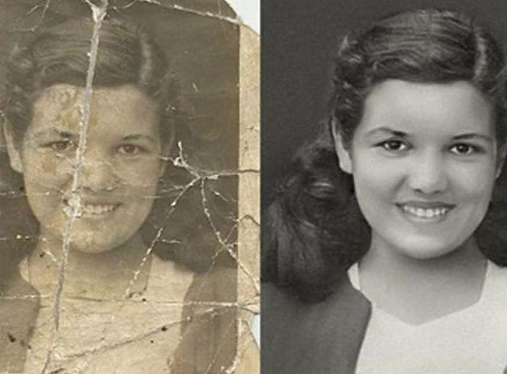
RESULTS
3/21/2024 Annual Review
10

