Slide 1

Stock Anomaly Monitor
- An Interactive Dashboard for Stock Analysis
Harish R 25BCE1060
Subrahmanian Ramakrishnan 25BCE1094
Prithyu Ram B 25BCE1126
4 Stocks
Interactive Dashboard

Slide 2



Why the app?
The application exists to simplify stock market monitoring by automatically identifying unusual price and trading volume movements. It addresses the difficulty of manually tracking multiple stocks and recognizing abnormal market behaviour, providing users with adaptive anomaly detection, personalized watchlists, price alerts, and a centralized dashboard.

Slide 3

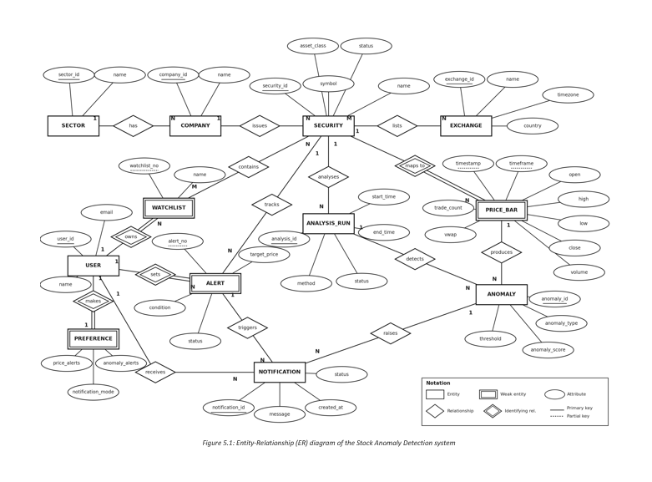
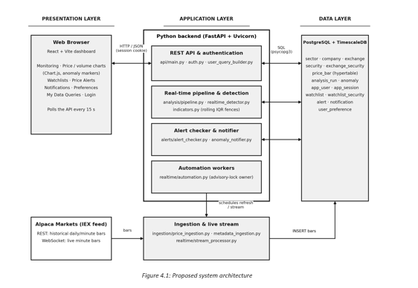
System Architecture

Slide 4
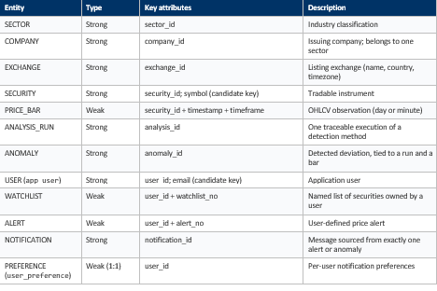
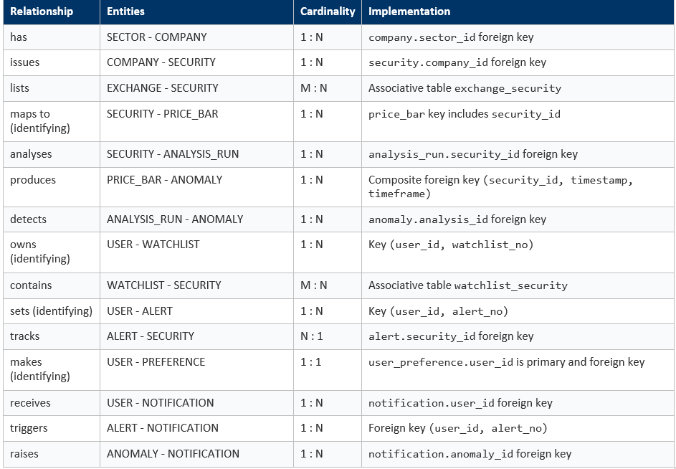
Schema Information
Schemas
Relationships

Slide 5
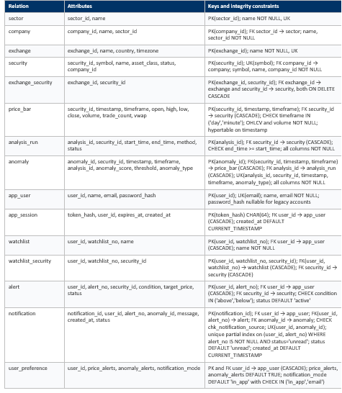
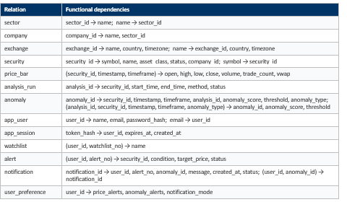
Attributes with Constraints
Functional Dependencies
Normalized upto 3NF

Slide 6
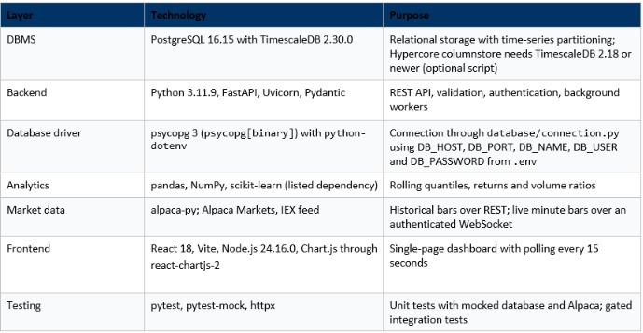
Implementation Details

Slide 7
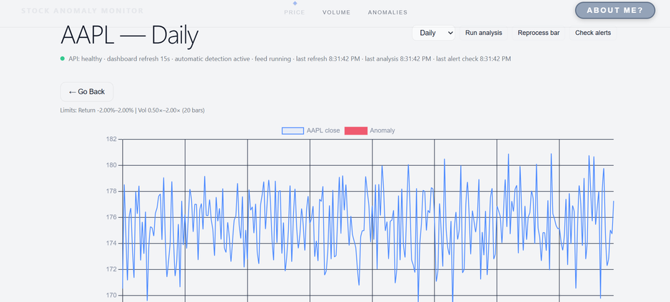
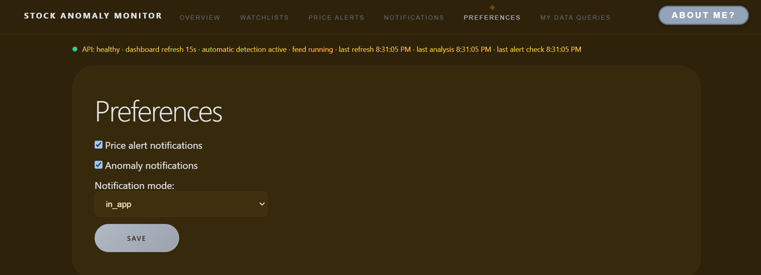
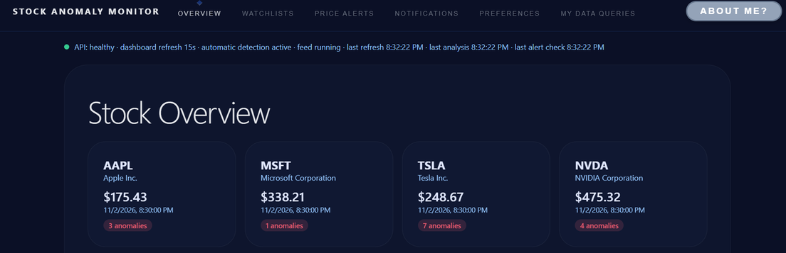
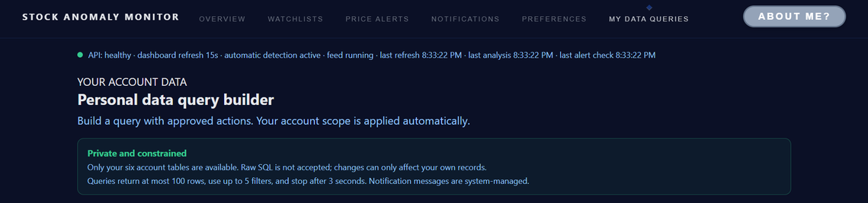
Working Screenshots

Slide 8
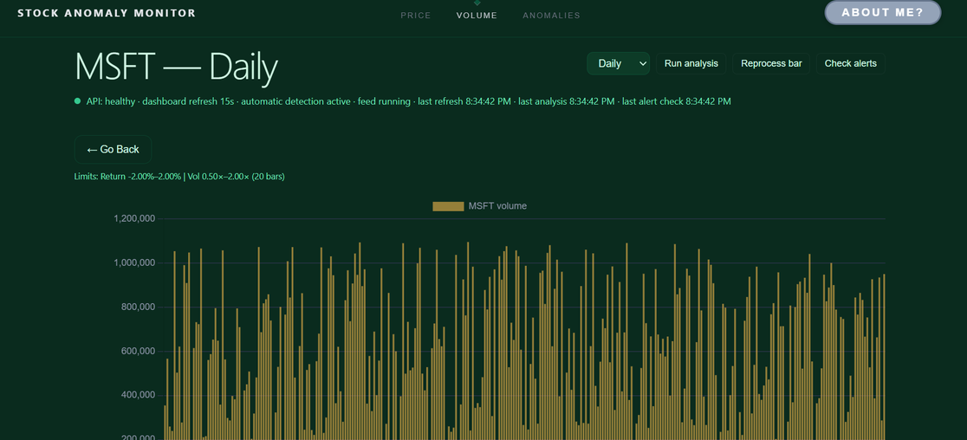
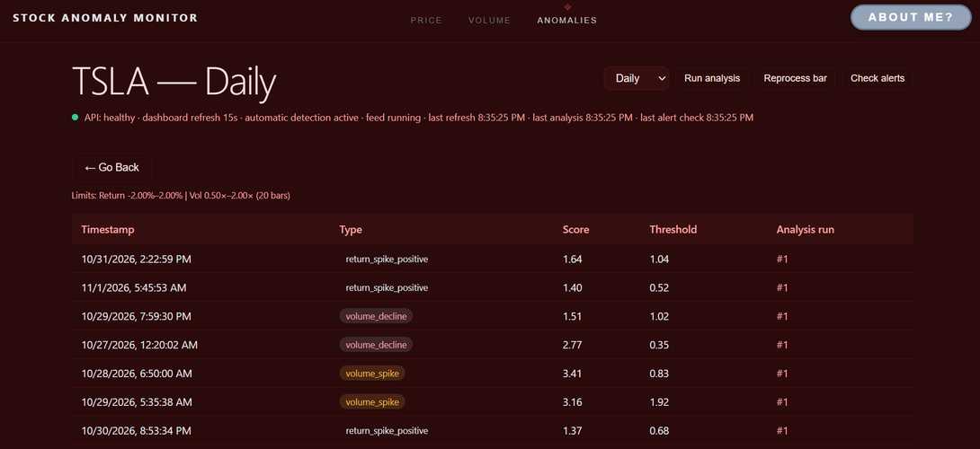
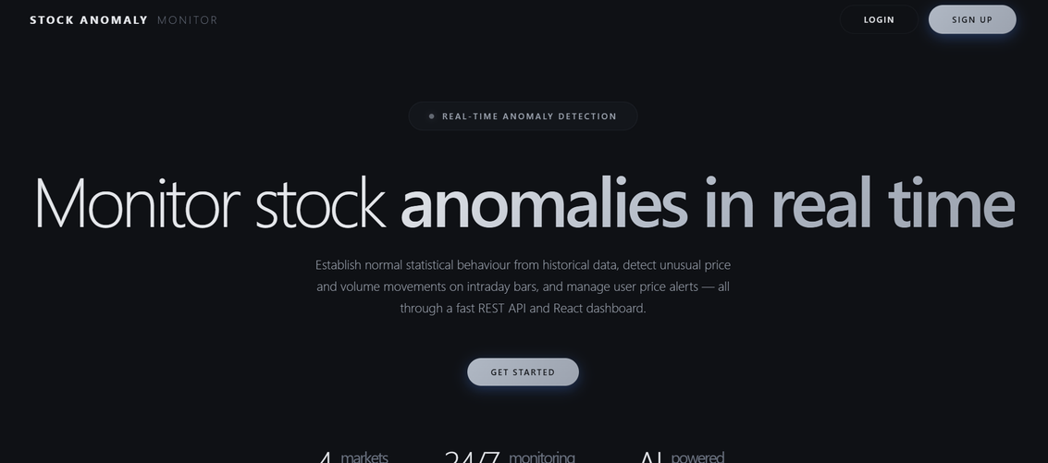
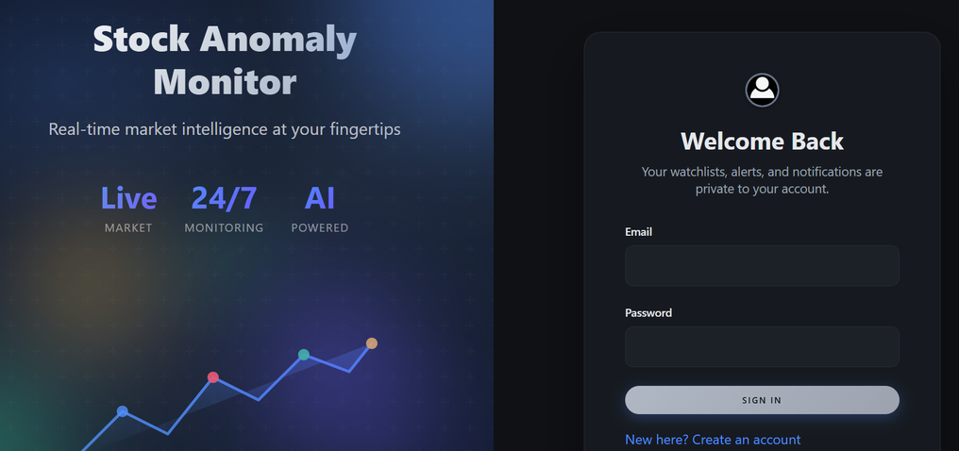

Slide 9


Result
The system successfully demonstrates adaptive stock anomaly detection, real-time monitoring, and personalized alert management. It integrates market data with a time-series database and provides traceable anomaly records through an interactive dashboard.
Finding 01: Adaptive Detection
Rolling Tukey IQR fences identify unusual price and volume movements based on each stock's recent behaviour.
Finding 02: Reliable Data Management
PostgreSQL constraints and TimescaleDB ensure data integrity, anomaly traceability, and duplicate-free user notifications.

Slide 10

Limitations
The system currently relies on the IEX market data feed and supports only four symbols. It lacks time-of-day normalization, email notifications, and load testing. Dashboard updates use polling rather than continuous real-time streaming, and some API tests require updates for authenticated sessions.
Limited Data Coverage
The system currently supports four stock symbols and uses only the IEX feed, restricting market coverage and data diversity.
Incomplete Real-Time Capabilities
Time-of-day normalization, email alerts, continuous dashboard streaming, and load testing remain unimplemented, leaving scope for future improvements.

Slide 11

Future Improvements
The system can be enhanced by expanding market data coverage, introducing time-of-day normalization, and implementing continuous real-time dashboard updates. Additional improvements include email notifications, broader stock support, performance optimization, and load testing to improve scalability and reliability.
Enhanced Market Coverage
Improved System Performance
Integrating additional market data feeds and supporting more stock symbols would improve data availability and monitoring coverage.
Implementing streaming updates, email alerts, time-of-day normalization, and load testing would enhance responsiveness, reliability, and scalability.

