Slide 1
Real-Time Dense Map Matching
Naive hidden Markov models: delay versus accuracy
G Harish reddy | PES1UG24AM366
SHARANABASAVA H | PES1UG24AM399
UE24CS352A Machine Learning
UE24CS352A | Harish & Sharanabasava | 01 / 12
Notes:
Naive hidden Markov models: delay versus accuracy
G Harish reddy | PES1UG24AM366
SHARANABASAVA H | PES1UG24AM399
UE24CS352A Machine Learning
Reference: supplied Ahres et al. CS229 paper; Newson and Krumm Seattle benchmark. Explain implementation adaptations honestly. Contribution assignments are not verified.

Slide 2
Problem and motivation
GPS noise can place a vehicle on the wrong road.
Estimate the hidden directed road arc for each reading.
Waiting N readings provides future evidence but delays output.
Avoid shortest-path searches; study the measured trade-off.
UE24CS352A | Harish & Sharanabasava | 02 / 12
Notes:
GPS noise can place a vehicle on the wrong road.
Estimate the hidden directed road arc for each reading.
Waiting N readings provides future evidence but delays output.
Avoid shortest-path searches; study the measured trade-off.
Reference: supplied Ahres et al. CS229 paper; Newson and Krumm Seattle benchmark. Explain implementation adaptations honestly. Contribution assignments are not verified.

Slide 3
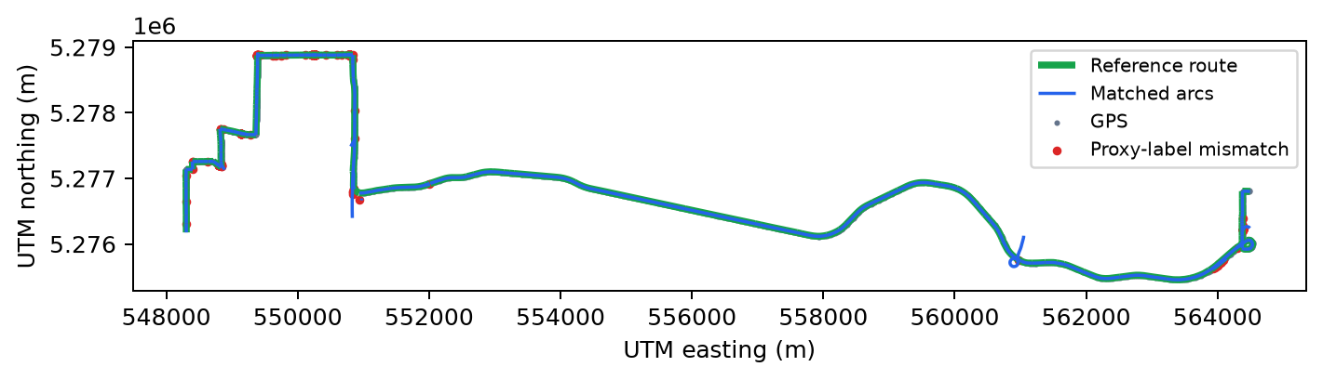
Seattle benchmark
7,531 readings; 158,167 road edges; 576 reference-route edges.
Nominal 1 Hz with four gaps; coordinates projected to metres.
60% train / 10% validation / 30% held-out test.
Point labels derived from route alignment: evaluation proxies.
UE24CS352A | Harish & Sharanabasava | 03 / 12
Notes:
7,531 readings; 158,167 road edges; 576 reference-route edges.
Nominal 1 Hz with four gaps; coordinates projected to metres.
60% train / 10% validation / 30% held-out test.
Point labels derived from route alignment: evaluation proxies.
Reference: supplied Ahres et al. CS229 paper; Newson and Krumm Seattle benchmark. Explain implementation adaptations honestly. Contribution assignments are not verified.

Slide 4
Pipeline
GPS + roads -> nearby directed arc candidates
Distance, heading, speed features -> emissions
History and displacement features -> transitions
Log-domain sliding-window Viterbi -> irrevocable predictions
UE24CS352A | Harish & Sharanabasava | 04 / 12
Notes:
GPS + roads -> nearby directed arc candidates
Distance, heading, speed features -> emissions
History and displacement features -> transitions
Log-domain sliding-window Viterbi -> irrevocable predictions
Reference: supplied Ahres et al. CS229 paper; Newson and Krumm Seattle benchmark. Explain implementation adaptations honestly. Contribution assignments are not verified.

Slide 5
HMM and features
States: all directed arcs within 50 m; sigma = 10 m.
Emission: Gaussian distance, heading dot product, speed constraint.
Transition: backtrack prevention and midpoint discrepancy.
Positive weighted potentials; no connectivity guarantee.
UE24CS352A | Harish & Sharanabasava | 05 / 12
Notes:
States: all directed arcs within 50 m; sigma = 10 m.
Emission: Gaussian distance, heading dot product, speed constraint.
Transition: backtrack prevention and midpoint discrepancy.
Positive weighted potentials; no connectivity guarantee.
Reference: supplied Ahres et al. CS229 paper; Newson and Krumm Seattle benchmark. Explain implementation adaptations honestly. Contribution assignments are not verified.

Slide 6
Window T and buffer N
At reading t, solve over max(0, t-T+1) through t.
Clamp overlapping committed states at their actual times.
Commit prediction for t-N; never revise it later.
Flush final N points at EOF; report online-only error separately.
UE24CS352A | Harish & Sharanabasava | 06 / 12
Notes:
At reading t, solve over max(0, t-T+1) through t.
Clamp overlapping committed states at their actual times.
Commit prediction for t-N; never revise it later.
Flush final N points at EOF; report online-only error separately.
Reference: supplied Ahres et al. CS229 paper; Newson and Krumm Seattle benchmark. Explain implementation adaptations honestly. Contribution assignments are not verified.

Slide 7
Learning feature weights
Balanced L1 LinearSVC; candidates/pairs labelled from reference.
10 expanding folds, 15-reading gap; C in {0.1, 1, 10}.
Selected C: emission 10, transition 10.
Positive coefficients normalized; intercept discarded.
UE24CS352A | Harish & Sharanabasava | 07 / 12
Notes:
Balanced L1 LinearSVC; candidates/pairs labelled from reference.
10 expanding folds, 15-reading gap; C in {0.1, 1, 10}.
Selected C: emission 10, transition 10.
Positive coefficients normalized; intercept discarded.
Reference: supplied Ahres et al. CS229 paper; Newson and Krumm Seattle benchmark. Explain implementation adaptations honestly. Contribution assignments are not verified.

Slide 8
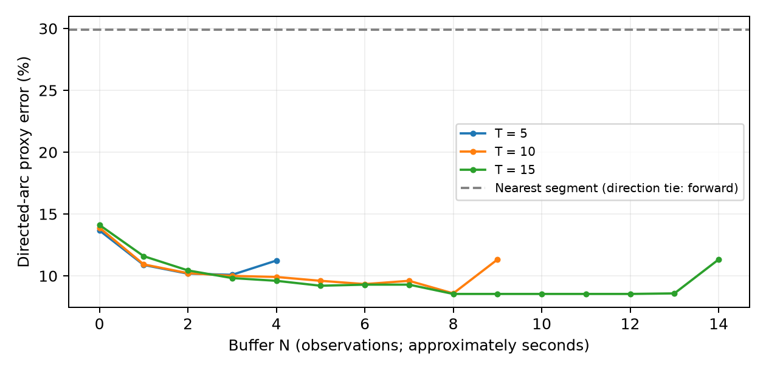
Delay versus accuracy
Validation selected T=10, N=7.
Test directed error: 9.60%.
Test edge error: 4.60%.
Minimum is not always at T/2; curves are not uniformly convex.
UE24CS352A | Harish & Sharanabasava | 08 / 12
Notes:
Validation selected T=10, N=7.
Test directed error: 9.60%.
Test edge error: 4.60%.
Minimum is not always at T/2; curves are not uniformly convex.
Reference: supplied Ahres et al. CS229 paper; Newson and Krumm Seattle benchmark. Explain implementation adaptations honestly. Contribution assignments are not verified.

Slide 9
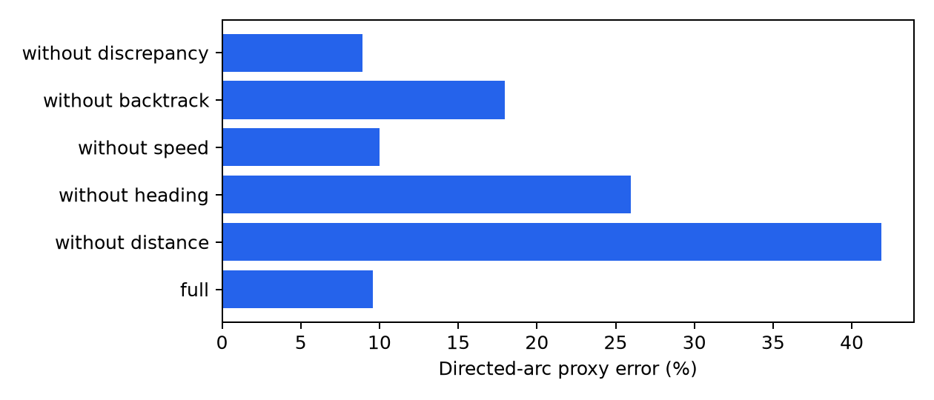
Baseline and ablations
Nearest-road edge error: 8.01%.
Full model edge error: 4.60%.
Removing heading or distance sharply worsens error.
Removing discrepancy improves directed error to 8.94%.
UE24CS352A | Harish & Sharanabasava | 09 / 12
Notes:
Nearest-road edge error: 8.01%.
Full model edge error: 4.60%.
Removing heading or distance sharply worsens error.
Removing discrepancy improves directed error to 8.94%.
Reference: supplied Ahres et al. CS229 paper; Newson and Krumm Seattle benchmark. Explain implementation adaptations honestly. Contribution assignments are not verified.

Slide 10
Live demonstration
python run_demo.py --T 10 --N 7 --slice 5300 5600
Open results/demo_map.html: completely offline replay.
Compare N=0 and N=7 using the same slice.
Static PNG is the backup; runtime excludes map rendering.
UE24CS352A | Harish & Sharanabasava | 10 / 12
Notes:
python run_demo.py --T 10 --N 7 --slice 5300 5600
Open results/demo_map.html: completely offline replay.
Compare N=0 and N=7 using the same slice.
Static PNG is the backup; runtime excludes map rendering.
Reference: supplied Ahres et al. CS229 paper; Newson and Krumm Seattle benchmark. Explain implementation adaptations honestly. Contribution assignments are not verified.

Slide 11
Conclusions and limitations
Buffering and heading help on this single benchmark.
Derived labels and one trip limit generalization.
Training/inference history differ; no network connectivity check.
Next: independent labels, multiple trips, filtering, turn features.
UE24CS352A | Harish & Sharanabasava | 11 / 12
Notes:
Buffering and heading help on this single benchmark.
Derived labels and one trip limit generalization.
Training/inference history differ; no network connectivity check.
Next: independent labels, multiple trips, filtering, turn features.
Reference: supplied Ahres et al. CS229 paper; Newson and Krumm Seattle benchmark. Explain implementation adaptations honestly. Contribution assignments are not verified.

Slide 12
Code, contribution and Q&A
src/: loader, candidates, features, Viterbi, training, evaluation.
Tests verify causal commitments and future-evidence effects.
Both members should review the full pipeline and run the demo.
Record actual individual contributions; private GitHub publishing pending.
UE24CS352A | Harish & Sharanabasava | 12 / 12
Notes:
src/: loader, candidates, features, Viterbi, training, evaluation.
Tests verify causal commitments and future-evidence effects.
Both members should review the full pipeline and run the demo.
Record actual individual contributions; private GitHub publishing pending.
Reference: supplied Ahres et al. CS229 paper; Newson and Krumm Seattle benchmark. Explain implementation adaptations honestly. Contribution assignments are not verified.

