Slide 1
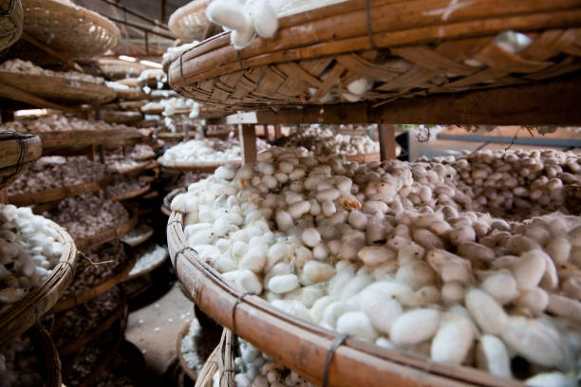
Integrated Temperature and Humidity Management System for Sericulture Sheds. BY HARISH S Guide: Dr. Devi K

Slide 2
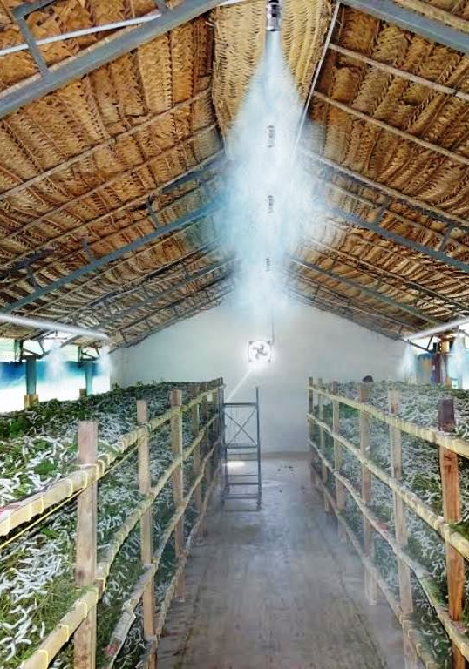
outline
Introduction
Literature review
Scope and Problem Statement
Research Challenges
Research Objective
Methodology
System Design
Implementation Progress
Results and Discussion
References

Slide 3
Introduction
Sericulture is a critical industry requiring precise environmental management for silkworm health and silk production.
Manual processes are inefficient and error-prone.
Automation using IoT and machine learning provides a robust solution for managing temperature and humidity in silkworm-rearing sheds.

Slide 4
Literature review
S.No. | Area | Reference | Key Findings | Relevance to Project
1 | Automated Smart Sericulture Plant | Nithin H V, Mubina Bapusaheb Naikwadi, Meghana G H, Jyothi B K, Kamala Priya V L (2021) | An IoT-based system for real-time sericulture monitoring using temperature and humidity sensors. Ensures healthy silkworm development through automated environmental control and disinfection. | Provides insights on using IoT for improving sericulture efficiency and productivity.
2 | Sericulture Monitoring | Automatic Sericulture Monitoring Using Image Processing by V. Kavithamani, A. Parameswari, S. Kathiresan, R. Manikandan, P. Vinoth (2021) | Image processing techniques are used for monitoring various aspects of sericulture automatically. | Supports the development of a comprehensive monitoring system for sericulture.
3 | Automated Sericulture System | IoT Based Automated Sericulture System by Srinivas B, Khushi Kumari, Goverdhan Reddy H, Niranjan N, Hariprasad S A, Sunil M P, International Journal of Recent Technology and Engineering (IJRTE), ISSN: 2277-3878, Volume-8 Issue-2, July 2019 | Development of an automated system using IoT to monitor and control environmental parameters in silkworm rearing houses, leading to improved quality and quantity of silk. | Crucial for implementing modern technology in sericulture to enhance silk production and quality through automation and IoT.
4 | Energy Consumption and GHG Emission | (2017) Energy Consumption and Estimation of Greenhouse Gas Emission from Garment | Analyses the energy consumption and greenhouse gas emissions in garment production. | Provides insights into the environmental impact of sericulture-related industries.
5 | Silkworm Egg Detection and Categorization | Pavitra, H.V., & Raghavendra, C.G. (2022). An overview on detection, counting and categorization of silkworm eggs using image analysis approach. Global Transitions Proceedings, 3, 285-288. | This review article discusses various algorithms used for counting, detecting, and classifying silkworm eggs using image processing techniques. It highlights the strengths and limitations of these algorithms and suggests that modern tools like computer vision, machine learning, and deep learning are essential for accurate and efficient counting and classification. | This paper explores modern image processing techniques to improve accuracy and efficiency in detecting, counting, and classifying silkworm eggs, highlighting technological advancements and potential research gaps in sericulture.

Slide 5
Literature review (Cont.)
6 | Dead Cocoon Classification | Classification of Dead Cocoons Using Convolutional Neural Networks and Machine Learning Methods (2023) | Convolutional neural networks and machine learning methods are successful in classifying dead cocoons. | Useful for quality control and improving the yield in sericulture by identifying and removing dead cocoons.
7 | CA-YOLOv5: Detection model for healthy and diseased silkworms in mixed conditions based on improved YOLOv5 | CA-YOLOv5: Detection model for healthy and diseased silkworms in mixed conditions based on improved YOLOv5. Int J Agric & Biol Eng, 2023; 16(6): 236–245. | Proposed CA-YOLOv5 model improves detection accuracy for healthy and diseased silkworms in mixed conditions, achieving 96.46% mAP, outperforming existing methods. | Enhances precision in identifying and locating diseased silkworms, aiding in the development of accurate disease control technologies.
8 | IoT and Image Processing Integration | Ahmed Farooq, Abul Kashem Shahriyar (2023) | Real-time monitoring of silkworm health using IoT devices. Smart silkworm rearing systems for optimal growth conditions. Automated cocoon inspection, disease detection, and harvest optimization through image processing. Predictive analytics for improved resource utilization and productivity. | Demonstrates the advanced applications of IoT and image processing in enhancing sericulture practices, which could be relevant for improving efficiency and productivity in sericulture projects.
9 | Smart Sericulture System using Image Processing | Baddula Lakshith Reddy, Manjunath Bhaskar (21-01-2022) | Automated monitoring of temperature, humidity, and harmful gases. Image processing for detecting diseased worms. Automated medicine sprayer controlled by Arduino UNO. System includes sensors (temperature, humidity, gas), camera, and machine learning algorithms for worm classification. | Provides a comprehensive automated solution for sericulture, addressing environmental control and disease management, relevant for improving efficiency and accuracy in silk production.
10 | Image Processing for Sericulture | Gavina C G, Kavyashree V, Lakshmireddygari.Greeshmalatha, Lakshmithra K, Prakruthi V (2014) | India is a major producer of silk, with significant production in five states. Seasonal variations impact silkworm crop quality. The study uses ResNet50 for image processing to detect healthy/unhealthy silkworms and recommend medicine. The automated system improves silk production with minimal human intervention. | The system enhances sericulture by automating disease detection and management, reducing manual labour and improving the efficiency and quality of silk production.

Slide 6
Literature review (Cont.)
11 | Automated Sericulture with Image Processing | Yogeshraj N S, Thamilarasi N, Sailaja S, Poonguzhali C, Kannagi S (2022) | India is a major silk producer with significant socio-economic impact. - Temperature and humidity are crucial for silkworm health. - Uses image processing and CNN to detect health issues in silkworms based on color changes. - Includes a disinfection system to address biological factors. | The system enhances sericulture by integrating image processing and embedded systems to monitor silkworm health, manage environmental factors, and automate disease detection and treatment.
12 | Silkworm Cocoon Gender Classification | Raj, A.N.J., Sundaram, R., Simeone, A., Mahesh, V.G.V., Zhuang, Z. (2019) | The paper presents a multi-sensor system for gender classification of silkworm cocoons. It uses a load sensor and a digital camera to capture weight and image data. These features are used with a Support Vector Machine (SVM) classifier for gender separation. The system was tested on CSR2 and Pure Mysore breeds. Key advantages include reduced human intervention, lower misclassification error, and improved speed and repeatability compared to manual methods. | This system's approach to automating gender classification is highly relevant as it enhances accuracy and efficiency, aligning with the project's goal to improve sericulture processes through advanced technologies.
13 | Sericulture Monitoring and Disease Management | Harsha R, Prithvi Veera B, Rohan M.N, Hemanth Chandra N, "Survey on Sericulture: An IoT-based Cocoon Worms Monitoring for Disease Identification and Management for Quality Silk Rearing" (2024) | The study proposes an IoT-based monitoring system integrating sensors for temperature, humidity, and light with machine learning algorithms for early detection of silkworm diseases such as pebrine, flacherie, grasserie, and muscardine. It aims to minimize production losses and enhance silk yield by ensuring optimal rearing conditions and proactive disease management. | The research is highly relevant as it addresses critical challenges in disease management within sericulture. By implementing advanced technologies and monitoring systems, it supports efforts to improve silk production quality and yield, which aligns with the project's goal of enhancing the sericulture sector's sustainability and economic impact.
14 | Integrated Analysis of Machine Learning and Deep Learning in Silkworm Pupae (Bombyx mori) Species and Sex Identification | He, H., Zhu, S., Shen, L., Chang, X., Wang, Y., Zeng, D., Xiong, B., Dai, F., & Zhao, T. (2023). Integrated Analysis of Machine Learning and Deep Learning in Silkworm Pupae (Bombyx mori) Species and Sex Identification. Animals, 13(23), 3612. | This study employs machine learning and deep learning for the automatic identification of silkworm pupae species and sex. A dataset of 3600 images from five species of male and female pupae was used. The study compared traditional feature-based approaches (e.g., HOG, LBP) with deep learning approaches (e.g., ConvNeXt-S) and found that combining HOG, ConvNeXt-S, and MLP achieved the highest accuracy (99.09% for separate recognition, 98.40% for simultaneous recognition). | The paper provides an advanced approach for identifying silkworm pupae species and sex, addressing posture variability and offering a high accuracy model that could enhance sericulture practices.
15 | sericulture industry | S.R. Naphade, C.J. Hiware, R.J. Chavan (2023) | The paper reviews the global and national status of the sericulture industry, highlighting Maharashtra's increasing role. It discusses the industry's cultural and economic impacts, challenges, and potential for innovation and sustainability. | Provides a comprehensive overview of the sericulture industry, focusing on trends and challenges in Maharashtra, which is relevant for understanding regional developments and opportunities.

Slide 7
Literature review (Cont.)
16 | SILKWORM DISEASE DETECTION USING AI AND ML | Manjunatha Siddappa, Sindhu B S, Sirisha R, Tejas Gowda R (2024) | The paper presents an AI-driven system using Raspberry Pi and a camera for real-time monitoring of silkworms and cocoons. The system employs computer vision algorithms to track growth parameters, health conditions, and disease outbreaks, optimizing sericulture practices and reducing manual labor. | Provides a practical approach to enhance silkworm disease detection and management using AI and machine learning, improving productivity and sustainability.
17 | Smart Sericulture System | Prof. Narayana Reddy D, Asha Patil, Yasin Dhalait, Meghana Sattigeri, Kavya Masaraddi (2023) | The paper presents a smart sericulture system using IoT for automation in silk production. It utilizes ESP8266 NodeMCU and various sensors (temperature, humidity, light) to monitor and control environmental conditions in the silkworm rearing house. The system sends notifications and allows remote control via a mobile app, improving silk production and quality. | Enhances sericulture by integrating IoT for real-time monitoring and control of environmental parameters, leading to better silk production and quality.
18 | Smart Sericulture System | Dr. Mahesh Kaluti, Darshan M, Rakesh Sharma K, Rohith R M (2023) DOI: | The paper describes an IoT-based model for sericulture that monitors environmental conditions (temperature, humidity), detects hazards (fire, predators, disease), and takes preventive measures. It also includes features like live video streaming and 24/7 farm security. The system improves silk production by automating monitoring and response. | Provides automation for monitoring and controlling environmental conditions, enhancing safety and productivity, which is crucial for optimizing silk production.
19 | IoT in Sericulture | Jambukar, A. R., & Dawande, N. A. (2020) | Proposed an IoT-based system for monitoring and controlling environmental conditions in sericulture. Key parameters include temperature, humidity, light intensity, airflow, and air quality. The system logs data in an Oracle database and uses machine learning for analysis and forecasting. Data is visualized using Tableau. | Offers a comprehensive solution for automated environmental control in sericulture, improving silk yield quality and quantity.
20 | Image Classification for Silkworm using Deep Neural Network-VGG 19 | Nisha S Ail, Nishali M Suvarna, Sudarshan K, Nishmitha KL, Prajna P K (2021) | The paper utilizes the VGG-19 deep neural network model for classifying silkworm images into diseased and healthy categories. It reports high classification accuracy (up to 98.6%) and suggests improvements for accuracy in detecting silkworm diseases. | Provides a method for accurate silkworm classification using deep learning, which can enhance disease detection and improve silk production quality.

Slide 8
Scope and Problem Statement
Scope:
Develop an automated system for maintaining optimal environmental conditions in sericulture sheds.
Incorporate real-time monitoring, predictive analytics, and remote-control capabilities.
Problem Statement:
Environmental fluctuations negatively impact silkworm health and silk yield.
Manual adjustments are time-consuming, lack precision, and are prone to errors.
Need for an intelligent system to address these challenges efficiently.

Slide 9
Research Challenges
Accurate prediction of optimal environmental conditions for varying silkworm growth stages.
Integrating reinforcement learning for environmental optimization.
Ensuring real-time system responsiveness.
Energy efficiency in actuator control.
Seamless integration of hardware and software components using Node-RED and IoT platforms.

Slide 10
Research Objective
Design and develop an Integrated Temperature and Humidity Management System for sericulture sheds.
Employ reinforcement learning for predictive analytics and federated learning for decentralized actuator control.
Optimize energy consumption and ensure real-time monitoring and control using IoT.
Improve silk yield and reduce operational complexities.

Slide 11
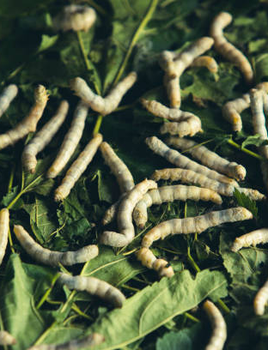
Methodology

Slide 12
Methodology
System Design:
Sensors (DHT22, SHT31) collect temperature and humidity data.
Central Control Unit (Raspberry Pi) processes sensor data using ML models.
Actuators (heater, cooler, humidifier, dehumidifier) controlled via Node-RED.

Slide 13
Methodology (cont.)
Implementation Progress:
Developed Python-based reinforcement learning algorithm for temperature and humidity prediction.
Integrated federated learning model for actuator control in Node-RED.
Initial testing with sensors and actuators completed; real-time adjustments verified.

Slide 14
Results & Discussions
Results:
.Adaptive learning model predicted the optimal temperature and humidity.
Automated Actuator adjustments were functioning without any fluctuations.
System maintained temperature and humidity within optimal ranges for initial tests
Discussion:
Early results demonstrate the system’s potential to improve sericulture productivity.
Further testing required under diverse environmental conditions.

Slide 15
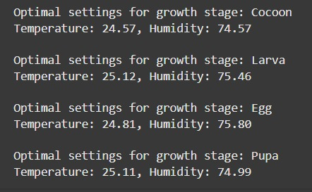
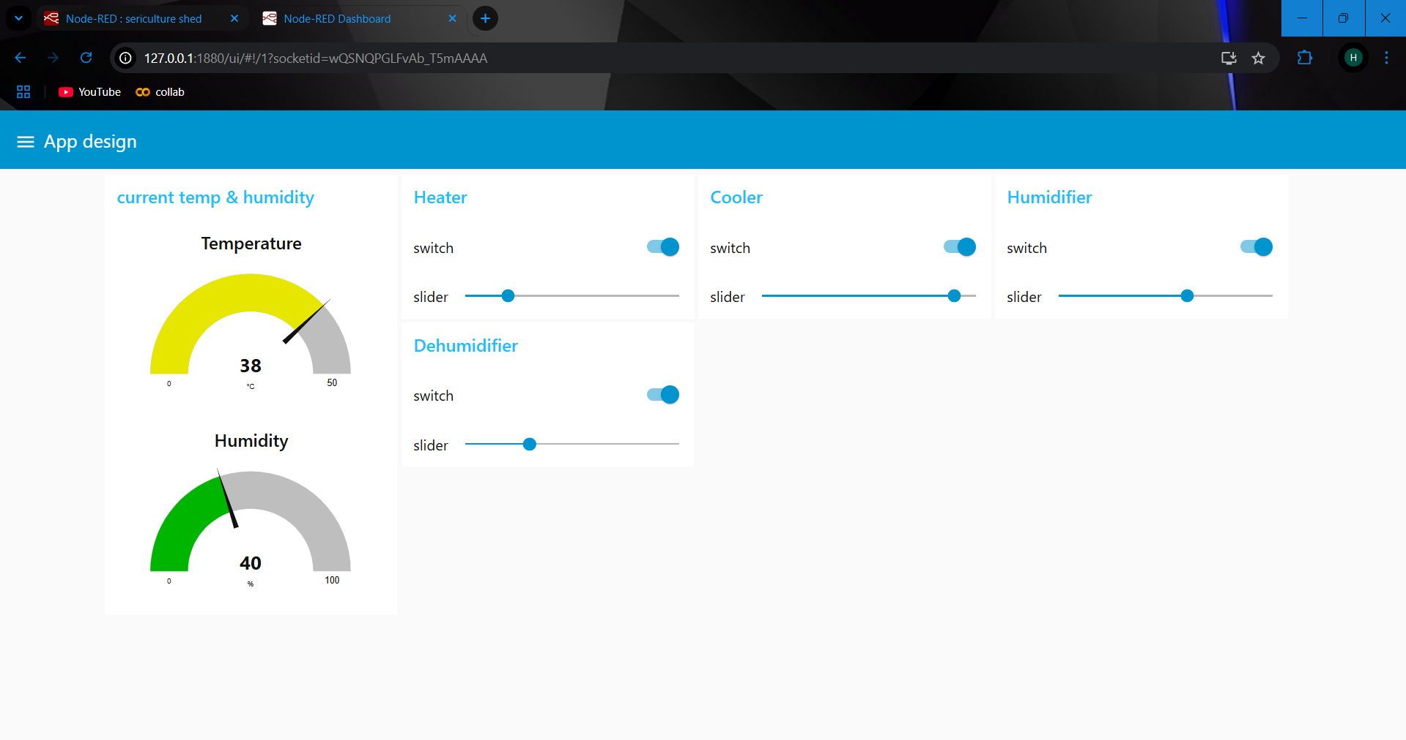
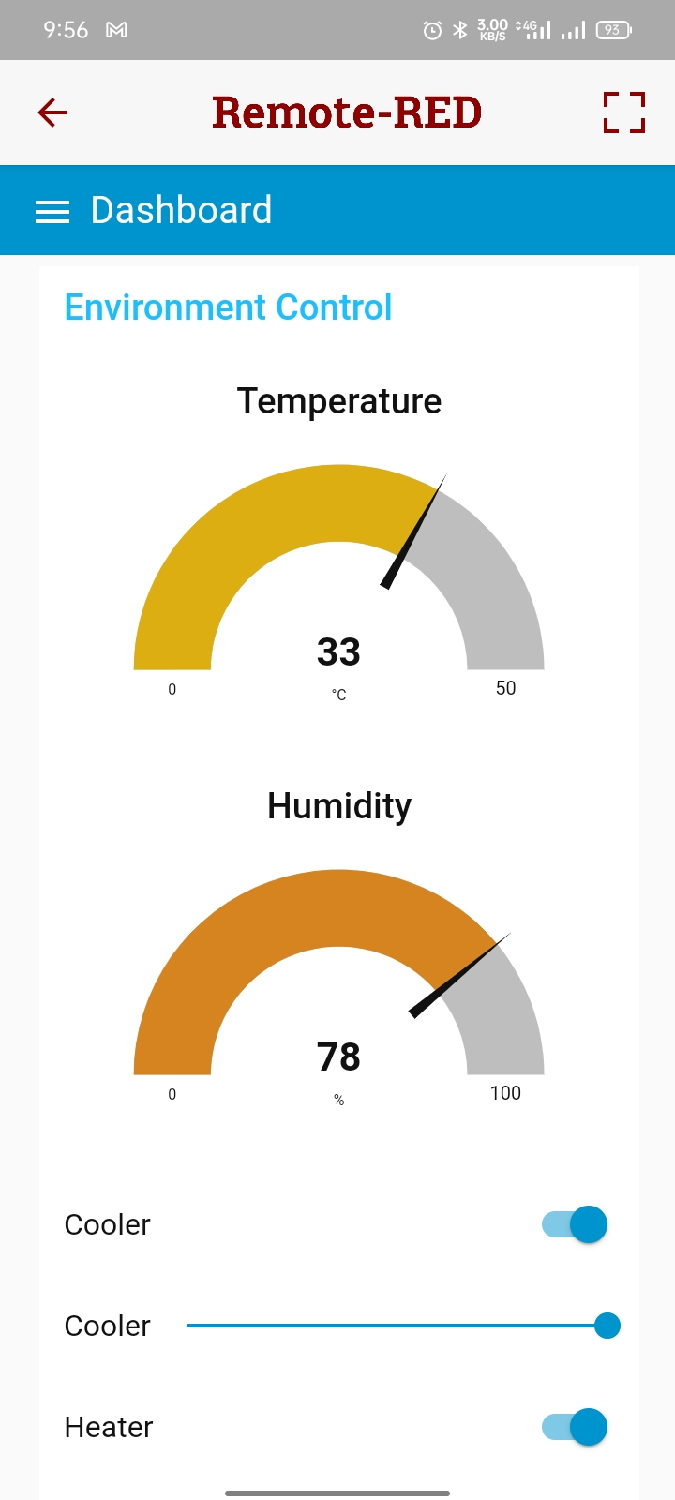
Output
The reinforcement learning model predicts the optimum condition for the silkworm growth stages.
Fig.: Python execution output
The federated learning model adjusts the frequencies of the climate control devices using node-red(platform) to obtain the optimum condition
Fig.: Web & mobile Application Output

Slide 16
System Architecture / Data Acquisition & Data Set
System Architecture:
Sensors: Temperature and humidity sensors (e.g., DHT22, SHT31) placed strategically around the sericulture shed.
Central Control Unit (CCU): A PLC or microcontroller (e.g., Arduino or Raspberry Pi) for real-time data processing and control.
Climate Control: Automated HVAC units, humidifiers, and dehumidifiers to adjust the environment based on sensor readings.
Remote Monitoring: A mobile app interface to allow caretakers to monitor and control conditions remotely​.
Data Acquisition:
Data is continuously logged from sensors, providing real-time and historical data on temperature and humidity variations.
Data Set: Sensor data from silkworm rearing sheds, including temperature, humidity, and silkworm health metrics. (For real-time implementation only)
Randomly generated data in node-red inject node is being used for this model, which later can also be integrated with the IoT hardware system for real-time usage.

Slide 17
References
Nithin H. V., Mubina Bapusaheb Naikwadi, Meghana G. H., Jyothi B. K., Kamala Priya V. L. (2021). "An IoT-based system for real-time sericulture monitoring using temperature and humidity sensors." Automated Smart Sericulture Plant. Ensures healthy silkworm development through automated environmental control and disinfection. Provides insights on using IoT for improving sericulture efficiency and productivity.
V. Kavithamani, A. Parameswari, S. Kathiresan, R. Manikandan, P. Vinoth (2021). "Automatic Sericulture Monitoring Using Image Processing." Supports the development of a comprehensive monitoring system for sericulture using image processing techniques.
Srinivas B., Khushi Kumari, Goverdhan Reddy H., Niranjan N., Hariprasad S. A., Sunil M. P. (2019). "IoT Based Automated Sericulture System." International Journal of Recent Technology and Engineering (IJRTE), ISSN: 2277-3878, Volume-8 Issue-2, July 2019. This paper discusses the development of an automated system using IoT to monitor and control environmental parameters in silkworm rearing houses, enhancing the quality and quantity of silk.
(2017). "Energy Consumption and Estimation of Greenhouse Gas Emission from Garment." Analyzes energy consumption and greenhouse gas emissions in garment production, providing insights into the environmental impact of sericulture-related industries.
Ahmed Farooq, Abul Kashem Shahriyar (2023). "Real-time monitoring of silkworm health using IoT devices." This study demonstrates the advanced applications of IoT and image processing in sericulture, including automated cocoon inspection, disease detection, and harvest optimization.
Baddula Lakshith Reddy, Manjunath Bhaskar (2022). "Smart Sericulture System using Image Processing." This automated system addresses environmental control and disease management through temperature, humidity, and gas monitoring, combined with machine learning algorithms for worm classification.

Slide 18
thank you
HARISH S - 20MIS1045
harishs.swe@gmail.com

