Slide 1

MSPM’S Deogiri Institute of Engineering and Management Studies, Aurangabad Department of Computer Science and Engineering Subject: Theory of Computation Topic: Password Generation Submitted by Harish Udavant (36147)
Prashika Gaikwad (36148) Under the Guidance of Prof. Sarika Chavan Asst.Prof.Department of CSE (Deogiri Institute Engineering and Management Studies) 2019-2020

Slide 2
Chomsky normal form
Method of simplifying a CFG
Definition: A context-free grammar is in Chomsky normal form if every rule is of one of the following forms
A → BC
A → a
where a is any terminal and A is any variable, and B, and C are any variables or terminals other than the
start variable
the rule S → ε is permitted,
where S is the start variable

Slide 3
CFG’s and Chomsky normal form
Theorem: Any context-free language is generated by a context-free grammar in Chomsky normal form.
Proof idea: Convert any CFG to one in Chomsky normal form by removing or replacing all rules in the wrong form
Add a new start symbol
Eliminate ε rules of the form A → ε
Eliminate unit rules of the form A → B
Convert remaining rules into proper form

Slide 4
Convert a CFG to Chomsky normal form
Add a new start symbol
Create the following new rule
S₀ → S
where S is the start symbol and S₀ is not used in the CFG

Slide 5
Convert a CFG to Chomsky normal form
Eliminate all ε rules A → ε, where A is not the start variable
For each rule with an occurrence of A on the right-hand side, add a new rule with the A deleted
R → uAv becomes R → uAv | uv
R → uAvAw becomes R → uAvAw | uvAw | uAvw | uvw
If we have R → A, replace it with R → ε unless we had already removed R → ε

Slide 6
Convert a CFG to Chomsky normal form
Eliminate all unit rules of the form A → B
For each rule B → u, add a new rule A → u, where u is a string of terminals and variables, unless this rule had already been removed
Repeat until all unit rules have been replaced

Slide 7
Convert a CFG to Chomsky normal form
Convert remaining rules into proper form
What’s left?
Replace each rule A → u₁u₂…u_{k}, where k ≥ 3 and u_{i} is a variable or a terminal with k-1 rules
A → u₁A₁ A₁ → u₂A₂ … A_{k-2} → u_{k-1}u_{k}

Slide 8
introduction
According to the book, the right hand side of the rule in a CFG in Chomsky Normal Form must have length two.
So, there are 3 kind of rules that need to be removed/replaced:
Long rules (eg. A->BCD)
Empty rules (eg. A->e)
Short rules (eg. A->a)

Slide 9
Input
User's input include:
Number of rules
Initial state
Rules, each on in a space-delimited form (A BC, for A->BC)

Slide 10
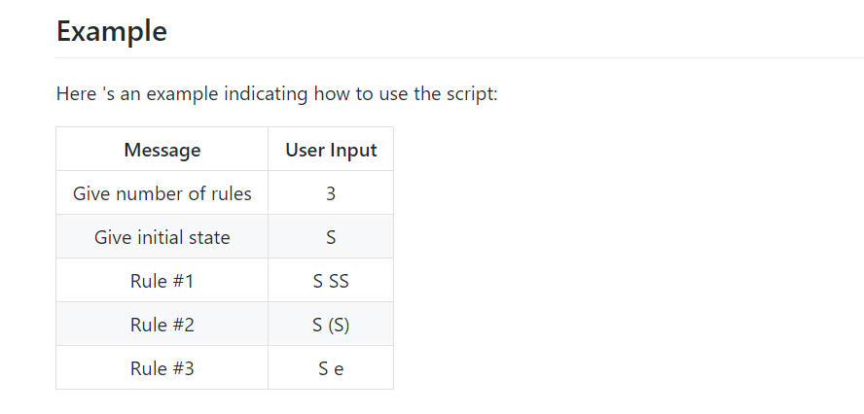

Slide 11
Application
CNF conversion is used in some algorithms as a preprocessing step, e.g., the CYK algorithm, a bottom-up parsing for context-free grammars, and its variant probabilistic CKY.
Context-free grammars arise in linguistics where they are used to describe the structure of sentences and words in a natural language, and they were in fact invented by the linguist Noam Chomsky for this purpose, but have not really lived up to their original expectation. In an early application, grammars are used to describe the structure of programming languages.
In a newer application, they are used in an essential part of the Extensible Markup Language (XML) called the Document Type Definition.
In most programming languages opening and closing of braces, curly brackets is taken care. It mainly track it and if any closing bracket is not there, it will throw error.

Slide 12
Conclusion
CNf are has a power as CFG practically.
CNF exist for every CFG.
Language of CNF is super set of CFG.

