Slide 1
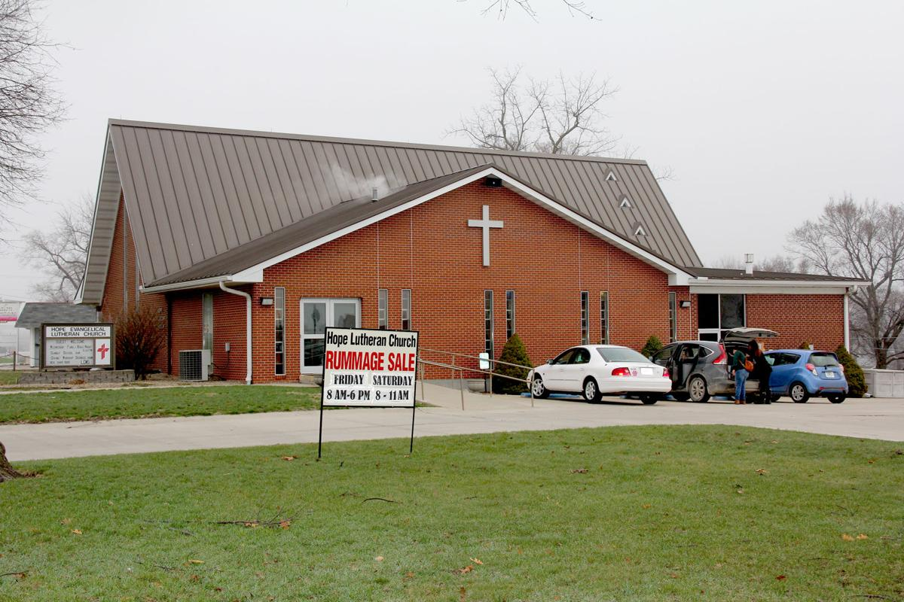
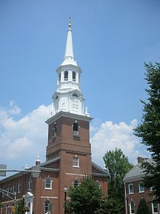
SELECT YOUR CHURCH
HOPE LUTHERN CHURCH
HOLY TRINITY LUTHERN CHURCH

Slide 2
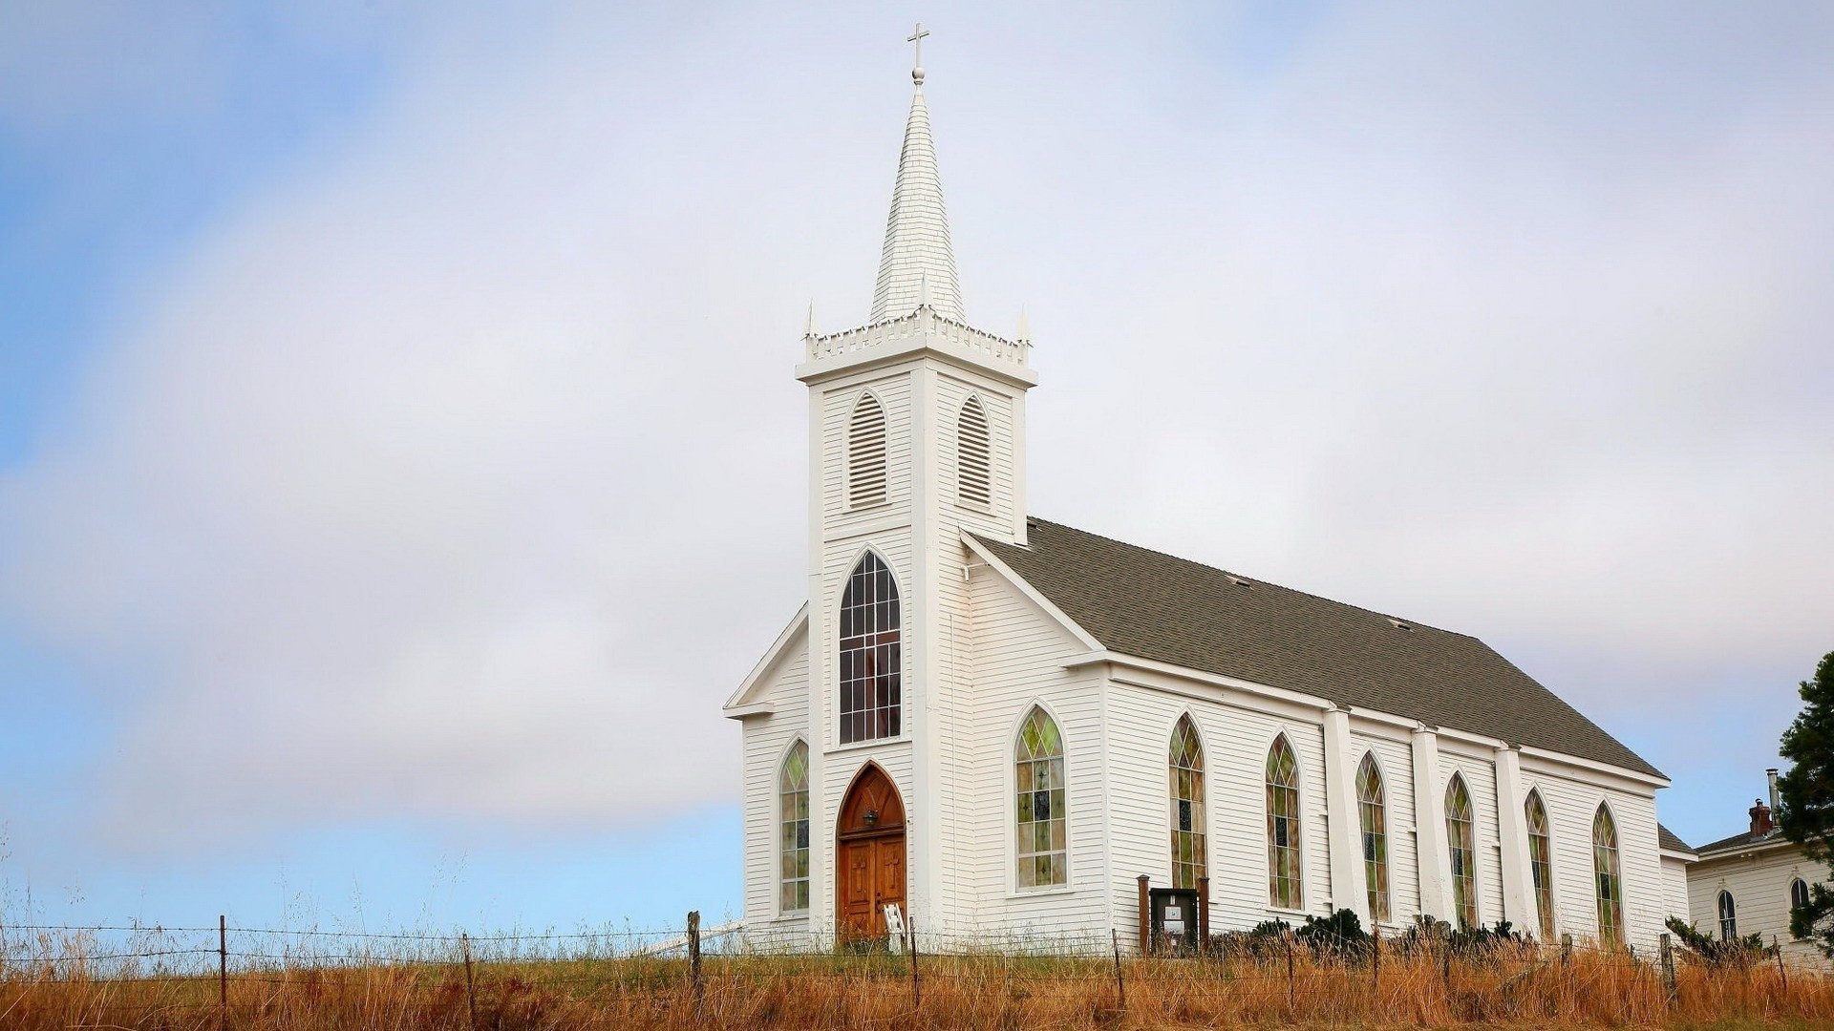

ALTAR GUILD
LOGIN
USERNAME
PASSWORD
LOGIN

Slide 3
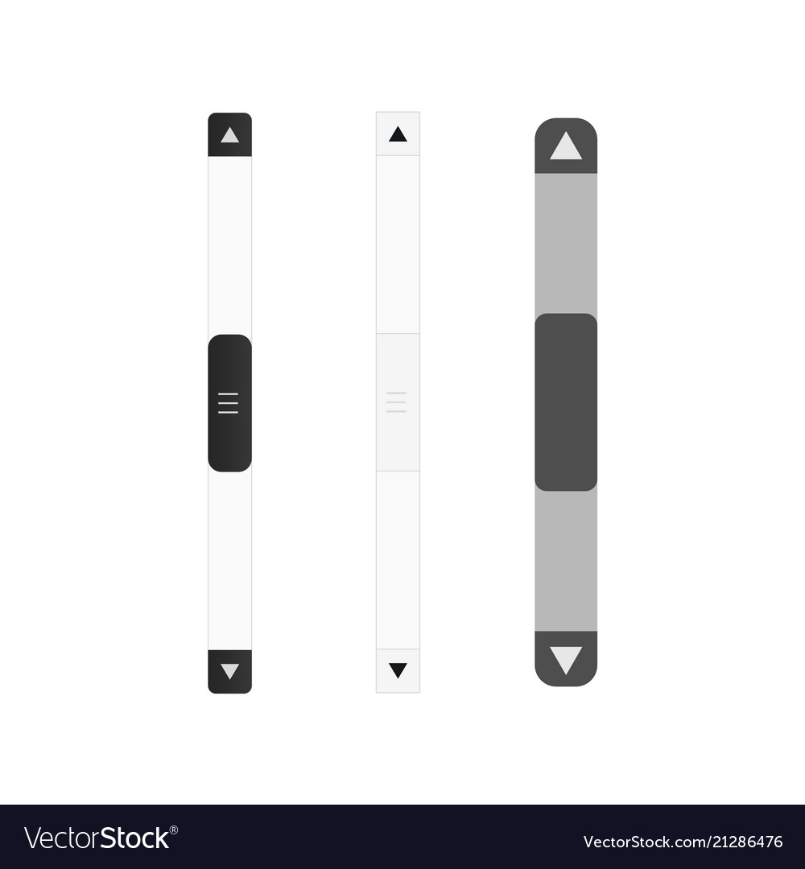
HOME
ALL SEASONS
MEMEBERS INFO
CURRENT FESTIVAL : - NOV 28TH 2019, WHITE CLOTH
THANKS GIVING
NEXT FESTIVALS :
ADVENT – DEC 23RD 2019, BLUE
CHRISTMAS – DEC 25TH 2019, WHITE
ADVENT
CHRISTMAS
EPIPHANY
ASH WEDNESDAY
DEC 2-23
DEC 25-30
JAN 6 – 13
MAR 6

Slide 4
JAN
TWLYA AND MARIE
FEB
KIM AND PHYLLIS
MAR
JEAN AND JAN
APR
PHYLLIS, MARIE AND MARY ANN

Slide 5


HOME
ALL EVENTS
MEMEBERS INFO
CHRISTMAS:
PARAMENT COLOR: WHITE
DATE | FESTIVAL | FIRST READING | EPISTLE | GOSPEL
DEC 25 | CHIRSTMAS DAY | IS. 52:7-10 | Heb. 1:1-6(7-12) | John 1:1-14(15-18)
DEC 30

Slide 6
HOME
ALL SEASONS
MEMEBERS INFO
CURRENT FESTIVAL : - NOV 28TH 2019, WHITE CLOTH
THANKS GIVING
NEXT FESTIVALS :
ADVENT – DEC 23RD 2019, BLUE
CHRISTMAS – DEC 25TH 2019, WHITE
ADVENT
CHRISTMAS
EPIPHANY
ASH WEDNESDAY
DEC 2-23
DEC 25-30
JAN 6 – 13
MAR 6

Slide 7
JAN
TWLYA AND MARIE
FEB
KIM AND PHYLLIS
MAR
JEAN AND JAN
APR
PHYLLIS, MARIE AND MARY ANN

Slide 8
JANUARY :
EPIPHANY
JAN 6- 13
EPIPHANY
JAN 20 – FEB 24
ASSIGNED MEMBERS :
TWYLA 222-222-2222 TWYLA@ALTAR.COM
MARIE 333-333-3333 MARIE@ALTAR.COM
RESPOSIBILITIES:
ONE PARAMENT CHANGE
ONE BANNER CHANGE

Slide 9
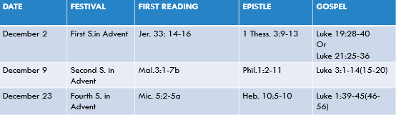

ALL SEASONS:
HOME
ALL EVENTS
MEMEBERS INFO
ADVENT:
PARAMENT COLOR: BLUE

Slide 10
ALL SEASONS:
HOME
ALL EVENTS
MEMEBERS INFO
CHRISTMAS:
PARAMENT COLOR: WHITE
DATE | FESTIVAL | FIRST READING | EPISTLE | GOSPEL
DEC 25 | CHIRSTMAS DAY | IS. 52:7-10 | Heb. 1:1-6(7-12) | John 1:1-14(15-18)
DEC 30

Slide 11

DELETE
BANNER HISTORY:
IT WAS PRINTED IN THE YEAR 2016
12*16*19
WHERE TO FIND:
3RD RACK IN THE BASEMENT
TOP SHELF
IN THE BLUE ROUND ROLL
SPECIAL INSTRUCTIONS
BANNER CODE : 3TBR
CLICK ME WHEN YOU USE THIS BANNER

Slide 12
DELETE
BANNER HISTORY:
IT WAS PRINTED IN THE YEAR 2016
12*16*19
WHERE TO FIND:
3RD RACK IN THE BASEMENT
TOP SHELF
IN THE BLUE ROUND ROLL
SPECIAL INSTRUCTIONS
BANNER CODE : 3TBR
CLICK ME WHEN YOU USE THIS BANNER
Used this banner for 3 times
Last used on 07/03/2019

