Slide 1
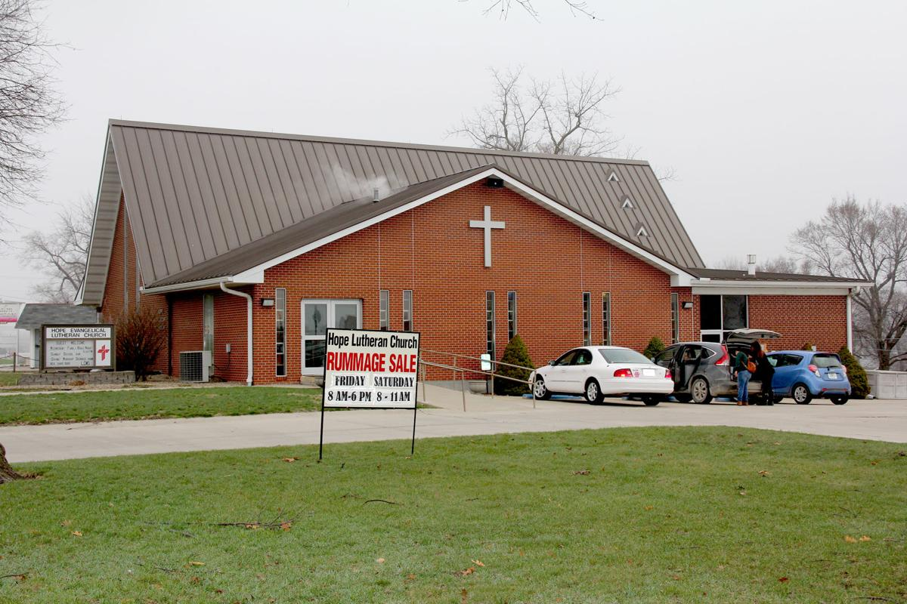
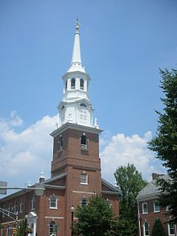
ALTAR GUILD PROJECT
HOPE LUTHERAN CHURCH
HOLY TRINITY LUTHERAN CHURCH
SELECT YOUR CHURCH

Slide 2
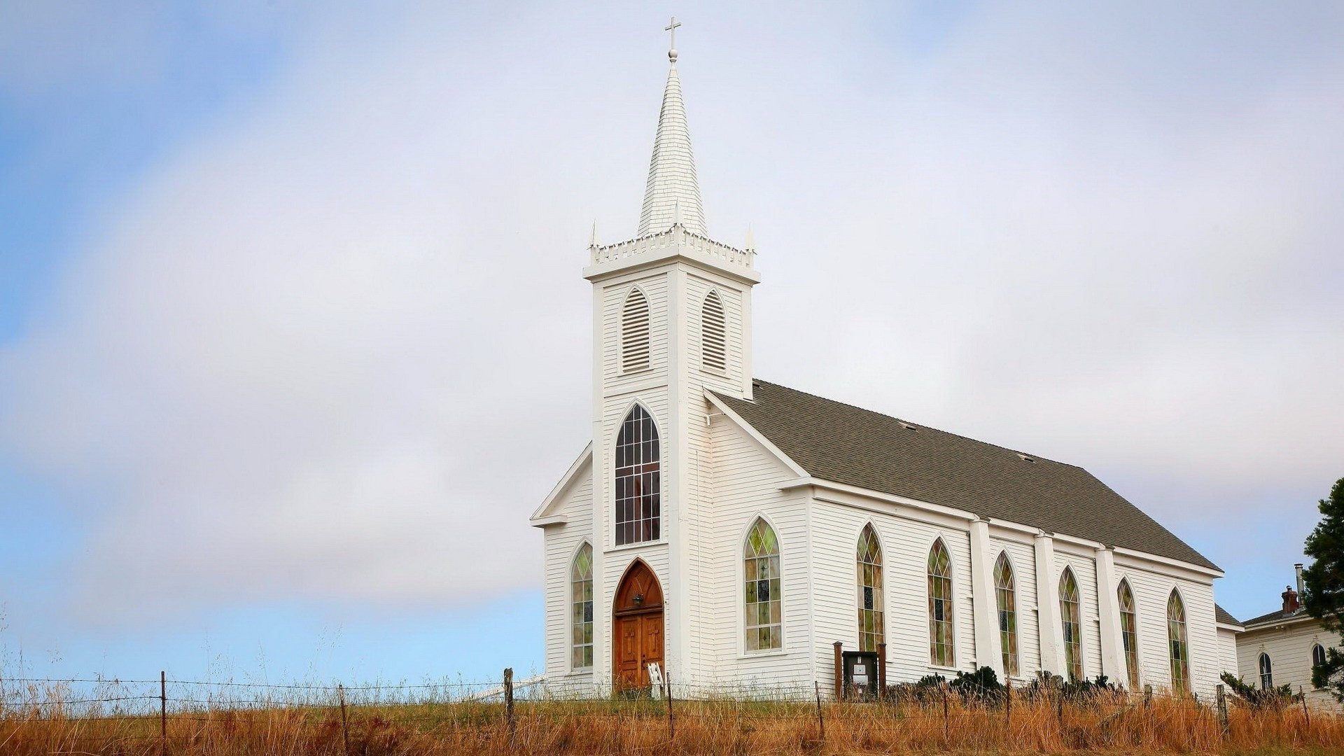
ALTAR GUILD
USERNAME
PASSWORD
LOGIN

Slide 3
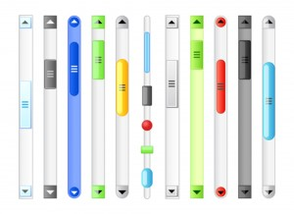
HOME
ALL SEASONS
MEMEBERS INFO
ADMIN PAGE
CURRENT FESTIVAL : - NOV 28TH 2019, WHITE CLOTH
THANKSGIVING
NEXT FESTIVALS :
ADVENT – DEC 23RD 2019, BLUE
CHRISTMAS – DEC 25TH 2019, WHITE
SEASONS:
ADVENT
CHRISTMAS
EPIPHANY
ASH WEDNESDAY
DEC 2-23
DEC 25-30
JAN 6 – 13
MAR 6

Slide 4
RESPONSIBILITIES:
JAN
TWLYA AND MARIE
FEB
KIM AND PHYLLIS
MAR
JEAN AND JAN
APR
PHYLLIS, MARIE AND MARY ANN

Slide 5
HOME
ALL SEASONS
MEMEBERS INFO
ADMIN PAGE
JANUARY :
EPIPHANY
JAN 6- 13
EPIPHANY
JAN 20 – FEB 24
EDIT INFO
ASSIGNED MEMBERS :
TWYLA 222-222-2222 TWYLA@ALTAR.COM
MARIE 333-333-3333 MARIE@ALTAR.COM
RESPOSIBILITIES:
ONE PARAMENT CHANGE
ONE BANNER CHANGE

Slide 6
HOME
ALL SEASONS
MEMEBERS INFO
ADMIN PAGE
CURRENT FESTIVAL : - NOV 28TH 2019, WHITE CLOTH
THANKSGIVING
NEXT FESTIVALS :
ADVENT – DEC 23RD 2019, BLUE
CHRISTMAS – DEC 25TH 2019, WHITE
SEASONS:
ADVENT
CHRISTMAS
EPIPHANY
ASH WEDNESDAY
DEC 2-23
DEC 25-30
JAN 6 – 13
MAR 6

Slide 7


HOME
ALL SEASONS
MEMEBERS INFO
ADMIN PAGE
CHRISTMAS:
PARAMENT COLOR: WHITE
DATE | FESTIVAL | FIRST READING | EPISTLE | GOSPEL
DEC 25 | CHIRSTMAS DAY | IS. 52:7-10 | Heb. 1:1-6(7-12) | John 1:1-14(15-18)
DEC 30

Slide 8
HOME
ALL SEASONS
MEMEBERS INFO
ADMIN PAGE
BANNER HISTORY:
DELETE
IT WAS PRINTED IN THE YEAR 2016
12*16*19
EDIT INFO
WHERE TO FIND:
CLICK ME WHEN YOU USE THIS BANNER
3RD RACK IN THE BASEMENT
TOP SHELF
IN THE BLUE ROUND ROLL
SPECIAL INSTRUCTIONS
BANNER CODE : 3TBR

Slide 9
HOME
ALL SEASONS
MEMEBERS INFO
ADMIN PAGE
BANNER HISTORY:
DELETE
IT WAS PRINTED IN THE YEAR 2016
12*16*19
EDIT INFO
WHERE TO FIND:
CLICK ME WHEN YOU USE THIS BANNER
3RD RACK IN THE BASEMENT
TOP SHELF
IN THE BLUE ROUND ROLL
SPECIAL INSTRUCTIONS
BANNER CODE : 3TBR
Used this banner 3 times
Last used on 07/03/2019

Slide 10

HOME
ALL SEASONS
MEMEBERS INFO
ADMIN PAGE
ALL SEASONS:
ADVENT:
PARAMENT COLOR: BLUE
CHRISTMAS:
PARAMENT COLOR: WHITE

Slide 11


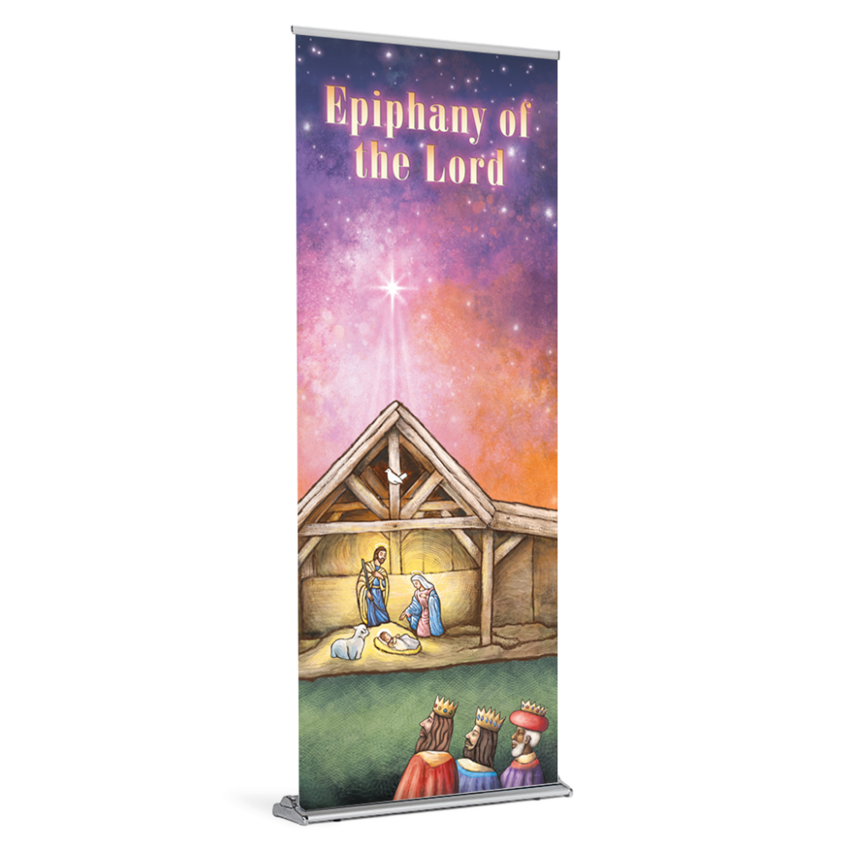

HOME
ALL SEASONS
MEMEBERS INFO
ADMIN PAGE
EPIPHANY:
PARAMENT COLOR: GREEN
EPIPHANY:
PARAMENT COLOR: GREEN

Slide 12
HOME
ALL SEASONS
MEMEBERS INFO
ADMIN PAGE
MEMBERS INFORMATION:
NAME
E- MAIL
PHONE
ADDRESS
1
Dr. Jean Memken
jmemken@mac.com
3098255326
Maryville
X
2
Phyllis
X
3
Pat
X
4
Jan
X
5
Beth
X
6
Twyla
X

Slide 13
HOME
ALL SEASONS
MEMEBERS INFO
ADMIN PAGE
NAME
E- MAIL
PHONE
ADDRESS
7
Kim
X
8
Liz
X
9
Pam
X
10
Marie
X
11
Mary Ann
X
ADD MEMBER

Slide 14
HOME
ALL SEASONS
MEMEBERS INFO
ADMIN PAGE
ADD CHURCH
ADD BANNER
DELETE CHURCH
ADD GUILD MEMBER

