Slide 1
ALTAR GUILD PROJECT BY TEAM BETTER HAPPO

Slide 2

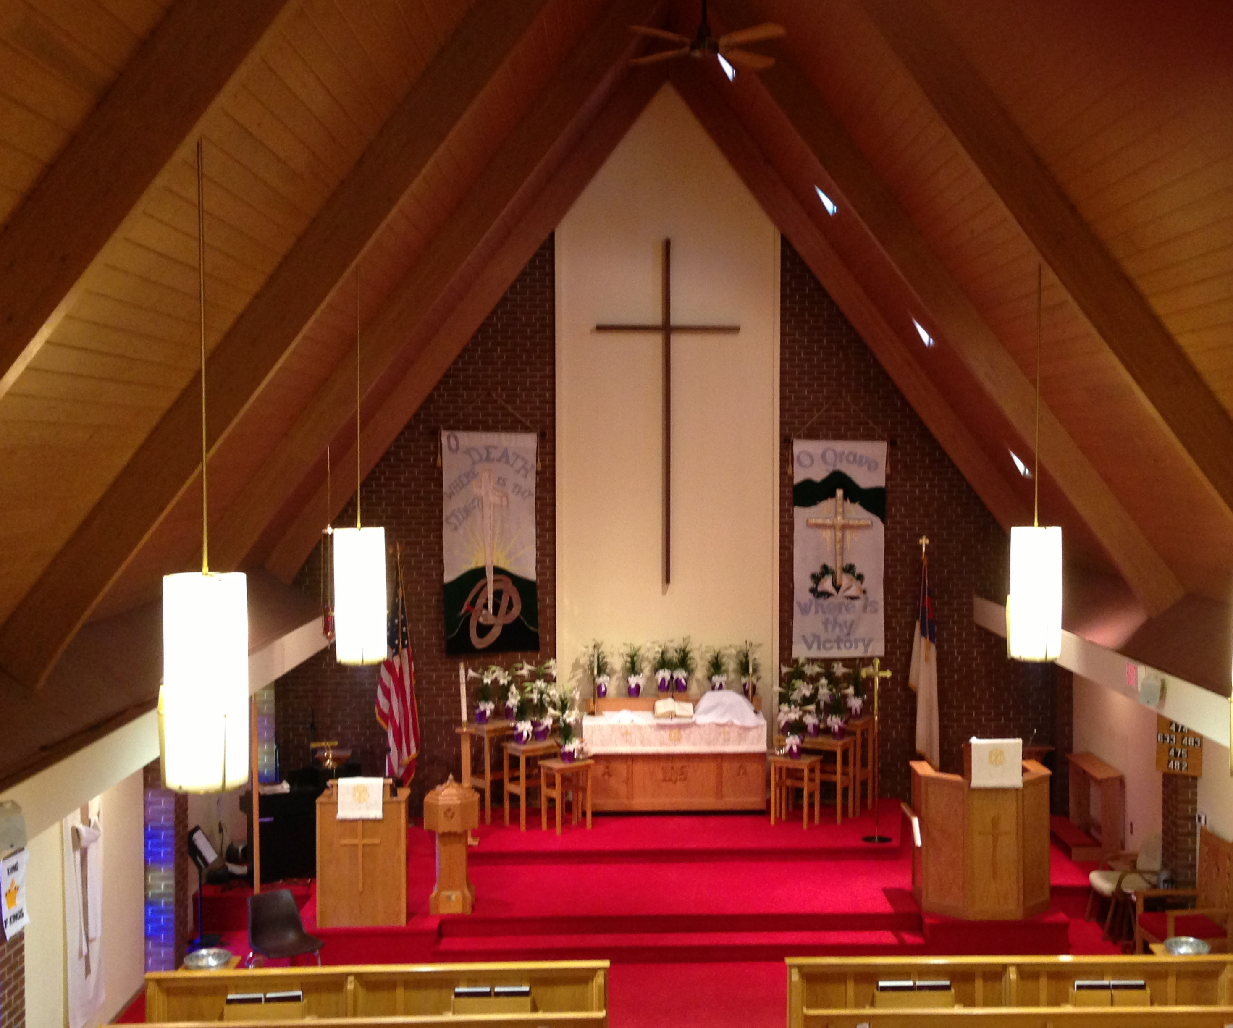
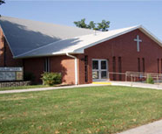
Introduction
Hope Lutheran Church
Church interior:
Paraments
Cloths on Altar, Pulpit and Lectern
Different Colors for Different Seasons
Banners – Change with season and holidays
2 front banners
1 side banner
Small Aisle banners
Committee of 10 members
Church year

Slide 3
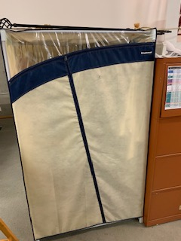
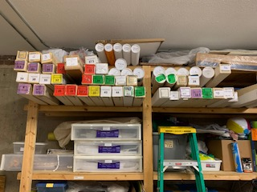
Banner Organization
Currently everything is identified manually by referring the appropriate documents.
There is no track of when is the banner used last time and how many times it has been used.
They should refer documents to identify the festival dates and parament colors.
Banners are color coded and numbered, but not all are associated with seasons.
No good coordination of information.
Banner notebook stored in the basement with banners, whereas schedule and contact information is located upstairs near sanctuary which involves a lot of time and effort.

Slide 4
Things done by Altar guild
There are many things that need to be identified to celebrate the festivals at church.
What is the date of particular festival?
Identify the color of the parament for each week of the church year
Identify banners associated with each season
Identify whether the banners are front banners, side banners or aisle banners
Identify banner pairs (2 banners that are always hung together in the front)
Identify any special preparations for each banner
Identify where the banner is stored
When is a particular banner used last time?
Who are responsible for that particular festival?
Identify Guild members and their contact information
What are the things to be done by the person when assigned to the festival?
Identify which months the guild members are assigned to work

Slide 5
Our solution to the problem
Everything is made available on the website.
All the information can be identified from the mobile or desktop.
Can identify festival dates, parament color to be used for that particular events and what are current and next events from website easily.
All the banners are available on the website sorted by the seasons.
Responsible members for each month will be displayed on the website.
Every year calendar is automatically generated.
Can track the usage of the banner like how many times is has been used and when was it last used.

