Slide 1
Reject-Before-Propagate
Build-Time Citation Gates for Agentic Literature-Synthesis Pipelines
N. Harish Vidyarth*, A. L. Reshma, R. Divya
Dept. of CSE (Cyber Security), Rajalakshmi Engineering College, Chennai
Target venue: ICACCS 2027 (IEEE Xplore) · * corresponding author
Notes:
Thesis in one line: LLM pipelines that review literature can emit citations that are wrong or fabricated. We stop that structurally, by making citation grounding a build-time invariant rather than a score a later stage can ignore.

Slide 2
What this talk covers
1
The problem
2
Why a score is not enough
3
The idea: Verify-or-Reject Grounding
4
The reference system
5
The certification algorithm
6
Evaluation and the central finding
VoRG · Reject-Before-Propagate
2
Notes:
Six beats. Keep the problem and the finding as the two you must land.

Slide 3
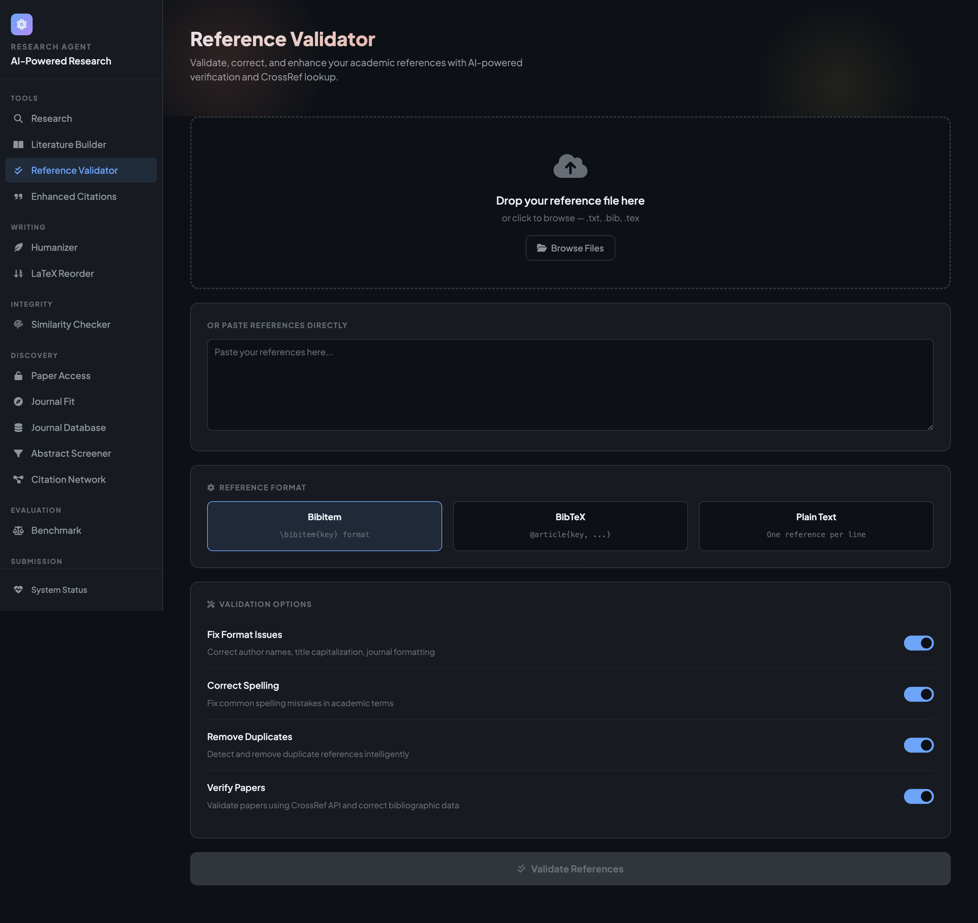
The problem: hallucinated and fabricated citations
▸ LLM pipelines extract claims, detect contradictions, and draft synthesis prose over a set of papers.
▸ Hallucination: the generated sentence looks well supported, but nothing in the source says it.
▸ Citation-level failure: the cited paper does not make the claim, or the reference does not exist.
▸ Example: a pipeline emitted “GNNs outperform descriptor baselines on ADMET tasks” with confidence 0.71; the cited paper never makes that comparison.
▸ When the output feeds a real manuscript, one wrong citation is expensive to catch later.
Today the citation check exists, but only as an advisory score.
VoRG · Reject-Before-Propagate
3
Notes:
Ground the stakes with the concrete example. The screenshot shows the reference validator: the check is there, it just does not gate.

Slide 4
Scored grounding leaves a gap
Scored grounding
A confidence value, a flag, or a review-queue entry is attached to the output.
The value sits next to the text; it does not control whether the text is emitted.
If the next stage reads the text field and not the score field, the unverified sentence propagates.
A hurried human reviewer can do the same.
What we want instead
The check is part of the stage's output type, not a value beside it.
An unverifiable value is never produced, so no later stage can receive one.
The guarantee holds for stages added later, without them knowing a score existed.
VoRG · Reject-Before-Propagate
4
Notes:
Key distinction. Scored grounding is a property of the output and is skippable. We move the guarantee into the pipeline itself.

Slide 5
Verify-or-Reject Grounding (VoRG)
Treat citation grounding as a build-time invariant. Every stage satisfies one of three conditions, or the build fails:
1. Deterministic
The stage transforms only already-verified inputs.
It adds no new hallucination surface.
2. Explicit check
A verification step discards any non-conforming output before it propagates.
3. Build error
The stage cannot verify its output, so it fails loudly instead of degrading quietly.
Same reject-by-default logic as the fail-safe-defaults principle in protection-system design (Saltzer and Schroeder, 1975).
VoRG · Reject-Before-Propagate
5
Notes:
VoRG is a property of the pipeline. A downstream stage cannot bypass it by ignoring a score it was never given.

Slide 6
Reference system: an eight-stage pipeline
GATE
GATE
GATE
Topic
expansion
Paper
discovery
Claim
extraction
Claim
normalisation
Contradiction
detection
Research-gap
detection
Citation
building
Persistence
Three subsystems enforce verify-or-reject grounding explicitly:
Evidence-grounded synthesis: verbatim substring check, deterministic aggregation, citation verifier.
Contradiction detection: judgments below the Likert threshold are discarded, not reported with low confidence.
Journal-metadata reconciliation: a metric is reported only when a source states it; conflicts are surfaced, never averaged.
VoRG · Reject-Before-Propagate
6
Notes:
Gold boxes are gated. Evaluation is stage-level, in the spirit of AgentBench, not a single end-to-end demo.

Slide 7
Inside the evidence-grounded synthesis gate
Evidence extraction
Every field must be a verbatim or near-verbatim substring of the source before it enters the evidence table.
▼
Synthesis matrix
A methods-by-datasets grid built deterministically, with no LLM call, so the aggregation-heavy step adds no hallucination surface.
▼
Narrative generation
The LLM drafts prose that cites evidence rows.
▼
Narrative verifier
Any sentence whose citation key does not resolve to a verified row is a build error, not a warning.
VoRG · Reject-Before-Propagate
7
Notes:
Structurally close to the evidence-retrieval step in FEVER, except an unsupported extraction is discarded, not scored 'not enough info'.

Slide 8
VoRG-Certify: linear-time certification
A naive scored implementation checks every generated sentence against every evidence row.
VoRG-Certify hashes the evidence table by citation key once, then certifies the whole narrative in a single pass.
BuildIndex(E): H[key(e)] <- e # expected O(1) each
Certify(N, H):
for each sentence s in N: # one pass
keys <- ExtractKeys(s) # one regex scan
if no keys or key not in H: reject(s) # build error
else: keep(s)
O(n · m) → O(n + M)
the quadratic term is gone
Legend
n = evidence rows
m = generated sentences
M = total narrative length
Same index-then-certify structure is reused for contradiction judgments and journal-metadata fields, so the bound carries over.
VoRG · Reject-Before-Propagate
8
Notes:
This is the technical core reviewers will probe. Stress that certification stays linear as the evidence base grows.

Slide 9
Evaluation design
Full pipeline
all gates on
Scored ablation
same decomposition and LLM calls, every gate replaced by a score, nothing dropped
Pattern-mode
rule-based extraction, gates on
Naive baseline
one prompt for claims, contradictions, gaps
Provider Groq, model openai/gpt-oss-120b · 3 runs per configuration
Pilot corpus: 10 papers, abstract coverage lifted from 1/10 to 7/10 by Semantic Scholar and OpenAlex backfill
Downstream-error metrics: unsupported sentences in the narrative, retained false-positive contradictions, narrative build failed
VoRG · Reject-Before-Propagate
9
Notes:
The scored ablation is the key comparison: reject versus score on otherwise identical output. Gold labels are authored by correcting pipeline output, not rubber-stamping it.

Slide 10
Results: claim extraction
Configuration | Precision | Recall | F1
Full pipeline (verify-or-reject) | 0.294 | 0.889 | 0.442
Pattern-mode ablation | 0.439 | 0.667 | 0.510
Naive single-LLM baseline | 0.104 | 0.333 | 0.158
Both decomposed configurations beat the naive baseline (F1 2.8x and 3.2x).
Pattern-mode's higher point estimate rides on a 3-sentence gold set and 5x the variance;
the multi-topic study is designed to settle rule-based versus LLM extraction.
VoRG · Reject-Before-Propagate
10
Notes:
Be honest about the tiny gold set. The point is the next slide.

Slide 11
Results: contradiction detection and research gaps
Contradiction detection
False-positive rate 0.0
on hand-labelled negative pairs, across all nine runs
Research-gap detection
recall 0.17 · precision@3 = 0.0
this stage has no verify-or-reject gate
The concrete failure
Top-ranked gap: “no studies have applied graph-based generative models for de novo molecular generation.”
Directly contradicted by the corpus's own paper: “Molecular generative Graph Neural Networks for Drug Discovery.”
The candidate gap was generated and ranked, but never checked against the corpus it judges.
VoRG · Reject-Before-Propagate
11
Notes:
The green versus red contrast previews the finding. Read the false gap quote slowly.

Slide 12
The finding: a gap-to-failure correspondence
Two gated stages → zero output contradicted by the reviewed corpus
One ungated stage → one confirmed false claim, contradicted by a corpus paper
The failure lands exactly where the architecture has no gate. This correspondence, not the F1 numbers, is the evidence for build-time rejection over post-hoc scoring.
Notes:
The money slide. It emerged during evaluation of the existing pipeline; it was not staged as a test of VoRG.

Slide 13
What this means
▸ Nothing about the pattern is specific to literature review.
▸ Any pipeline that generates text or structured records from retrieved sources can apply the same accept-or-reject check before passing output downstream.
▸ The evaluation shows where verification is already load bearing, and where its absence produces a concrete, corpus-contradicted failure.
▸ It does not claim VoRG solves hallucination in every setting.
VoRG · Reject-Before-Propagate
13
Notes:
Generalise, then scope honestly.

Slide 14
Limitations and next steps
Limitations
One topic with adjudicated gold; three gold claims, so claim-extraction numbers are underpowered.
Pilot corpus was abstract-poor; backfill lifted coverage to 7 of 10.
Multi-topic F1 and the pooled scored-ablation counts are still pending gold annotation.
Next steps
Run the matched scored-grounding ablation on identical output.
Extend to three to five gold-annotated topics with an independent annotator.
Apply the verify-or-reject gate to research-gap detection.
Submit to an IEEE Xplore venue; camera-ready carries the multi-topic tables.
VoRG · Reject-Before-Propagate
14
Notes:
The harness for all three next steps is implemented and released; what remains is human gold annotation.

Slide 15
Contributions
Pattern + algorithm
VoRG stated formally; VoRG-Certify runs in O(n+M), removing the O(n·m) term.
1
System + harness
Three gated subsystems in an eight-stage pipeline, with a reproducible evaluation harness, released.
2
The finding
A gap-to-failure correspondence: gated stages produce no corpus-contradicted output; the one ungated stage does.
3
VoRG · Reject-Before-Propagate
15
Notes:
Three chips. This is the slide people photograph.

Slide 16
Make the gate the pipeline, not the score.
github.com/harishvidyarthcsecs/Research
Thank you. Questions on the complexity argument and the gap-to-failure result are welcome.
harishvidyarth.n.2024.csecs@rajalakshmi.edu.in
Notes:
Close on the one-line thesis and the repo.

