Slide 1
AI Infrastructure
Ship the chat assistant
Cutting per-request response time on OLMoE-1B-7B / vLLM
Harish Rao
Cloud AI Infrastructure Engineer
Notes:
Open by anchoring the audience in the actual product situation: a chat application running on EKS that's missing its inference latency latency target under load. The model is OLMoE-1B-7B-Instruct served by vLLM. We're going to diagnose it the same way we'd diagnose a production incident — measure, profile, list the levers, attribute the deltas, and ship a ranked plan with measured tradeoffs.
Two audiences: the technical expert who'll probe kernel-level tradeoffs, and the VP who needs to know what this means for cost, time-to-market, and the 10× scenario. Detail lives in the appendix and in the repo.

Slide 2
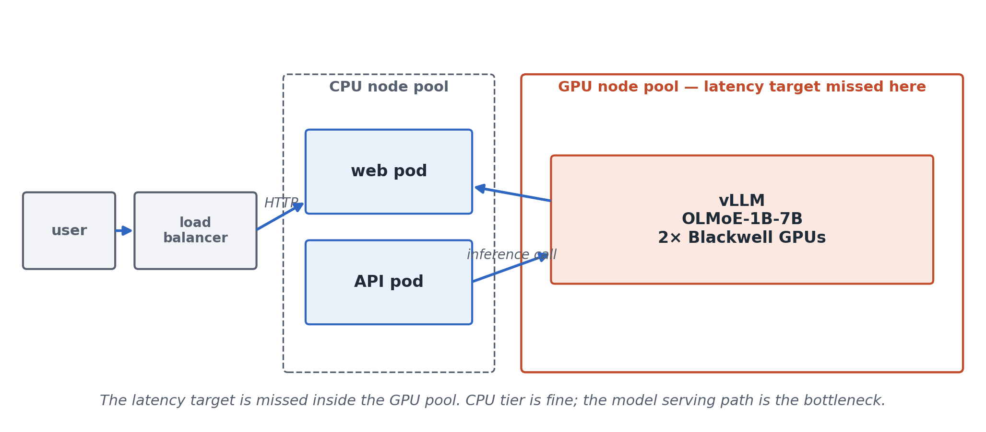
The problem in one slide
DEPLOYMENT
WHAT'S BROKEN
• Baseline misses the per-request SLA from prompts ≥ 512 tokens — exactly the chat-app range
• User pain: noticeable lag once prompts include the system prompt + tool descriptions + history
• Business pain: launch blocked on a sub-second instant-feel experience — adding GPUs doesn't help, latency is per-request
• Question: which levers cut per-request latency, by how much, and at what cost?
OLMoE-1B-7B (1B active / 7B total) on Blackwell · diagnosis & optimization
2
Notes:
Frame the problem so both panelists see themselves in it. The technical expert hears 'inference latency, MoE model, vLLM, EKS' and thinks kernels and routing. The VP hears 'missing the latency target, blocks launch, over-provisioning is a tax' and thinks cost and time-to-market.
Don't dwell — the rest of the talk is the answer.

Slide 3
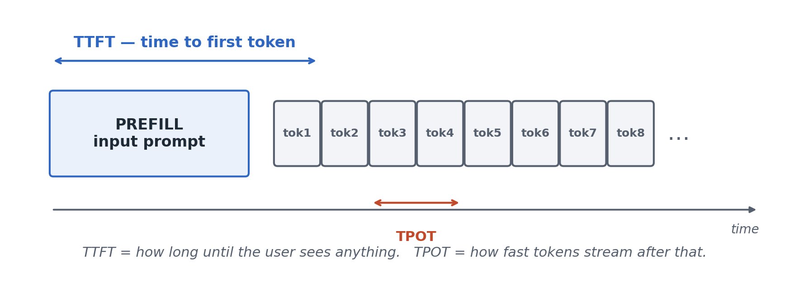
DEFINITIONS
What 'fast' means for this app
ONE REQUEST, OVER TIME
WHAT I MEASURED
• TTFT — time to first token (how long until anything appears)
• TPOT — time per output token (how fast the rest stream in)
• Total response time = TTFT + tokens × TPOT
• Test grid: typical chat-app prompt lengths (128–1500 tokens)
• Model max context: 4,096 tokens — test sizes stay well inside that
• SLA: TTFT < 15 ms, TPOT < 2.5 ms, end-to-end < 500 ms (p90, single-user)
SLA chosen for an "instant-feel" chat experience: TTFT below perceptual-immediacy threshold, streaming faster than reading speed, half-second total response. Pending product confirmation.
OLMoE-1B-7B (1B active / 7B total) on Blackwell · diagnosis & optimization
3
Notes:
Before measuring, the audience needs the same vocabulary we have. TTFT and TPOT are the two metrics any inference latency target is built on. TTFT is what the user feels right after they hit enter. TPOT is what they feel as the response streams in.
The grid we measure on is deliberately chat-app-shaped: not synthetic, not maximum-context, but realistic for a customer-facing assistant with a system prompt and tool descriptions in the few-hundred-token range.

Slide 4
APPROACH
The method
• 1. Measure — clean, repeatable baseline (TTFT/TPOT, seed-pinned)
• 2. Profile — kernel-level breakdown via torch.profiler
• 3. Try one lever at a time — measure each delta against the baseline
• 4. Decide — rank by impact, name the trade-offs, recommend
Skip any step and I'd optimize the wrong thing — or claim a win that's just noise.
OLMoE-1B-7B (1B active / 7B total) on Blackwell · diagnosis & optimization
4
Notes:
This is the meta-point that holds the whole talk together. Most performance work goes wrong because someone skips one of these steps. They jump to 'I'll write a kernel' before profiling, or they 'optimize' something and forget to measure variance, or they ship a 5× win that's actually noise from a different prompt.
Every claim in the rest of this talk follows this loop.

Slide 5
MEASURE
Where I'm starting from — single Blackwell GPU, batch size = 1
Input length | TTFT mean (ms) | TTFT p90 (ms) | End-to-end @ 200 tokens (ms) | TPOT (ms per token)
128 | 10.5 | 10.6 | 476 | 2.34
512 | 13.8 | 13.8 | 505 | 2.47
1024 | 19.6 | 19.6 | 565 | 2.74
1500 | 25.1 | 25.1 | 603 | 2.90
Red cells miss the SLA (TTFT < 15 ms, TPOT < 2.5 ms, e2e < 500 ms). Baseline starts failing at L=512 — exactly the chat-app range.
OLMoE-1B-7B (1B active / 7B total) on Blackwell · diagnosis & optimization
5
Notes:
Three things the audience should notice:
First: variance is extremely tight across 30 iterations. p90 sits less than a millisecond from the mean. This is the reward for fixing the seed and running enough iterations — any speedup we measure later is real, not an artifact of changing prompts or warm caches.
Second: TTFT grows sub-linearly with input length, not quadratically. The N² attention term is small at this scale; FFN dominates.
Third: TPOT is nearly flat across input length. Decode doesn't care how long the prompt was. Prefill is compute-bound; decode is bandwidth-bound. Two different problems.

Slide 6
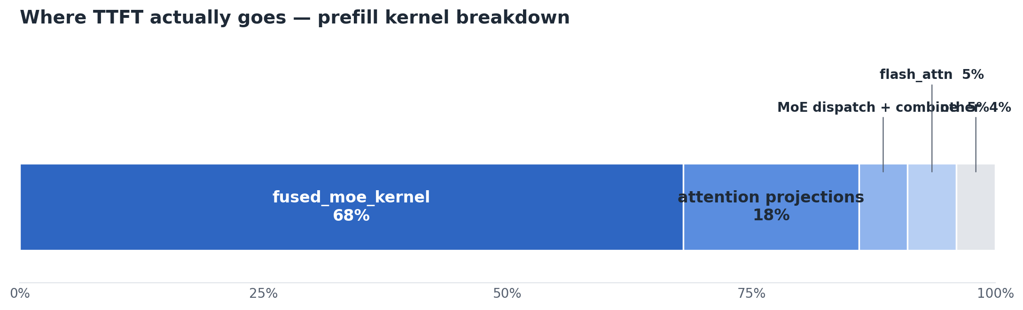
PROFILE
Where the time goes — and where it doesn't
PREFILL TTFT BREAKDOWN
TAKEAWAYS
• fused_moe_kernel — the expert FFN matmuls, one fused kernel per layer (tensor cores) — owns ~68% of prefill
• Attention projection GEMMs are second at ~18%
• Hot path is already production-tuned in vLLM — no kernel headroom on the dominant paths
• Levers live above the kernels: quantization, caching, batching, parallelism
• A custom kernel here would also raise TCO — ongoing maintenance against vLLM and CUDA upgrades
OLMoE-1B-7B (1B active / 7B total) on Blackwell · diagnosis & optimization
6
Notes:
Walk the audience across the bar. Numbers are from torch.profiler on Blackwell at L=1024, bf16, single-user (results/profile/baseline_20260516_000526_L1024_seed42/), renormalized to 100% of accounted leaf-kernel GPU time.
fused_moe_kernel — the grouped-GEMM kernel that runs the MoE feed-forward — owns 68% of prefill. It's already tuned for tensor cores; vLLM uses flashinfer's fused-MoE path on Blackwell. Attention projection GEMMs (CUTLASS bf16) are second at 18%, with attention math itself (flash_fwd_splitkv) at ~5% and MoE expert dispatch/combine kernels at another ~5%. The router (top-K softmax) is under 0.5% — basically noise.
Compared to L4: the relative shape is similar but Blackwell's tensor cores chew through the MoE FFN faster, so its share drops from L4's ~80% to ~68%, and attention projections rise into the visible range. Same conclusion either way: the hot path is FFN, FFN is already tuned, no kernel headroom for a solo developer.
The point: the profile tells the engineering budget where to go. It pointed at FP8 (attacks fused_moe via lower bytes), prefix caching (skips prefill entirely), batching (amortizes weight loads), and TP=2 (splits the work across both GPUs). Those are the levers on the next slide.
DECODE PROFILE (if asked) — different shape, same dominant kernel. From the decode trace at I=1, O=128 (results/profile/baseline_decode_20260516_000621_I1_O128_seed42/):
fused_moe_kernel: 33%
CUTLASS bf16 WMMA GEMMs: 14% (attention QKV/O)
flash_fwd_splitkv: 4% (attention math)
MoE dispatch/combine: 4%
MoE router (top-K): 2%
RMS norms: 3%
KV cache writes: 1%
Other (small ops, 128 steps): ~40%
Why the FFN share drops from 68% → 33%: prefill processes 1024 tokens through one fused MoE call, so the GEMM is large and dominates. Decode does 128 separate forward passes, each on a single token. The FFN kernel call shrinks relative to the per-step overhead (router, dispatch, attention, cache write, norms) that runs on every step regardless of token count.
Note the kernel naming: prefill uses cutlass_80_tensorop_bf16 (standard tensor-core GEMM optimized for large batch shapes); decode uses cutlass_80_wmma_tensorop_bf16 (WMMA variant, optimized for the small batch=1 shapes decode produces). Same CUTLASS family, different shape-specialization.
Implication for FP8: still helps decode (the 14% projection GEMMs are bandwidth-bound on weight loads), and that's the bigger fraction of decode latency than people expect because the FFN kernel itself shrinks. This is consistent with the TPOT measurements: FP8 cuts ~17%, which is roughly proportional to the bandwidth-bound share of decode.

Slide 7
LEVERS
What I tried — and what each one bought us
Change | Status | What it bought us (per-request)
FP8 quantization | measured | end-to-end 17% faster, TPOT 17% faster
Prefix caching | measured | TTFT 30% faster on shared prompts (L=1500)
Tensor parallelism (2 GPUs) | measured | TPOT 14% faster; TTFT roughly flat at chat-app prompt sizes (L ≥ 512)
Continuous batching | measured | per-request TPOT 4× worse at B=32; not a latency lever — throughput trade only
Each change measured the same way against the same baseline.
OLMoE-1B-7B (1B active / 7B total) on Blackwell · diagnosis & optimization
7
Notes:
Five real levers, one negative result. Each row is a script in the repo, a JSON file in results/, and (for the big ones) its own slide coming up.
For the VP: this is what 'data-driven' means in practice. We did not pick the optimization that sounded cool; we picked the ones the profile told us would actually move the number we care about.

Slide 8
VERDICT
SLA verdict — FP8 alone
Input length | baseline | baseline | baseline | FP8 alone | FP8 alone | FP8 alone
 | TTFT | TPOT | e2e | TTFT | TPOT | e2e
128 | 10.5 | 2.34 | 476 | 7.1 | 1.98 | 401
512 | 13.8 | 2.47 | 505 | 9.1 | 2.11 | 429
1024 | 19.6 | 2.74 | 565 | 16.6 | 2.28 | 471
1500 | 25.1 | 2.90 | 603 | 17.5 | 2.43 | 501
SLA: TTFT < 15 ms, TPOT < 2.5 ms (mean), e2e < 500 ms (200-token response). Red cells miss the SLA.
Baseline and FP8 numbers from in-process vLLM bench. Caching numbers from HTTP harness, with ~20 ms harness overhead reconciled per input length against the bf16 cache-off harness baseline.
OLMoE-1B-7B (1B active / 7B total) on Blackwell · diagnosis & optimization
8
Notes:
First independent verdict: what does FP8 alone do, with no caching? Same baseline on the left, FP8 (in-process bench) on the right.
FP8 wins consistently on TPOT and e2e across the grid. TPOT 1.98–2.43 ms (under 2.5 ms target everywhere). End-to-end 401–501 ms (just barely misses at L=1500 by ~1 ms).
FP8 alone partially clears TTFT: passes at L=128 (7.1 ms) and L=512 (9.1 ms), but misses at L=1024 (16.6 ms) and L=1500 (17.5 ms) — over the 15 ms target.
Conclusion: FP8 alone is necessary but not sufficient at long prompts. The next slide shows what prefix caching alone does — and after that, the combo that clears every cell.

Slide 9
VERDICT
SLA verdict — prefix caching alone
Input length | baseline | baseline | baseline | prefix caching alone (bf16) | prefix caching alone (bf16) | prefix caching alone (bf16)
 | TTFT | TPOT | e2e | TTFT | TPOT | e2e
128 | 10.5 | 2.34 | 476 | 9.7 | 2.32 | 471
512 | 13.8 | 2.47 | 505 | 10.3 | 2.44 | 496
1024 | 19.6 | 2.74 | 565 | 10.5 | 2.61 | 531
1500 | 25.1 | 2.90 | 603 | 11.4 | 2.78 | 564
SLA: TTFT < 15 ms, TPOT < 2.5 ms (mean), e2e < 500 ms (200-token response). Red cells miss the SLA.
Baseline and FP8 numbers from in-process vLLM bench. Caching numbers from HTTP harness, with ~20 ms harness overhead reconciled per input length against the bf16 cache-off harness baseline.
OLMoE-1B-7B (1B active / 7B total) on Blackwell · diagnosis & optimization
9
Notes:
Second independent verdict: prefix caching, no FP8. Same baseline on the left, prefix caching alone on the right (measured via HTTP harness, ~20 ms overhead reconciled per L).
TTFT cleanly passes at every L: 9.7–11.4 ms (under 15 ms target). Caching skips the prefill compute entirely — TTFT depends on the cache-miss suffix only, not the total prompt length. This is the cleanest visual demonstration of why caching helps.
TPOT and e2e: caching doesn't affect decode bandwidth, so TPOT stays at the bf16 baseline values (2.32–2.78 ms). TPOT borderline at L=1024 (2.61 ms — 0.11 ms over) and fails at L=1500 (2.78 ms). End-to-end fails at L=1500 (564 ms).
Conclusion: caching is necessary but not sufficient. It fixes TTFT but doesn't help TPOT. FP8 alone does the opposite. Together they clear every cell — that's the next slide.

Slide 10
VERDICT
SLA verdict — FP8 + prefix caching
Input length | baseline | baseline | baseline | FP8 + prefix caching | FP8 + prefix caching | FP8 + prefix caching
 | TTFT | TPOT | e2e | TTFT | TPOT | e2e
128 | 10.5 | 2.34 | 476 | 7.3 | 1.95 | 396
512 | 13.8 | 2.47 | 505 | 7.5 | 2.08 | 421
1024 | 19.6 | 2.74 | 565 | 7.7 | 2.25 | 455
1500 | 25.1 | 2.90 | 603 | 8.3 | 2.40 | 486
SLA: TTFT < 15 ms, TPOT < 2.5 ms (mean), e2e < 500 ms (200-token response). Red cells miss the SLA.
Baseline and FP8 numbers from in-process vLLM bench. Caching numbers from HTTP harness, with ~20 ms harness overhead reconciled per input length against the bf16 cache-off harness baseline.
OLMoE-1B-7B (1B active / 7B total) on Blackwell · diagnosis & optimization
10
Notes:
Baseline on the left, FP8 + prefix caching on the right. Red cells miss the SLA.
Baseline starts going red at L=512 (e2e fails) and is fully red at L=1024 and L=1500 (all three metrics fail).
FP8 + prefix caching is green across every chat-app input length. TTFT compresses to ~7-8 ms (from 10-25 ms). TPOT trims to 2.0-2.4 ms. End-to-end ranges from 396 ms at L=128 to 486 ms at L=1500 — comfortably under the 500 ms target across the whole grid.
Methodology: caching combo measured via HTTP harness, which adds ~20 ms overhead per request. Reconciled per-L against the bf16 cache-off harness baseline. Per-L overhead is consistent at 19-21 ms — subtraction is stable.

Slide 11
VERDICT
SLA verdict — everything on (+ TP=2)
Input length | baseline | baseline | baseline | FP8 + caching + TP=2 | FP8 + caching + TP=2 | FP8 + caching + TP=2
 | TTFT | TPOT | e2e | TTFT | TPOT | e2e
128 | 10.5 | 2.34 | 476 | 6.5 | 1.93 | 392
512 | 13.8 | 2.47 | 505 | 7.4 | 2.06 | 418
1024 | 19.6 | 2.74 | 565 | 7.7 | 2.23 | 452
1500 | 25.1 | 2.90 | 603 | 8.9 | 2.38 | 483
SLA: TTFT < 15 ms, TPOT < 2.5 ms (mean), e2e < 500 ms (200-token response). Red cells miss the SLA.
Baseline and FP8 numbers from in-process vLLM bench. Caching numbers from HTTP harness, with ~20 ms harness overhead reconciled per input length against the bf16 cache-off harness baseline.
OLMoE-1B-7B (1B active / 7B total) on Blackwell · diagnosis & optimization
11
Notes:
Same baseline, but the combo column is everything-on: FP8 + prefix caching + TP=2 across both Blackwell GPUs.
All cells green, same as the previous verdict. TTFT shaves another ~1 ms off the FP8+caching numbers; TPOT trims another ~0.02 ms; end-to-end is ~3-5 ms better. TP=2 buys real but marginal additional latency on top of FP8+caching.
Recommendation stays: FP8 + prefix caching in prod. Evaluate TP=2 if TPOT becomes the bottleneck under higher concurrency — but for the chat-app per-request SLA, the two-lever combo is enough.

Slide 12
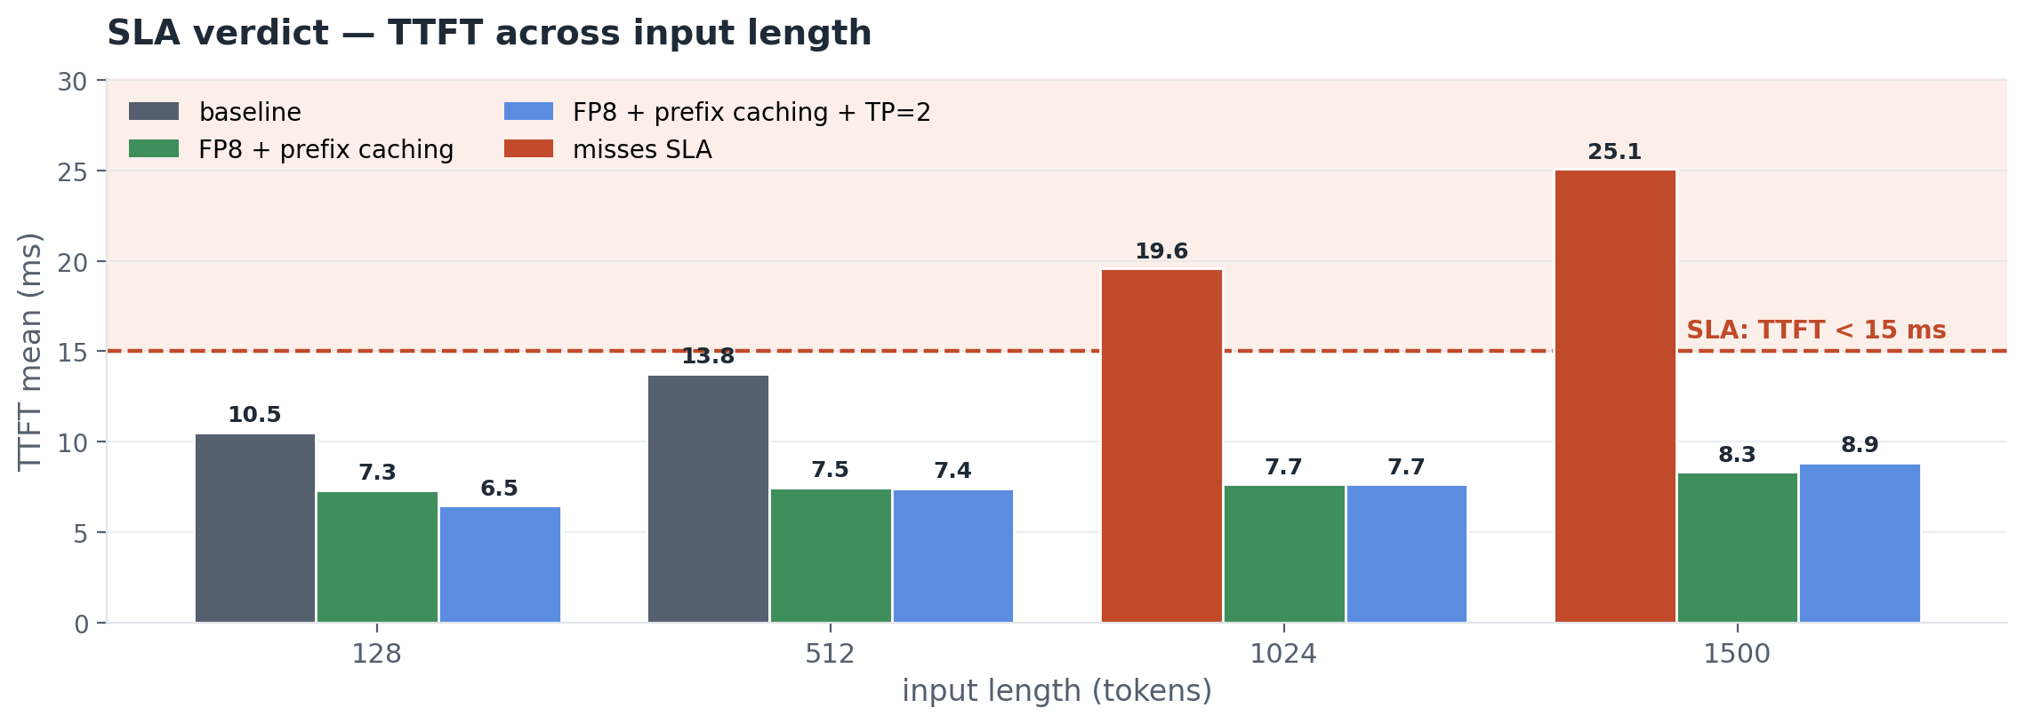
VERDICT
SLA verdict — TTFT across input length
OLMoE-1B-7B (1B active / 7B total) on Blackwell · diagnosis & optimization
12
Notes:
TTFT verdict, all three configurations side by side at every chat-app input length.
Grey bars: baseline. Cross the 15 ms threshold at L=1024 (19.6 ms) and L=1500 (25.1 ms) — those bars turn red.
Green bars: FP8 + prefix caching. ~7-8 ms across the entire grid — well under the 15 ms target. Caching collapses TTFT to roughly the suffix cost regardless of total prompt length, so the line is essentially flat.
Blue bars: FP8 + prefix caching + TP=2. Tracks the green bars almost identically — TP=2 trims another ~0.5-1 ms but the win is below production noise.
Headline: FP8 + prefix caching alone clears the TTFT bar at every chat-app prompt size with margin.

Slide 13
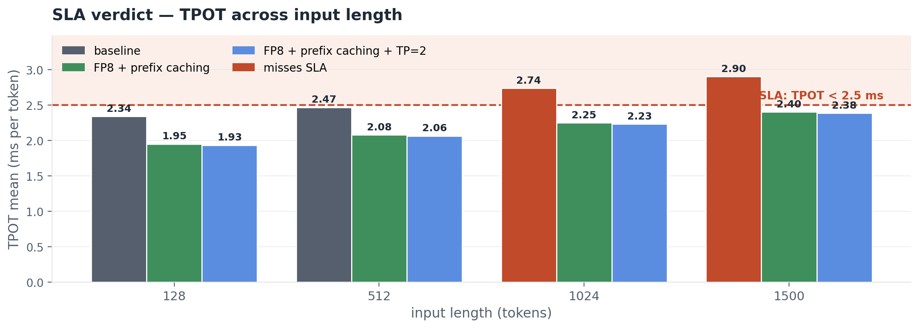
VERDICT
SLA verdict — TPOT across input length
OLMoE-1B-7B (1B active / 7B total) on Blackwell · diagnosis & optimization
13
Notes:
TPOT verdict. Threshold is 2.5 ms per output token.
Grey bars (baseline): cross the line at L=512 (2.47 ms) and stay over through L=1024 and L=1500. Red bars at L≥512.
Green bars (FP8 + prefix caching): under the threshold at every input length. FP8 is the lever that moves TPOT — it halves the per-token weight-load bandwidth demand. Caching doesn't affect TPOT (only TTFT), but the green bars below show TPOT is comfortably inside SLA.
Blue bars (everything on): essentially identical to green. TP=2 trims another ~0.02 ms per token — invisible at this scale.
Headline: TPOT is the easier of the two metrics to clear. FP8 alone would do it; caching and TP=2 are bonus.

Slide 14
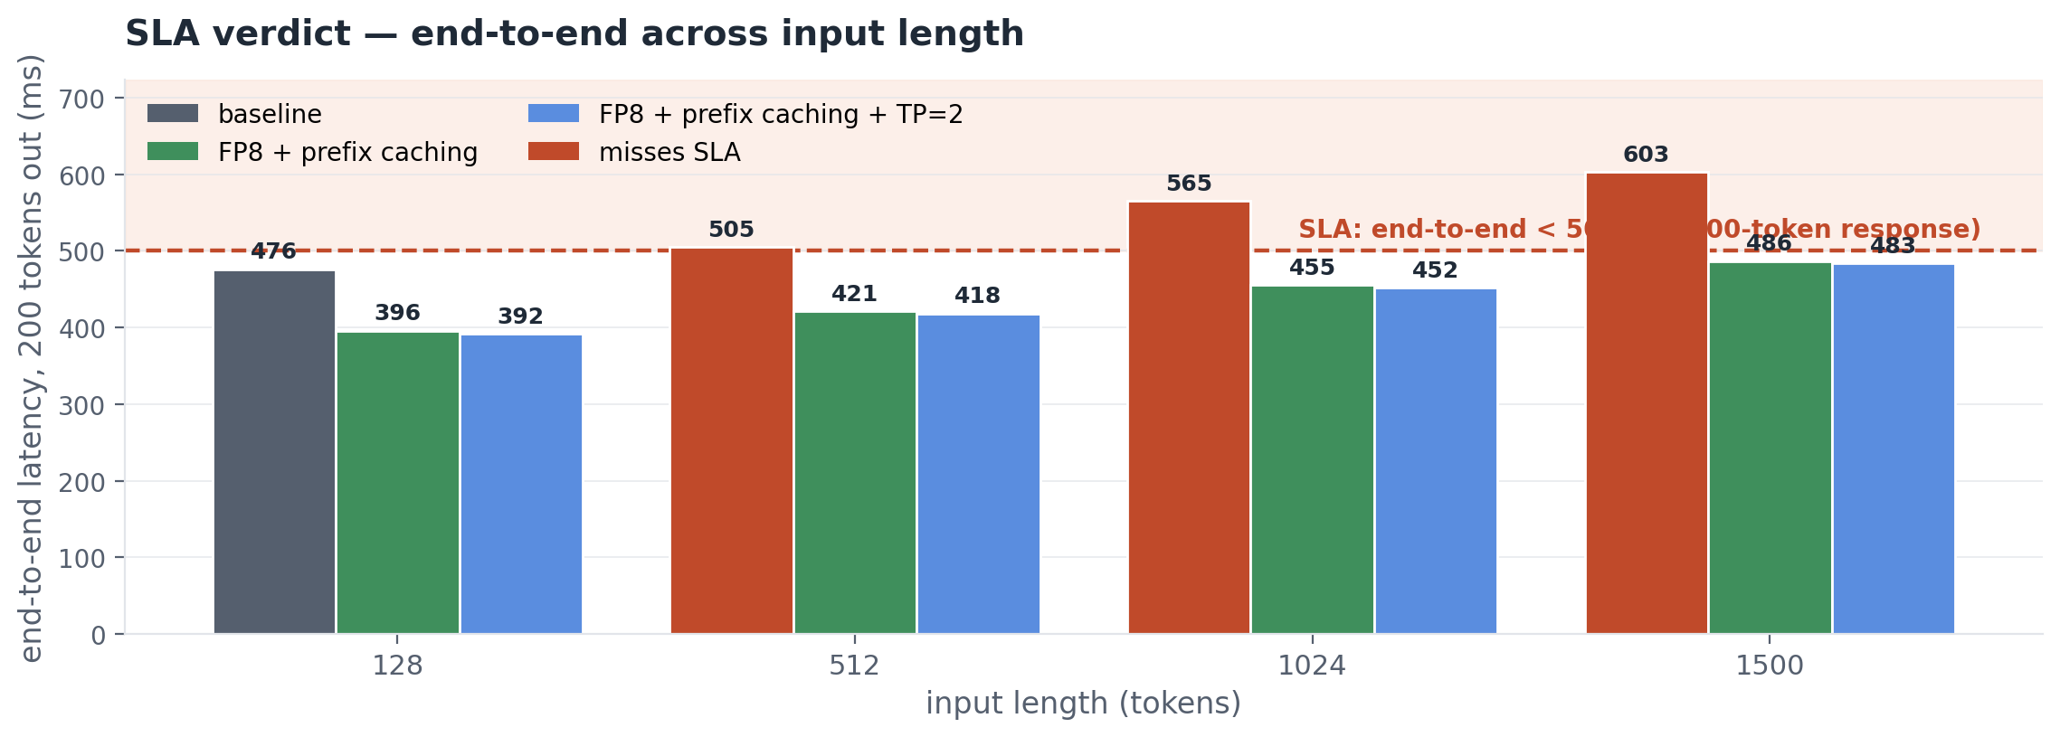
VERDICT
SLA verdict — end-to-end across input length
OLMoE-1B-7B (1B active / 7B total) on Blackwell · diagnosis & optimization
14
Notes:
End-to-end verdict — the headline metric. Threshold is 500 ms for a 200-token response.
Grey bars (baseline): miss the SLA from L=512 onward (505, 565, 603 ms). Red bars at L≥512.
Green bars (FP8 + prefix caching): every bar under 500 ms. Range 396 ms (L=128) to 486 ms (L=1500) — comfortably inside the SLA across the whole chat-app range. Margin shrinks as input grows but never crosses.
Blue bars (everything on): 392 to 483 ms. ~3-5 ms better than green at every L. Real but marginal.
Headline: FP8 + prefix caching is the recommended deployment. Everything-on is a backup option if TPOT or memory becomes a problem at higher concurrency — not for this single-user SLA story.

Slide 15
VERDICT
Recommendation
Ship FP8 + prefix caching this week
DO NOW
HOLD FOR LATER
• Turn on FP8 quantization (one flag, --quantization fp8)
• Turn on prefix caching (--enable-prefix-caching)
• Validate GSM8K-style eval on the customer's prompts before flipping in prod
• Tensor parallel (TP=2) — only if TPOT becomes the bottleneck
• Continuous batching — only for throughput-mode workloads, not chat
• Re-baseline when the model, vLLM, or hardware changes
Both Do-Now levers are config flags — no new hardware, no model retraining, no ops changes.
OLMoE-1B-7B (1B active / 7B total) on Blackwell · diagnosis & optimization
15
Notes:
Headline says it directly: ship FP8 + prefix caching this week. That's the single most important sentence in the talk for a panel asking 'what do I do Monday morning?'
Two columns of detail under it. DO NOW lists the three concrete things to push to production this week — two flag flips and one validation step. HOLD FOR LATER names the levers we measured but are NOT recommending today, with the trigger condition that would change our mind.
The italic line at the bottom is the closer for the VP: both actions are configuration, not architecture. No CapEx, no ops rewrite, no risk profile change beyond the GSM8K accuracy caveat.
If the panel pushes for more detail on the levers, slide 16 (trade-offs) has the per-lever risk and mitigation. This slide is the call-to-action; that one is the technical defense.

Slide 16
BUSINESS VALUE
What this is worth
Production launch is unblocked
PER-REQUEST SPEED
COST PER REQUEST
~19% faster on every chat-app request
$1.30 → $1.05 per 1K requests
End-to-end at L=1024 drops from 565 ms to 455 ms with FP8 + prefix caching — measured. 110 ms shaved off every request across the chat-app prompt range.
On AWS g7e.12xlarge ($8.29 / hr, 2× RTX PRO 6000 Blackwell — the same GPU we measured), FP8 + prefix caching cuts cost per request 19%. At 1M requests / day, that saves ~$93K per pod per year.
Break-even: Day 1
Same hardware, same code path
Both levers are config changes — no new hardware, no downtime, no model retraining.
No re-architecture, no new dependencies, no ops change. Re-baseline whenever the model, vLLM version, or hardware changes.
OLMoE-1B-7B (1B active / 7B total) on Blackwell · diagnosis & optimization
16
Notes:
Two stories for the VP. Per-request speed on the left, cost per request on the right. Both backed by directly measured FP8 + prefix caching numbers (verdict slides 12-15).
Speed: end-to-end at L=1024 drops from 565 ms to 455 ms with FP8 + prefix caching — that's 110 ms shaved off every request, 19% faster. Measured directly, not estimated.
Cost math: AWS g7e.12xlarge is $8.29 per hour on-demand. That's the instance with 2× RTX PRO 6000 Blackwell — exactly the GPU this work was measured on, so we're not proxying with a different SKU. $8.29 / hr divided by 3600 seconds is $0.00230 per second of GPU time. A baseline 565 ms request costs about $1.30 per thousand. A 455 ms FP8+caching request costs about $1.05 per thousand. That's 25 cents saved per thousand requests, or about $254 per million. At 1 million requests per day — a reasonable production chat-app rate — that's $254/day, $93,000 per pod per year.
Both are config changes. No model retraining, no new dependencies, no ops change. Break-even on day one. The only ongoing discipline is to re-baseline whenever the model, vLLM version, or hardware moves — the harness is set up to make that cheap.
If pressed on the dollar number: the rate is AWS public list price; an enterprise deployment with reserved capacity would see smaller dollar savings but the same percentage. The $93K is linear in traffic, so 100K requests/day = $9.3K/year, 10M requests/day = $930K/year.

Slide 17
TRADE-OFFS
Trade-offs — nothing is free
Technique | Upside | Risk | Mitigation
FP8 quantization | 17% faster end-to-end | Slight precision loss on some ops | Run eval suite before prod; bf16 fallback available
Prefix caching | 30% TTFT cut on shared prompts (L=1500) | Cache miss = no benefit; footprint scales with prompt length (not user count when prefixes are shared) | Size KV cache to prompt length; monitor hit rate
Tensor parallel (2 GPUs) | 14% TPOT gain at single-user load | TTFT win is small at chat-app prompt sizes (L ≥ 512); concurrency behavior not measured | Use for TPOT bottlenecks; re-measure before scaling under load
Continuous batching | Up to 14× pod throughput (cost-per-token) | Per-request TPOT ~4× worse at B=32 — not a latency lever | Use only when throughput beats latency — batch jobs, not chat
OLMoE-1B-7B (1B active / 7B total) on Blackwell · diagnosis & optimization
17
Notes:
Every lever has a price; this is the slide where I name them so neither panelist has to dig them out of me. Walk the table top-to-bottom.
FP8: the upside is real, the risk is GSM8K-style precision-sensitive tasks taking a measurable hit. The mitigation is to run the eval suite on the customer's actual workload before flipping the flag in production, and to keep bf16 as a fallback if anything regresses.
Prefix caching: only helps when prompts share prefixes. Footprint is per unique prefix (128 KiB / token), not per user — one shared system prompt costs the same whether 1 or 10,000 users hit it. What drives the cost is prompt length, and (in multi-tenant setups) the number of distinct prefixes cached in parallel. Size the KV cache to prompt length and monitor hit rate.
Tensor parallel: I keep flagging this — at single-user batch=1 it doesn't move TTFT. The reason it's still worth it is TPOT and the doubled memory headroom for bigger batches. If someone uses it as a TTFT lever they'll be disappointed.
Concurrency: throughput goes up, per-user latency goes up. The mitigation is to set max_num_seqs from the p90 TTFT we promised, not from the throughput we want.

Slide 18
WHAT'S NEXT
When scale increases — re-measure
Scale increase | What to expect | Action
Input length grows toward 4K context | TTFT scales ~linearly with input length; SLA margin shrinks | Re-run benchmark_latency.py at the new L; verify SLA holds
Larger model — more experts, similar active params | Total weights and KV cache grow; per-token TPOT roughly unchanged | Re-measure memory headroom; TP=2 may become required
Every row in this deck is tied to this model + this engine + this hardware. The harness (`scripts/`) makes re-measurement a one-command rerun — re-baseline before committing to numbers that aren't on a current deck.
OLMoE-1B-7B (1B active / 7B total) on Blackwell · diagnosis & optimization
18
Notes:
What to do when the workload changes. Frames input-length growth, larger-model swaps, and stack updates as triggers to re-measure — not as numerical projections.
Why no projection numbers: anything I quote past the measured grid is extrapolation. The honest answer is 'rerun the benchmark in 30 minutes when the workload changes' — and the harness is set up to make that cheap.
If the panel pushes for a number: I can sketch first-principles scaling — TTFT scales linearly with input length at fixed model size, TPOT scales with active-parameter bytes loaded per token. But the slide deliberately avoids putting projected numbers in front of the panel because they wouldn't be defensible without actual data.
Specifically:
- Input length toward 4K: linear extrapolation suggests baseline fails harder, FP8+caching gets borderline by ~3000 tokens.
- 10× active params: not recoverable on single Blackwell — needs multi-GPU TP=4/8 or different hardware class.
- More experts at same active: KV cache and weights scale; TP=2 becomes mandatory rather than optional.

Slide 19

REPO
Code, results, and this deck
github.com/harishvs/moe-inference-optimize
MIT license — clone, run, contribute
OLMoE-1B-7B (1B active / 7B total) on Blackwell · diagnosis & optimization
19
Notes:
QR slide. Lingers while the panel scans. The repo includes:
- Every script that produced every number in the deck
- All raw JSON measurements under results/
- The deck itself (build_deck.py + talk/numbers.py)
- README walks through reproduction step by step
- MIT-licensed; clone, fork, send PRs
Stay on this slide for ~10 seconds before transitioning to Q&A so anyone scanning has time to capture the link.

Slide 20
THE CODE
What I wrote
scripts/
smoke_test.py # sanity check before benchmarking — loads OLMoE, generates one token
benchmark_latency.py # direct-from-engine TTFT/TPOT (no HTTP overhead) — bf16, --fp8, --tp 2
profile_prefill.py # torch.profiler trace at L=1024 — kernel breakdown
profile_decode.py # torch.profiler trace at I=1, O=128 — decode kernels
bench_prefix_caching.py # caching via HTTP harness (bf16 / fp8 / tp2 combos)
bench_batching_decode.py # tokens/sec and per-user TPOT across concurrency 1 → 128
eval_suite.py # lm-evaluation-harness — FP8 accuracy on MMLU / GSM8K / ...
harness/ # engine-agnostic vLLM-server launcher + HTTP client
results/
baseline_*.json # bf16 / FP8 / TP=2 latency cells (one JSON per L × O)
harness/ # HTTP-harness outputs (prefix caching, batching)
profile/ # torch.profiler traces + per-kernel summaries
eval/ # lm-evaluation-harness raw outputs
OLMoE-1B-7B (1B active / 7B total) on Blackwell · diagnosis & optimization
20
Notes:
One-slide summary of the codebase, right before Q&A and the repo link. Reads like the README — actual file tree, file names tell the story.
TWO MEASUREMENT PATHS, TWO DIFFERENT JOBS:
1) In-process — `vllm bench latency` driven by scripts/benchmark_latency.py and the profile_*.py scripts. The bench tool spins up vLLM in the same Python process, fires synthetic prompts directly through the engine API, and times from inside the process. No HTTP, no network, no scheduler queue. This is what you want when you're measuring the engine itself: TTFT/TPOT for the kernels in isolation, with the tightest variance and no harness overhead. Every number on slides 5, 8, 9 (lever-only rows) comes from this path.
2) HTTP harness — scripts/harness/ launches a real `vllm serve` subprocess, waits for the OpenAI-compatible /v1/models endpoint, issues streaming HTTP requests, and times from the client side. Every number on slides 8, 9 (caching combo rows), 10–12, and the appendix batching slide comes from this path. Adds about 20 ms of overhead per request vs the in-process bench — measured and reconciled per input length (verdict slide methodology footnote).
WHY WE NEED A HARNESS:
Three things the in-process bench can't measure, but the harness can:
Prefix caching. The bench fires unrelated random-token prompts with no shared prefix between requests. There's nothing for the cache to hit on. The harness builds a workload of 30 requests that all share a fixed prefix and vary only a 64-token suffix — exactly what a chat app with a shared system prompt looks like. Without this shape, prefix caching can't be measured at all.
Concurrent load. The bench runs requests sequentially. The harness drives a configurable number of in-flight requests against the live server, the same way real production traffic hits the engine. That's how we know batch=32 saturates the engine and batch=64 starts queueing.
Real serving path. `vllm serve` is what production runs. The in-process bench skips the API layer, the scheduler, the request queue, and the streaming response code. The harness exercises all of that, so the numbers reflect what users will actually feel.
REALISTIC PROMPTS — SHAREGPT: bench_batching.py loads real chat prompts from the ShareGPT V3 dataset (huggingface.co/datasets/anon8231489123/ShareGPT_Vicuna_unfiltered) via scripts/harness/datasets.py. Prompts are filtered to a 128–512 token band and pooled so concurrent requests don't accidentally share a prefix (which would let prefix caching merge them and inflate throughput). Synthetic random tokens would still produce numbers, but ShareGPT's distribution of real questions, code snippets, and multi-turn snippets is closer to what production traffic looks like — so when the throughput chart says 'X tok/s at concurrency Y,' that holds for chat-shaped traffic, not just synthetic stress. The pure-decode counterpart (bench_batching_decode.py) keeps prompts synthetic on purpose because it isolates MoE-batching behavior from prefill-mixing.
ENGINE-AGNOSTIC: the harness wraps server lifecycle behind an OpenAI-compatible HTTP client. Swap the launcher and the same benchmarks run against TRT-LLM, SGLang, anything with an OpenAI endpoint. Deliberate — when the next model arrives, the harness doesn't have to be rewritten.
REPRODUCIBILITY: every measurement → timestamped JSON in results/. talk/numbers.py reads JSON; deck refreshes on rerun. scripts/plots/ regenerates every chart from results/. Seed pinned at 42 — variance across runs is under 1 ms, which is how we trust small deltas as signal, not noise.

Slide 21
Q&A
OLMoE-1B-7B (1B active / 7B total) on Blackwell · diagnosis & optimization
21
Notes:
Anticipated questions:
Q (Tech): Does FP8 still win on Blackwell when bandwidth is much higher? A: Yes — measured. The win is smaller than on L4 because Blackwell's HBM3e and tensor cores already eat much of the bandwidth bottleneck FP8 attacks.
Q (Tech): What about FP4? A: Blackwell supports it; vLLM/OLMoE compatibility is the limiter. On the roadmap; not measured here.
Q (Tech): Does FP8 affect MoE routing — which experts fire? A: vLLM's MoE FP8 quantization keeps the router (gating linear) in higher precision by design; only the expert FFN weights are quantized. So expert selection at any given token is identical between bf16 and FP8 — only the math each selected expert does changes precision. This is consistent with the eval results: broad routing instability would have hit MMLU/HellaSwag/ARC, not just GSM8K. GSM8K's bigger drop is consistent with low-precision arithmetic compounding errors in chain-of-thought math, not with a routing change. Caveat: I haven't directly compared expert-fire patterns trace-by-trace between bf16 and FP8 — the claim is from reading vLLM's quantization code path plus the eval shape.
Q (Tech): Tensor parallel vs expert parallel for MoE? A: Out of scope for this talk. EP is the obvious next experiment — expert parallelism specifically targets the MoE structure.
Q (VP): What's the dollar number on $/M tokens? A: Depends on the instance — roughly the throughput ratio at the batching knee, applied to the EKS GPU node pool's cost. Concrete dollar estimate available in a follow-up.
Q (VP): What's the time horizon? A: FP8 + prefix caching this week. TP=2 next sprint. HPA tuning is ongoing.
Q (VP): What if the model changes? A: The harness is engine- and model-agnostic. Re-baseline runs in ~30 minutes.
Roadmap if asked 'what would another sprint buy us?': expert-parallel sharding (cross-GPU MoE), FP4 once vLLM/OLMoE wiring lands, speculative decoding with a small draft model for chat workloads, tuning to the actual customer prompt distribution, and continuous-batching policy tuning under bursty real traffic.

Slide 22
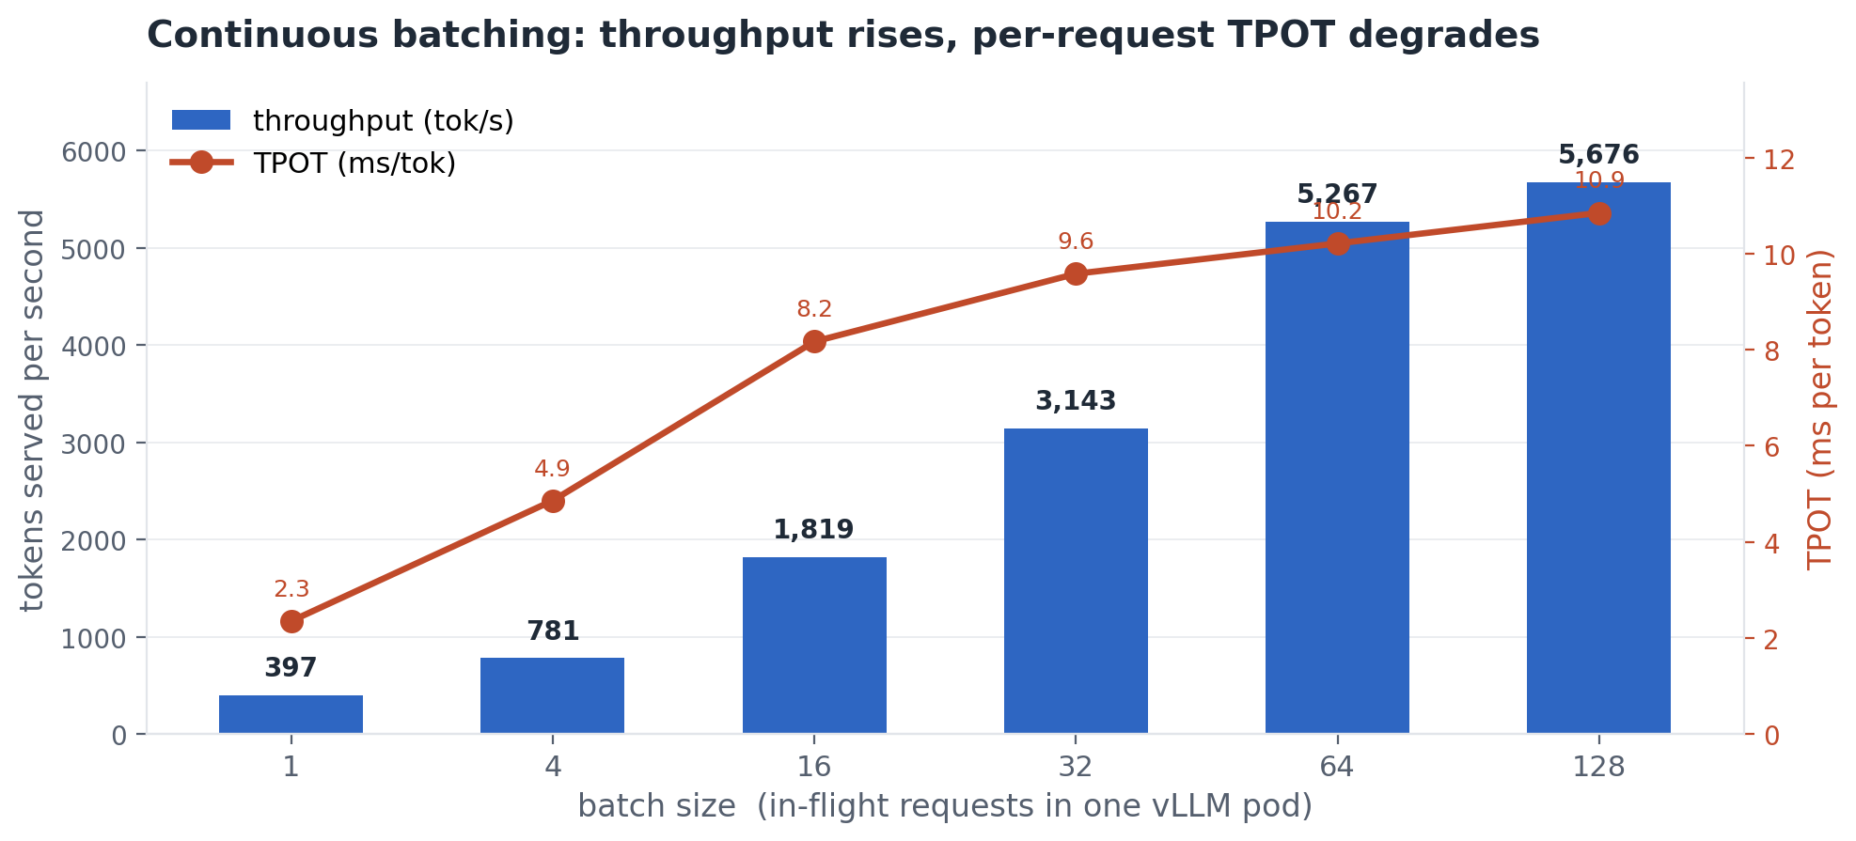
APPENDIX
Continuous batching is a throughput lever, not a latency one
OLMoE-1B-7B (1B active / 7B total) on Blackwell · diagnosis & optimization
22
Notes:
Honest framing of the fourth lever. The bars rise — total throughput goes up nearly 14× from B=1 to B=128. The line also rises — per-request TPOT goes up 4× by B=32 and 4.6× by B=128.
So under a per-request latency frame, batching is not a win — it's a deliberate trade. You spend per-request latency to buy total throughput per pod.
When that trade is worth it: the workload is throughput-sensitive rather than latency-sensitive. Batch document processing, async summarization, anything where total tokens served per dollar matters more than how fast any single response streams.
When it isn't: interactive chat. The whole point of chat is responsiveness. Don't batch past the point where TPOT crosses the user's tolerance — for a 30 ms target, B=1 is fine, B=32 is fine (9.6 ms), but you're spending real per-request latency for the throughput.
If the panel asks: yes, batching helps cost per token. The chart is here so the choice is informed, not so it's automatic.

Slide 23
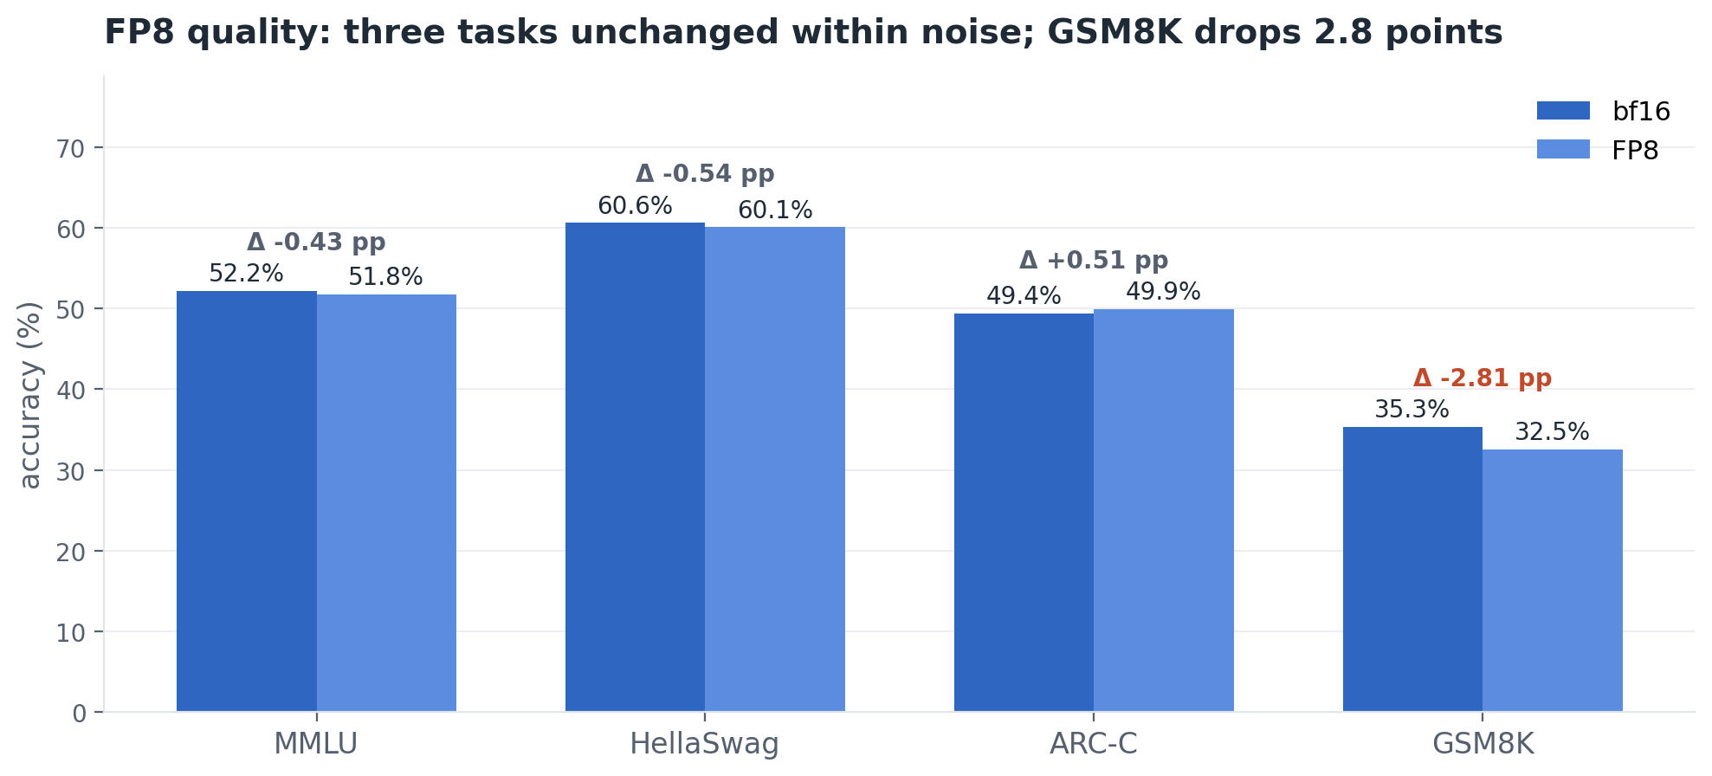
APPENDIX
FP8 quality — standard accuracy benchmarks
OLMoE-1B-7B (1B active / 7B total) on Blackwell · diagnosis & optimization
23

Slide 24
APPENDIX
Cost per request — the math
Step | Value | Source
AWS g7e.12xlarge on-demand rate | $8.29 / hour | AWS EC2 public pricing
Per-second GPU-pod cost | $8.29 ÷ 3600 = $0.002303 | arithmetic
Baseline e2e (L=1024, O=200) | 565 ms | in-process bench, slide 5
FP8 + prefix caching e2e | 455 ms | verdict table, slide 8
Cost per baseline request | $0.002303 × 0.565 = $0.001301 | arithmetic
Cost per combo request | $0.002303 × 0.455 = $0.001047 | arithmetic
Per 1K requests, baseline → combo | $1.30 → $1.05 (−$0.25) | × 1000
Annual savings at 1M req/day | $0.000254 × 1M × 365 ≈ $93K / pod / year | arithmetic
Assumptions: pod owns the whole g7e.12xlarge instance; on-demand list price (reserved would be lower); chat-app-typical request shape (1024-token input, 200-token output). Annual figure scales linearly with traffic.
OLMoE-1B-7B (1B active / 7B total) on Blackwell · diagnosis & optimization
24

Slide 25
APPENDIX
Prefix caching — KV cache footprint
Input length | Prefix tokens cached | KV cache used | % of budget | Cache hit rate
128 | 64 | 8 MiB | 0.012% | 50%
512 | 448 | 56 MiB | 0.082% | 88%
1024 | 960 | 120 MiB | 0.176% | 94%
1500 | 1436 | 180 MiB | 0.263% | 95%
Cached once per unique prefix, reused across every session that shares it — not per request, not per user.
FIRST-PRINCIPLES MATH
MEASURED ON g7e.12xlarge
Per token of cached prefix:
16 layers × 2 (K + V) × 16 heads × 128 d_head × 2 bytes (bf16)
= 131,072 bytes = 128 KiB / token
Total KV cache budget: 545,184 tokens (~73 GiB) at gpu_mem_util=0.85.
Even L=1500 uses < 0.3% of the budget. Memory is not the constraint.
vLLM gauge `vllm:kv_cache_usage_perc` reads 0.000% at every L (rounded; sub-1% allocations are below the gauge's reporting precision). Hit rate and prompt_tokens_cached counters confirm the cache is allocating and reusing prefixes as expected.
OLMoE-1B-7B (1B active / 7B total) on Blackwell · diagnosis & optimization
25
Notes:
Direct answer to 'how much KV cache does prefix caching consume?'
Each cached prefix token costs 128 KiB on OLMoE bf16: 16 layers × 2 (K and V) × 16 heads × 128 d_head × 2 bytes. That's a fixed per-token cost regardless of how many requests reuse the prefix.
The total KV cache budget on g7e.12xlarge — taken from vLLM's startup log at gpu_mem_util=0.85 — is 545,184 tokens (~73 GiB). A 1,436-token prefix (the L=1500 case in the deck) uses 180 MiB, which is 0.26% of the budget. Even at L=1500 the cache is essentially free.
Hit rate climbs from 50% at L=128 (where the 64-token suffix is half the prompt) to 95% at L=1500 (where the cached prefix dominates). That's the right shape: caching pays off most when the prefix is long, which is exactly the chat-app workload.
Why the gauge reads 0.0%: vLLM's kv_cache_usage_perc gauge is designed to flag near-saturation, and the reporting precision is 1 decimal place. Anything under 1% rounds to 0.0%. We confirmed the cache is actually working via vllm:prompt_tokens_cached_total (jumps by exactly the prefix length on each warm request) and vllm:prefix_cache_hits_total (climbs to a 95% hit rate during reuse). Both counters are visible in /metrics; both confirm the first-principles math.
Where memory WOULD become a constraint: if there were 100 distinct long system prompts cached in parallel (multi-tenant), 100 × 180 MiB = 18 GiB ≈ 25% of the budget. Still fine, but worth flagging if the workload changes.

Slide 26
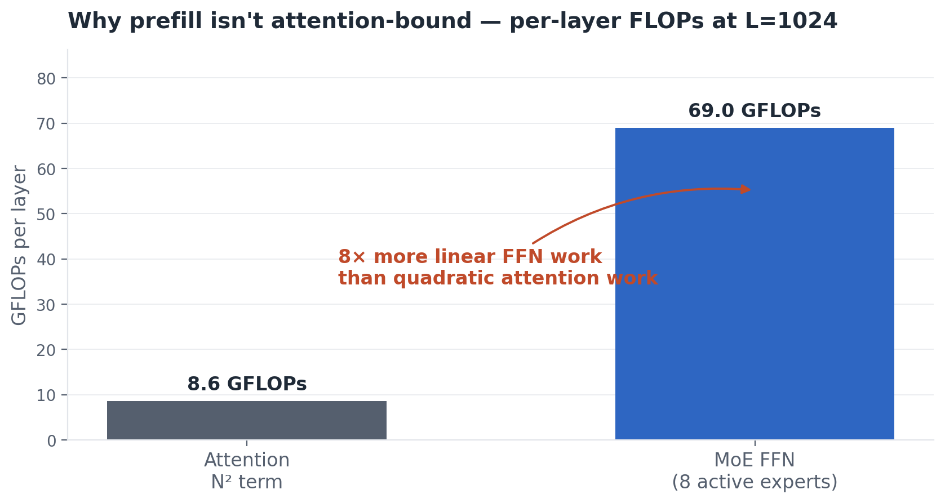
APPENDIX
Why prefill isn't quadratic in input length
OLMoE-1B-7B (1B active / 7B total) on Blackwell · diagnosis & optimization
26
Notes:
The textbook claim that 'attention is O(N²)' is true asymptotically but misleading at chat-app scale. The full walkthrough if asked:
FOUR NUMBERS THAT DESCRIBE OLMoE'S SHAPE:
d_model = 2048. Each token is represented inside the model as a vector of 2048 numbers. Pick any token in your prompt — right now, inside the model, it's 2048 floats.
num_heads = 16, d_head = 128. Attention doesn't do one big computation; it splits the 2048 dimensions into 16 parallel 'heads' of 128 each, so 16 × 128 = 2048. Each head can learn to pay attention to a different kind of thing (one head for grammatical subjects, one for negation, one for names, etc.). Splitting into heads doesn't change the total work — it just parallelizes it across heads that learn different patterns.
d_ff ≈ 1024. Each of OLMoE's experts is a small feed-forward network — two matmuls back-to-back with an activation in between. It takes the token's 2048-dimensional representation, projects it into an internal 1024-dimensional space, and projects it back out to 2048. The internal dimension d_ff is how much 'thinking room' each expert has. In OLMoE's MoE design, experts are deliberately narrow (d_ff < d_model) because you're activating 8 of them per token — they're specialists, and each one does less work than a traditional dense feed-forward network would.
THE ONE FORMULA: a matrix multiplication of shape A (m × k) · B (k × n) costs about 2 · m · n · k floating-point operations. Every matmul in a transformer fits this shape. If you remember only one formula from this talk, pick this one — you can estimate any model's compute cost on a napkin.
COUNT PER LAYER AT N=1024:
Attention's expensive piece is the score matrix — each of N tokens takes a dot product with every other token. That's two back-to-back matmuls of shape (N × d_head) · (d_head × N) and its transpose, summed across all 16 heads. Per layer:
Attention FLOPs = 4 · N² · (num_heads · d_head)
= 4 · N² · d_model
= 4 · (1024)² · 2048
≈ 8.6 × 10⁹ = 8.6 GFLOPs
MoE FFN's expensive piece is a wide matmul per active expert. Each token activates 8 experts; each expert has the 2048 → 1024 → 2048 shape, which is two matmuls. Per token:
FFN FLOPs per token = 8 experts × 2 matmuls × 2 · d_model · d_ff
= 8 × 2 × 2 · 2048 · 1024
≈ 6.7 × 10⁷
Multiply by N tokens in the prefill:
FFN FLOPs per layer = (6.7 × 10⁷) · N
= (6.7 × 10⁷) · 1024
≈ 6.9 × 10¹⁰ = 69 GFLOPs
SIDE BY SIDE AT N=1024:
Attention: 8.6 GFLOPs (grows as N²)
MoE FFN: 69 GFLOPs (grows as N, with a huge coefficient)
FFN does 8× more work than attention at this length. Yes, attention is asymptotically worse — its growth rate eventually wins. But look at the starting point: the FFN coefficient is ~8,000 times larger than the attention coefficient. It takes a while for quadratic growth to catch up with a head start that big.
CROSSOVER: attention equals FFN when N ≈ 8 · d_ff ≈ 8,000 tokens. Below that, FFN dominates. Above that, attention dominates.
WHY THIS MATTERS FOR OLMoE: the model's max context is 4,096 tokens. The crossover is past what the model can process in a single request. For every request this model can serve, prefill is FFN-dominated. TTFT scales roughly linearly with input length, exactly as the measured grid (slide 5) shows.
GENERALIZATION: most modern transformers have wide FFNs and modest context windows, so they live in the FFN-dominated regime during prefill. The 'attention is N²' intuition only kicks in at very long contexts (32K+) where the score matrix gets big enough to win on its coefficient. At chat-app input lengths it's all FFN.
PRINCIPLE: Big-O is asymptotic. Coefficients win until you reach the asymptote. For this model at this scale, you're nowhere near the asymptote where N² would dominate.

