Slide 1
Teaching LLMs to Solve Math
with Reinforcement Learning
From RL Basics to Training Qwen on GSM8K
Custom Trainer → veRL → Monarch on EKS
Harish Rao, SA | April 2026

Slide 2
Why Reinforcement Learning for LLMs?
Supervised Learning
Here's the question AND the answer.
Learn to copy it.
Reinforcement Learning
Here's the question. Try something.
I'll tell you: right or wrong.
Figure it out.
Why this matters
No human-written solutions needed
Model discovers its own strategies
Works for math, code, logic — anything checkable
Our result:
14.5% → 87% accuracy on grade-school math

Slide 3
The RL Training Loop
1 GENERATE
Model writes 8 attempts per problem
Repeat 233 times
(one pass through GSM8K)
That's it.
2 SCORE
Check each answer: correct = 1, wrong = 0
3 COMPARE
Which attempts were better than average?
4 UPDATE
Make good patterns more likely, bad ones less

Slide 4
Key RL Concepts
Policy
The model's current strategy
Reward
Right = 1, Wrong = 0. Only feedback.
Advantage
How much better than the group average?
Clipping
Limits change per step (safety rail)
KL Penalty
Prevents drifting too far from start

Slide 5
GRPO vs PPO
 | PPO (classic) | GRPO (DeepSeek-R1)
Baseline | Learned critic network | Group average of rewards
Extra model | Yes (2× GPU memory) | No
Advantage | Complex: GAE from critic | Simple: (reward - mean) / std
Attempts/problem | 1 | 8 (group comparison)
Best for | General RL | Verifiable rewards (math, code)
GRPO trades more generation for simpler training.
For tasks where checking answers is free — it's a clear win.

Slide 6
The Dataset: GSM8K
7,473 train / 1,319 test problems
Q: Janet's ducks lay 16 eggs per day. She eats 3 for breakfast
and bakes muffins with 4. She sells the rest at $2 each.
How much does she make daily?
A: 16 - 3 - 4 = 9. 9 × $2 = $18. #### 18
We only check the final number. Model discovers reasoning on its own.
Base model accuracy: 14.5%

Slide 7
What We Built: Three Approaches
Approach | Accuracy | Time | Key Insight
Custom Trainer (from scratch) | ~60% | 26 hrs | Learning exercise — every RL bug
veRL (ByteDance) | 77% | 35 min | Colocated GPUs, zero sync cost
Monarch (Meta) | 87% | 100 min | Split placement, weight sync bottleneck
Same model (Qwen 1.5B), same data (GSM8K), same cluster (16× A100)
Custom: 800 lines Python, 5 attempts, 12 hours debugging
veRL: 50 lines config, worked first try
Monarch: 12 training runs, 20+ issues fixed, no prior FSDP example existed

Slide 8
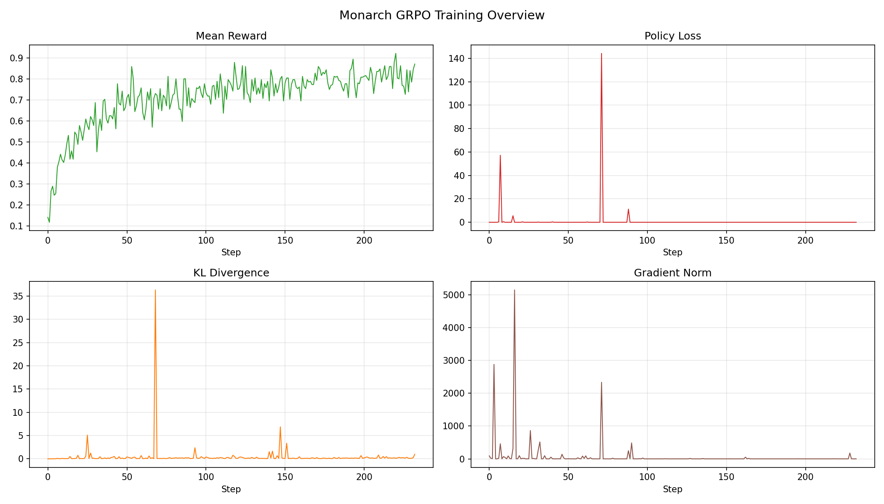
Monarch Result: 14.5% → 87%
233 steps, 100 minutes, 1 epoch. KL stable with frozen reference model.

Slide 9
Why the Speed Difference?
The #1 bottleneck: getting updated weights from trainer → generator
 | veRL (35 min) | Monarch (100 min)
Architecture | All GPUs switch roles | Separate nodes per role
Weight sync | Zero — same GPUs | 47s per step (3GB over network)
GPU utilization | 16 / 16 | 5 / 16
veRL: no data moves. Same GPU memory, just resharded.
Monarch: 3GB transfer every step. 45% of training time.
RDMA would fix this (~1s) but p4d EFA doesn't support it. P5+ does.

Slide 10
Key Takeaways
1. RL + binary reward = LLMs that reason
14.5% → 87%, no human solutions needed
2. The algorithm is simple, the infra is hard
GRPO fits on one slide. Weight sync took 12 runs.
3. Hyperparameters > Architecture
kl_coef 100× wrong mattered more than any infra optimization
4. Code: github.com/harishvs/rl_grpo_qwen_math
3 implementations, all logs, Terraform, K8s manifests

