Slide 1
Teaching a Small LLM to Solve Math with RL
GRPO Training on GSM8K — From Scratch to Production
Harish Rao, SA

Slide 2
The Punchline
A QWEN 1.5B parameter model with 15% base accuracy → 77% accuracy after just 35 minutes of RL training.
A QWEN 7B model → 88% accuracy in 83 minutes.
No human-written solutions. Just a binary signal: right or wrong.
Notes:
This is the headline result. We took small language models that could barely do grade-school math and trained them using reinforcement learning with the simplest possible reward — did you get the right number? Yes or no. No step-by-step solutions, no human feedback, no learned reward model. The rest of this talk is about how we got here — the algorithm, the infrastructure, the bugs, and what we learned along the way.

Slide 3
What is Reinforcement Learning?
Reinforcement learning: here’s the question, try something, I’ll tell you if it worked — figure out how to get it right
The model explores on its own, gets a reward signal (right/wrong), and gradually improves. No hand-crafted solutions needed — just a way to check the answer.
Supervised learning: here’s the question, here’s the correct answer — learn to copy it
Notes:
Think of it like teaching someone to cook. Supervised learning gives them a recipe to follow step by step. RL just lets them taste the result and says “good” or “bad” — they figure out the recipe themselves. This is powerful because the model can discover strategies that humans might not think of.

Slide 4
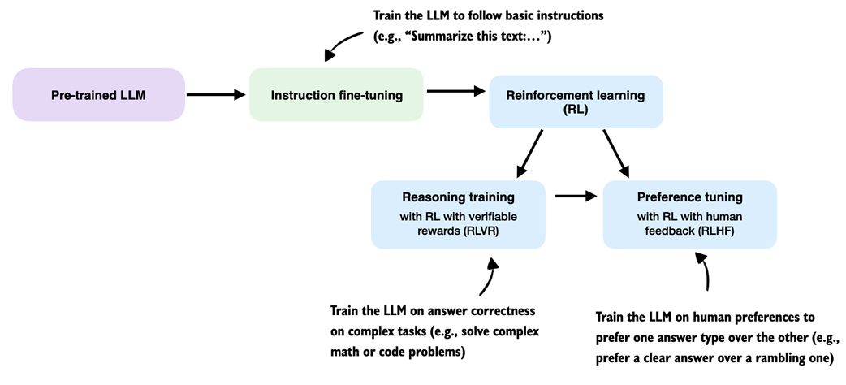
Where RL Fits in LLM Training
RL in the LLM training pipeline
Instruction fine-tuning teaches the model to follow instructions (“Summarize this text…”)
RL with verifiable rewards (RLVR) trains on answer correctness — math, code, factual questions
RL with human feedback (RLHF) trains on human preferences — clarity, safety, tone
Our work lives in the RLVR box: binary reward (right/wrong answer), no human feedback needed.
Notes:
This diagram shows where reinforcement learning fits in the modern LLM training pipeline. You start with a pre-trained model, fine-tune it to follow instructions, then apply RL. There are two main flavors of RL: RLVR uses verifiable rewards — did you get the math problem right? — while RLHF uses human preferences — is this response helpful and safe? Our GRPO training on GSM8K is squarely in the RLVR category. We have a ground truth answer we can check against, so we don’t need human annotators or a learned reward model.

Slide 5
The Goal
Train Qwen2.5-1.5B / 7B on GSM8K math reasoning using GRPO (DeepSeek-R1).
Dataset: GSM8K — 7,473 train / 1,319 test, binary reward (correct = 1.0)
Infrastructure: EKS, 2× p4d.24xlarge (16× A100 40GB)
Two approaches: Hand-rolled GRPO trainer (learning exercise) → veRL framework (production)
Notes:
GSM8K is grade-school math — 2 to 8 step arithmetic problems. Simple enough that a small model sometimes gets them right, hard enough that the base model gets 85% wrong. Binary reward means we just check if the final number is correct. We ran on 16 A100 GPUs across 2 nodes on EKS. We tried building our own trainer first to learn how GRPO works, then switched to veRL for the real training.

Slide 6
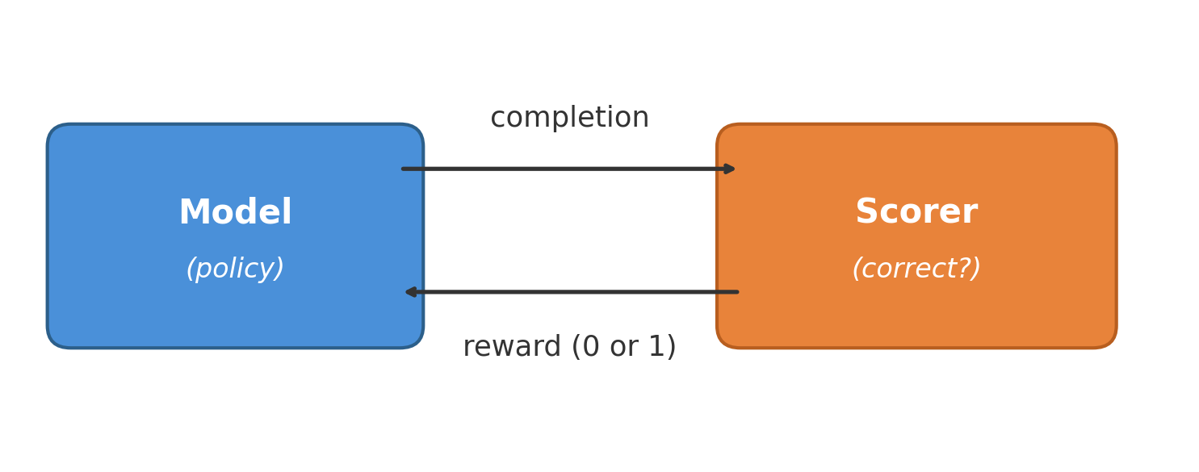
GRPO Setup
GSM8K example:
Q: Janet’s ducks lay 16 eggs per day. She eats three for breakfast and bakes muffins with four. She sells the rest for $2 each. How much does she make daily?
A: 16 - 3 - 4 = 9 eggs. 9 × $2 = $18. #### 18 — we only use this final number
Notes:
This is a real example from GSM8K. The dataset has step-by-step solutions with calculator annotations, but we throw all of that away. We only extract the number after the #### marker and use it as the ground truth for the binary reward. The model never sees the solution text — it has to discover its own reasoning.

Slide 7
How GRPO Works
No critic needed — compare each attempt against the group average, not a learned value function
8 attempts per problem — winners get reinforced, losers get penalized
Clipping + KL penalty — prevent the model from changing too much in one step
No human solutions needed — only check the final number, model discovers its own reasoning

Slide 8
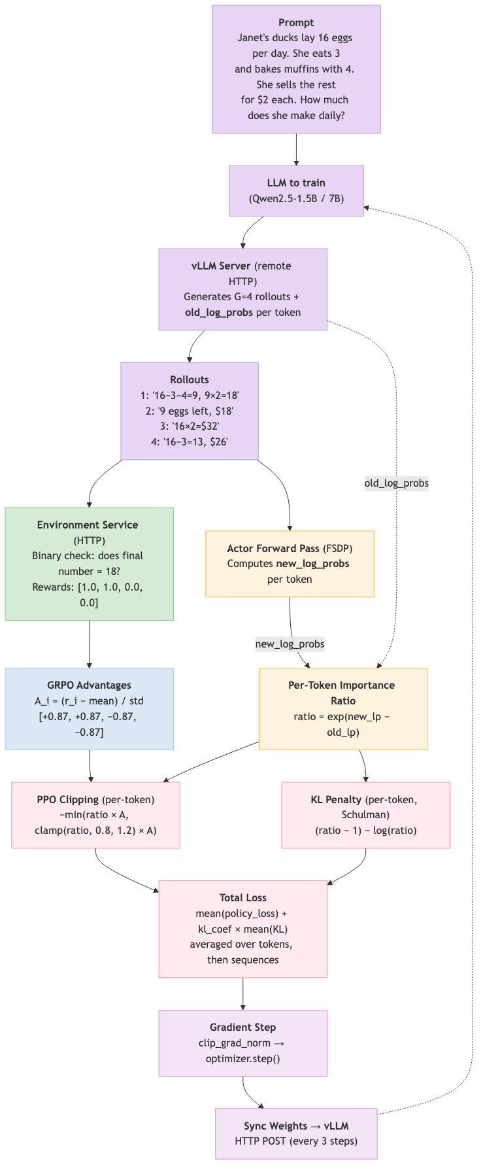
GRPO — Custom Trainer Data Flow
Notes:
This diagram shows exactly how our custom trainer implements GRPO. Let me walk through each component intuitively.
Log probs — Log probabilities measure how likely the model considers each generated token under its current parameters. For example, if the model is very confident about a token, the log prob is close to 0; if uncertain, it’s a large negative number like -5 or -10. We compute these by running the model forward on each rollout and extracting the probability it assigns to each token it actually generated. In GRPO, we work with per-token log probs rather than summing them into a single sequence-level number.
GRPO Advantages — Rewards alone just tell us if an answer was right or wrong. Advantages tell us how each rollout did relative to the group. The formula is simple: A_i = (reward_i - mean) / std. If you got 4 rollouts with rewards [1, 1, 0, 0], the mean is 0.5, so correct answers get positive advantages (+0.87) and wrong ones get negative (-0.87). These values directly scale the gradients — positive advantages increase the likelihood of actions that produced that rollout, negative advantages decrease their likelihood, and if all rollouts got the same reward, advantages are zero and the model learns nothing. The “GR” in GRPO stands for “group relative” — we compare rollouts against each other rather than against a learned value function.
PPO Clipping — The importance ratio (ratio = exp(new_log_prob - old_log_prob)) tells us how much the policy has changed since it generated the rollout. If old and new log probs are identical, the ratio is 1.0. Clipping limits how far the new policy can move from the old one in a single step. We clamp the ratio to [0.8, 1.2] and take the minimum of the clipped and unclipped objectives. Without clipping, a large ratio would scale the advantage substantially, leading to a very large gradient step that can destabilize training — the model shifts too far, token probabilities change drastically, and you get reward crashes or entropy collapse. Our clip range of 0.2 is much tighter than DeepSeek-R1’s clip_eps of 10, because we operate per-token rather than at the sequence level.
KL Penalty — KL divergence measures how much the current policy deviates from a reference. While clipping limits how large each individual step can be, the KL term controls drift over the full training trajectory. We use the Schulman estimator: (ratio - 1) - log(ratio), which is always non-negative and equals zero when ratio = 1 (policies match). This gets added to the loss weighted by kl_coef, so updates that push the model far from its reference behavior are penalized even if they improve reward. In our custom trainer, we skip the frozen reference model to save GPU memory and instead use old_log_probs from generation time as the reference — a pragmatic tradeoff that works when the policy changes slowly between steps.
The prompt goes to the LLM, which generates 4 rollouts via a remote vLLM server. The environment service checks the final number and returns binary rewards. After the gradient step, weights sync back to vLLM every 3 steps.

Slide 9
Two Approaches
Built custom trainer first to learn GRPO internals, then switched to veRL for production.
 | Custom Trainer | veRL Framework
Code | ~800 lines, hand-rolled | ~50 lines config
Debug time | 12 hours, 5 attempts | Worked first try
Throughput | 2,304 seq/hr | 104,448 seq/hr
1 epoch | ~26 hours | 35 minutes
Notes:
The custom trainer was a learning exercise — we wanted to understand every piece of the GRPO pipeline: how importance ratios work, how KL penalties interact with clipping, how to manage FSDP weights with vLLM. It took 5 attempts and 12 hours of debugging. veRL by ByteDance is a production framework that handles all of this out of the box. The throughput difference is 45x — mostly from colocated vLLM and much larger batch sizes.

Slide 10
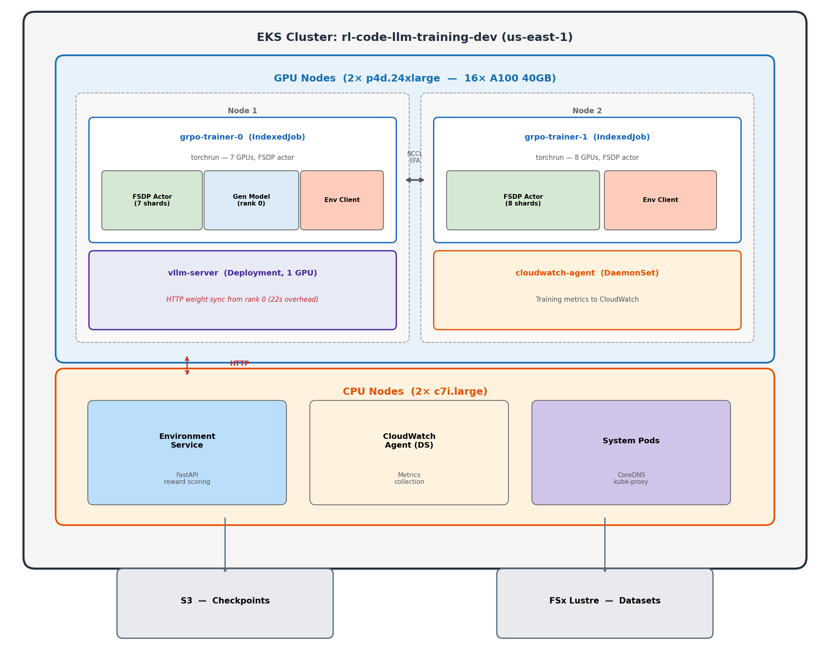
Experiment 1: Custom Trainer — The Journey
Notes:
This is the architecture we built from scratch. The vLLM server runs on its own GPU and generates completions via HTTP. The trainer pods run FSDP across 14 GPUs on 2 nodes. The environment service on a CPU node checks if answers are correct. The awkward part is the weight sync — every 3 steps, rank 0 has to serialize 3GB of weights and POST them to the vLLM server over HTTP. That takes 22 seconds each time. Why HTTP and not RDMA/NCCL? Because vLLM runs in a separate process with its own CUDA context — it can’t join the trainer’s NCCL process group without deadlocking. We tried running vLLM inside torchrun and it hung on initialization because both vLLM and FSDP fight over NCCL. So the only way to communicate was through the network stack — HTTP was the simplest option. This is the fundamental bottleneck that veRL solves by colocating everything in the same process and doing zero-copy weight resharding. An alternative we didn’t try: torchrun with nproc_per_node=7 on node 1 (leaving GPU 0 free for vLLM) and nproc_per_node=8 on node 2. This works because torchrun’s c10d rendezvous backend — a TCP key-value store on the master node — handles asymmetric process counts. Each node registers however many processes it launched, and once all check in, ranks are assigned. With this setup, GPU 0 is completely outside the NCCL group, so no deadlock. Weight sync could then use shared memory or cudaIpcMemHandle (same-node GPU-to-GPU memory sharing) instead of HTTP — cutting 22 seconds down to 1-2 seconds. We jumped straight to separate pods which forced us into HTTP.

Slide 11
Attempt 1: OOM Immediately
batch_size=8, group_size=8 → 64 sequences/step
Rank 0 holds FSDP shard + full generation model
Crashed on step 1 — GPU 0 out of memory
Fix: Reduce batch_size to 4.
Notes:
Our first attempt was too ambitious with batch size. With 8 prompts times 8 completions, that’s 64 sequences per step. GPU 0 was especially constrained because it holds both its FSDP shard and the full generation model for producing completions. Dropping to batch_size=4 gave us 32 sequences per step and fit in memory.

Slide 12
Attempt 2: KL Explosion
Root cause: Computing importance ratio on sequence-level summed log probs — exp(sum of 200 token shifts) → exponential blowup.
Step | KL Divergence
1 | 0.42
2 | 194.8 💥
3 | OOM crash
Notes:
This was the most instructive bug. KL went from 0.42 to 194.8 in a single step, then the model diverged so badly it OOM’d from NaN activations. The root cause: we were summing log probabilities across the entire sequence (200+ tokens) and then taking exp() of the difference. Even tiny per-token shifts of 0.01 accumulate into a sum of 2.0, and exp(2) = 7.4. After one gradient step with that inflated ratio, the next step gets exp(50) which is astronomical. The DeepSeek paper is clear that the importance ratio is a per-token concept.

Slide 13
Attempt 2: The Fix
Per-token importance ratio instead of sequence-level:
Broken (sequence-level): ratio = exp(-448 - (-450)) = exp(2.0) = 7.4 ← unstable Fixed (per-token): ratio = exp(0.01) = 1.01 ← stable
After fix: KL stayed at 0.0004–0.0009 ✓
Notes:
The fix is straightforward — compute the importance ratio per token, apply clipping per token, then average. This keeps every individual ratio close to 1.0 and within the clip range of 0.8 to 1.2. We verified numerically: with 200 tokens and per-token shifts of 0.02 standard deviation, the old method gives ratio=1.46 and KL=0.08, while the new method gives mean ratio=1.002 and KL=0.0002. Night and day difference.

Slide 14
Attempt 3: Too Slow
Per-token fix worked — KL stable, no OOM
But: 5 min/step, 12 steps/hr
1,868 total steps → 156 hours for 1 epoch
Capacity block: 32 hours
Problem: 32 sequential HuggingFace model.generate() calls per step (one per rollout, no batching).
Notes:
The math fix worked perfectly but exposed a performance problem. Each step made 32 separate generate calls, each triggering an FSDP all-gather across 14 GPUs. At 5 minutes per step and 1,868 steps for one epoch, we’d need 156 hours. Our GPU capacity block was only 32 hours. We needed at least a 5x speedup.

Slide 15
Attempt 4: Batched Generation
Used num_return_sequences=8 in HuggingFace model.generate() — generates all 8 completions per prompt in one call, sharing the KV cache.
4 generate calls instead of 32 → 3× speedup.
 | Before | After
Step time | 5 min | 1.5 min
Steps/hr | 12 | 40
1 epoch | 156 hours | 47 hours
Notes:
The key insight was that HuggingFace generate supports num_return_sequences — you give it one prompt and it generates 8 completions in a single forward pass, sharing the KV cache for the prompt tokens. This reduced 32 generate calls to 4 (one per prompt in the batch). 3x speedup to 1.5 minutes per step. Still not fast enough for a full epoch in our time window, but the reward was starting to trend upward — we could see the model learning.

Slide 16
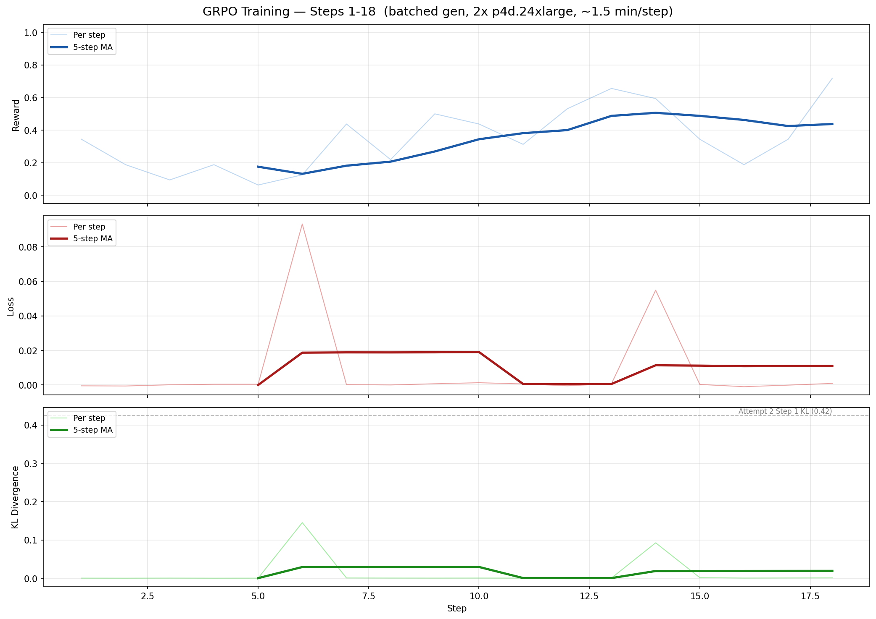
Attempt 4: Training Progress

Slide 17
Attempt 5: vLLM Server
Deployed vLLM as separate K8s pod with HTTP weight sync. Crashed at step 50 — checkpoint save bug (local_rank vs global_rank).
 | HF Batched | vLLM Server
Step time | 1.5 min | 50s
Steps/hr | 40 | 72
1 epoch | 47 hours | 26 hours
Notes:
vLLM is much faster than HuggingFace generate for inference — it uses PagedAttention and continuous batching. But we couldn’t run it inside torchrun because it conflicts with NCCL. So we deployed it as a separate Kubernetes pod and communicated via HTTP. Got down to 50 seconds per step. But it crashed at step 50 due to a checkpoint bug — we used local_rank instead of global_rank to decide who saves, so on multi-node, node 2’s local rank 0 tried to save an empty state dict. Even before the crash, reward was oscillating without a clear trend because 32 sequences per step is just too noisy for stable learning.

Slide 18
Custom Trainer: Speed Evolution
6× faster over 3 iterations — but still not enough.
Attempt | Method | Step Time | Steps/hr
3 | Sequential model.generate() | 5 min | 12
4 | Batched num_return_sequences=8 | 1.5 min | 40
5 | vLLM separate pod, HTTP API | 63s | 57
5+ | vLLM + batched log_probs | 50s | 72
Notes:
We got a 6x speedup through three rounds of optimization. But even at 72 steps per hour with only 32 sequences per step, the effective throughput was 2,304 sequences per hour. The fundamental problem wasn’t speed per step — it was that we could only fit 4 prompts per batch due to memory constraints in our hand-rolled code. veRL solves this by properly managing GPU memory across phases.

Slide 19
Key Bugs Found
Bug | Impact | Fix
Sequence-level importance ratio | KL explosion (194.8) | Per-token ratio
log_probs.mean() | Wrong gradient signal | .sum() per sequence
Checkpoint local_rank == 0 | Crash on multi-node | rank == 0 (global)
vLLM inside torchrun | NCCL/CUDA deadlock | Separate vLLM pod
Clamped KL estimator | KL = 0 for 99% of steps | Schulman estimator
Notes:
These are the five most impactful bugs we found. The importance ratio bug was the showstopper — it made training diverge in one step. The log_probs mean vs sum bug meant the policy gradient was length-normalized, so short and long responses contributed equally regardless of sequence probability. The checkpoint bug only manifests on multi-node — local_rank 0 exists on every node, but only global rank 0 should save. The vLLM deadlock taught us that vLLM and NCCL can’t coexist in the same process. And the clamped KL was giving zero penalty 99% of the time because the naive log ratio was slightly negative at low learning rates.

Slide 20
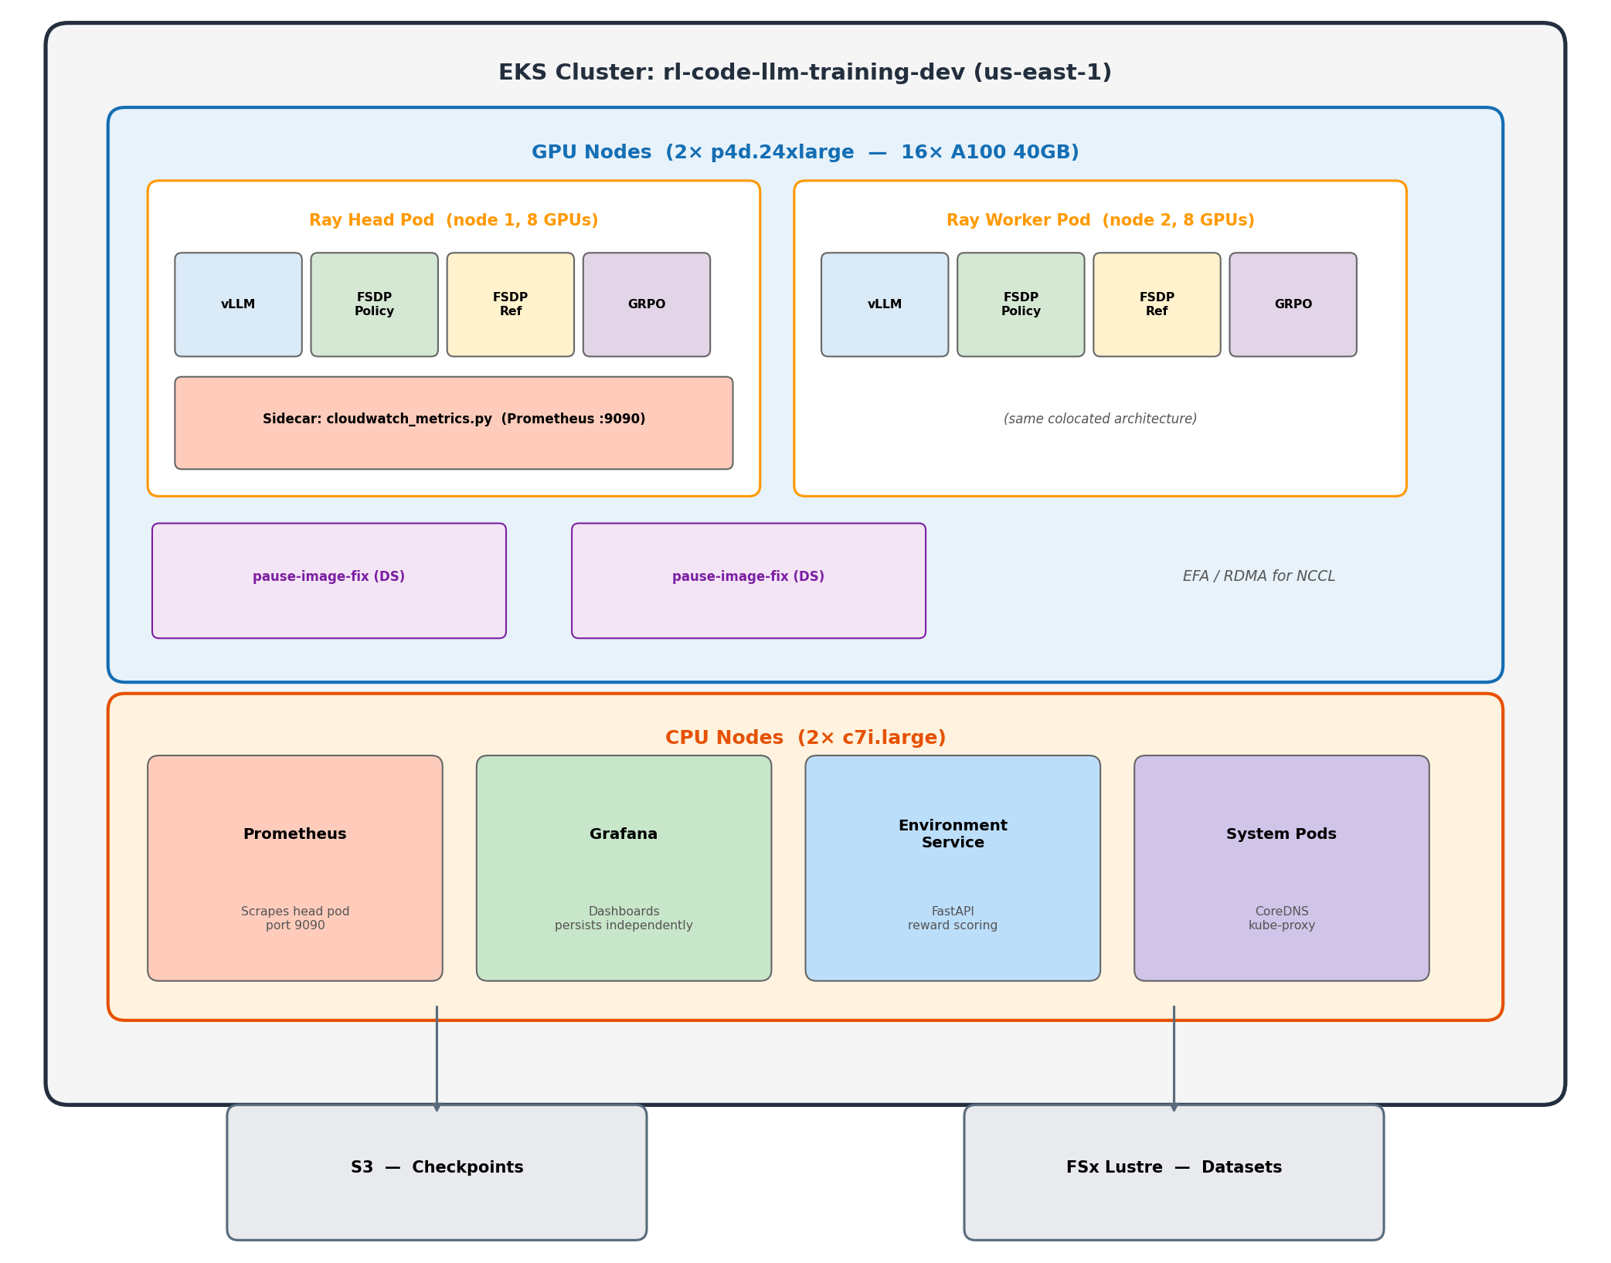
Experiment 2: veRL Framework
Switched to veRL (ByteDance) — production RL post-training framework.
Notes:
After 12 hours of debugging the custom trainer, we switched to veRL. The architecture is fundamentally different — every GPU runs all roles by cycling through phases. No separate vLLM pod, no HTTP weight sync, no memory fragmentation from dedicated roles. veRL manages GPU memory by loading and unloading models between phases. The ref model lives on CPU and only comes to GPU briefly for log prob computation. How does veRL avoid the NCCL deadlock we hit? It doesn’t run vLLM and FSDP simultaneously — it time-shares the same GPUs. During generation, the FSDP actor is offloaded and vLLM takes over. During training, vLLM’s KV cache is freed and FSDP loads back. The WorkerDict abstraction holds both engines on each GPU and orchestrates turns. Weight resharding between FSDP’s sharded layout and vLLM’s tensor-parallel layout happens via DTensor — a metadata operation that remaps how the same physical memory is viewed, not an actual data copy. So veRL didn’t solve the NCCL conflict — it avoided it entirely by never running both at the same time.

Slide 21
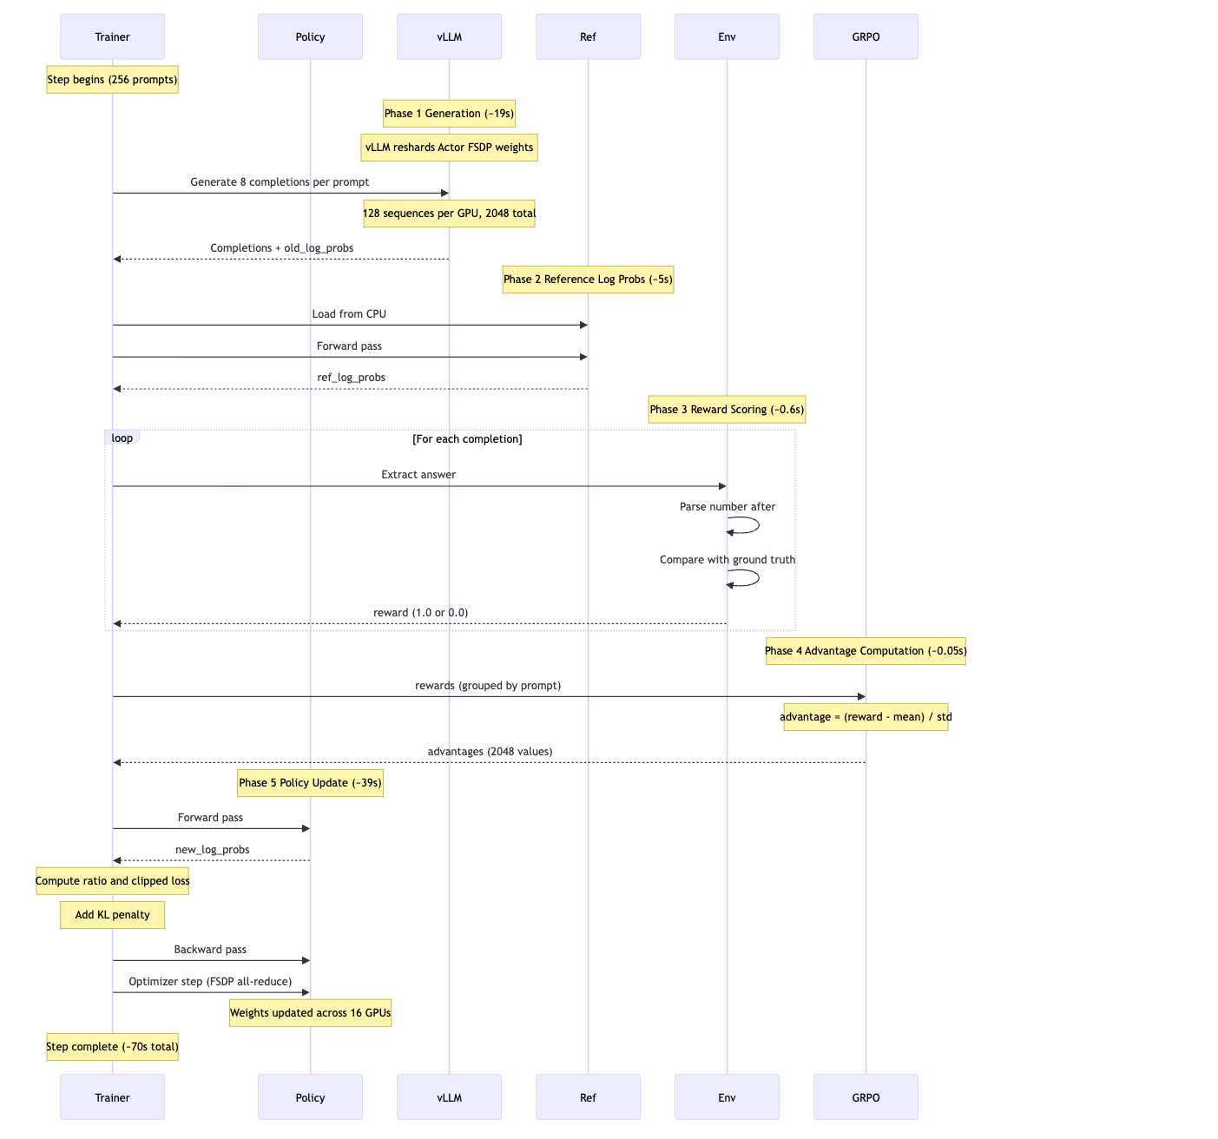
veRL Architecture
Every GPU runs all roles by cycling through phases:
Notes:
Each step takes about 70 seconds for 2,048 sequences. Generation is 19 seconds using vLLM engines on all 16 GPUs in parallel. The actor update dominates at 39 seconds — that’s the FSDP training forward and backward pass. Ref log probs take 5 seconds — the ref model is offloaded to CPU between steps and loaded back for this phase. Reward is trivial at 0.6 seconds — just CPU string matching. The key insight is zero-copy weight resharding between the FSDP actor and the vLLM engine — no serialization or network transfer needed.

Slide 22
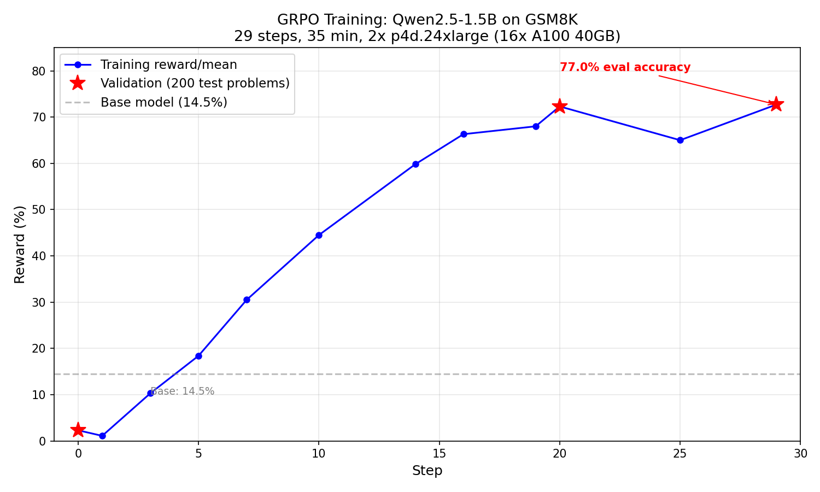
veRL: 1.5B Results
Notes:
This is the training curve for Qwen2.5-1.5B. Reward climbs steadily from near zero to about 65-70% over 29 steps. The validation reward at step 20 was 72.3% and at step 29 was 72.7% — the model had essentially converged. Total training time was 35 minutes for one full epoch of GSM8K. Compare this to the custom trainer which couldn’t even finish one epoch in 26 hours.

Slide 23
veRL: 1.5B Results (cont.)
29 steps, 35 minutes, 1 full epoch. Eval: Base 14.5% → GRPO-trained 77.0%
Step | Reward | KL
0 (val) | 2.3% | —
10 | 44.5% | —
20 (val) | 72.3% | —
29 (val) | 72.7% | —
Notes:
The eval was done on 200 random test problems with greedy decoding using the same chat template as training. Base model gets 14.5% — it can actually do math (56% with a non-chat prompt) but doesn’t know the chat format. After GRPO training, it scores 77% — the model learned both the format and improved its reasoning. The 2.3% initial validation is lower than 14.5% because it was measured before any training with a slightly different eval setup. KL stayed very low throughout — 0.0007 at step 3, never spiking. veRL’s implementation is rock solid.

Slide 24
veRL: 7B Results
14.3% → 88.0% in 10 steps (~83 min). Saturated by step 9.
Step | Reward
0 (val) | 14.3%
9 | 88.8%
10 (val) | 88.0%
Notes:
The 7B model is dramatically faster at learning. It went from 14.3% to 88% validation accuracy in just 10 steps — about 83 minutes of training. By step 9 it was already at 88.8% training reward and essentially saturated. The remaining steps from 10 to 19 just oscillated between 83 and 88%. Unfortunately our GPU capacity block expired after step 19, one step before the checkpoint save at step 20. We’ve since changed the save frequency to every 10 steps. Each step takes about 502 seconds — 7x slower than 1.5B because the model is bigger and we had to halve the batch size to fit in memory.

Slide 25
7B vs 1.5B Learning Curves
7B learns faster (fewer steps) and reaches a higher ceiling, but each step takes 7× longer.
 | 1.5B | 7B
Base accuracy | 14.5% | 14.3%
Peak validation | 77.0% (step 29) | 88.0% (step 10)
Steps to 70%+ | ~20 | ~7
Step time | 70s | 502s
Notes:
Both models start at roughly the same baseline — about 14% accuracy. But the 7B model reaches 70% in just 7 steps versus 20 for the 1.5B, and peaks at 88% versus 77%. The larger model has more capacity to represent complex reasoning patterns. The tradeoff is wall-clock time per step — 502 seconds versus 70 seconds — because the 7B model needs more memory (halving the batch size) and more compute for forward and backward passes. In total wall-clock time, the 7B took about 83 minutes to reach 88% while the 1.5B took 35 minutes to reach 77%.

Slide 26
Custom Trainer vs veRL
45× throughput from colocated vLLM, memory management, and 64× larger batches.
 | Custom | veRL
Code | ~800 lines | ~50 lines
Debug time | 5 attempts, 12h | First try
Sequences/step | 32 | 2,048
Throughput | 2,304 seq/hr | 104,448 seq/hr
1 epoch | ~26 hours | 35 min
Notes:
The 45x throughput difference comes from three things. First, colocated vLLM eliminates the 22-second HTTP weight sync. Second, veRL’s phase-based memory management lets it fit 256 prompts per batch versus our 4 — that’s 64x more sequences per step. Third, all 16 GPUs run vLLM in parallel during generation versus our single dedicated GPU. The custom trainer was invaluable for understanding the internals — we wouldn’t have appreciated veRL’s design without struggling through those 5 attempts. But for production training, there’s no contest.

Slide 27
Infrastructure
Component | Details
EKS Cluster | rl-code-llm-training-dev (us-east-1, EKS 1.29)
GPU Nodes | 2× p4d.24xlarge (8× A100 40GB each)
CPU Nodes | 2× AL2023_x86_64_STANDARD
Orchestration | KubeRay v1.3.0 (Terraform-managed)
Framework | veRL 0.6.1 + vLLM 0.8.4
Storage | S3 for checkpoints
Monitoring | Prometheus + Grafana
IaC | Terraform for everything
Notes:
Everything runs on EKS in us-east-1. The GPU nodes are p4d.24xlarge instances with 8 A100 40GB GPUs each, connected via EFA for fast NCCL communication. We use capacity blocks for the GPU instances since they’re expensive — about $32/hr per node. CPU nodes run the monitoring stack and environment service. KubeRay manages the Ray cluster for veRL. All infrastructure is Terraform-managed — no manual kubectl or console changes for persistent resources.

Slide 28
Observability
Prometheus + Grafana on CPU nodes, persisting independently of GPU pods.
Metrics tracked: Reward, KL divergence, policy loss, entropy, gradient norm, step time, GPU memory, throughput, validation reward.
Sidecar script on head pod tails veRL logs → exposes via prometheus_client → PodMonitor scrapes → Grafana dashboard auto-provisioned via ConfigMap.
Notes:
Observability was critical — GPU training pods are ephemeral and expensive, so we needed metrics to persist independently. A sidecar Python script on the Ray head pod parses the veRL worker log in real time and exposes metrics via the Prometheus client library on port 9090. A PodMonitor tells Prometheus to scrape it. The Grafana dashboard is auto-provisioned via a ConfigMap so it survives pod restarts. This is how we captured all the 7B training metrics even after the capacity block expired and the pods died.

Slide 29
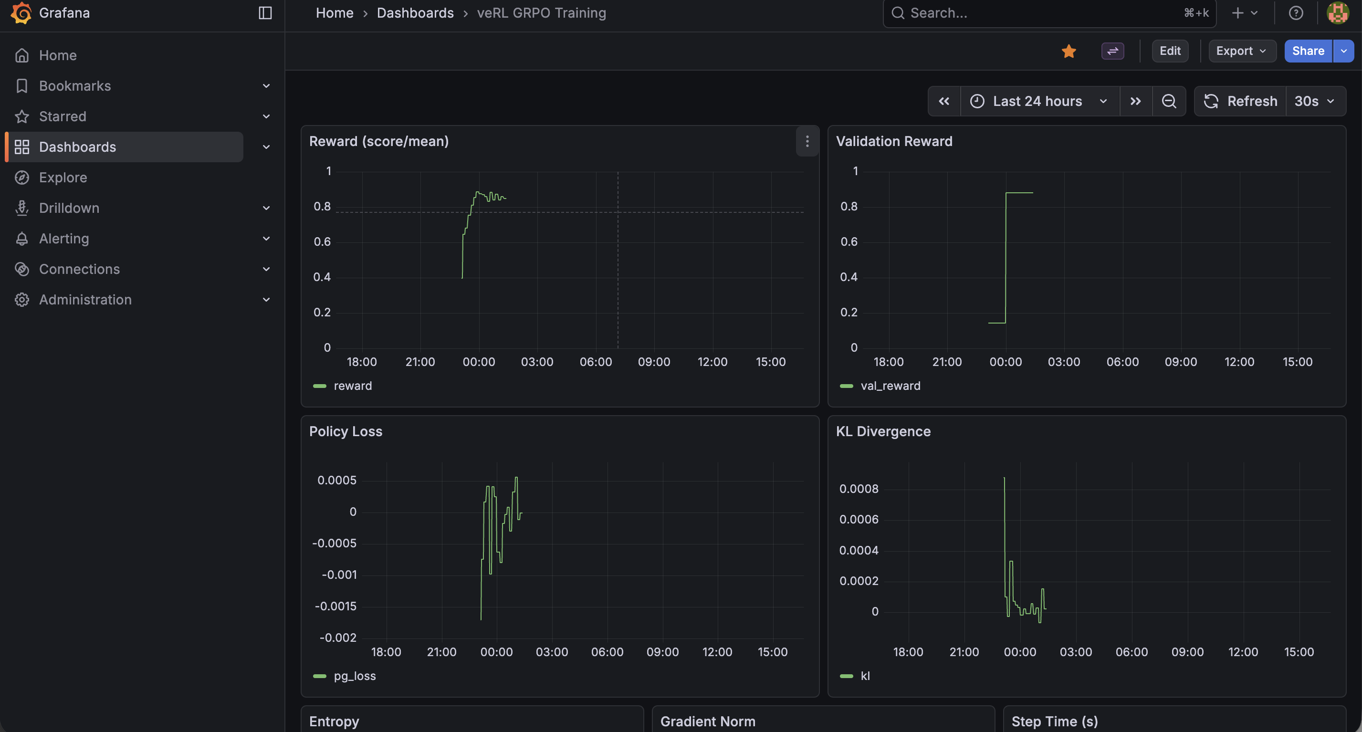
Grafana Dashboard
Notes:
This is the actual Grafana dashboard from the 7B training run. You can see reward climbing rapidly in the first 10 steps then plateauing, KL staying stable throughout, step time rock-steady at 502 seconds, and GPU memory utilization near maximum. The dashboard auto-refreshes and was our primary monitoring tool during training — we could check progress from anywhere without needing kubectl access.

Slide 30
What We Learned: Implementation
Per-token ratios are critical — sequence-level importance ratios explode exponentially
Schulman KL estimator — naive KL with clamp gives zero signal at low learning rates
Batch size matters enormously — 32 seq/step = noisy, 2,048 seq/step = smooth learning
Colocated inference is key — separate vLLM pod adds 22s/sync; colocated = 0s
Notes:
These are the engineering lessons. The per-token ratio bug was the most painful — it’s subtle because sequence-level log probs are correct for the policy gradient, but the importance ratio must be per-token or it explodes. The Schulman KL estimator is a drop-in replacement that’s always non-negative without clamping. Batch size was the biggest factor in training stability — 32 sequences per step gave us random-looking reward curves, while 2,048 gave smooth monotonic improvement. And colocating vLLM with the trainer eliminates the entire weight sync bottleneck.

Slide 31
What We Learned: Results
RL works — a 1.5B model goes from 14.5% → 77% with just a reward signal, no solutions needed
Bigger models learn faster — 7B hit 88% in 10 steps vs 1.5B needing 29 steps for 77%
Notes:
The high-level takeaway: reinforcement learning with a simple binary reward signal is enough to teach small models to reason about math. No human-written solutions, no reward model, just “right or wrong.” And scale helps — the 7B model learns faster and reaches a higher ceiling, even though each step is slower. Both results were achieved in under 2 hours of GPU time on 16 A100s.

Slide 32
What’s Next: Task & Model
Code generation — move from math to coding benchmarks (HumanEval, SWE-bench). Reward = does the code pass tests? Same binary signal, harder reasoning.
Larger models — 70B+ with multi-node tensor parallelism
Multi-turn reasoning — chain multiple RL steps where the model critiques and refines its own output

Slide 33
What’s Next: Infrastructure
Separate GPU pools with RDMA sync — dedicated generation pool + dedicated training pool, weight sync via RDMA/EFA. This is the architecture used at scale for large model RL training — separate pools keep both generation and training GPUs fully utilized rather than time-sharing.
PyTorch Monarch — evaluate Monarch as an alternative to Ray for RL orchestration. Native PyTorch distributed stack, potentially lower overhead for GPU coordination.
Notes:
Code generation is the natural next step — the reward signal is just as clean as math (run the tests, pass or fail) but the reasoning is much harder. For infrastructure, the separate GPU pool architecture is what strategic customers training large models actually use in production. veRL’s colocated time-sharing works great for small-to-mid models, but at scale (70B+, hundreds of GPUs), the phase transition overhead adds up — GPUs sit idle while switching between generation and training. The production pattern is: one pool of GPUs runs vLLM continuously for generation, another pool runs FSDP/Megatron for training, and weights are synced via RDMA over EFA. EFA gives 400 Gbps per node — syncing even a 70B model takes seconds, not minutes. The tradeoff is cost (2x GPUs) but both pools run at near 100% utilization, which is more efficient at scale than time-sharing where each pool is idle 50% of the time.

Slide 34
Summary
All it takes is a binary reward signal and the right RL algorithm.
Model | Before | After | Time
Qwen2.5-1.5B | 14.5% | 77.0% | 35 min
Qwen2.5-7B | 14.3% | 88.0% | ~83 min
Notes:
To summarize: we took two small language models that could barely solve grade-school math and trained them to 77% and 88% accuracy using only a binary reward signal — no human-written solutions. The 1.5B model trained in 35 minutes, the 7B in about 83 minutes. Building the custom trainer taught us how GRPO works at every level, but veRL is what made the actual training feasible. The code for the custom trainer is about 800 lines; the veRL config is about 50 lines. Both are in the repo if you want to explore.

