Slide 1
Uncertainty-Aware Graph Neural Network for Dynamic NOMA User Grouping under Imperfect CSI
A Semi-Supervised Graph Learning Framework for B5G/6G NOMA
Rahul Bodduna – 2520040002
Harishwar Reddy Mogiligari – 2520040015
Akshay Boppudi – 2520040029
Department of Electronics & Communication Engineering
PYTORCH GEOMETRIC • GRAPHSAGE • CSI UNCERTAINTY
Notes:
Introduce the project as a machine-learning system that assigns users to NOMA groups from channel-related features and graph relationships. Emphasize that CSI uncertainty is explicitly represented and that transmission-layer optimization is outside the present scope.

Slide 2
Executive Summary
• Reported test accuracy: 75.60%
• Macro precision: 75.71% | Macro recall: 75.60% | Macro-F1: 75.31%
• Four-group task across 100 scenarios and 2,000 users
• Proposed model combines masked supervision, graph consistency, and uncertainty-gated pseudo-labels
• Best class-wise F1: Group 1 = 90.17%; Groups 2–3 remain the main ambiguity region
TEST ACCURACY
MACRO PRECISION
75.60%
75.71%
MACRO RECALL
MACRO F1
75.60%
75.31%
L_total = L_sup + λ L_cons + μ L_pseudo
UNCERTAINTY-AWARE GNN | TECHNICAL PROJECT PRESENTATION
02 / 18
Notes:
Summarize the system and results without overstating them. The metrics describe grouping classification, not measured NOMA sum-rate or SINR. Point out that the confusion matrix shows most errors occur between the two intermediate groups.

Slide 3
Background & Motivation
• B5G/6G networks face growing demand for spectral and energy efficiency
• Power-domain NOMA allows multiple users to share a time-frequency resource
• Group composition influences interference relationships and potential SIC feasibility
• Channel conditions and user geometry change over time
• Dynamic grouping must adapt to channel features while managing imperfect observations
VISUAL / DIAGRAM
Base-station illustration with four users sharing a resource; annotate stronger/weaker channel examples.
η = R / B [bit/s/Hz] — context metric; not measured by this ML core
UNCERTAINTY-AWARE GNN | TECHNICAL PROJECT PRESENTATION
03 / 18
Notes:
Explain that NOMA superposes multiple user signals on a shared resource and relies on receiver processing to separate them. User grouping is an upstream decision. Better classification accuracy may help downstream design, but spectral-efficiency improvement must be demonstrated later with a physical-layer evaluation.

Slide 4
The Core Challenge: Imperfect CSI
• CSI estimates can be affected by pilot noise, Doppler, feedback delay, and model mismatch
• Two users may appear similar because of true channel similarity—or estimation error
• Uncertainty is exposed as a feature and used to screen pseudo-label candidates
• Exact |h − ĥ|² requires true CSI in the benchmark; deployment needs a measurable proxy
• Conventional feature-only grouping may treat high- and low-reliability observations alike
VISUAL / DIAGRAM
Complex-plane diagram: true CSI point, estimated CSI point, error vector, and squared-error annotation.
eᵢ = hᵢ − ĥᵢ | uᵢ = |eᵢ|² = (hᵣ−ĥᵣ)² + (hᵢ−ĥᵢ)²
UNCERTAINTY-AWARE GNN | TECHNICAL PROJECT PRESENTATION
04 / 18
Notes:
Define imperfect CSI and derive the uncertainty measure. Clarify the important operational caveat: in a simulated dataset the true channel can be known, but in a live network it is not directly observable. A deployed implementation would need an estimator uncertainty output or a proxy.

Slide 5
Research Scope & Project Boundaries
• IN SCOPE: feature engineering, scenario graphs, GNN training/inference, alignment, metrics, artifacts
• Predicted groups come directly from Softmax argmax
• OUT OF SCOPE FOR THIS PHASE: power allocation, SIC, SINR, BER, sum-rate optimization
• Downstream modules will consume predicted groups through a defined interface
• Keep grouping-model evaluation separate from physical-layer performance evaluation
VISUAL / DIAGRAM
Two-box architecture: solid ML core → dashed future physical-layer evaluation.
pᵢ = Softmax(zᵢ); ŷᵢ = arg max_c pᵢ,c
UNCERTAINTY-AWARE GNN | TECHNICAL PROJECT PRESENTATION
05 / 18
Notes:
Stress that there is no K-Means post-processing step. The GNN classifier directly predicts group labels. Power allocation, SIC and rate calculations are future integration stages and should not be described as already validated.

Slide 6
End-to-End System Pipeline
• External scenario CSV → schema validation and feature preprocessing
• Fit scaler on training scenarios only; freeze it for validation/test
• Build one graph per scenario using user features and k-NN/channel similarity
• Train GraphSAGE with supervised, consistency, and pseudo-label objectives
• Evaluate with label alignment; export predictions, metrics, embeddings, and GraphML
External
CSV
Preprocess
train-only scale
Scenario
Graph
GNN
training
Evaluate
& align
Artifacts
CSV → Preprocess → Graph Builder → GNN → Align/Evaluate → Artifacts
UNCERTAINTY-AWARE GNN | TECHNICAL PROJECT PRESENTATION
06 / 18
Notes:
Walk left to right. Explain that scenario-level splitting occurs before scaler fitting, and that validation selects settings while the test split is held out for final reporting. Graphs are built within scenarios rather than connecting unrelated scenarios.

Slide 7
Data Preprocessing & CSI Uncertainty Modeling
• Features: channel_gain, distance, SNR, channel_real/imag, estimated_channel_real/imag, CSI uncertainty
• Compute CSI error from true minus estimated complex channel
• Use the squared magnitude of the complex error as a non-negative uncertainty scalar
• StandardScaler is fitted only on training scenario rows
• Apply the frozen transform to validation and test; gate pseudo-labels on consistently scaled/raw uncertainty
xᵢ = [gain, distance, SNR, hᵣ, hᵢ, ĥᵣ, ĥᵢ, uᵢ]
Scaler.fit(train scenarios only)
Transform validation/test with frozen scaler
xᵢ = [gᵢ, dᵢ, γᵢ, hᵣ, hᵢ, ĥᵣ, ĥᵢ, uᵢ]ᵀ ∈ ℝ⁸
UNCERTAINTY-AWARE GNN | TECHNICAL PROJECT PRESENTATION
07 / 18
Notes:
Explain the eight-feature vector and the squared complex error. Mention that uncertainty thresholds must use the same scale as the uncertainty values; a raw threshold cannot be applied blindly to standardized values. This is an important implementation check.

Slide 8
Dynamic Graph Construction Framework
• Each scenario becomes a graph; nodes represent users
• Edges encode channel similarity or spatial proximity
• Configured k-NN: k = 4 nearest neighbors per user
• Alternative builders: Gaussian channel similarity and fully connected topology
• Edge policy, symmetrization, distance metric, and weights must be documented
kNN k=4
Gaussian weights
Fully connected
G = (V, E, X, A) | wᵢⱼ = exp(−δ(qᵢ,qⱼ)² / 2σ²)
UNCERTAINTY-AWARE GNN | TECHNICAL PROJECT PRESENTATION
08 / 18
Notes:
Describe the graph as an inductive bias for message passing. kNN limits each node to local neighbors; Gaussian similarity adds graded edge weights; fully connected topology exposes global context but can blur distinctions. Keep graph construction consistent across model comparisons.

Slide 9
GNN Backbone Architecture
• Default backbone: GraphSAGE; supported alternatives: GCN and GAT
• Three message-passing layers build contextual node embeddings
• ReLU nonlinearity and dropout p = 0.2 regularize representation learning
• Linear classifier maps embeddings to four group logits
• Softmax probabilities directly determine predicted group labels
8 features
MP layer 1
MP layer 2
MP layer 3
Linear: 4
Softmax
hᵢ⁽ˡ⁺¹⁾ = σ(W⁽ˡ⁾ · CONCAT(hᵢ⁽ˡ⁾, MEAN_{j∈N(i)} hⱼ⁽ˡ⁾))
UNCERTAINTY-AWARE GNN | TECHNICAL PROJECT PRESENTATION
09 / 18
Notes:
Explain message passing in intuitive terms: each user combines its own representation with aggregated information from its neighbors. Three layers expand the contextual receptive field. Softmax is the final classification layer, not a clustering pre-stage.

Slide 10
True Semi-Supervised Learning Framework
• Supervised loss: masked cross-entropy over labeled nodes only; label −1 is ignored
• Consistency loss: stable predictions across perturbed graph views
• Pseudo-label loss: accepted unlabeled nodes become temporary training targets
• λ and μ balance auxiliary losses and should be selected on validation data
• Log each loss component and pseudo-label coverage to diagnose training behavior
L_sup
L_cons
L_pseudo
Masked CE
Dual-view consistency
Gated pseudo-labels
Combined objective
L_total = L_supervised + λ L_consistency + μ L_pseudo
UNCERTAINTY-AWARE GNN | TECHNICAL PROJECT PRESENTATION
10 / 18
Notes:
Explain that each term addresses a different source of learning signal. Supervised cross-entropy uses trusted labels; consistency uses unlabeled examples; pseudo-labeling adds targets only after confidence and uncertainty filters. Avoid implying that pseudo-labeling always improves results.

Slide 11
Dual-Perturbation Consistency & Uncertainty-Aware Pseudo-Labeling
• Create views G_A and G_B using 15% edge dropping and 10% feature masking
• Penalize prediction disagreement with symmetric KL divergence
• Candidate pseudo-label: ĉᵢ = argmax_c pᵢ,c; confidence sᵢ = max_c pᵢ,c
• Accept only when sᵢ ≥ 0.90 AND CSI uncertainty uᵢ ≤ τᵤ
• Handle empty accepted sets safely; report acceptance rate and accuracy
G_A
Graph G
KL
G_B
Pseudo-label gate:
confidence ≥ 0.90 AND uncertainty ≤ τᵤ
L_cons = ½[KL(P_A || P_B) + KL(P_B || P_A)] | mᵢ = 1[sᵢ≥0.90 ∧ uᵢ≤τᵤ]
UNCERTAINTY-AWARE GNN | TECHNICAL PROJECT PRESENTATION
11 / 18
Notes:
Walk through the two views and explain that perturbations should preserve the underlying group semantics. Symmetric KL penalizes distribution disagreement. The pseudo-label gate is deliberately conservative: high model confidence alone is insufficient if the channel estimate is considered unreliable.

Slide 12
Global Evaluation Metrics
• Test accuracy: 75.60%
• Macro precision: 75.71%
• Macro recall: 75.60%
• Macro-F1: 75.31%
• These are grouping metrics; they do not directly measure throughput, SINR, or sum-rate
Accuracy
75.60%
Precision
75.71%
Recall
75.60%
Macro-F1
75.31%
Accuracy = correct / total; F1_c = 2P_cR_c / (P_c + R_c); Macro-F1 = (1/C)Σ_c F1_c
UNCERTAINTY-AWARE GNN | TECHNICAL PROJECT PRESENTATION
12 / 18
Notes:
Define macro metrics as an equal-weight average over classes, which prevents the largest class from dominating the summary. Since each group has equal support in the supplied confusion matrix, class imbalance is not the main explanation for per-class differences. Physical-layer benefits remain unmeasured.

Slide 13
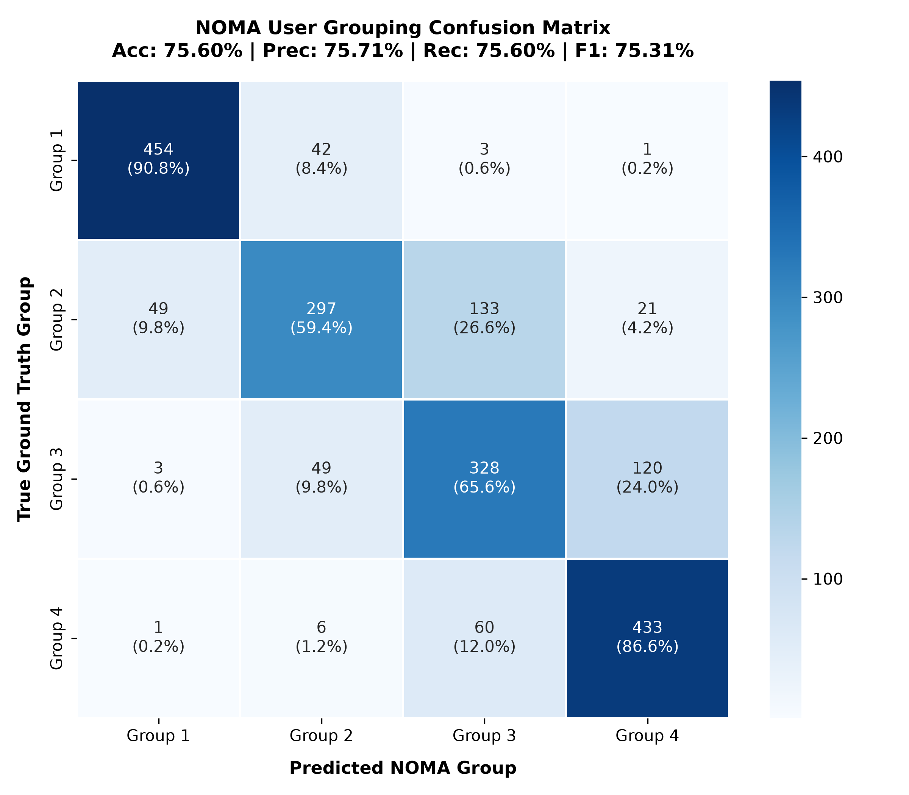
Confusion Matrix & Per-Group Breakdown
• Group 1: F1 = 90.17%; recall = 90.80% (strongest class)
• Group 2: F1 = 66.44%; recall = 59.40%
• Group 3: F1 = 64.06%; strongest confusion with Group 4 (120 cases)
• Group 4: F1 = 80.56%; recall = 86.60%
• Most important errors occur between intermediate Groups 2 and 3, and between Groups 3 and 4
Predicted group →
G1
454
42
3
1
G2
49
297
133
21
G3
3
49
328
120
G4
1
6
60
433
True group ↓ | 500 users per row
Diagonal = correct predictions; off-diagonal = confusion
UNCERTAINTY-AWARE GNN | TECHNICAL PROJECT PRESENTATION
13 / 18
Notes:
The supplied rows sum to 500 each. Group 1 is well separated in this feature space, while Groups 2 and 3 are more ambiguous. Group 3 is often predicted as Group 4, and Group 2 is often predicted as Group 3. Discuss these as empirical confusion patterns, not as proof of a single physical cause.

Slide 14
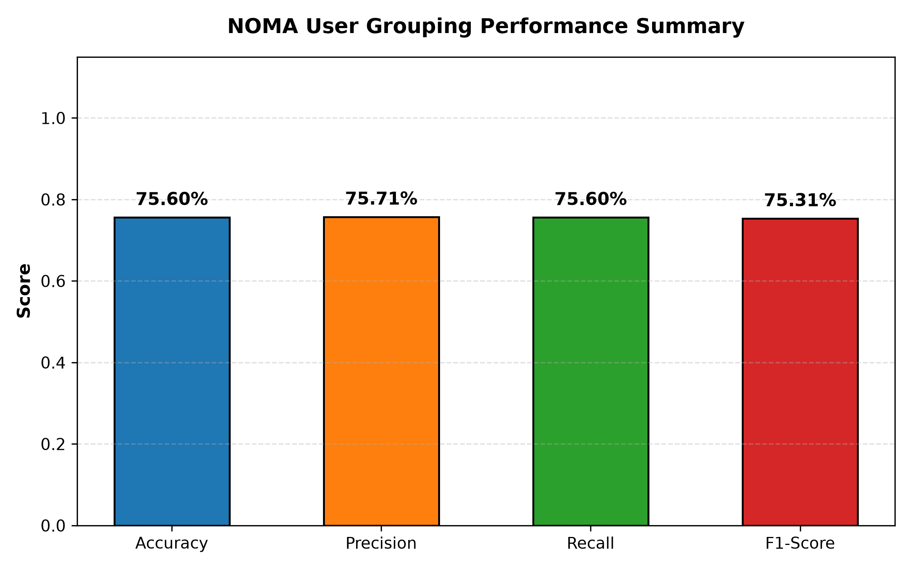
Baseline Model Comparisons
• Model 1 — Fully supervised GNN: accuracy 70.33%, precision 70.80%, F1 70.82%
• Model 2 — Semi-supervised GNN without CSI uncertainty: accuracy 67.33%, precision 66.50%, F1 66.34%
• Model 3 — Proposed uncertainty-aware semi-supervised GNN: accuracy 75.60%, precision 75.71%, F1 75.31%
• Proposed model is +5.27 percentage points in accuracy vs Model 1
• Proposed model is +8.27 percentage points in accuracy vs Model 2; verify identical split/seed/budget for fair attribution
Accuracy / Precision / F1 (%)
Fully supervised
70.3
70.8
70.8
Semi-supervised
no uncertainty
67.3
66.5
66.3
Proposed model
75.6
75.7
75.3
Proposed accuracy gain: +5.27 pp vs supervised
ΔAccuracy(Model 3 − Model 1) = 75.60 − 70.33 = +5.27 pp
UNCERTAINTY-AWARE GNN | TECHNICAL PROJECT PRESENTATION
14 / 18
Notes:
Present the numbers as supplied. The proposed model has the highest reported accuracy and precision, while its F1 is reported as 75.31%. Because the baseline F1 and precision figures differ in their rounding/definitions, verify the metric implementation and ensure identical test splits and label alignment before drawing strong causal conclusions.

Slide 15
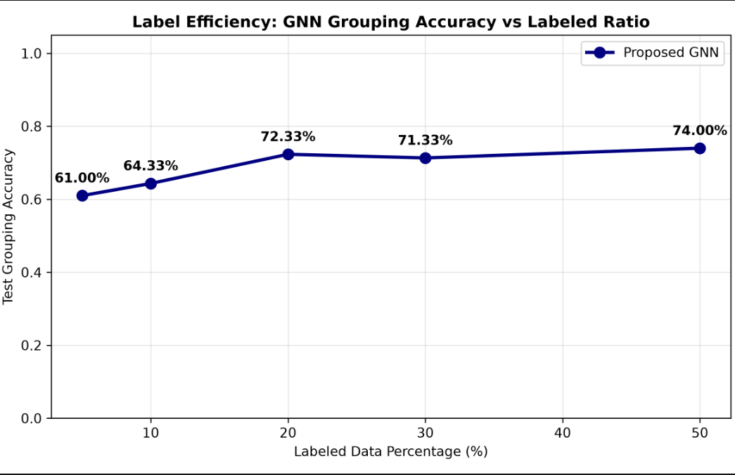
Label Efficiency & CSI Uncertainty Sensitivity
• 5% labeled: 61.67% accuracy
• 10% labeled: 65.00% accuracy
• 20% labeled: 73.67% accuracy
• 50% labeled: 72.00% accuracy
• Peak reported accuracy is at 20%; non-monotonic results warrant repeated seeds and uncertainty-bin counts
73.67
72.00
65.00
61.67
5%
10%
20%
50%
Label fraction
30% value not supplied in prompt — verify before plotting.
CSI sensitivity: plot accuracy + confidence by uncertainty bin
UNCERTAINTY-AWARE GNN | TECHNICAL PROJECT PRESENTATION
15 / 18
Notes:
Explain that performance rises through 20% labels but decreases at 50% in the supplied results. More labels do not guarantee a better result if optimization varies, splits differ, or pseudo-label dynamics change. The prompt mentions CSI sensitivity plots but gives no numerical bins, so describe the analysis and do not fabricate values.

Slide 16
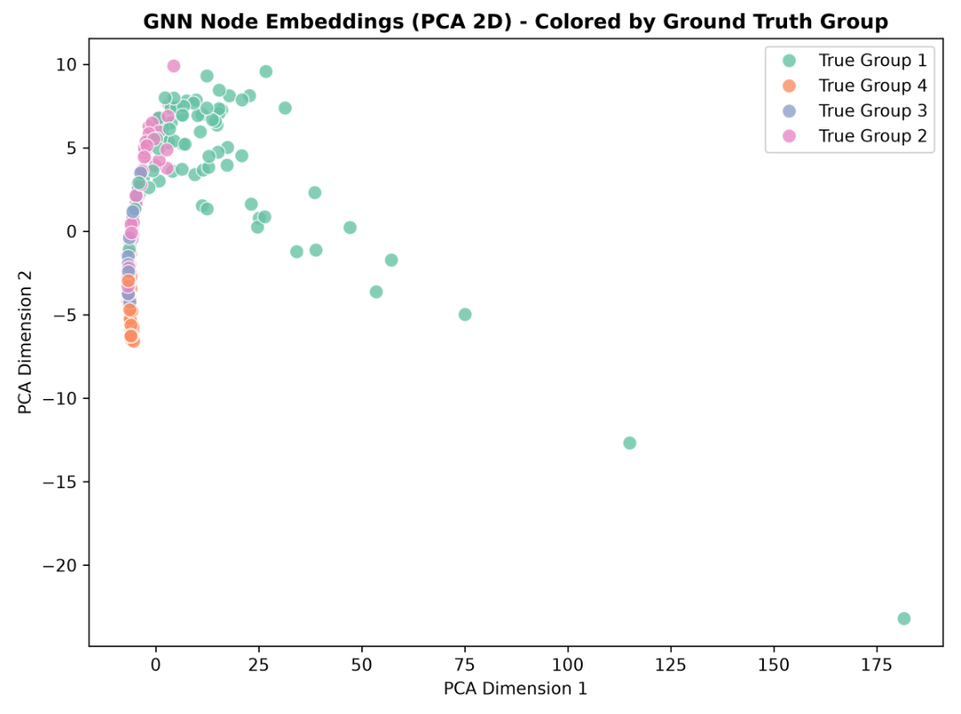
Visual Analytics: Dynamic User Graphs & Scorecard
• NetworkX visualization: node color = predicted group
• Node size encodes CSI uncertainty magnitude; edge thickness encodes similarity
• On-canvas scorecard summarizes accuracy, precision, recall, and F1
• Visuals help inspect group structure, ambiguous boundaries, and potentially noisy nodes
• Graph visualization is diagnostic; it does not independently validate physical-layer feasibility
METRICS
Acc: 75.60%
Prec: 75.71%
Recall: 75.60%
F1: 75.31%
Node i: color(ŷᵢ), size ∝ uᵢ; edge (i,j): width ∝ wᵢⱼ
UNCERTAINTY-AWARE GNN | TECHNICAL PROJECT PRESENTATION
16 / 18
Notes:
Point out how the graph links the prediction to the relational structure. Large nodes indicate higher uncertainty under the chosen visualization scale, not necessarily higher error in every case. Use the scorecard as a compact summary and cross-check it against exported metrics.

Slide 17
Node Embedding Space & Output Artifacts
• PCA and t-SNE project learned node embeddings into two dimensions
• Inspect class separation, overlap, and ambiguous boundaries
• Artifacts: predicted_groups.csv, confusion_matrix.csv, per_group_metrics.csv, metrics_summary.csv
• Additional artifacts: node_embeddings.csv, graph_edges.csv, predicted_graph.graphml
• Keep user/scenario IDs and class mapping consistent across all exports
Illustrative embedding layout — replace with actual PCA/t-SNE outputs
H ∈ ℝ^(N×D) → PCA/t-SNE → Z₂D ∈ ℝ^(N×2)
UNCERTAINTY-AWARE GNN | TECHNICAL PROJECT PRESENTATION
17 / 18
Notes:
Explain that PCA is a linear projection and t-SNE is a nonlinear visualization that can distort global distances. Embedding separation is qualitative support, not a replacement for held-out metrics. The CSV and GraphML files make predictions and graph structure inspectable.

Slide 18
Summary, Next Steps & Future Roadmap
• Established an uncertainty-aware semi-supervised GNN pipeline for four-group user assignment
• Reported 75.60% test accuracy and 75.31% macro-F1; Groups 2–3 are the main error region
• Next: repeated-seed confidence intervals, ablations, calibration, and uncertainty-bin analysis
• Then integrate group outputs with power allocation and SIC feasibility checks
• Finally evaluate SINR, BER/reliability, and sum-rate under explicit channel and receiver assumptions
PHASE 1
PHASE 2
PHASE 3
ML validation
Power allocation + SIC
SINR / sum-rate
ML grouping → Power allocation → SIC/SINR evaluation → Sum-rate and reliability
UNCERTAINTY-AWARE GNN | TECHNICAL PROJECT PRESENTATION
18 / 18
Notes:
Close by distinguishing completed classification evaluation from future communications evaluation. Prioritize reproducibility, repeated seeds, and uncertainty calibration before making deployment claims. The downstream stage should test whether predicted groups lead to feasible SIC and measurable rate or reliability benefits.

