Slide 1
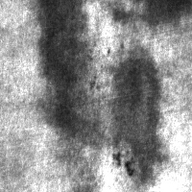
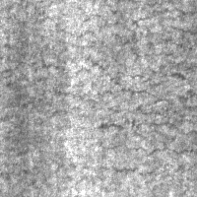
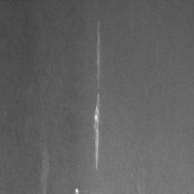
METAL SURFACE DEFECTS DEEP LEARNING
MSc in Data Science
NCSR Demokritos
University of Peloponnese
Nikos Nteits
Apostolis Tsergas
Haris Sideris

Slide 2
AGENDA
01
02
03
04
05
06
DEEP LEARNING from scratch – 1st dataset
1st DATASET
2nd DATASET
TRANSFER LEARNING
1st attempt
TRANSFER LEARNING 2nd attempt
DEEP LEARNING from scratch – 2nd dataset
07
REMARKS

Slide 3
1st dataset – NEU Metal Surface Defects
Kaggle
Organized in folders (train, valid, test)
6 balanced classes
Crazing
Inclusion
Patches
Pitted
Rolled
Scratches
1600 train images, 72 validation, 72 test images
200x 200 pixels

Slide 4
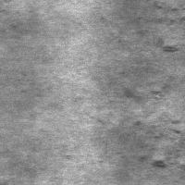
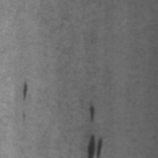
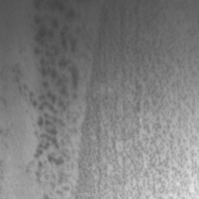
1st dataset – NEU Metal Surface Defects
Crazing
Patches
Rolled
Inclusion
Scratches
Pitted

Slide 5
02
Deep Learning from scratch 1st dataset

Slide 6
Deep Learning from scratch - NEU dataset
Resize
1st conv layer
200x200x1
1st fc layer
64x64x1
64x64x8
32x32x8
1024x1
64x1
8 kernels 3x3x1
Maxpooling 2x2x1
16 kernels 3x3x1
6x1
Maxpooling 2x2x1
Maxpooling 2x2x1
32 kernels 3x3x1
Maxpooling 2x2x1
64 kernels 3x3x1
32x32x16
2nd fc layer
16x16x16
16x16x32
8x8x32
8x8x64
4x4x64
2nd conv layer
3rd conv layer
4th conv layer
Batch size: 32
Batch Normalization
ReLu
Maxpooling: 2x2
Dropout: 0.2
Learning rate:0.002
CrossEntropy Loss
Adam Optimizer
flattening
90,614 Trainable Params

Slide 7

Deep Learning from scratch - NEU dataset
1st filter
2nd filter
3d filter
4th filter

Slide 8
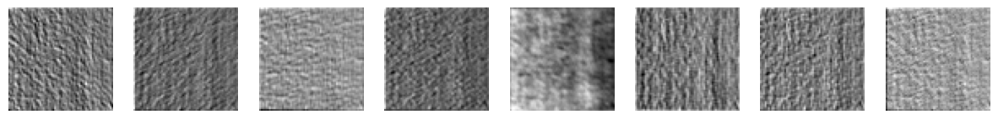
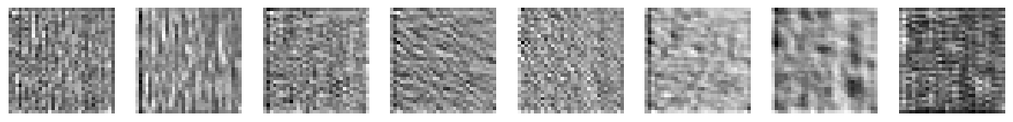
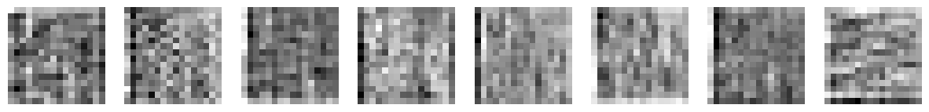

Deep Learning from scratch - NEU dataset
1st filter
2nd filter
3rd filter
4th filter

Slide 9
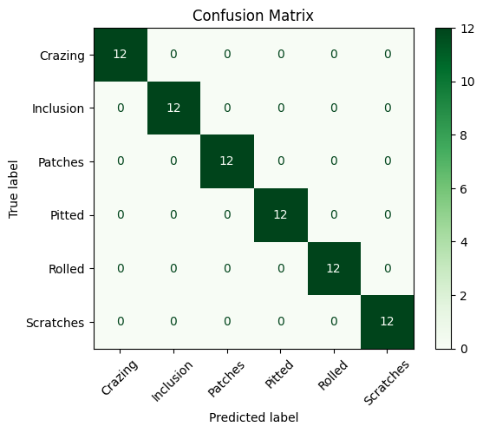
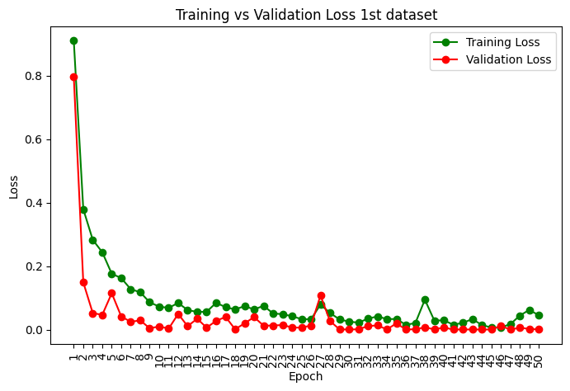
Deep Learning from scratch - NEU dataset
Accuracy → 100%

Slide 10
03
2nd dataset

Slide 11
2nd dataset X-SDD
Kaggle
Unorganized folders
7 imbalanced classes
Finishing roll printing
Iron sheet ash
Oxide scale of plate system
Oxide scale of temperature system
Red Iron
Slag inclusion
Surface scratch
70% train – 15% validation – 15% test
1360 images, 200 x 200 pixels

Slide 12
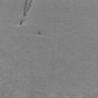
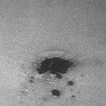
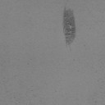
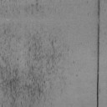
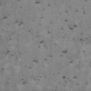
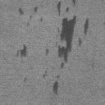
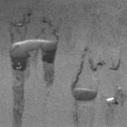
2nd dataset X-SDD
Finishing roll printing
Iron sheet ash
Oxide scale of plate system
Surface scratch
Oxide scale of temperature system
Red iron
Slag inclusion

Slide 13
04
Transfer learning – 1st attempt

Slide 14
Transfer learning – unfreeze 2nd fc layer
Resize
1st layer
200x200x1
1st fc layer
64x64x1
64x64x8
32x32x8
1024x1
64x1
7x1
32x32x16
2nd fc layer
16x16x16
16x16x32
8x8x32
8x8x64
4x4x64
2nd layer
3rd layer
4th layer
Batch size: 32
Batch Normalization
ReLu
Maxpooling: 2x2
Dropout: 0.2
Learning rate:0.002
CrossEntropy Loss → weights
Adam Optimizer
flattening

Slide 15
Transfer learning – unfreeze 2nd fc layer
Resize
1st layer
200x200x1
1st fc layer
64x64x1
64x64x8
32x32x8
1024x1
64x1
7x1
32x32x16
2nd fc layer
16x16x16
16x16x32
8x8x32
8x8x64
4x4x64
2nd layer
3rd layer
4th layer
Batch size: 32
Batch Normalization
ReLu
Maxpooling: 2x2
Dropout: 0.2
Learning rate:0.002
CrossEntropy Loss → weights
Adam Optimizer
flattening
455 Trainable Params

Slide 16
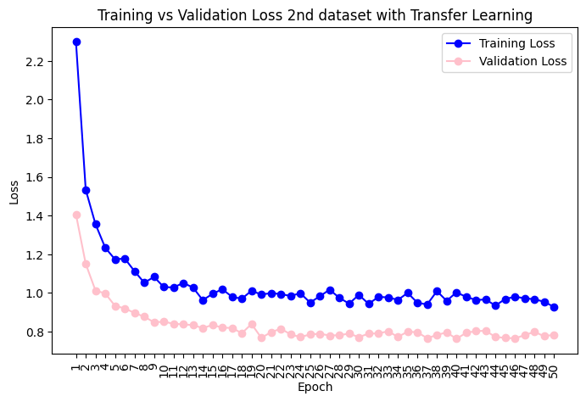
Transfer learning – unfreeze 2nd fc layer

Slide 17
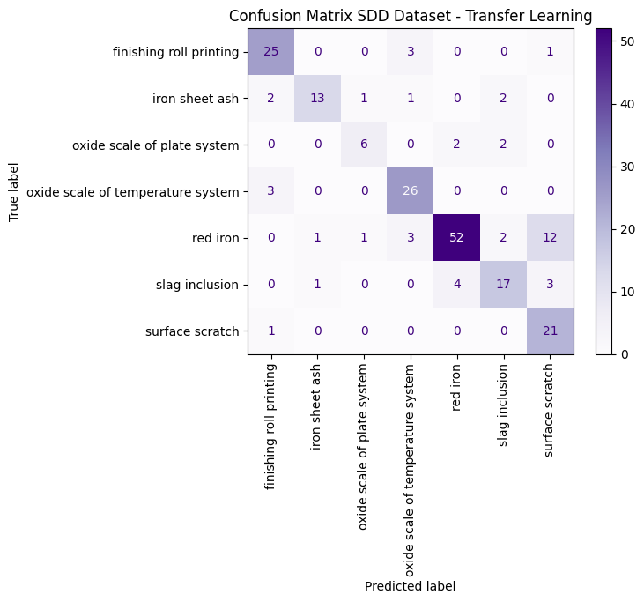
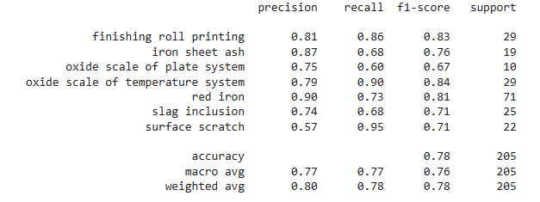
Transfer learning – unfreeze 2nd fc layer
Accuracy → 78,05%

Slide 18
05
Transfer learning – 2nd attempt

Slide 19
Transfer learning – unfreeze 1st and 2nd fc layers
Resize
1st layer
200x200x1
1st fc layer
64x64x1
64x64x8
32x32x8
1024x1
64x1
7x1
32x32x16
2nd fc layer
16x16x16
16x16x32
8x8x32
8x8x64
4x4x64
2nd layer
3rd layer
4th layer
Batch size: 32
Batch Normalization
ReLu
Maxpooling: 2x2
Dropout: 0.2
Learning rate:0.001
CrossEntropy Loss → weights
Adam Optimizer
flattening

Slide 20
Transfer learning – unfreeze 1st and 2nd fc layers
Resize
1st layer
200x200x1
1st fc layer
64x64x1
64x64x8
32x32x8
1024x1
64x1
7x1
32x32x16
2nd fc layer
16x16x16
16x16x32
8x8x32
8x8x64
4x4x64
2nd layer
3rd layer
4th layer
Batch size: 32
Batch Normalization
ReLu
Maxpooling: 2x2
Dropout: 0.2
Learning rate:0.001
CrossEntropy Loss → weights
Adam Optimizer
flattening
66,055 Trainable Params

Slide 21
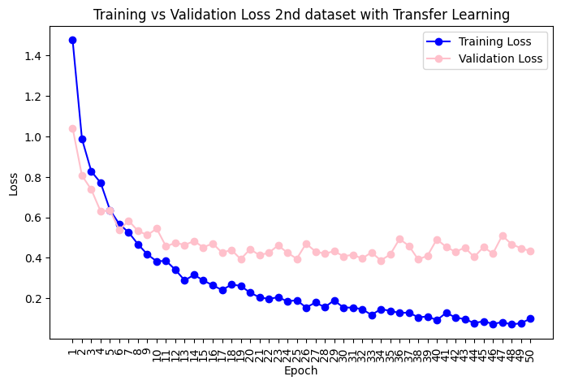
Transfer learning – unfreeze 1st and 2nd fc layers

Slide 22
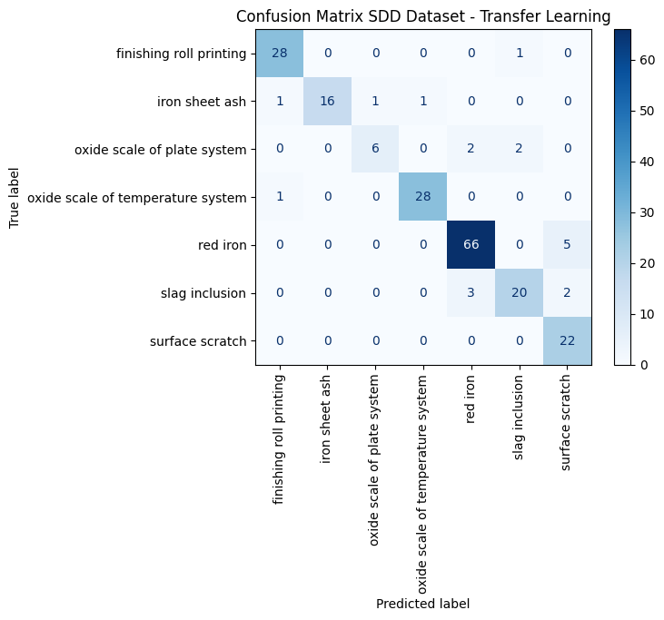
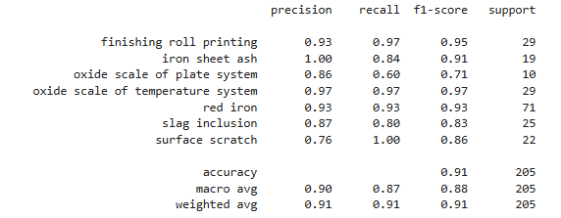
Transfer learning – unfreeze 1st and 2nd fc layers
Accuracy → 90,73%

Slide 23
06
Deep Learning from scratch 2nd dataset

Slide 24
Deep Learning from scratch – X SDD dataset
Resize
1st layer
200x200x1
1st fc layer
64x64x1
64x64x8
32x32x8
1024x1
64x1
7x1
32x32x16
2nd fc layer
16x16x16
16x16x32
8x8x32
8x8x64
4x4x64
2nd layer
3rd layer
4th layer
Batch size: 32
Batch Normalization
ReLu
Maxpooling: 2x2
Dropout: 0.2
Learning rate: 0.0005
CrossEntropy Loss → weights
Adam Optimizer
flattening

Slide 25
Deep Learning from scratch – X SDD dataset
Resize
1st layer
200x200x1
1st fc layer
64x64x1
64x64x8
32x32x8
1024x1
64x1
7x1
32x32x16
2nd fc layer
16x16x16
16x16x32
8x8x32
8x8x64
4x4x64
2nd layer
3rd layer
4th layer
Batch size: 32
Batch Normalization
ReLu
Maxpooling: 2x2
Dropout: 0.2
Learning rate: 0.0005
CrossEntropy Loss → weights
Adam Optimizer
flattening
90,679 Trainable Params

Slide 26
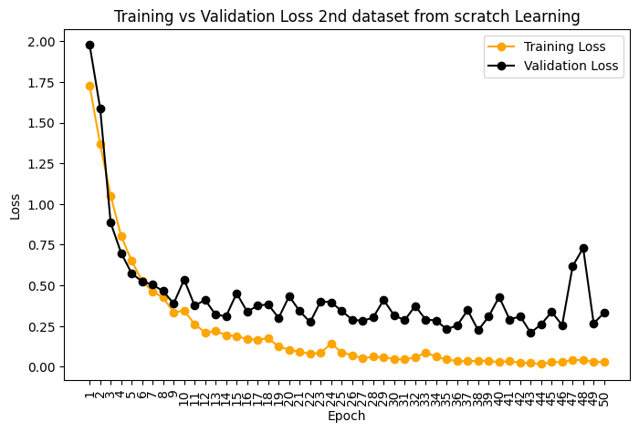
Deep Learning from scratch – X SDD dataset

Slide 27
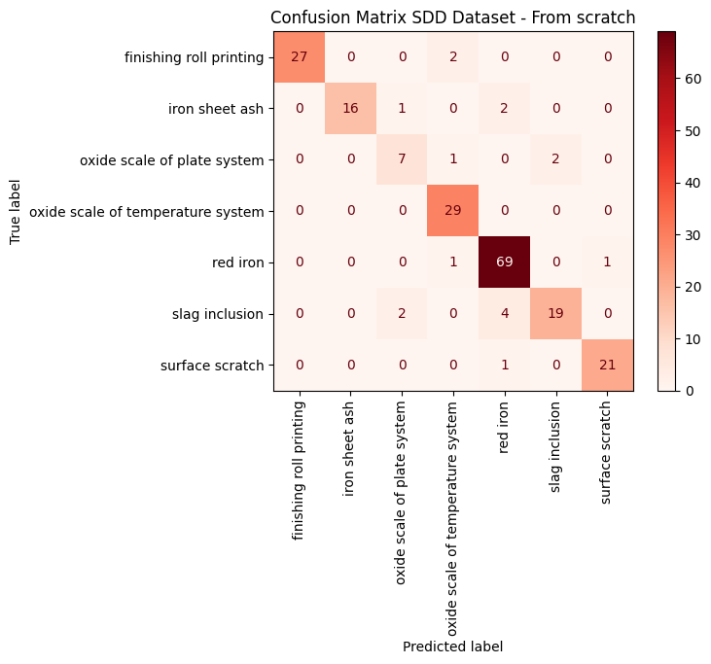
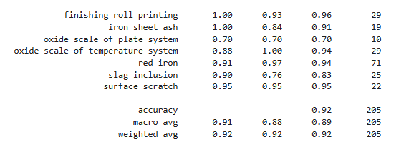
Deep Learning from scratch – X SDD dataset
Accuracy → 91,71%

Slide 28
07
Remarks

Slide 29
Remarks
Our first from-scratch model achieved 100% accuracy in detecting surface defects on the NEU Dataset.
The second from-scratch model achieved 91.71% accuracy on the X-SDD Dataset.
The initial attempt using one unfrozen fully connected (fc) layer did not perform well (78.05% accuracy).
By unfreezing an additional fc layer, the accuracy increased to 90.73%.
Next Steps
Train a model from scratch using a larger dataset (>10,000 images).
Use this model as a base for transfer learning on the second dataset.
Compare the performance of this transfer learning approach with the previous from-scratch model.

Slide 30
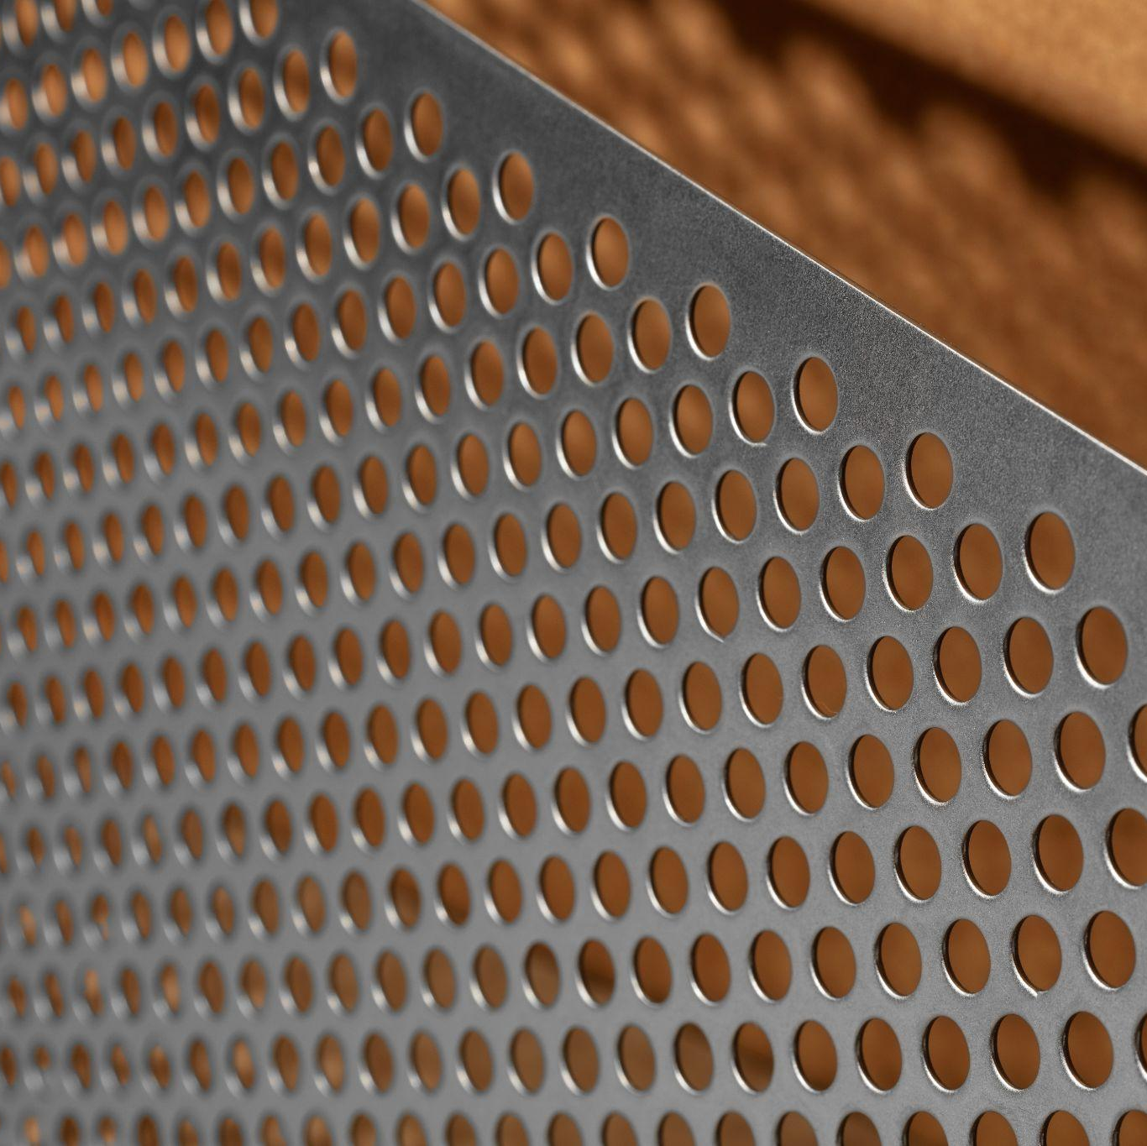
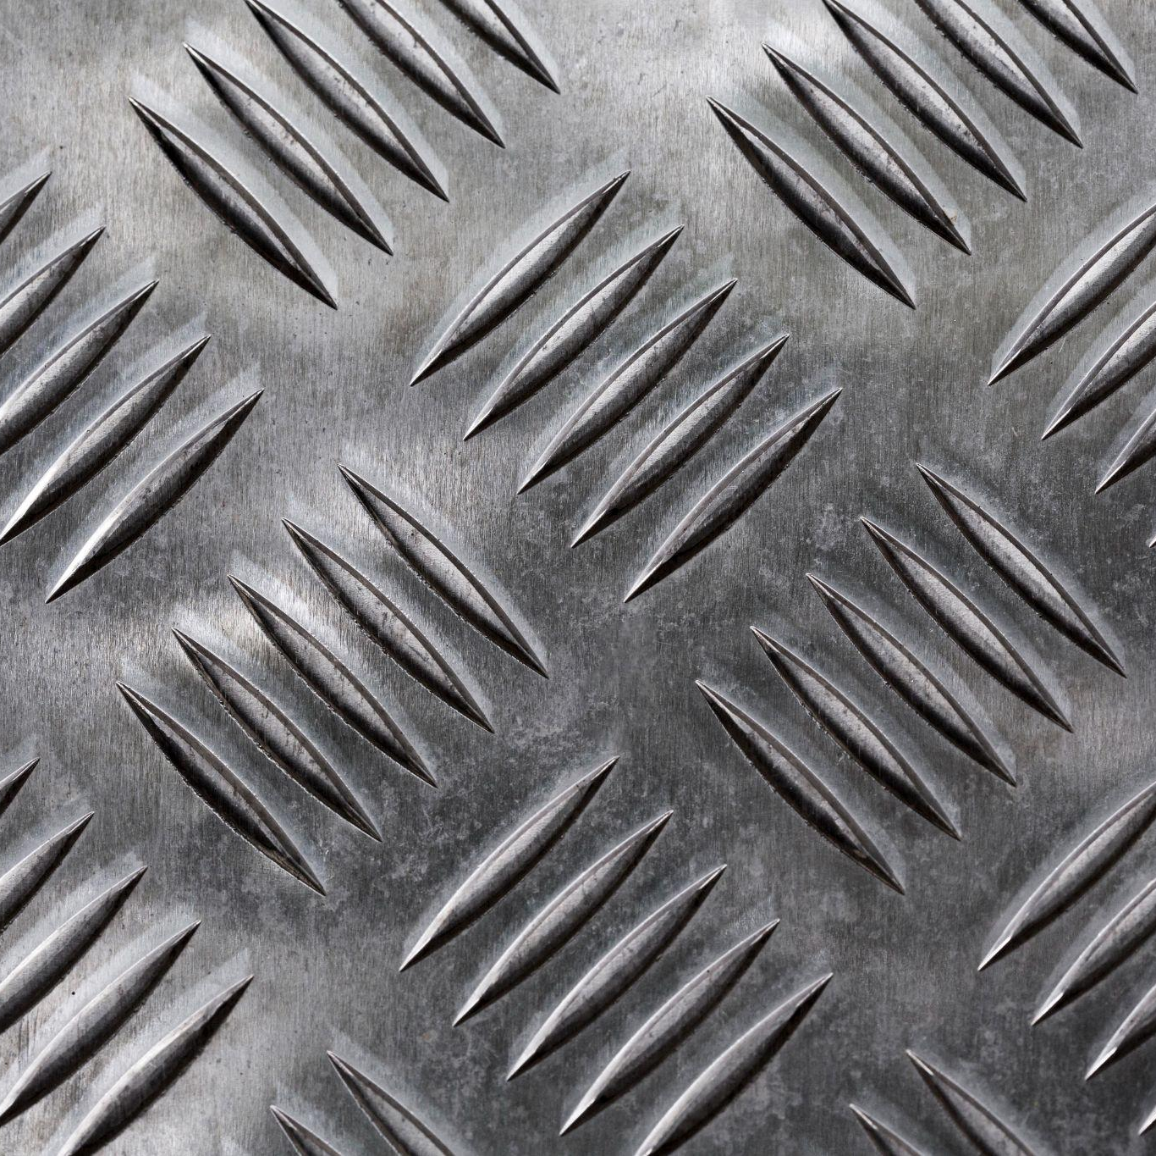
Thanks!
Questions?

