Slide 1
Wazuh 3D Visual Dashboard
Automatically generated from PDF report

Slide 2
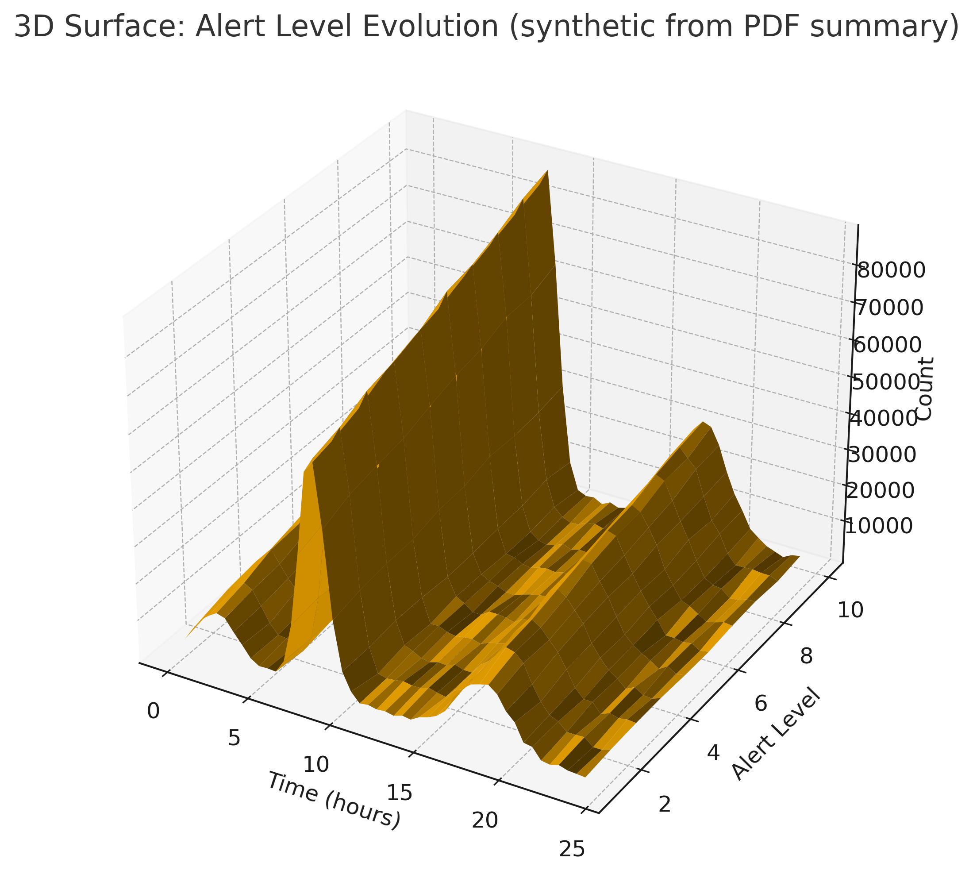
Alert Level Evolution (3D Surface)

Slide 3
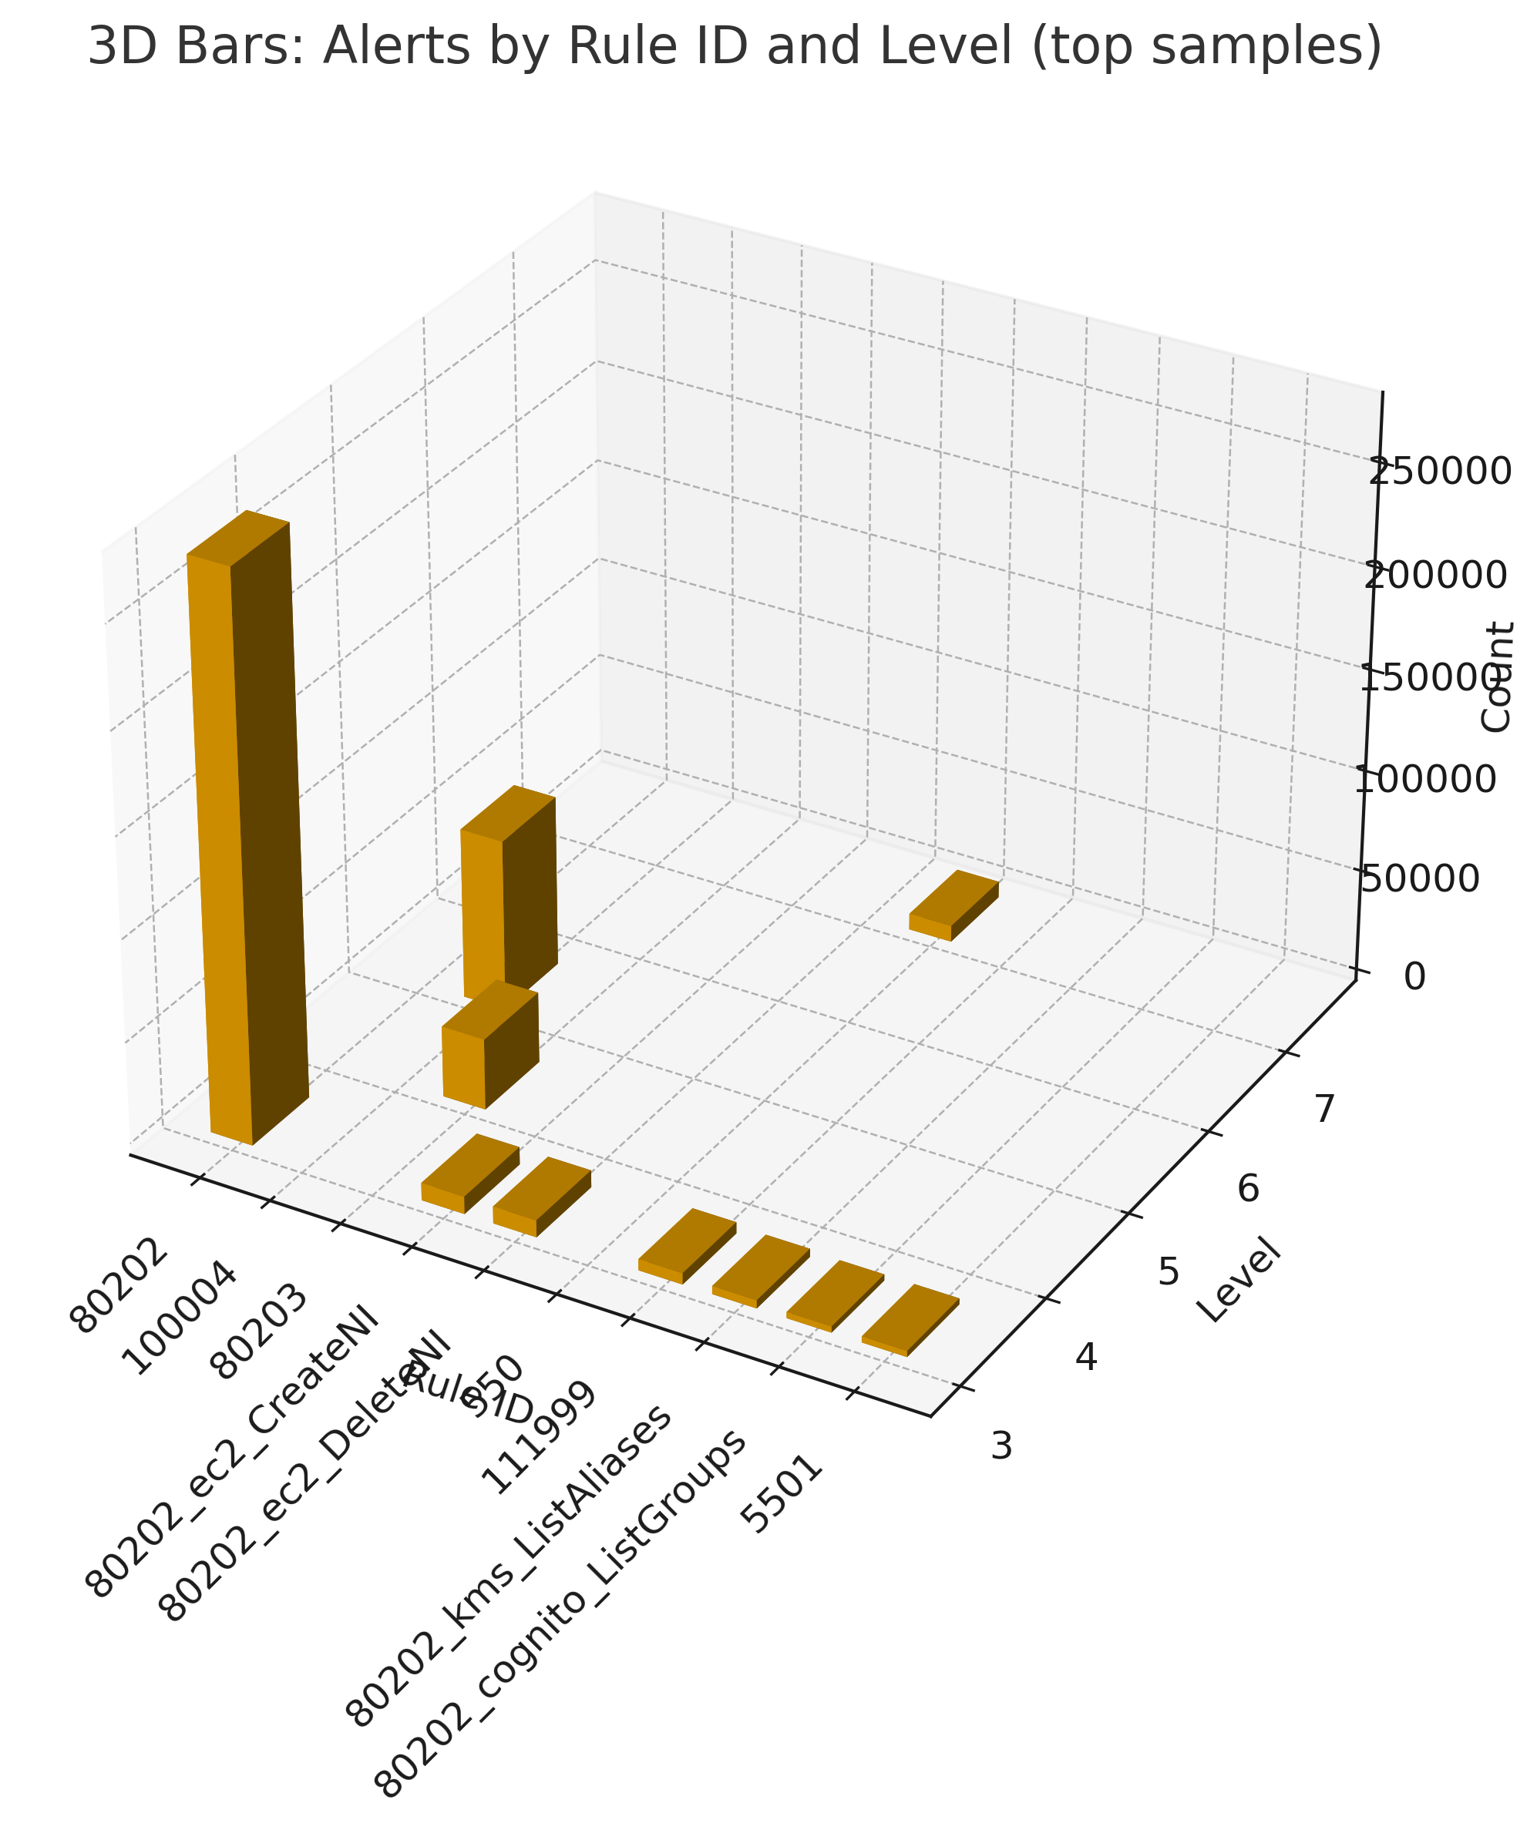
Alerts by Rule ID (3D Bars)

Slide 4
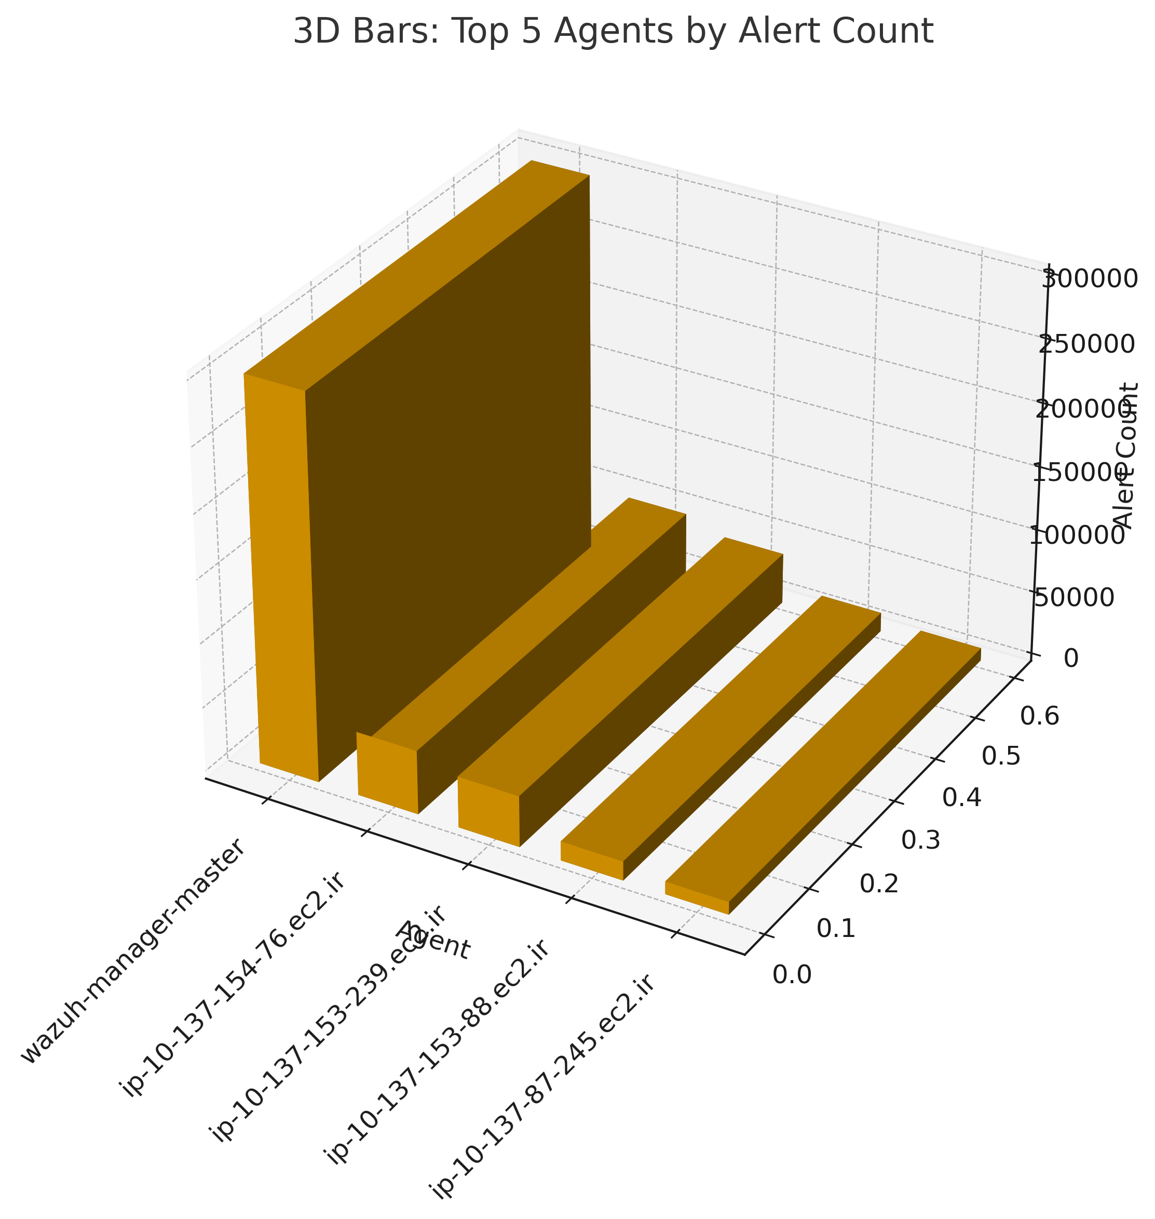
Top 5 Agents (3D Bars)

Slide 5
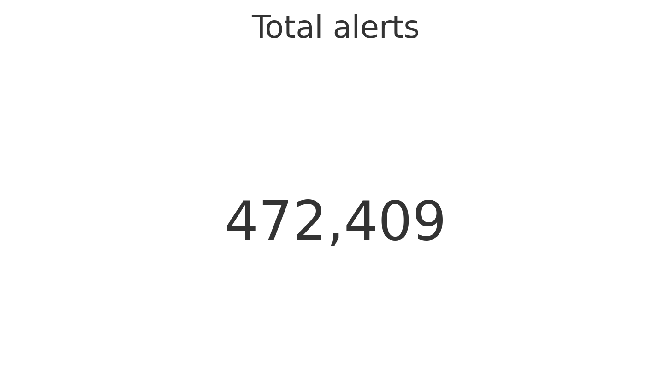
KPI – Total Alerts

Slide 6
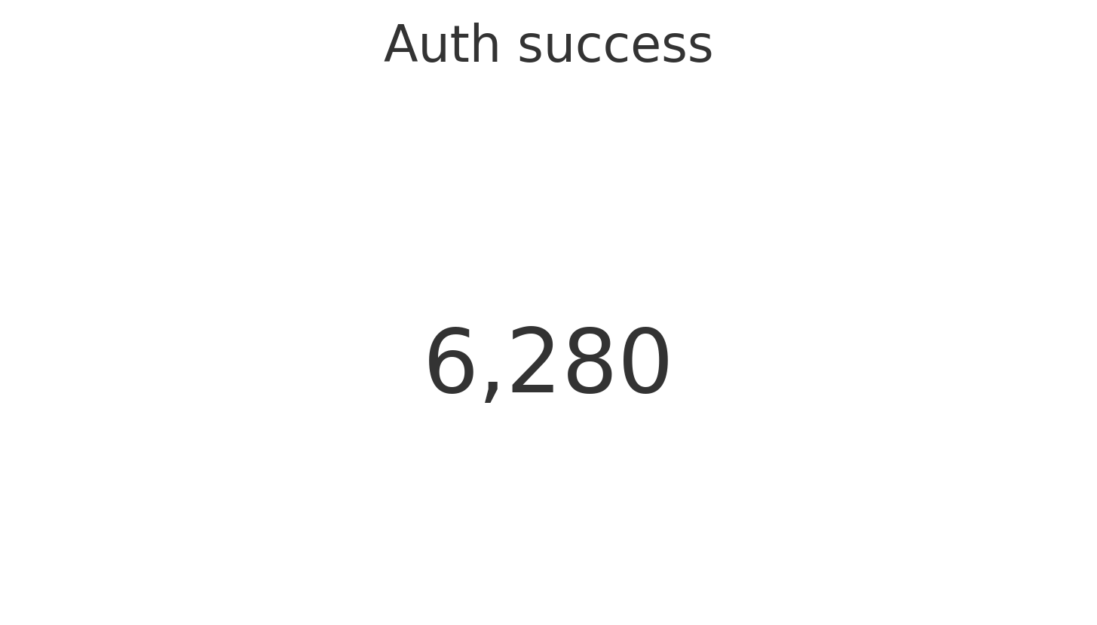
KPI – Auth Success

Slide 7
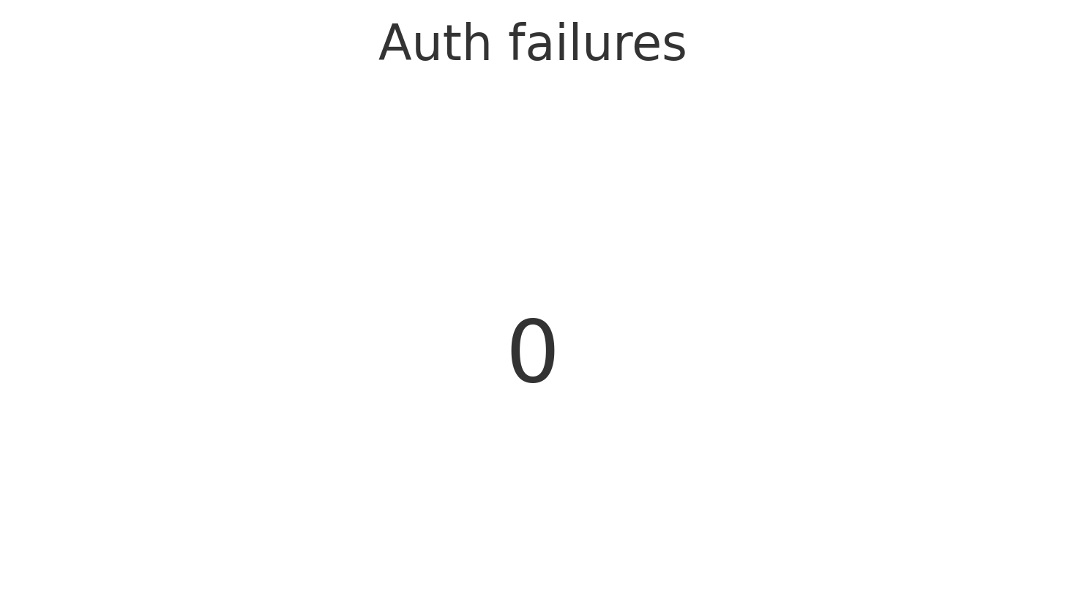
KPI – Auth Failures

Slide 8
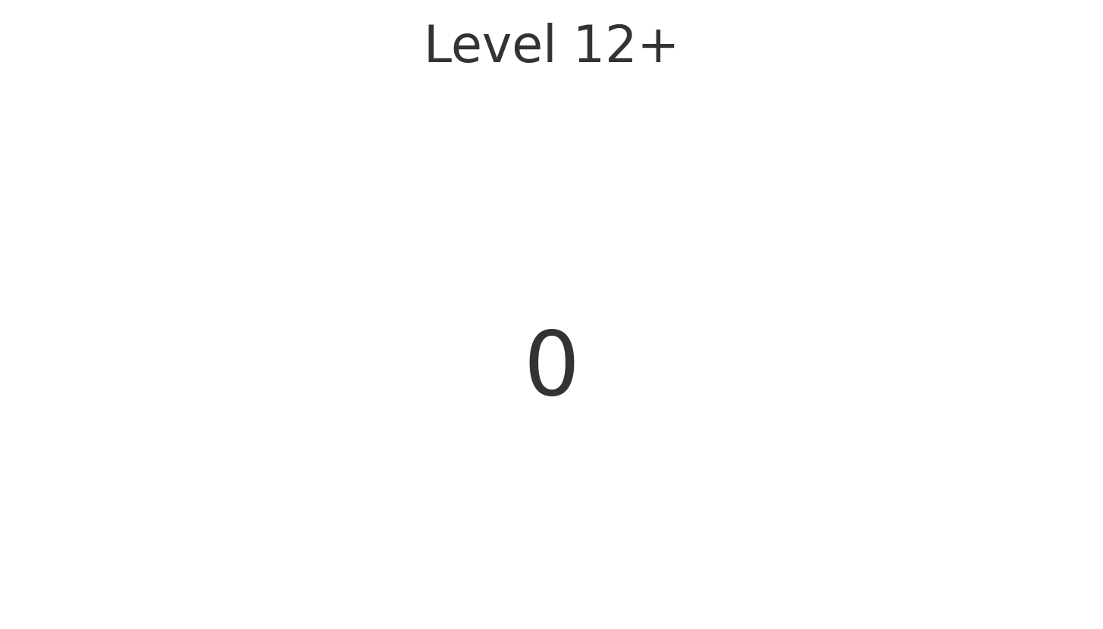
KPI – Level 12+

