Slide 1
Inventory Management System for a Pharmacy
Group Members:
Haris Jamal Khan 362535
Aqeel Ahmad 364244
Amad Ud Din Gakkhar 364715

Slide 2
Project Scope
In this project we aim to develop an inventory management system for a pharmacy.
For front end development we have used PyQt5, Qt designer.
To store data we have created a csv file using pandas (Python Library).

Slide 3
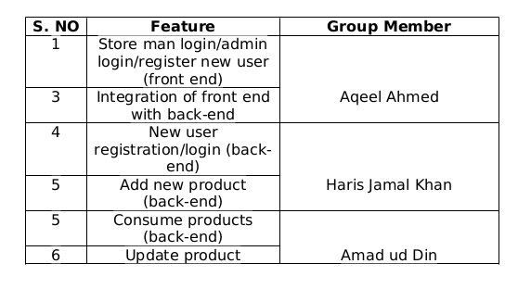
Task Distribution

Slide 4
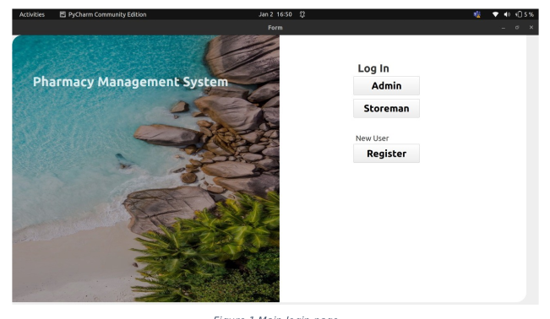
Main Page
The main page has the following functionality
Admin login
Store-man login
New user registration

Slide 5
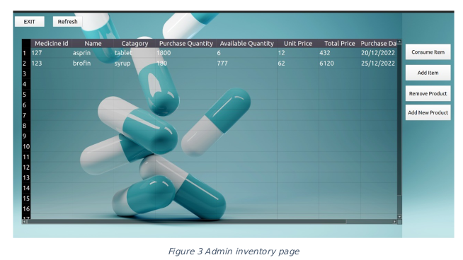
Admin Functionality
If a user is logged in as an Admin, they can perform the following functions
Consume item
Add item
Remove product
Add new product

Slide 6
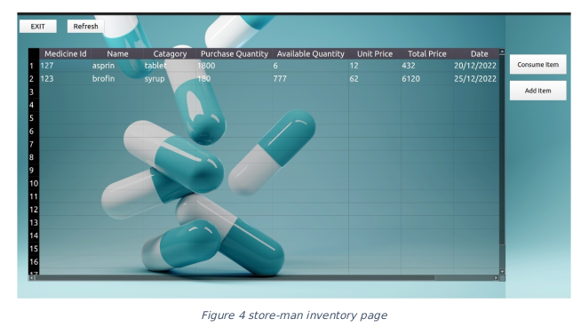
Store-man Login
If a user login as a store-man it can perform the following functions
Consume item
Add item

Slide 7
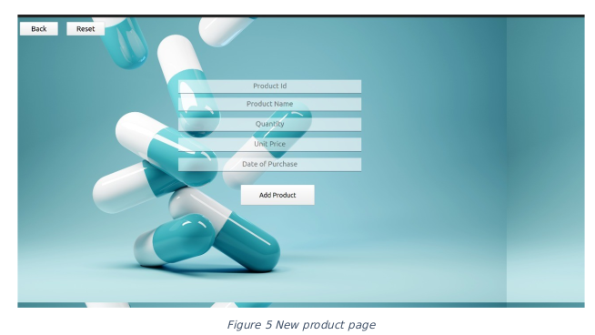
New Product
Admin can enter a new product in the database by providing the following information
Product name
Product id
Quantity
Unit price
Date of purchase

Slide 8
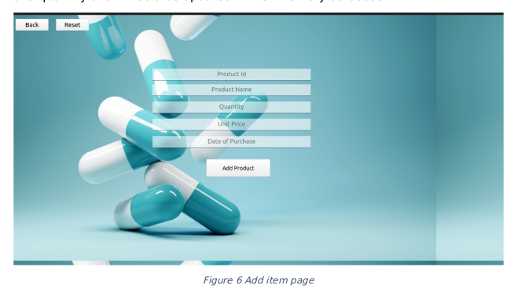
Add Item
One can add quantity to an existing product by providing product name and quantity and it would be updated in the inventory database

Slide 9
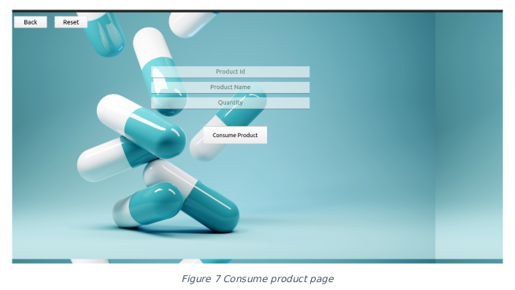
Consume Item
One can update the quantity of a product by providing product name and quantity

Slide 10
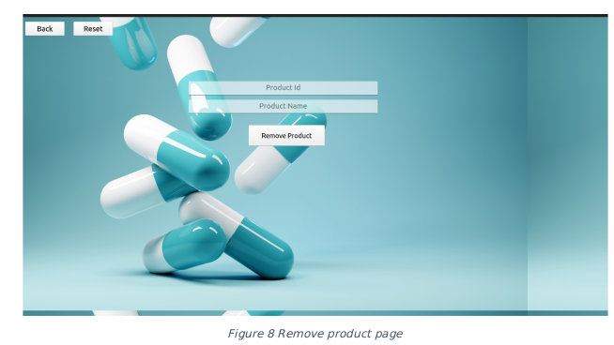
Remove Product
Product can be deleted by providing the product name

Slide 11
Thanks

