Slide 1
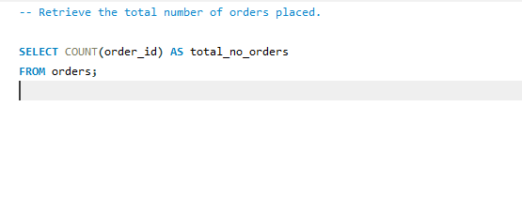
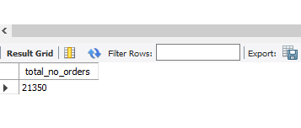
QUERY
OUTPUT

Slide 2


QUERY
OUTPUT

Slide 3
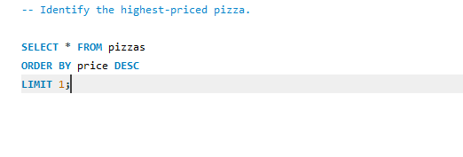

QUERY
OUTPUT

Slide 4
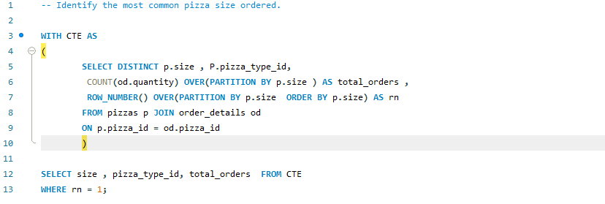
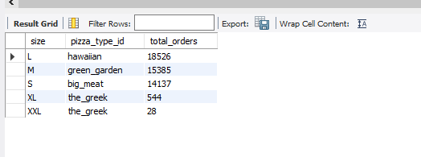
QUERY
OUTPUT

Slide 5
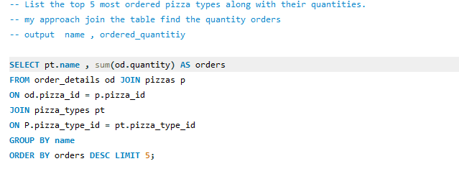

QUERY
OUTPUT

Slide 6


QUERY
OUTPUT

Slide 7

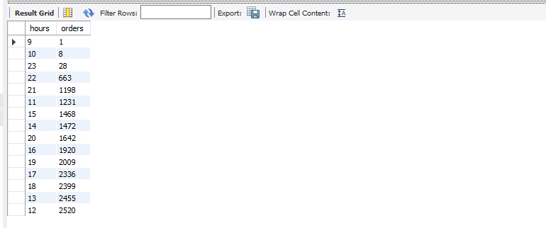
QUERY
OUTPUT

Slide 8


QUERY
OUTPUT

Slide 9


QUERY
OUTPUT

Slide 10
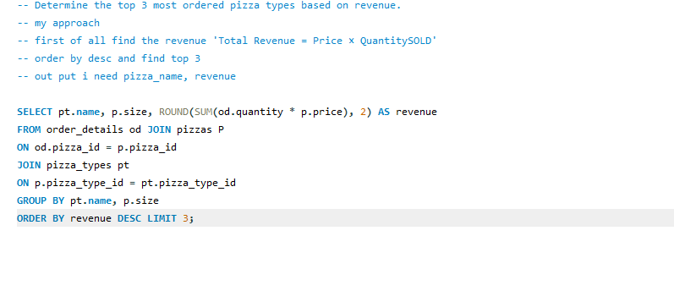

QUERY
OUTPUT

Slide 11
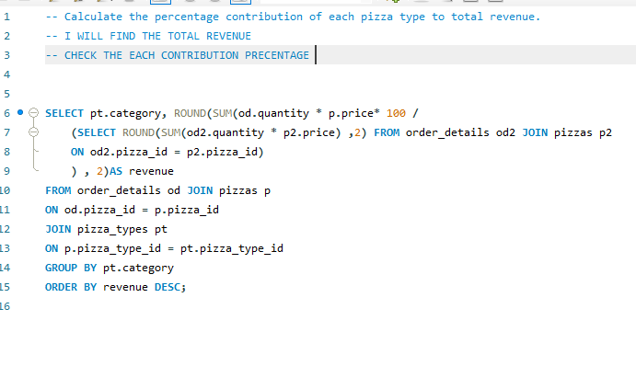

QUERY
OUTPUT

Slide 12
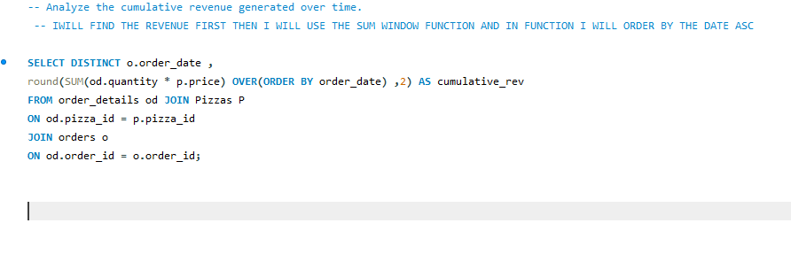
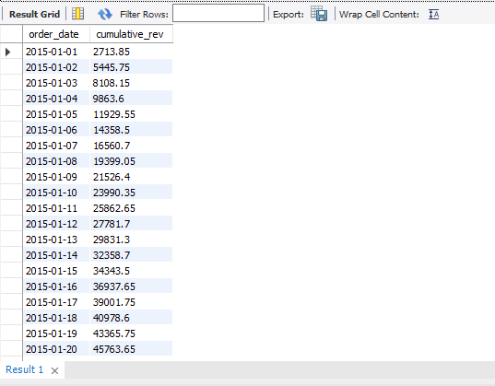
QUERY
NOT FULL OUTPUT

Slide 13
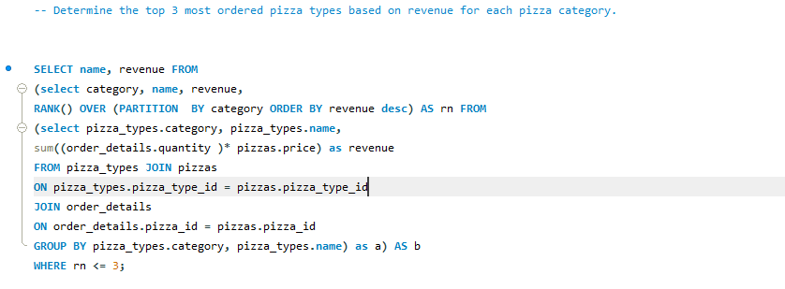
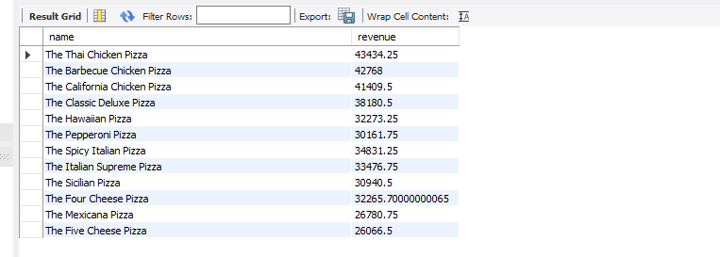
QUERY
OUTPUT

