Slide 1
Genetic Algorithm Optimization of Distributed Database Queries
Md Haris Iqbal M. tech IT 1st Year
Department of Information Technology
NITK Surathkal

Slide 2
Introduction
A database that consists of two or more data files located at different sites on a computer network is called Distributed Database.
Query optimization is the process of finding the most efficient way to execute a query.
Genetic algorithm is a search heuristic algorithm that mimics the process of natural selection.

Slide 3
Target Problem
A distributed tree query involving n tables located on n distinct network nodes is given.
A minimum cost schedule to fully reduce all tables in the query

Slide 4
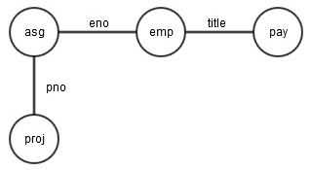
Approach
Representing the query as a graph
Applying semi-join to completely reduce one root schedule.
Use the root schedule to reduce all other schedules.

Slide 5
Genetic Algorithm (Steps)
Generate random schedules.
Loop over generations
Selection of schedules.
Reproduce new schedules by crossing over two already existing schedules.
Apply one of the randomly selected mutations to the schedule.
Until done

Slide 6
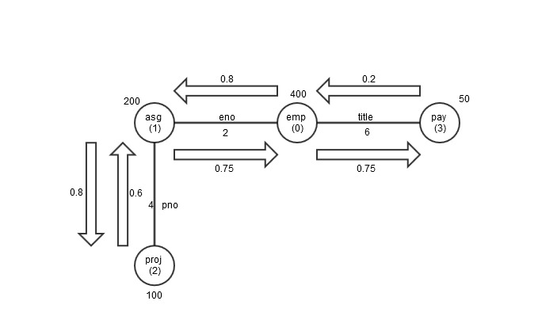
Experimental Setup

Slide 7
Data Dictionary & Data Structures
Table Matrix & Tables array.
Relation Dictionary.
Selectivity Factor.
Communication Cost.
Full Reduce Cost.
Schedules and their Cost.

Slide 8
Implementation Methodology
A root table is selected randomly for every schedule.
The edges between the nodes (sites) are selected randomly for every schedule.
Loop over generations
Two schedules are chosen for crossover (reproduction).
One of the mutation methods are chosen randomly and applied to every schedule.
If the newly found schedule has cost smaller than the old one, it is replaced.
Until done

Slide 9
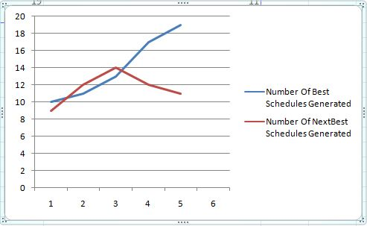
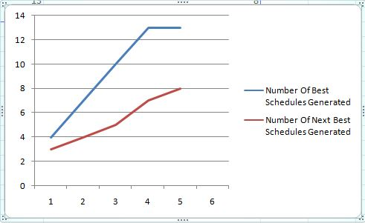
Results
Genetic Algorithm
Random Search

Slide 10
Improvement
Close observation of the best schedules reveal that they always start with a join which has the least selection criteria.
In terms of this, one can customize the generation of schedules.
Instead of random generation, the schedules are generated on the basis of increasing order of selection criteria between the relations.

Slide 11
Conclusion
Using genetic algorithm, the optimized cost of the schedule is considerably less, when compared to other methods like random search.
Although there is a possibility of improvement in the initialization phase.

Slide 12
References
http://ieeexplore.ieee.org/stamp/stamp.jsp?tp=&arnumber=699724
http://en.wikipedia.org/wiki/Relational_algebra
http://www.dbspecialists.com/files/presentations/semijoins.html
http://dba.stackexchange.com/questions/78316/ascending-and-descending-semi-joins

Slide 13
Thank You

