Slide 1
Prevention of Information Leakages in a Web Browser by Monitoring System Calls
Md Haris Iqbal M. tech IT 1st Year
Department of Information Technology
NITK Surathkal

Slide 2
Introduction
Web browser is an application that is used to retrieve, traverse and present information from the World Wide Web.
It is becoming one of the major applications for the present World Wide Web.
Most of the contents of the internet is accessed using the web browser.
Due to this factor it has become a major target for the hackers.

Slide 3
Target Problem
To monitor the browser process and keep a check on the execution of information leaking and potentially malicious scripts.
To achieve the protection with as minimum overhead as possible.

Slide 4
Approach
Every application asks the operating system to execute a task by issuing system calls.
Web browser uses the same system calls to connect to a website, send/receive data, read/write to a file, etc.
Therefore, to check on every activity of the web browser, we intercept all the system calls made by the browser process.

Slide 5
Implementation Methodology
A program starts tracing the running browser process.
Every system calls that the browser makes is intercepted by the program for analysis.
The system call is checked if it contains any malicious code, or a possibility of data theft.
If something suspicious is found related to that system call, then it is blocked.
If the system call doesn’t have anything wrong with its parameters, then it is allowed to execute.

Slide 6
Experimental setup
To implement the tracer program we use the system call ptrace.
Ptrace allows us to read from the browser process's memory addresses where the system call parameters are kept.
Extracting these parameters, we can check on the behavior of the browser process.
The system call log is dumped into a file, so that later it could be analyzed for attacks that went undetected.

Slide 7
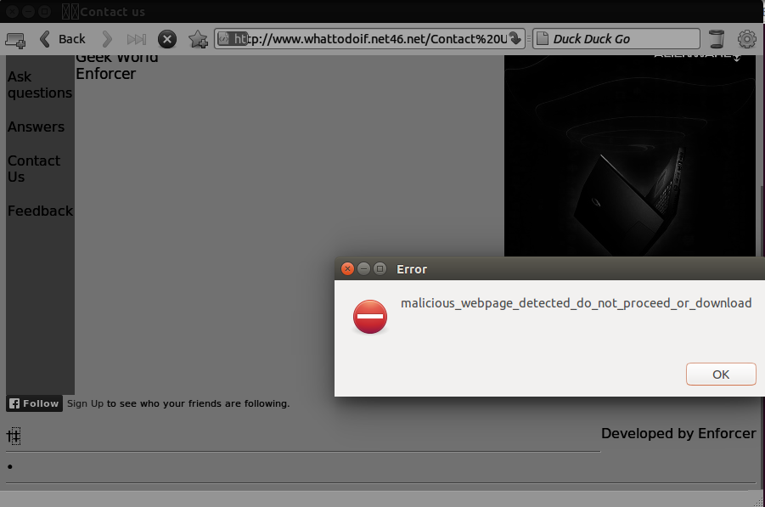
Results & Analysis
Blocking obfuscated JavaScript

Slide 8
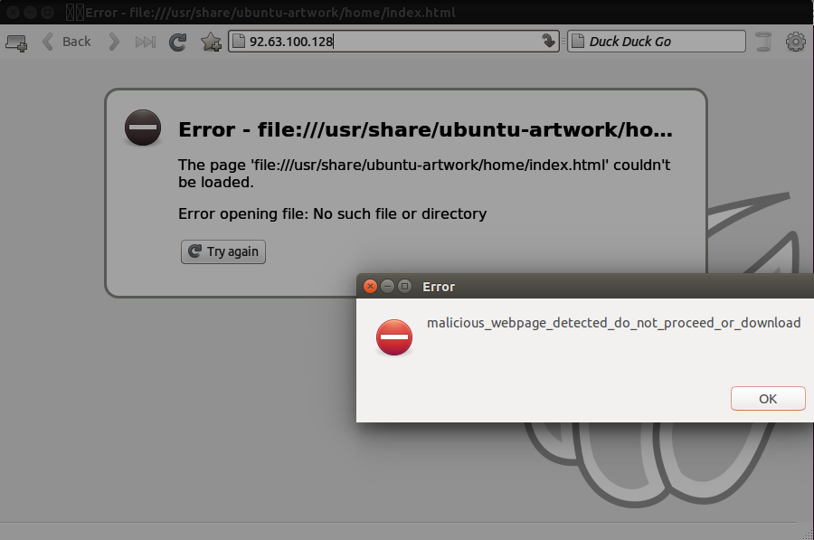
Results & Analysis (Cont)
Blocking black listed IP address

Slide 9
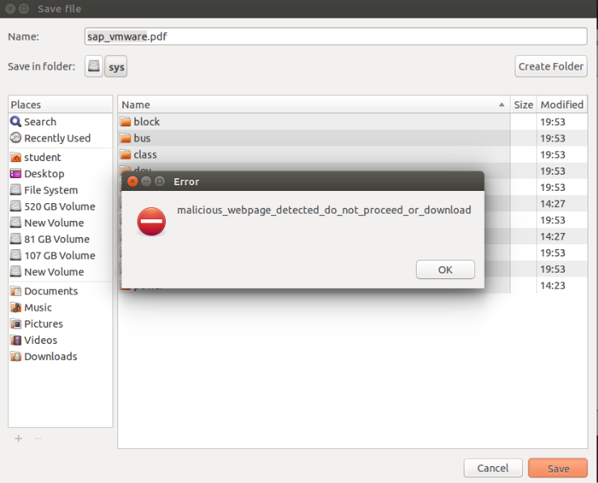
Results & Analysis (Cont)
Blocking Malicious file save

Slide 10
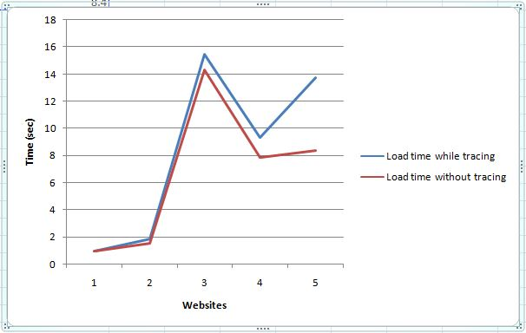
Performance comparison

Slide 11
Improvement
The browser process was analyzed in the beginning to identify the system calls that were the most important ones.
The methods devised to identify the attacks were an addition to the paper.

Slide 12
Conclusion
Most of the attacks could be identified and blocked before it is executed if we work on the system call level.
To achieve this, one has to know how the attacks works in the system level.
This method has an added advantage of incurring less overhead.

Slide 13
Reference
http://man7.org/linux/man-pages/man2/ptrace.2.html
https://blog.nelhage.com/2010/08/write-yourself-an-strace-in-70-lines-of-code/
http://sourceforge.net/projects/strace/files/
http://www.linuxjournal.com/article/6100

Slide 14
Thank You

