Slide 1

DAFR-Net: A Damage-Aware Frequency-Guided Dual-Branch Network for Ancient Mural Restoration Summer Research Project 2024–25 – Phase 1: Core Restoration Pipeline — Trained & Deployed Department of Computer Science and Engineering
Under the guidance of
Dr. N.Sasikaladevi
Associate Professor,
Department of Computer Science and Engineering,
School of Computing,
SASTRA Deemed University,Thanjavur,TN,India.
By
K Anirudh & S Harish Siddharth,
M. Tech Artificial Intelligence and Data science
Department of Computer Science and Engineering,
School of Computing,
SASTRA Deemed University ,Thanjavur,TN,India.

Slide 2

Agenda
Problem Statement & Motivation
Objectives
Dataset — MuralDH Benchmark
System Architecture
Key Novelties
Implementation & Training Setup
Results
Merits & Limitations
Comparison with Existing Work
Conclusion & Future Work

Slide 3
Problem Statement & Motivation
Why Damage-Aware, Frequency-Guided Restoration?
Ancient murals degrade through cracks, fading, and missing (spalled) regions — each with distinct visual statistics.
Manual restoration is slow, expensive, and depends on rare conservator expertise.
Generic deep inpainting (GANs / diffusion) treats all damage types identically and relies only on spatial cues, ignoring frequency-domain degradation patterns.
Goal: classify damage first, then restore it using both structural and frequency information, jointly fused.

Slide 4
Base Paper
Deng & Yu (2023) — Structure-Guided Two-Branch (SGTB) Mural Inpainting, Heritage Science 11:131
Two-stage GAN pipeline: a Structure Reconstruction Network (SRN) first predicts the missing structure map (via Canny edges), then a Content Restoration Network (CRN) restores texture and colour guided by that structure.
SRN combines Gated Convolutions with Fast Fourier Convolution (FFC) residual blocks, splitting features into local (spatial) and global (spectral/FFT) branches to capture long-range structural context.
CRN uses a two-branch parallel encoder plus a cascaded attention module (channel + spatial attention) to reduce the texture-blur and colour-bias seen in prior CNN/GAN inpainting methods.
Trained on 3,466 curated ancient murals (augmented to 10,398); outperforms DS-Net, RFR, EdgeConnect and MISF on PSNR, SSIM and LPIPS across both simulated and real mural damage.
Relation to DAFR-Net: this is the foundational reference for frequency-guided, structure-aware mural restoration — DAFR-Net extends its FFC idea into a full learned FFT branch and adds explicit damage-type classification (crack/fade/missing) before restoration, which the base paper does not perform.

Slide 5
Objectives
Project Objectives
Classify mural damage into crack / fade / missing before restoration.
Design a dual-branch encoder that jointly learns structural (Swin Transformer) and frequency-domain (FFT) features.
Fuse both branches with cross-attention and decode to a restored image via a UNet inpainting head.
Train and validate end-to-end on the MuralDH benchmark dataset.
Serve the trained pipeline through a REST API for real-time demonstration.

Slide 6
Dataset — MuralDH Benchmark
MuralDH: Public Mural Damage Benchmark
Source: MuralDH (tearsheaven/MuralDH), DOI 10.5061/dryad.bnzs7h4jd.
Mural_seg/: 760 train + 201 test annotated image-mask pairs (512x512, binary damage masks).
Mural512/: 5,096 unannotated high-resolution crops used for self-supervised pretraining.
Mural_SR/: 512 HR/LR pairs reserved for the Phase 2 super-resolution head.
All images resized to 256x256; damage labels (crack/fade/missing) generated via heuristic mask analysis.

Slide 7
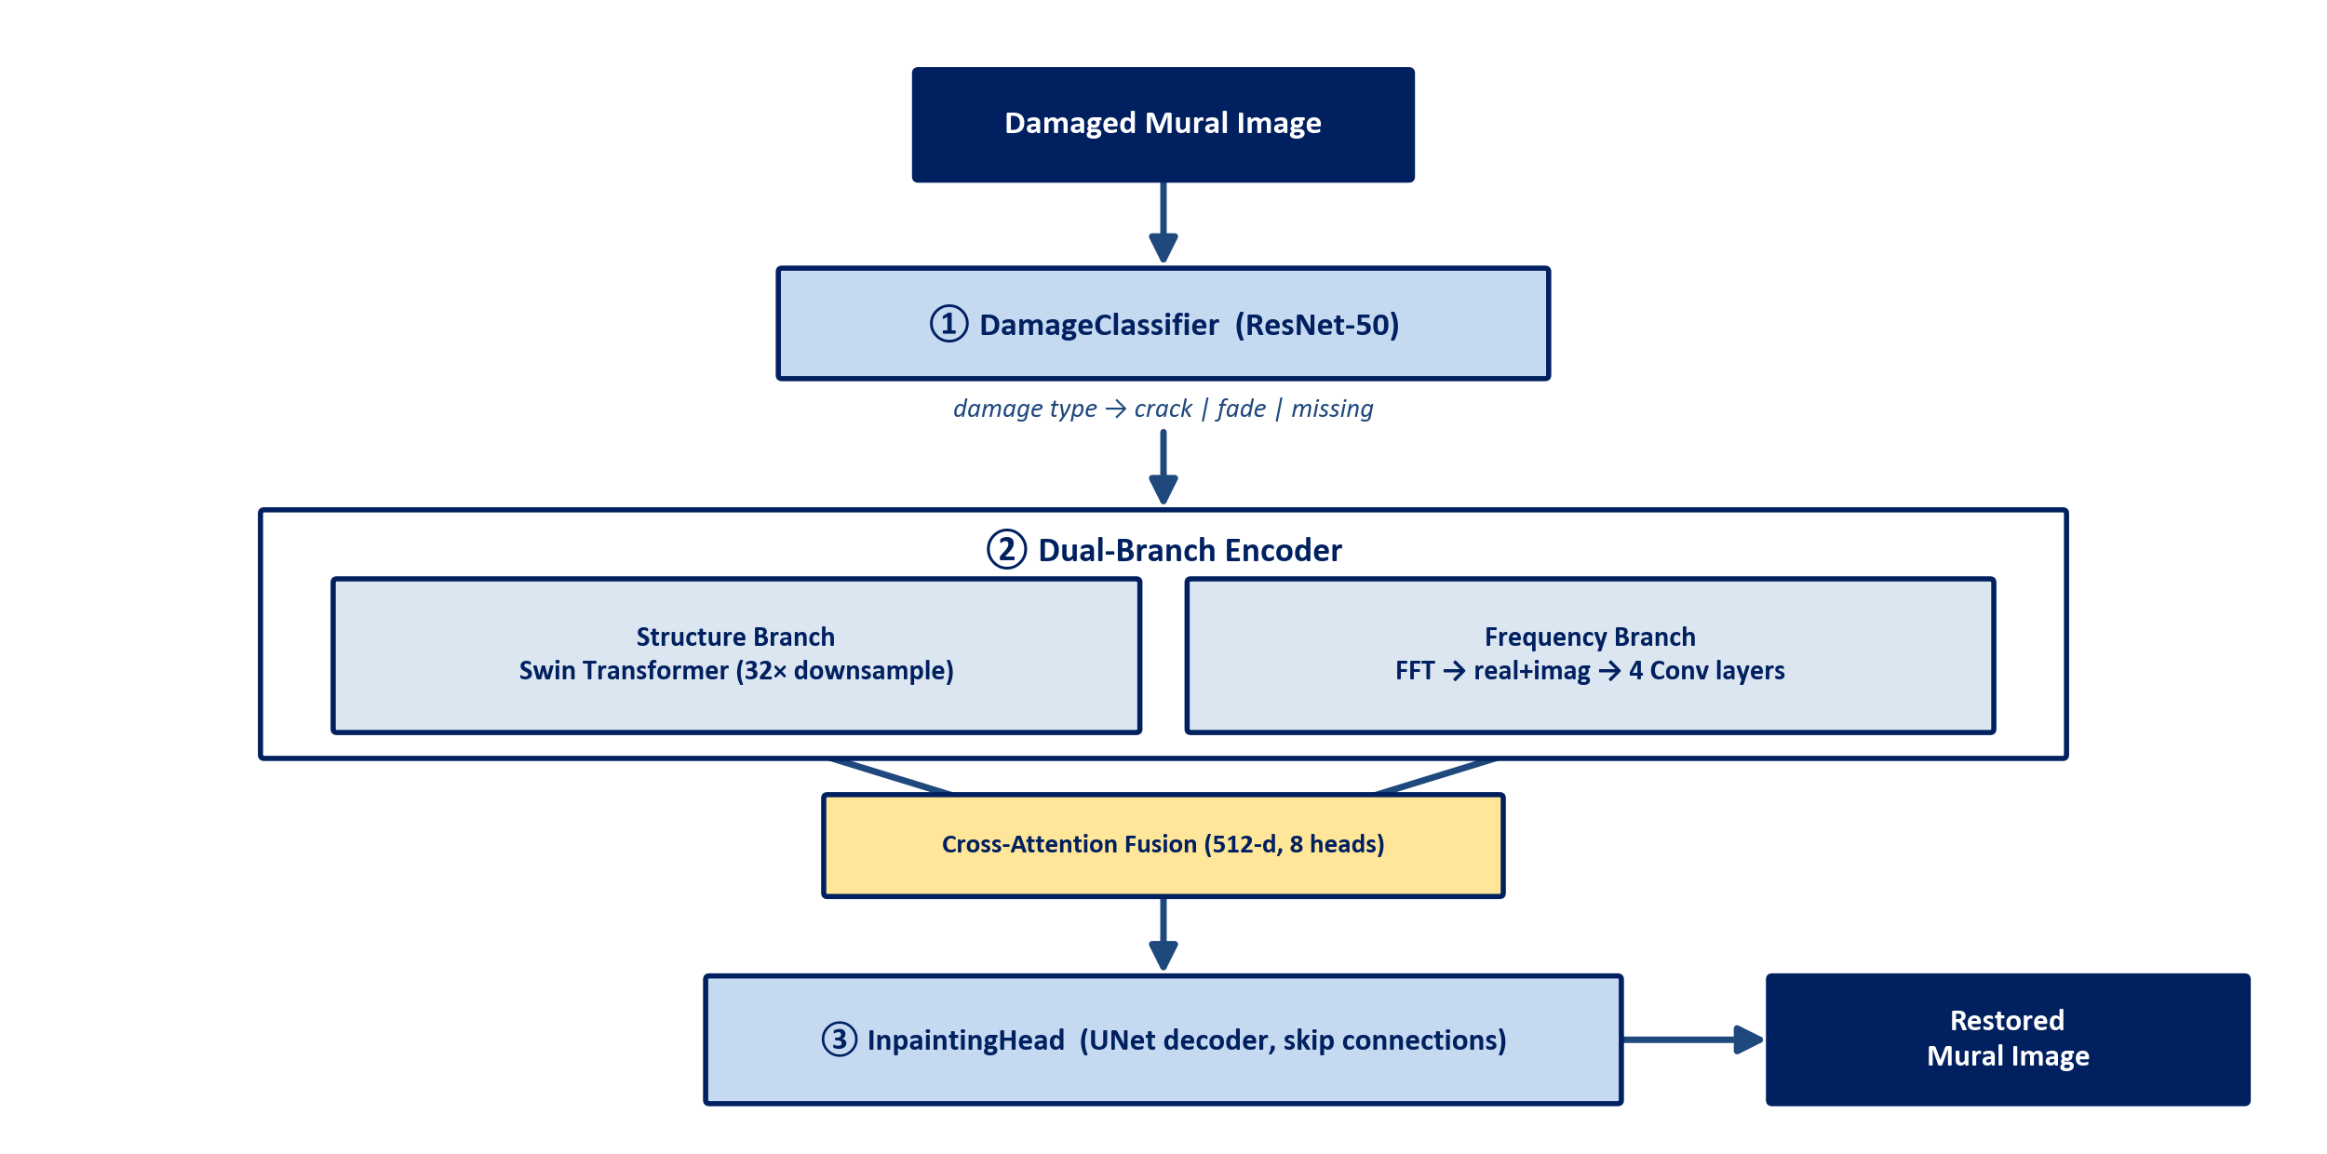
System Architecture
End-to-End Pipeline: Classify -> Fuse -> Restore
Three independently-ablatable stages: damage classification, dual-branch feature fusion, UNet-based restoration.

Slide 8
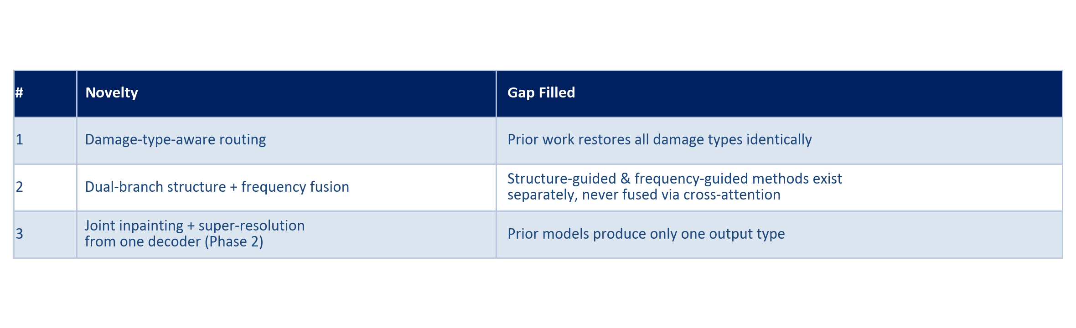
Key Novelties
What DAFR-Net Adds Over Prior Work

Slide 9
Implementation & Training Setup
Stack, Configuration & Environment
PyTorch 2.2 + PyTorch Lightning for training loops, checkpointing, mixed precision; timm for the Swin Transformer backbone.
FastAPI + uvicorn REST server (/classify, /restore, /health); Weights & Biases for experiment tracking.
Classifier: ResNet-50, 50 epochs (early-stopped), batch 32, cross-entropy loss.
Encoder + Decoder: Swin-Tiny + FFT branch + UNet decoder, 150 epochs, batch 8, L1 + SSIM loss.
Trained end-to-end, self-supervised (MuralDH has no paired clean reference), fully on Kaggle's free 2xT4 GPU tier.

Slide 10
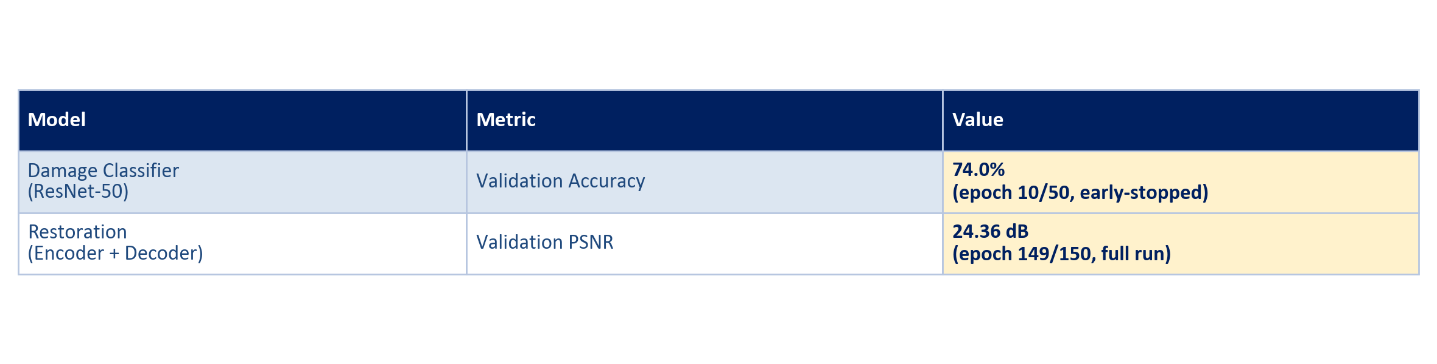
Results
Validation Performance
Restored outputs on held-out MuralDH images are visually coherent, with plausible mural content filled into damaged regions.
API smoke test confirms both models load and serve correctly end-to-end.

Slide 11
Merits
Modular 3-stage pipeline — each component independently testable/ablatable.
Damage-type conditioning is a genuinely underexplored idea in mural restoration literature.
Dual-branch fusion captures both spatial structure and frequency-domain degradation cues.
End-to-end trained and deployed — a working, callable API, not just a paper design.
Resource-efficient: trained fully on free-tier Kaggle GPUs, no paid compute.

Slide 12
Limitations
Validation PSNR (24.36 dB) is below the MuralDH baseline target (>28 dB) — Swin-Tiny fallback and disabled perceptual loss (T4 memory limits) cap fidelity.
Classifier accuracy (74.0%) leaves room for improvement — visually similar fade/crack cases are sometimes confused.
Self-supervised training (no paired clean ground truth) limits achievable sharpness.
Only PSNR is currently tracked — SSIM/LPIPS not yet computed.
Phase 2 components (ControlNet diffusion decoder, super-resolution head) not yet implemented.

Slide 13
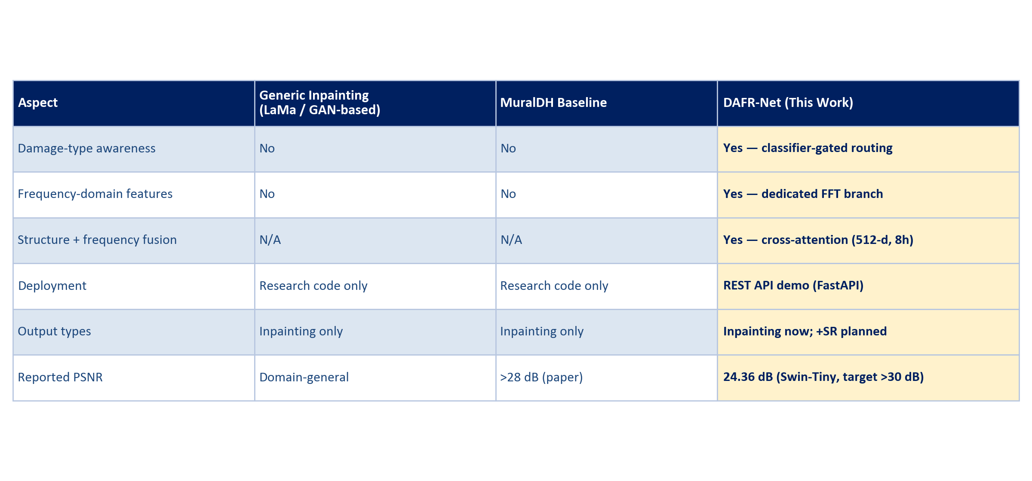
Comparison with Existing Work
DAFR-Net vs. Generic Inpainting vs. MuralDH Baseline

Slide 14
Conclusion & Future Work
Phase 1 delivers a fully working, trained, and API-served damage-aware restoration pipeline validated on MuralDH.
Phase 2 roadmap: ControlNet diffusion decoder, joint super-resolution head, frequency-guided loss, ablation study, full Swin-Base run.
Immediate next step: scale to Swin-Base with checkpoint-resume across Kaggle's 12-hour session cap to close the PSNR gap to baseline.

Slide 15
THANK YOU

