Slide 1
PAÜ FAST FOOD
Harisu Shehu Abdullahi
Course Instructor:- Yrd. Doç. Abdulkadir Yaldir

Slide 2
Contents
Project plan
Team Structure
Time management

Slide 3
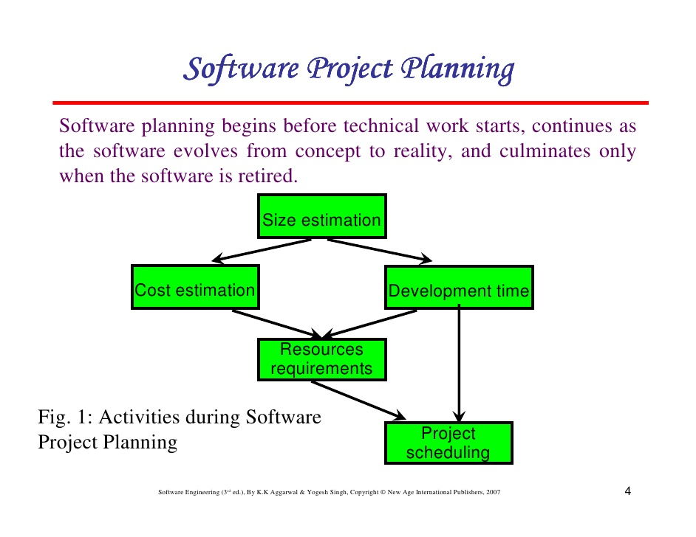
Project Plan

Slide 4
Project plan (cont...)
Which framework to use?
Which project management tool should be use?
What language should be used in implementation? Which environment should be use? Is there any constraint?

Slide 5
Team Structure
Scrum
MS team
Which methodology to follow?

Slide 6
Scrum
Product owner
Scrum master
Developer
Tester

Slide 7
MS Team Model
Product manager
Project manager
Developer
Tester

Slide 8
Time management
Time management is one of the project scope which is another key aspect of managing a project.
The main idea is to build processes and output into the project that assist the manager and team to complete the project in a timely manner.
Outputs are created during the planning process to illustrate how project tasks will be sequence and allocated.

Slide 9
Time management
The project is divided into different iterations in which some functionality (deliverables) are expected to be implemented in each step.
The number of iteration differs depending on the project size.
Interation 1...3 for small projects.

