Slide 1
PAÜ FAST FOOD
Harisu Shehu Abdullahi
Course Instructor:- Yrd. Doç. Abdulkadir Yaldir

Slide 2
Contents
Requirements Engineering
Context Diagram
Data Flow Diagram (DFD)
ER Diagram
Relational Database Model

Slide 3
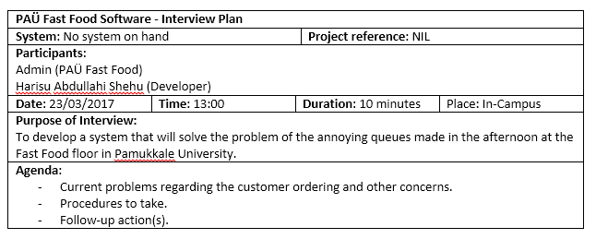

Slide 4
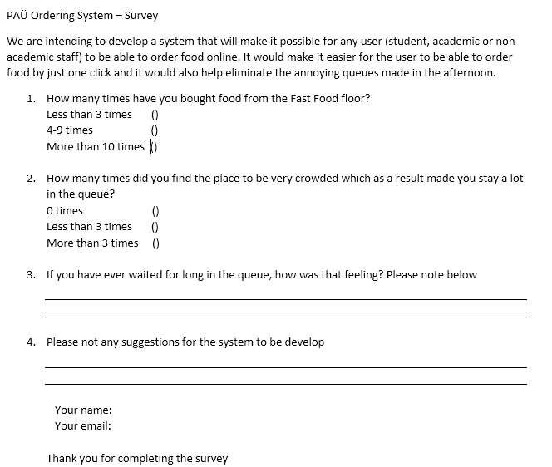

Slide 5
Requirements Engineering
Funtional requirements
User
login
order food
Admin
login
Add food
Update food
Delete food

Slide 6
Requirements Engineering
Non-Functional requirements
Reliability
Usability
Portability
Performace:
Responsiveness

Slide 7
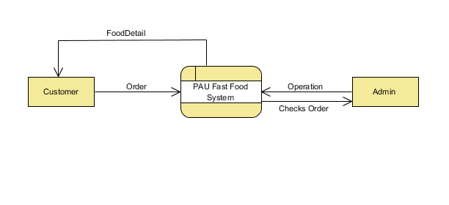
Context Diagram

Slide 8
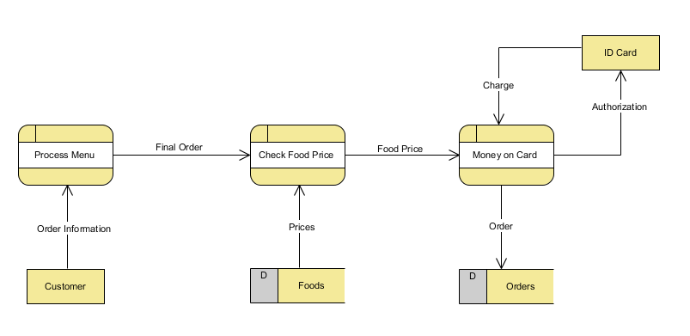
Data Flow Diagram (User)

Slide 9
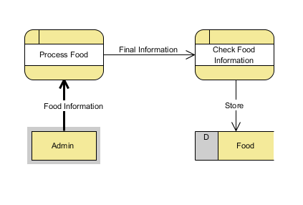
Data Flow Diagram (Admin)

Slide 10
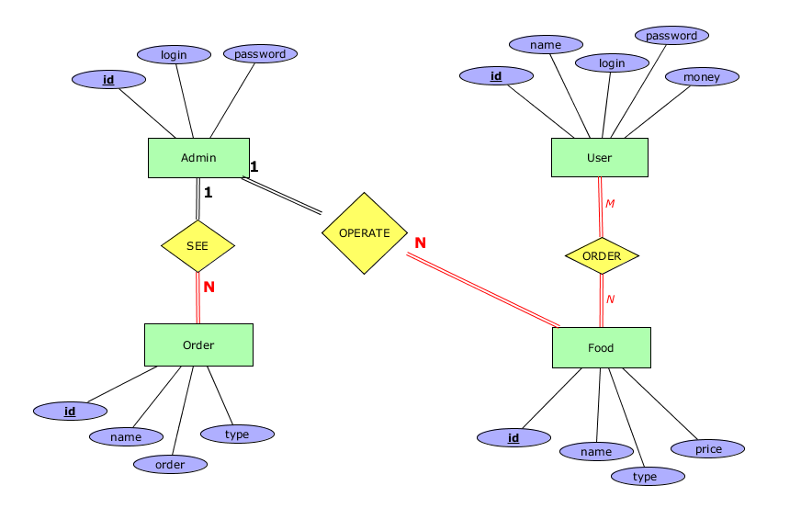
ER Diagram

Slide 11
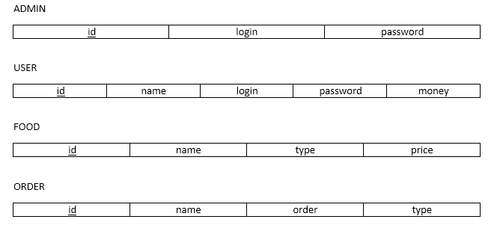
Relational Database Model

