Slide 1
PAÜ FAST FOOD
Harisu Shehu Abdullahi
Course Instructor:- Yrd. Doç. Abdulkadir Yaldir

Slide 2
Contents
Data Dictionary
Entity life histories (ELH)

Slide 3
Data Dictionary
order = id + name + surname + { foodName + Traditional Cuisine | Kids and Vegan | Happy Hour }

Slide 4
Data Dictionary (cont...)
order = customerDetails + {foodInfo}
customerDetails = id + name + surname
foodInfo = foodName + foodType
foodType = Traditional Cuisine | Kids and Vegan | Happy Hour
foodName = Pizza | Spaghetti | Milk Shake | Salad.....

Slide 5
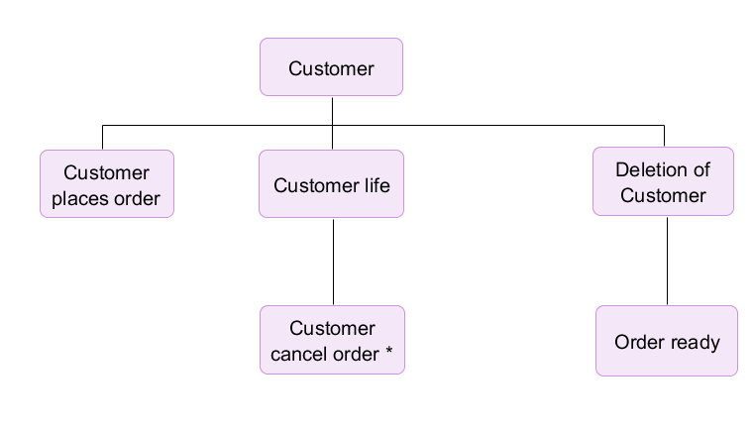
Entity life histories {Customer}

Slide 6
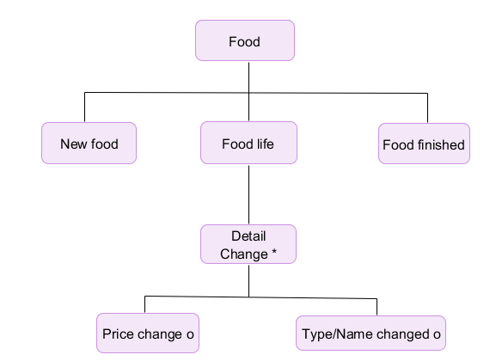
Entity life histories (cont...) {Food}

Slide 7
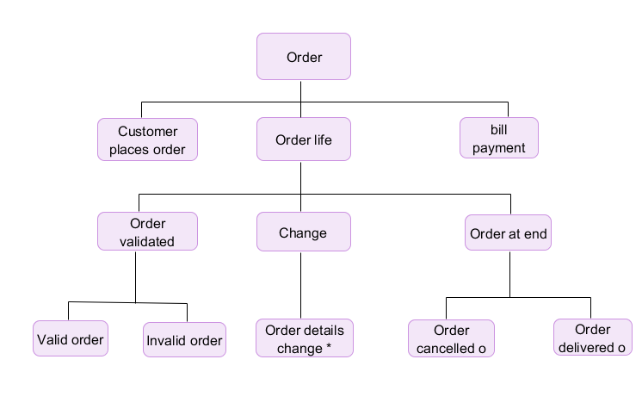
Entity life histories (cont...){Order}

