Slide 1

Digital Portfolio
STUDENT NAME: HARISYAM.K
REGISTER NO :2428N0065
NMID: 6062E42EE639326916C450FE850ED073 DEPARTMENT: BSC CS with CY
COLLEGE: SREE NARAYANA GURU COLLEGE
1

Slide 2

PROJECT TITLE
Digital portfolio:A Web -Based Personal Showcase
2

Slide 3



AGENDA
1.Problem Statement 2.Project Overview 3.End Users 4.Tools and Technologies 5.Portfolio design and Layout 6.Features and Functionality 7.Results and Screenshots 8. Conclusion 9.Github Link
3/21/2024 Annual Review
3

Slide 4


PROBLEM STATEMENT
Traditional resumes and paper portfolios are static and fail to showcase skills and achievements effectively. In today’s digital era, there is a need for an interactive and accessible platform where individuals can present their personal details, projects, and accomplishments in an organized and professional way. A Digital Portfolio provides this solution by offering a user-friendly and visually appealing medium to highlight one’s talents and experience
4

Slide 5

PROJECT OVERVIEW
The Digital Portfolio project aims to create an online platform for showcasing personal details, skills, projects, and achievements in a professional and interactive way. It provides a modern alternative to traditional resumes, making it easier for students and professionals to present their talents and gain better academic or career opportunities.
5

Slide 6
WHO ARE THE END USERS?
The end users of the Digital Portfolio are mainly students, job seekers, and professionals who want to showcase their skills and achievements online. Employers, teachers, and recruiters will also benefit as they can easily view and evaluate the candidate’s profile in a structured and interactive way.
6

Slide 7

TOOLS AND TECHNIQUES
The Digital Portfolio will be developed using web technologies such as HTML, CSS, and JavaScript for design and interactivity. Frameworks like Bootstrap can be used for responsive layouts, while PHP/MySQL or cloud storage may handle data management. Techniques like user-friendly UI design, responsive web design, and basic security practices will ensure the portfolio is professional, accessible, and efficient
7

Slide 8

POTFOLIO DESIGN AND LAYOUT
The Digital Portfolio will have a clean and organized design with sections for personal details, skills, projects, certifications, and contact information. A responsive layout will ensure it works on both computers and mobile devices. Simple navigation, consistent colors, and clear typography will make the portfolio professional and easy to use.
8

Slide 9
FEATURES AND FUNCTIONALITY
The Digital Portfolio will include features such as personal information display, project showcases, skill highlights, and a contact section. It will function as an interactive platform where users can update their details, share links, and present achievements in a professional and accessible manner.

Slide 10
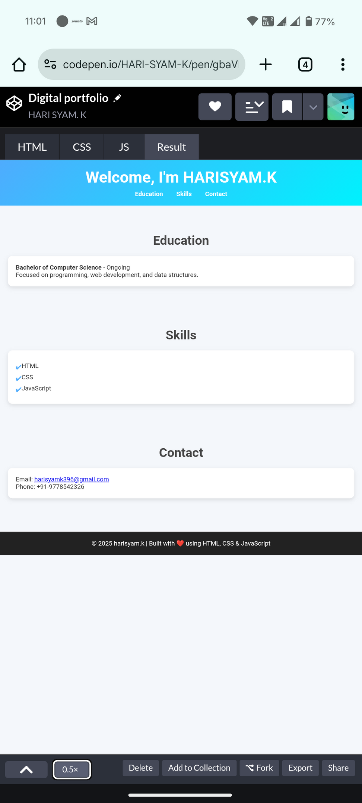

RESULTS AND SCREENSHOTS
3/21/2024 Annual Review
10

Slide 11
CONCLUSION
The Digital Portfolio provides a modern and effective way to present personal, academic, and professional achievements. It overcomes the limitations of traditional resumes by offering an interactive, organized, and accessible platform. This project helps students and professionals showcase their talents and creates better opportunities for growth and success.
11

