Slide 1
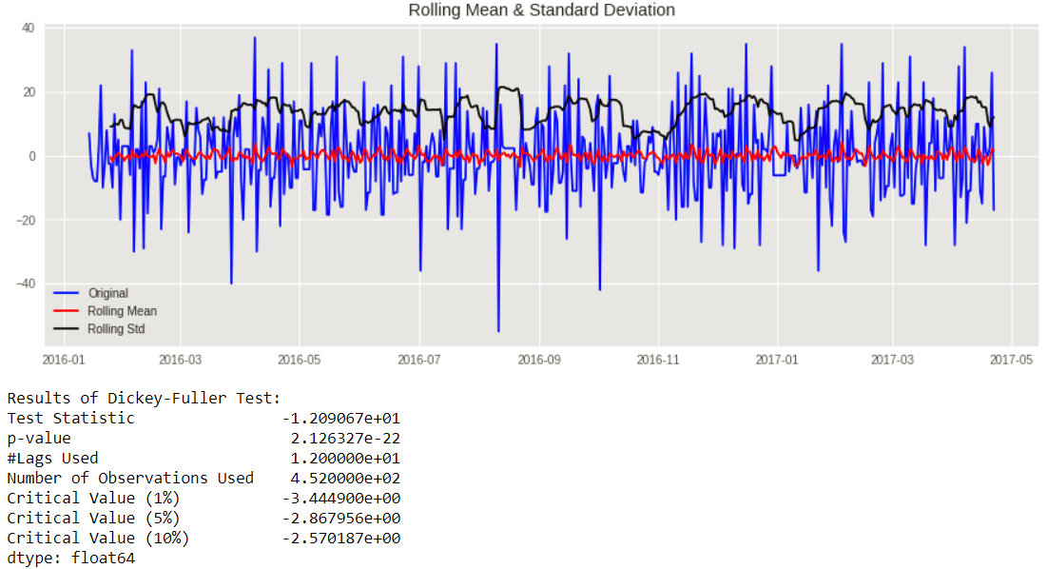
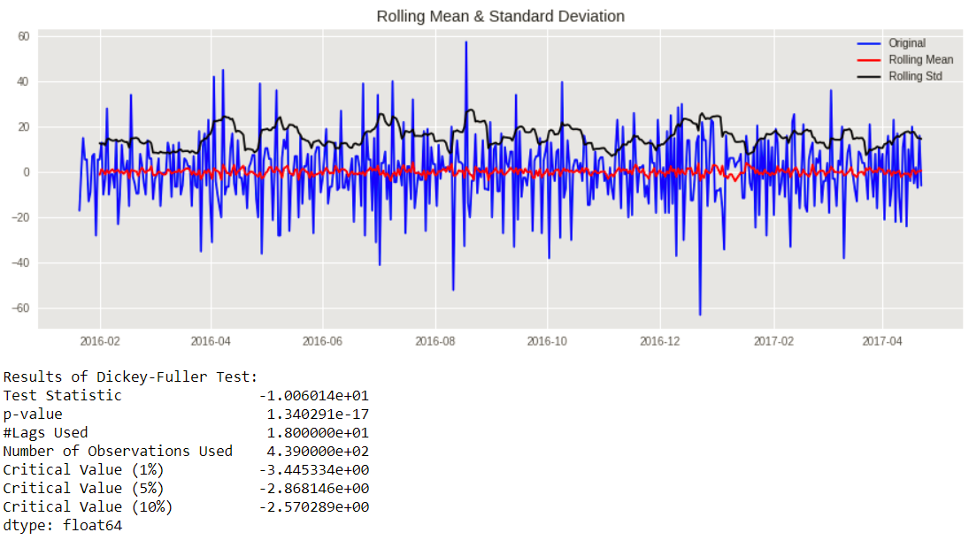

Slide 2
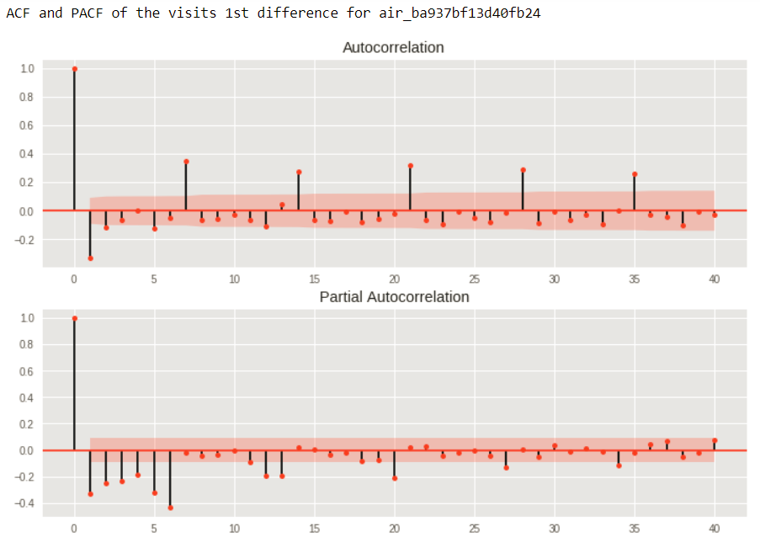
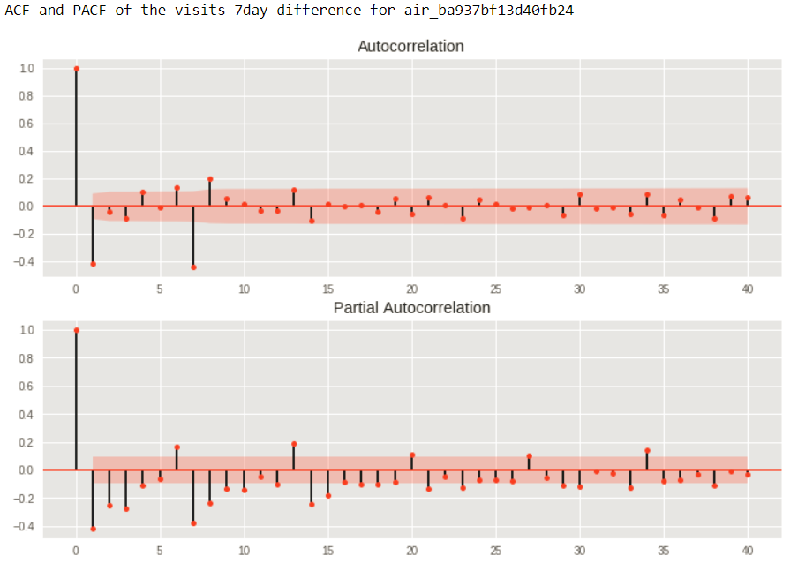
Lag
Lag

Slide 3
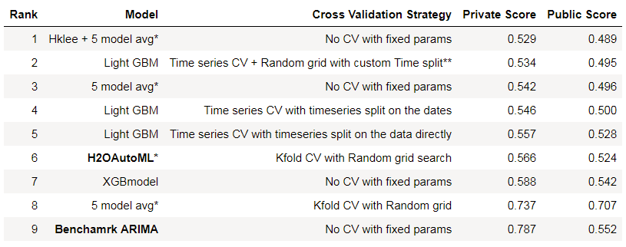
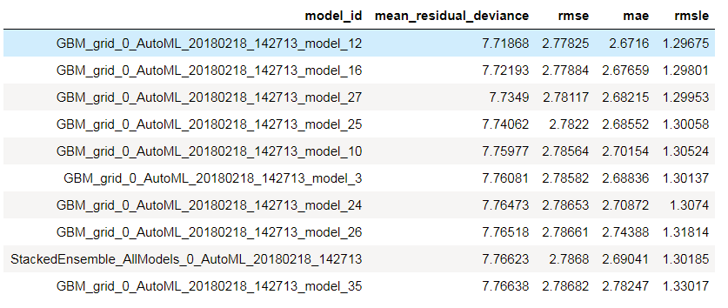
H2O AutoML Leaderboard – GBM: rank -1 and Stacked Ensemble: rank-9

Slide 4
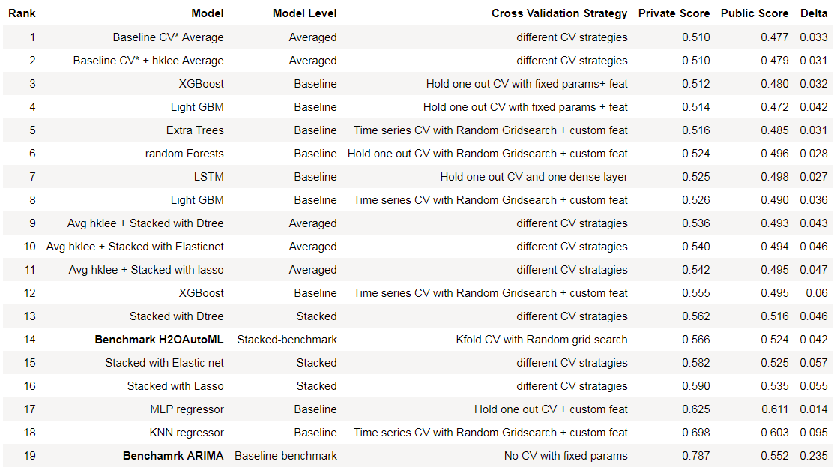
Note: Baseline CV consists of the first 6 models in the Baseline leaderboard
Delta := Private Score – Public Score

Slide 5
S.No | File Name | File Contents (features) | File Description
1 | air_reserve.csv | • air_store_id - the restaurant's id in the airREGI system • visit_datetime - the time of the reservation • reserve_datetime - the time the reservation was made • reserve_visitors - the number of visitors for that reservation | This file contains reservations made in the airREGI system. The reserve_datetime indicates the time when the reservation was created by user, whereas the visit_datetime is the time in the future where the visit will occur.
2 | air_visit_data.csv | • air_store_id - the restaurant's id in the airREGI system • visit_date - time series information • visitors - the number of visitors to the restaurant on a particular date. This is the target variable for the problem | This file contains historical visit data for all the customers in the airREGI restaurant system.
3 | air_store_info.csv | • air_store_id - the restaurant's id in the airREGI system • air_genre_name - airREGI restaurant genre / theme • air_area_name - air-restaurant’s city + district + area • latitude – coordinate for the restaurant • longitude – coordinate for the restaurant | This file contains information about air restaurants like the genre and it’s location in a particular with latitude and longitude co-ordinates
4 | hpg_store_info.csv | • hpg_store_id - the restaurant's id in the HPG system • hpg_genre_name - HPG restaurant genre / theme • hpg_area_name – restaurant city+ district +area Location • latitude - coordinate for the restaurant • longitude - coordinate for the restaurant | This file contains information about various HPG restaurants like the genre and it’s location in a particular with latitude and longitude co-ordinates.
5 | hpg_reserve.csv | • hpg_store_id - the restaurant's id in the HPG system • visit_datetime - the time of the reservation • reserve_datetime - the time the reservation was made • reserve_visitors - the number of visitors for that reservation | This file contains reservations made in the HPG system.
6 | store_id_relation.csv | • hpg_store_id • air_store_id | This file allows to join the restaurants that are both existent in the airREGI and HPG system.
7 | date_info.csv | • calendar_date – basically the visit date • day_of_week • holiday_flg – indicates a public holiday in Japan | This file gives basic information about the calendar dates in the dataset and also public holidays in Japan
8 | sample_submission.csv | • id - the id is formed by concatenating the air_store_id and visit_date with an underscore • visitors- the number of visitors to be forecasted for the AirREGI restaurant on a particular date | This file shows a submission in the correct format, including the days for which must be forecasted. Basically the test-set for the problem

Slide 6
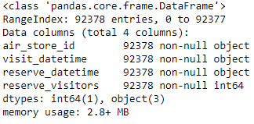
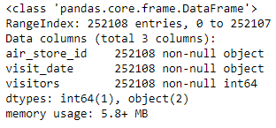
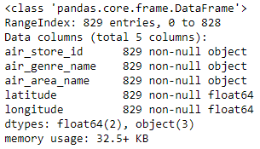
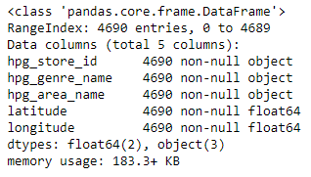
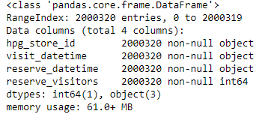
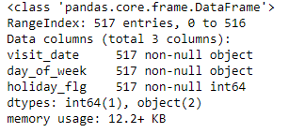
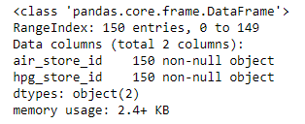
air_reserve.csv
air_visit_data.csv
air_store_info.csv
hpg_reserve.csv
hpg_store_info.csv
date_info.csv
store_id_relation.csv

Slide 7
S.No | Algorithm Source | Algorithm | Parameters |  | Cross-Validation Technique
1 | Scikit-learn | Random Forest Regressor | n_estimators: R [400,700] max_depth: R [6, 12] min_samples_leaf: R [1, 11] |  | Sequential Hold out CV
2 | Scikit-learn | K- Nearest Neighbor Regressor | n_neighbors: random number in [3,7] algorithm: ['ball_tree','kd_tree’], leaf_size: random number in [20,30] |  | 4-Fold Time Series CV + custom splitting
3 | Scikit-learn | Extra Tree Regressor | n_estimators: R [150,450] max_depth: R [12,16] min_samples_leaf: R [2,5] R := Random number in the range () |  | 4-Fold Time Series CV + custom splitting
4 | Microsoft | LigthGBM | learning_rate: 0.01 boosting_type: gbdt objective: regression sub_feature: 0.7 num_leaves: 60 other parameters are default-values | n_estimators: R [500, 900] learning-rate: R [0.1, 0.2] num_leaves: R [20, 60] min_child_weight: R [1, 10] min_child_samples: R [1, 100] max_depth: R [6,8] | Sequential Hold out CV | 4-Fold Time Series CV + custom splitting
5 | Git/Open-source | XGBoost | max_depth:10 min_child_weight:10 learning_rate: 0.01 obj: reg:linear n_estimators:1000 other parameters are default-values | learning_rate: R [0.01,0.15] n_estimators: R [80,400] subsample: R [0.8,0.9] colsample_bytree: R [0.8,0.9] max_depth: R [4,15] | Sequential Hold out CV | 4-Fold Time Series CV + custom splitting
6 | Keras/ Tensorflow | LSTM Network | LSTM(100) + Output Layer Dense (1) |  | Sequential Hold out CV
7 | Keras/ Tensorflow | MLP Network | Num of hidden layers: 2 , Output layer : 1 neuron Hidden Layer sizes: [50, 30] , Activation: Sigmoid Dropout probability: [0.2, 0.3] Output Activation: ReLu L2-kernel regularizer and Batch Normalization Optimizer: Stochastic Gradient Descent with momentum and decay |  | Sequential Hold out CV

