Slide 1


PRE-IDEATHON TEMPLATE
GENESIS
IDEATHON
TEAM & DOMAIN
  Team Name – Vishwamithra
  Team Members – Amirthamirra P CB.EN.U4ELC25057
Dheepika Raja CB.EN.U4ELC25007
Harita J CB.EN.U4ELC25013
Pooja S CB.EN.U4EEE25033
  Selected Domain – 4
  Problem Statement – Development of a Biofouling Resilient, Solar Powered IoT Node for Low Maintenance Rural Water Quality Monitoring

Slide 2


DOMAIN PROBLEM IN OUR WORDS
TEAM
Vishwamithra
  Every morning, a village wakes up to the quiet presence of its pond. Farmers depend on it for irrigation, families rely on its water, and the entire community needs it to remain safe. To monitor its condition, a small solar-powered sensor node is placed in the pond. It measures pH, turbidity, total dissolved solids (TDS), and dissolved oxygen (DO), sending readings through LoRa to a remote monitoring system.
  At first, everything works well. The readings help the community keep track of changes in water quality without frequent manual testing. But as weeks pass, algae, bacteria, and organic matter begin to coat the submerged sensors. A thin layer of biofilm slowly grows over their surfaces, affecting their ability to measure the water accurately.
  Soon, the readings become unreliable. The system may report contamination when the water has not changed, or fail to reflect a genuine change. False alarms worry villagers, while repeated inaccurate reports gradually destroy their trust in the monitoring system. Technicians must travel long distances to clean, recalibrate, and maintain the equipment, increasing costs.
  Attempts to fix the problem bring new difficulties. Mechanical wipers jam or wear out underwater. Continuous UV cleaning drains the battery, especially during monsoon and overcast periods when solar charging is limited. Chemical coatings gradually degrade and may release substances into the pond.
  The problem we set out to solve: How can a solar-powered rural water monitoring node distinguish genuine water contamination from biofouling-induced sensor errors while remaining reliable, energy-efficient, and affordable to maintain?
Genesis Ideathon – Pre-Ideathon Template
2

Slide 3
TEAM
Vishwamithra
WHO IS AFFECTED?
Primary users / target group
  State & Regional Water Boards (e.g., SWSM Tamil Nadu, TNPCB)
  Field Environmental Researchers
Secondary stakeholders
  National Regulators & Framework Authorities (Central Pollution Control Board - CPCB)
  National Policy & Funding Bodies
  Research Institutions & Validation Partners (ICAR - CIFRI, C-DAC)
  Gram Panchayats & Village Water Committees (VWSCs / Paani Samitis)
Who benefits if the problem is solved?
  Rural Communities & End Consumers (Public Health)
  High-Volume Industrial Operators (Thermal Power, Mining, Utilities)
  State Water & Sanitation Authorities / Jal Jeevan Mission (Fiscal & Operational)
Genesis Ideathon – Pre-Ideathon Template
3

Slide 4
TEAM
Vishwamithra
CURRENT SITUATION & CONTEXT
Existing Scenario and Background
  Groundwater & Local Water Reliance: Millions of rural residents in regions like Bangladesh, Southern Luzon (Philippines), and other off-grid areas rely on unmonitored artesian wells, deep wells, springs, cisterns, or sea/groundwater for drinking.
  Current IoT monitoring setups often remain grid-dependent, short-range, and vulnerable to degradation under harsh weather. Meanwhile, conventional purification systems (like standard RO) are unaffordable, grid-tied, waste up to three-fourths of input water, and strip essential minerals (Ca, Fe, Na).
Relevant Data or Facts
  Impacted Populations: 2.2 billion people globally lack access to safely managed drinking water. In Bangladesh, 60 million people consume water potentially contaminated by arsenic.
  Health & Mortality Metrics: 1.8 million people die annually from microbial contamination and untreated water. 297,000 children under 5 die yearly from diarrheal diseases related to poor water/hygiene.
  Basic Water Needs: 4 liters of water is the minimum daily requirement per person. In Haiti, a solar-powered filtration system provides pure drinking water to 200 children.
  Technical & Operational Specs: Prior LoRaWAN systems achieved 36 hours of continuous battery operation on solar power. Microcontrollers (TTGO LoRa32) demonstrated 2 km of data transmission range. Standard RO systems discard 75% of input water and require membrane replacements approximately once a year.
Genesis Ideathon – Pre-Ideathon Template
4

Slide 5
TEAM
Vishwamithra
KEY CHALLENGES
Main Difficulties & Bottlenecks
  Sensor fouling and drift: Deposits on probes slowly skew readings, often with no visible fault.
  Cleaning vs. damage: Aggressive cleaning scratches optics and wears membranes; gentle cleaning leaves residue.
  Limited solar energy: Cloud, monsoon and shading shrink the power budget for cleaning, sensing and transmission.
  Remote maintenance: Distant sites and scarce technicians let faults persist for weeks.
Root Causes
  Biofilm buildup: Microbes colonize within days and harden into a stubborn layer.
  Rigid fixed-interval cleaning: Timer-based cleaning under-cleans during blooms and over-cleans in clear periods.
  No intelligent edge alarms: The node cannot tell real contamination from fouling artifacts.
  No recovery verification: Nothing confirms the sensor returned to baseline after cleaning.
Consequences if Unsolved
  False alarms and missed contamination: Lost trust and real public-health risk.
  Compromised data records: Drifted, unverified data weakens trends and compliance.
  Higher operating costs: Frequent field trips, recalibration and early sensor replacement.
Genesis Ideathon – Pre-Ideathon Template
5

Slide 6
TEAM
Vishwamithra
KEY CHALLENGES
Existing Methods
  Direct Submersion: Sensors are continuously exposed to water, causing biofouling.
  Mechanical Cleaning: Wipers and brushes remove deposits but require moving parts and additional power.
  UV-C Sterilization: Helps control microbial growth but consumes significant energy.
  Anti-fouling Coatings: May degrade over time or introduce chemicals into the water.
  Cloud-Based IoT Monitoring: Often lacks local intelligence to identify fouling-related sensor errors.
Key Limitations
  Biofilm and sediment accumulation cause inaccurate readings and sensor drift.
  Mechanical cleaners are prone to jamming, wear, and high maintenance.
  High-power cleaning methods reduce battery life in solar-powered systems.
  Conventional monitoring struggles to distinguish actual contamination from sensor fouling.
Research Gaps
  Low-Power Cleaning: Effective anti-fouling with minimal energy consumption.
  Intelligent Fouling Detection: Distinguishing sensor drift from genuine water-quality changes using edge intelligence.
  Sensor Compatibility: Cleaning multiple sensor types without damaging sensitive surfaces.
  Closed-Loop Validation: Verifying sensor recovery after cleaning.
  Long-Term Reliability: Demonstrating low-cost, reliable operation under real-world conditions.
Genesis Ideathon – Pre-Ideathon Template
6

Slide 7
TEAM
Vishwamithra
PROBLEM INSIGHTS & OPPORTUNITY AREAS
Hardware Requirements
  Controller: STM32L4 low-power MCU with RTC wake-up, watchdog and brown-out reset
  Water-quality sensors: Turbidity, dissolved oxygen, EC/conductivity, temperature (dry-idle Zone A)
  pH electrode: Isolated flooded Zone B, protected from UV, ultrasound and wiping
  Self-cleaning: Air-burst sparging, wiper, UV-C LEDs, 40 kHz ultrasonic transducer, citric acid dosing
  Fluidics: Two peristaltic pumps, three latching ball valves, inlet strainer, Cu-Ni mesh sleeve
  Solar power: 10 W panel, MPPT charger, 12.8 V / 6 Ah LiFePO₄ battery with BMS, INA226 energy monitor
  Communication: LoRa/LoRaWAN module and gateway
  Enclosure: 3D-printed two-zone chamber (UV-safe materials), IP67 housing
Software Requirements
  Firmware: Low-power C++ on STM32L4 with an 8-state control machine
  Fouling detection: Sensor Health Index from response-rate loss, dead-time, dry-state residual and 24 h drift
  Adaptive cleaning: Escalation from air-burst → wiper → UV-C → citric acid + ultrasound
  Energy-aware control: Three power modes (30 / 60 / 120 min sampling) driven by battery state and solar harvest
  Dashboard: LoRaWAN network server feeding Grafana/InfluxDB or ThingsBoard
  Dashboard displays: Health index, fault flag, power mode, battery level, raw readings, with remote alerts
  Logic type: Rule-based and model-fit, not a trained neural network
Genesis Ideathon – Pre-Ideathon Template
7

Slide 8
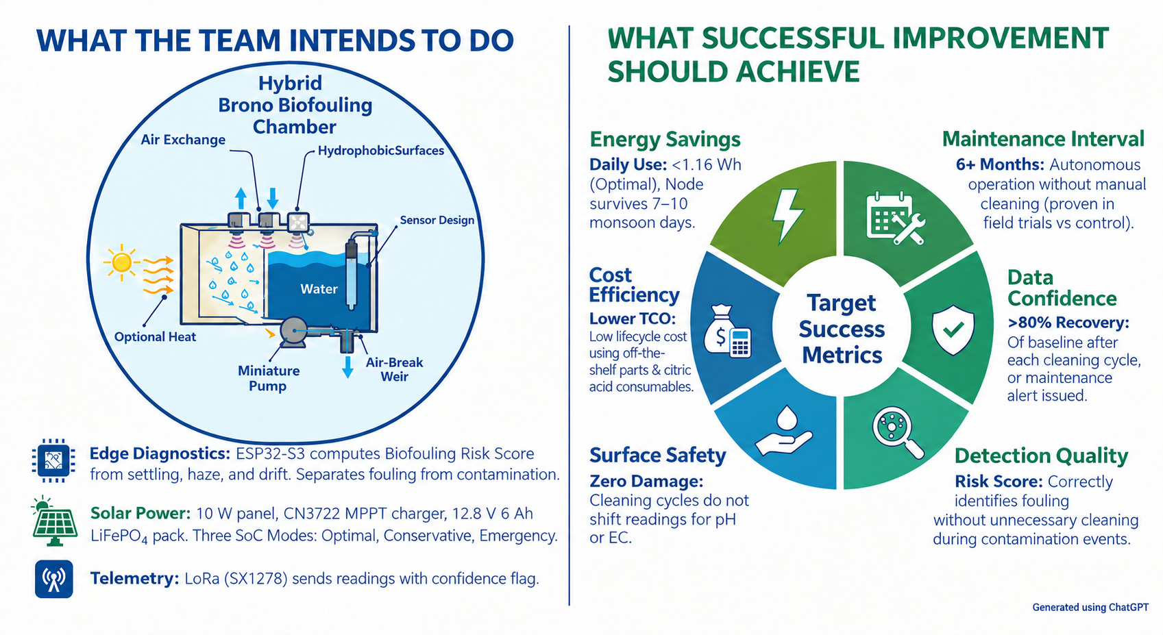
TEAM
Vishwamithra
INITIAL DIRECTION & EXPECTED OUTCOME
Genesis Ideathon – Pre-Ideathon Template
8

